Slide 1
Chapter - 5
Cloud simulation

Slide 2
Introduction
Cloud computing has advanced incredibly in the ongoing years because of its characteristics of being secure, and highly scalable.
We can say that it is able to dynamically deliver IT assets over the Internet for user applications that have different composition, configuration, and deployment requirements.
In cloud computing, access to the infrastructure incurs payments in real currency.
Simulation-based approaches offer significant benefits, as it allows cloud customers to test their services in repeatable and controllable environment free of cost, and to tune the performance bottlenecks before deploying on real clouds.

Slide 3
At the provider side, simulation environments allow evaluation of different kinds of resource leasing scenarios under varying load and pricing distributions.
Such studies could aid the providers in optimizing the resource access cost with a focus on improving profits.
In the absence of such simulation platforms, Cloud customers and providers have to rely either on theoretical and imprecise evaluations, or on trial-and-error approaches that lead to inefficient service performance and revenue generation.
The primary objective of this simulator is to provide a generalized and extensible simulation framework that enables seamless modelling, simulation, and experimentation of emerging cloud computing infrastructures and application services.
By using CloudSim, researchers and industry-based developers can focus on specific system design issues that they want to investigate, without being concerned about the low-level details related to cloud-based infrastructures and services.

Slide 4
CloudSim is an open-source framework, which is used to simulate cloud computing infrastructure and services.
It is developed by the CLOUDS Lab organization and is written entirely in Java.
It is used for modelling and simulating a cloud computing environment as a means for evaluating a hypothesis prior to software development in order to reproduce tests and results.
  For example, if you were to deploy an application or a website on the cloud and wanted to test the services and load that your product can handle and also tune its performance to overcome bottlenecks before risking deployment, then such evaluations could be performed by simply coding a simulation of that environment with the help of various flexible and scalable classes provided by the CloudSim package, free of cost.

Slide 5
CloudSim is a practical approach to implement and test Cloud scenarios.
It is new generalized and extensible simulation framework that enables seamless modelling, simulation, and experimentation of emerging cloud computing infrastructures and management services.
The CloudSim simulation layer offers help for demonstrating and simulation of virtualized Cloud-based server data centre conditions including committed administration interfaces for VMs, memory, storage, and data transmission.
The central issues, for example, provisioning of hosts to VMs, and managing application execution state are dealt with.
The data centre deals with various host elements.
The hosts are mapped out to at least one VMs dependent on a VM allotment strategy that ought to be characterized by the Cloud specialist organization.
  Here, the VM strategy represents the tasks control arrangements identified with VM life cycle, for example, provisioning of a host to a VM, VM creation, VM failure and VM migration.
  Thus, at least one application administrations can be provisioned inside a solitary VM case, alluded to as application provisioning with regards to Cloud computing.

Slide 6
In the context of CloudSim, an entity is an instance of a component.
A CloudSim component can be a class (abstract or complete) or set of classes that represent one CloudSim model (data center, host etc.).
A data center can manage several hosts that in turn manage VMs during their life cycles.
Host is a CloudSim component that represents a physical computing server in a Cloud:
  it is assigned a pre-configured processing capability (expressed in millions of instructions per second-MIPS), memory, storage, and a provisioning policy for allocating processing cores to VMs.
The Host component implements interfaces that support modelling and simulation of both single-core and multi-core nodes.
For each Host component, the allocation of processing cores to VMs is done based on a host allocation policy.
This policy takes into account several hard- ware characteristics, such as number of CPU cores, CPU share and amount of memory (physical and secondary), that are allocated to a given VM instance.
Hence, CloudSim supports simulation scenarios that assign specific CPU cores to specific VMs (a space-shared policy), dynamically distribute the capacity of a core among VMs (time-shared policy), or assign cores to VMs on demand.

Slide 7
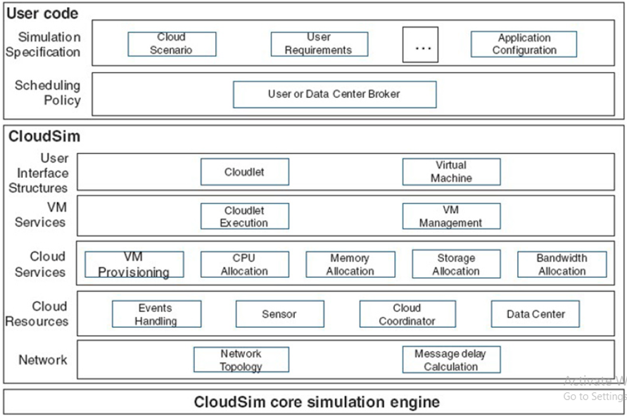
CloudSim Architecture

Slide 8
CloudSim runs on any Integrated Development Environment (IDE).
Choose your IDE such as NetBeans or Eclipse and create a new project.
Find a Java Runtime Environment (JRE) for running a CloudSim.
  This JRE could usually be downloaded from Github.
Right click on the project you created and choose properties.
Then click on Add Library and choose to Add Jar files.
Then choose the CloudSim JRE.
Additionally you need to download JAR files for math functions from http://commons.apache.org/proper/commonsmath/download_math.cgi.
Finally you start running your simulation by choosing org.cloudbus.cloudsim.examples.

Slide 9
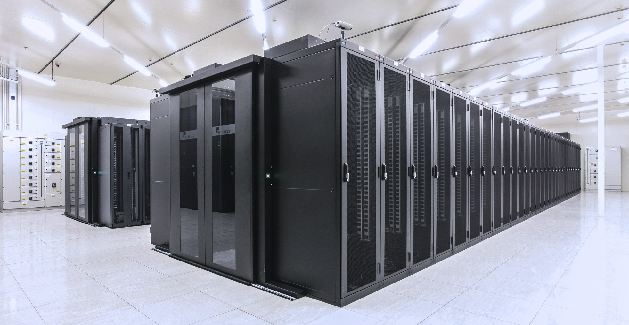
The basic components of CloudSim are:
Datacenter:
  Data center is used to model the core services at the system level of a cloud infrastructure.
  It consists of a set of hosts which manage a set of virtual machines whose tasks are to handle “low level” processing, and at least one data center must be created to start the simulation.
  It behaves like an IaaS provider by receiving requests for VMs from brokers and creating the VMs in hosts.
  This class provides methods to specify the functional requirements of the Datacenter as well as methods to set the allocation policies of the VMs etc.

Slide 10
The basic components of CloudSim are:
Host:
  This component is used to assign processing capabilities (which is specified in the milion of instruction per second that the processor could perform), memory and a scheduling policy to allocate different processing cores to multiple virtual machines that is in the list of virtual machines managed by the host.
Virtual Machines:
  This component manages the allocation of different virtual machines different hosts, so that processing cores can be scheduled (by the host) to virtual machines. This configuration depends on particular application, and the default policy of the allocation of virtual machines is “first-come, first-serve”.

Slide 11
Datacenter broker:
  The responsibility of a broker is to meditate between users and service providers, depending on the requirement of quality of service that the user specifies.
  In other words, the broker will identify which service provider is suitable for the user based on the information it has from the Cloud Information Service, and negotiates with the providers about the resources that meet the requirement of the user.
  The user of CloudSim needs to extend this class in order to specify requirement in their experiments.
Cloudlet:
  This component represents the application service whose complexity is modeled in CloudSim in terms of the computational requirements.
  A cloudlet class represents any task that is run on a VM, like a processing task, or a memory access task, or a file updating task etc.
  It stores parameters defining the characteristics of a task such as its length, size, mi (million instructions) and provides methods similarly to VM class while also providing methods that define a task’s execution time, status, cost and history.
CloudCoordinator:
  This component manages the communication between other CloudCoordinator services and brokers, and also monitor the internal state of a data center which will be done periodically in terms of the simulation time.

Slide 12
CloudSim Example
Algorithm 1: To create a datacenter with one host and run Cloudlet on it
Inputs: VMs id, VM Size
Output: Cloudlet objects
Steps:
  Step 1: Initialize the CloudSim package. It should be called before creating any entities
  Step 2: Create Datacenters
  Step 3: Create Broker
  Step 4: Create one VM
  Step 5: Add the VM to the vmList
  Step 6: Submit VM list to the broker
  Step 7: Create one Cloudlet with Cloudlet properties id, length, fileSize
  Step 8: Add the Cloudlet to the list
  Step 9: Submit Cloudlet list to the broker
  Step 10: Start the simulation
  Step 11: Print results when simulation is over
  Step 12: Prints the Cloudlet objects

