Slide 1
C/C++ Program Design
Lab 12, class inheritance
廖琪梅，王大兴

Slide 2
Class inheritance
Class inheritance
Polymorphism (virtual function)
Inheritance and dynamic memory allocation

Slide 3
Class inheritance
Inheritance is one of the most important feature of object-oriented programming. Inheritance allows us to define a class in terms of another class, which makes it easier to maintain an application. This also provides an opportunity to reuse the code functionality and fast implementation time.
The existing class is called the base class, and the new class is called the derived class.
Every derived-class object is an object of its base class, represents an is-a relationship.

Slide 4
Class inheritance
Inheritance syntax:
class derived_class_name : access_mode base_class_name
{
// body of subclass
};
Subclass,Derived class, Child class
public, protected, private
Base class, Super class, Parent class
The derived class consists of two parts:
The subobject of its base class (consisting of the non-static base class data members)
The derived class portion (consisting of the non-static derived class data members)
If you do not provide a copy constructor or an assignment operator for baseclass and derived
class, the compiler will synthesize a copy constructor and assignment operator for both a
derived class and a baseclass respectively.

Slide 5
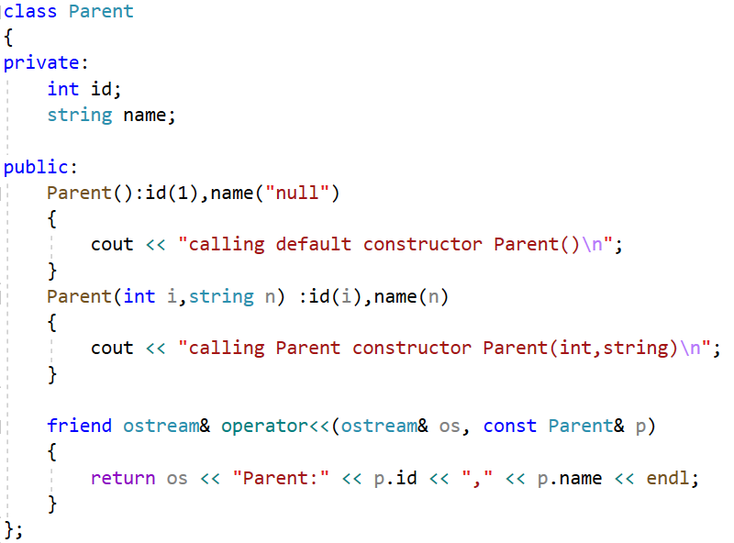
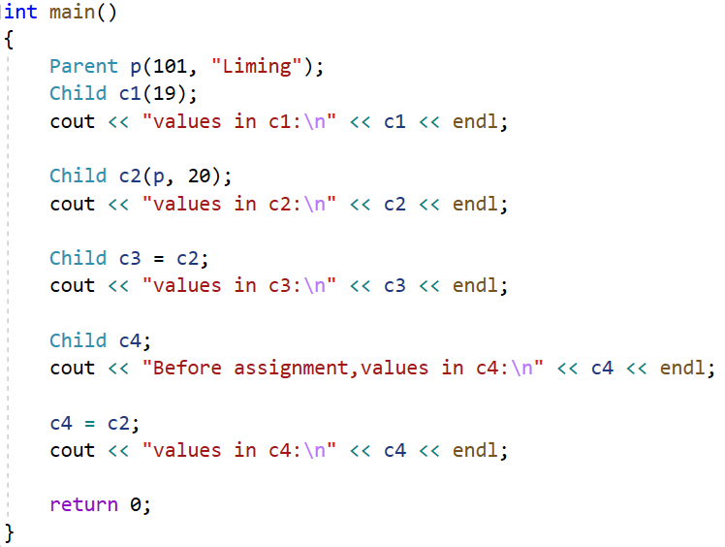
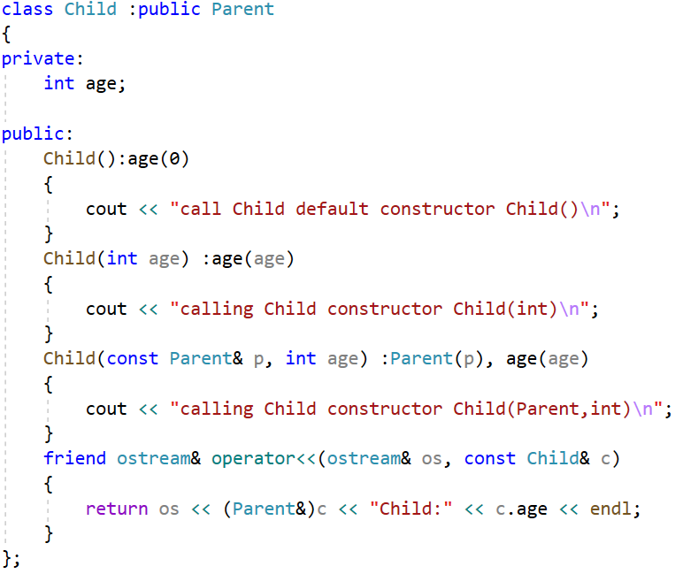
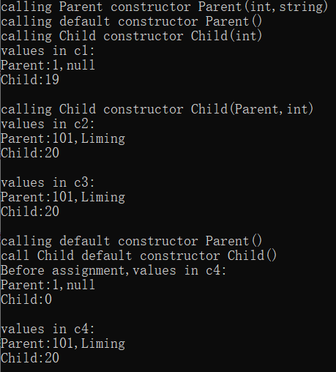
Calls Child copy constructor
Calls Child assignment operator
The derived class will call the baseclass default constructor
to initialize the component of baseclass.
Calls Parent copy constructor

Slide 6
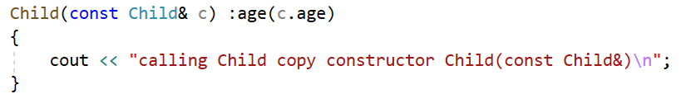
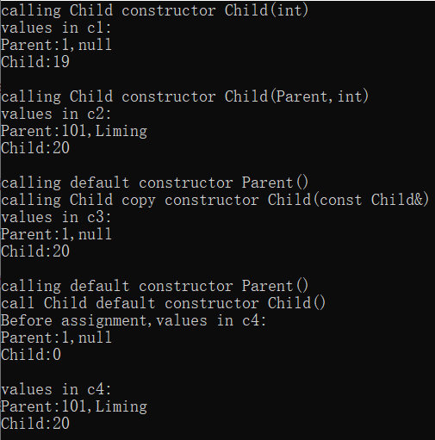
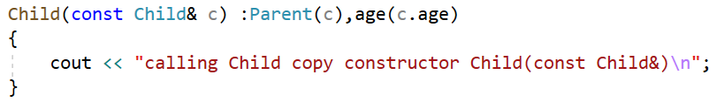
Define copy constructor of Child, but it does not initialize the baseclass component.
Call Parent copy constructor by Child object.

Slide 7
Note:
When creating an object of a derived class, a program first calls the base-class constructor and then calls the derived-class constructor. The base-class constructor is responsible for initializing the inherited data member. The derived-class constructor is responsible for initializing any added data members. A derived-class constructor always calls a base-class constructor.
When an object of a derived class expires, the program first calls the derived-class destructor and then calls the base-class destructor. That is, destroying an object occurs in the opposite order used to constructor an object.

Slide 8
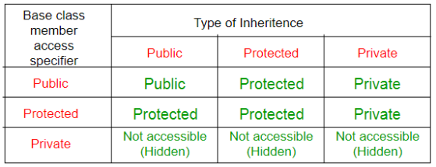
The below table shows the access specifier of the members of base class in the sub class when derived in public, protected and private modes:
In a base class definition, if a member declared as protected can be directly accessed by the derived classes but cannot be directly accessed by the general program.

Slide 9
Polymorphism
Polymorphism is one of the most important feature of object-oriented programming. Polymorphism works on object pointers and references using so-called dynamic binding at run-time. It does not work on regular objects, which uses static binding during the compile-time.
There are two key mechanisms for implementing polymorphic public inheritance:
1. Redefining base-class methods in a derived class
2. Using virtual methods

Slide 10
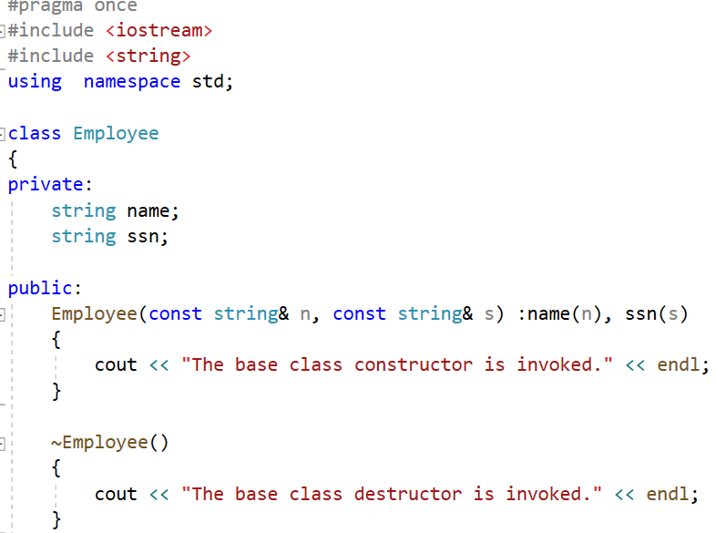
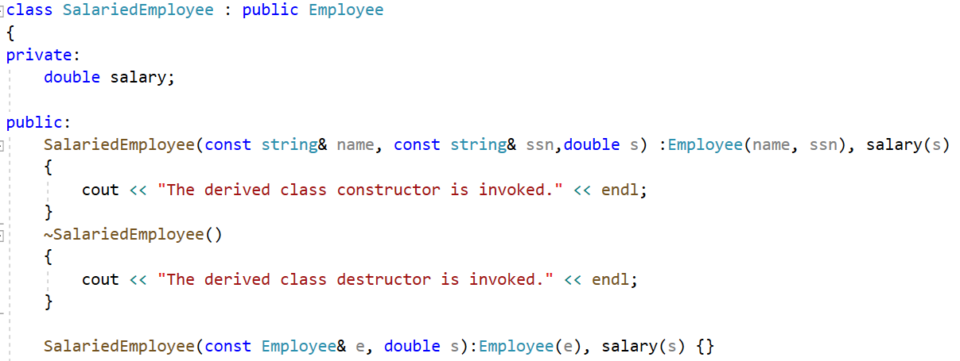
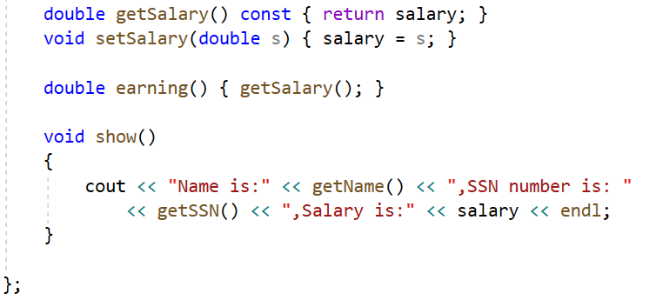
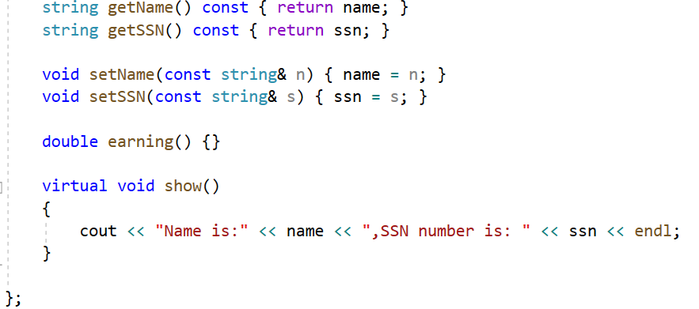
derived class
base class
If the access specifier is protected,
the derived class can access the data
override the function show() in SalariedEmployee
invoke base class method in derived class to get the name and snn
If you use the keyword virtual, the program choose a method based on the type of
object the reference or pointer refers to rather than based on the reference type or
pointer type.

Slide 11
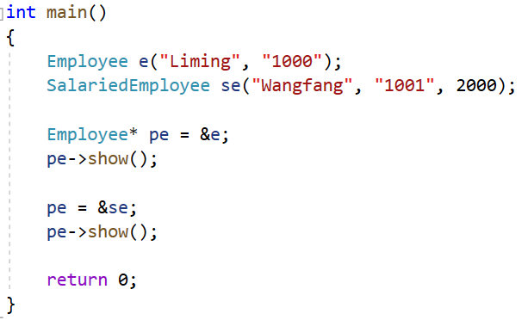
The pointer type of pe is Employee, it points to a different object respectively,
and invokes different objects’ show() functions. This is polymorphism.

Slide 12
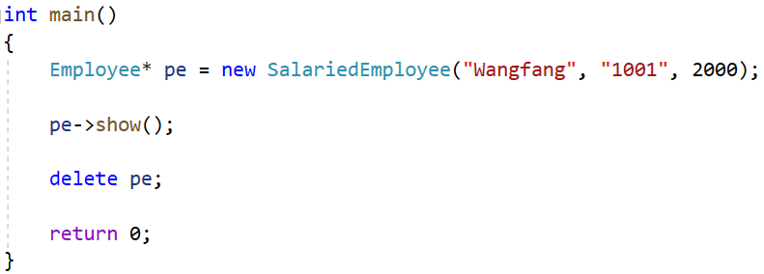

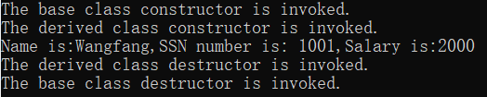
Destructors
If the destructors is not virtual, the delete statement invokes the ~Employee() destructor.
This frees memory pointed to by the Employee component of the SalariedEmployee object
not memory pointed to by SalariedEmployee component.
If the destructor is virtual, the same code invokes the ~SalariedEmployee() destructor, which frees memory pointed to by the SalariedEmployee component, and then calls the ~Employee() destructor to free memory pointed to by the Employee component.

Slide 13
Inheritance and Dynamic Memory Allocation
If a base class uses dynamic memory allocation and redefines assignment operator and a copy constructor, how does that affect the implementation of the derived class? The answer depends on the nature of the derived class.
If the derived class does not itself use dynamic memory allocation, you needn’t
take any special steps.
If the derived class does use new to allocate memory, you do have to define an explicit destructor, copy constructor, and assignment operator for the derived class.

Slide 14
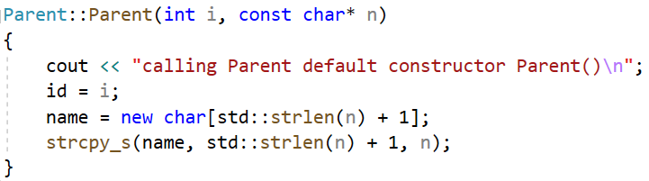
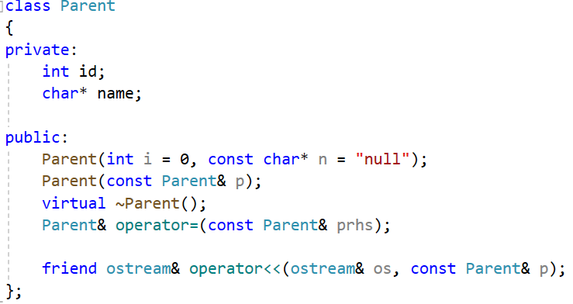
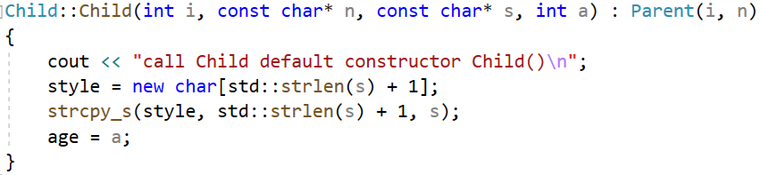
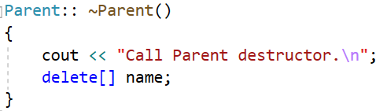
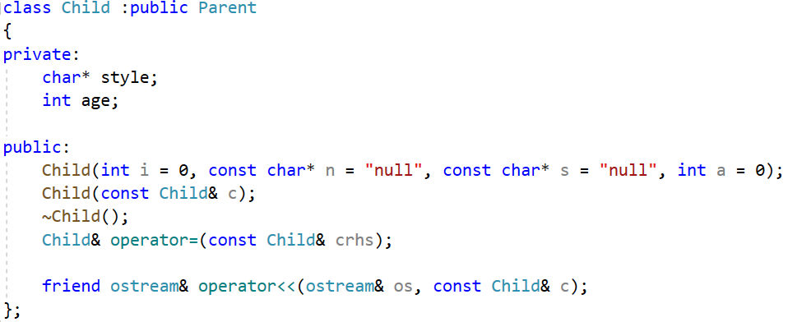
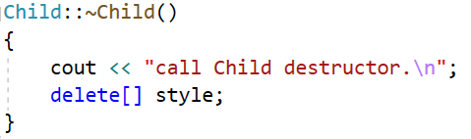
base class constructor
base class
derived class constructor
derived class
The data fields both in the base class
and the derived class hold pointers,
which indicate they would use dynamic
memory allocation.
A derived class destructor automatically calls the base-class destructor, so its own responsibility is to clean up after what the derived-class destructors do.

Slide 15
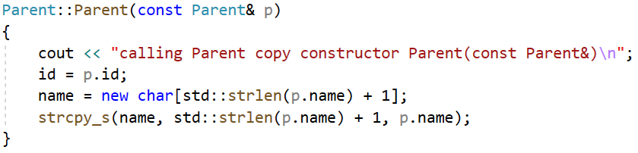
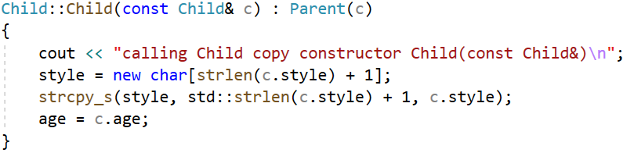
Consider copy constructor:
the base-class copy constructor
The derived class copy constructor can only accesses to its own
data, so it must invoke the base-class copy constructor to handle
the base-class share of the data.
The member initialization list passes a Child reference to a Parent constructor.
The Parent copy constructor has a Parent reference parameter, and a base class reference
can refer to a derived type. Thus, the Parent copy constructor uses the Parent portion of the
Child argument to constructor the Parent portion of the new object.

Slide 16
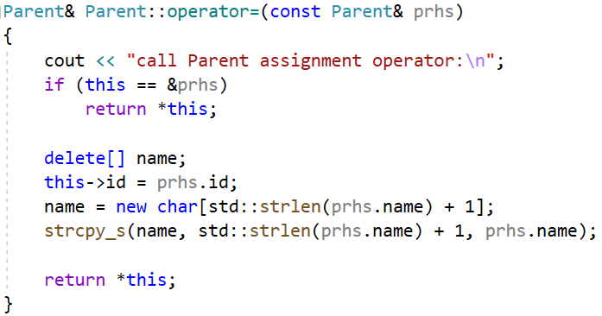
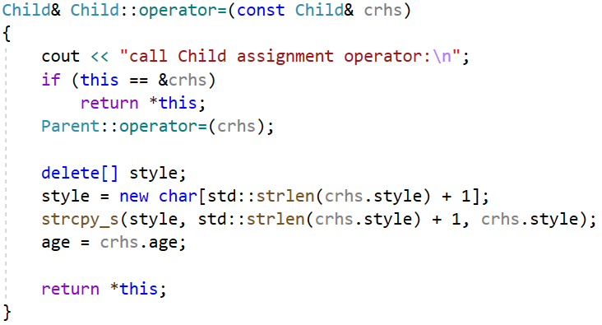
Consider assignment operators:
the Parent assignment operator
Because Child uses dynamic memory allocation,
it needs an explicit assignment operator. Being a
Child method, it only has direct access to its own
data.
An explicit assignment operator for a derived class also has to take care of assignment for the
inherited base class Parent object. You can accomplish this by explicitly calling the base class
assignment operator.

Slide 17
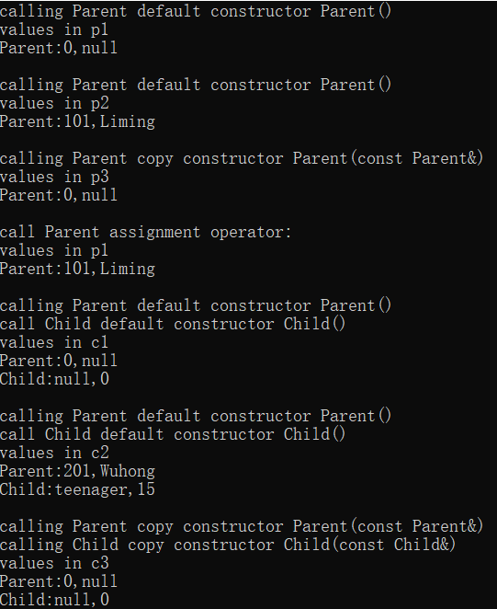
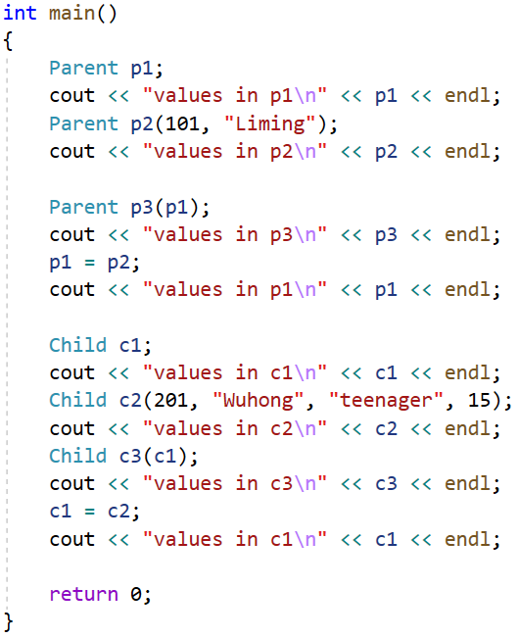
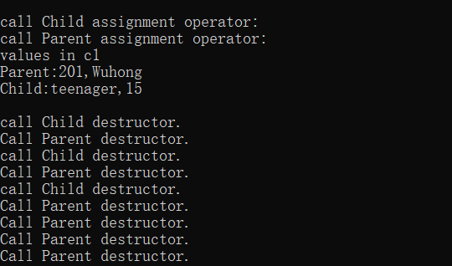

Slide 18
Exercise:
1. Design a stereo graphic class (CStereoShape class), and meet the following requirements:
A virtual function GetArea, which can get the surface area of the stereo graphic. Here we let it print out CStereoShape::GetArea() and return a value of 0.0, which means that CStereoShape’s GetArea is called.
A virtual function GetVolume, which can get the volume of the stereo graphic. Here we let it print out CStereoShape::GetVolume() and return a value of 0.0, which means that CStereoShape’s GetVolume is called.
A virtual function Show, which print out the description of the stereo graphics. But here we let it print out CStereoShape::Show(), which means that show of CStereoShape is invoked.
A static private integer variable named numberOfObject, whose initial value is 0, which denotes the number of Stereo graphics generated by our program.
A method named GetNumOfObject() that returns the value of numberOfObject.
Add constructor functions based on requirement.

Slide 19
2. Design a cube class (CCube class), which inherits the CStereoShape and meets the following requirements:
A no-arg constructor that creates a default Cube.
A constructor with parameters whose parameters correspond to the length, width, and height of the cube, respectively.
A copy constructor that creates a Cube object with the specified object of Cube.
Override GetArea, GetVolume of the CStereoShape class to complete the calculation of the surface area and volume of the cube, respectively.
Override Show() of the CStereoShape class to print out the description (includes length, width, height, the surface area and volume) for the Cube object.

Slide 20
3. Design a sphere class (CSphere class), which inherits the CStereoShape and meets the following requirements:
A no-arg constructor that creates a default Sphere.
A constructor with parameters whose parameters correspond to the radius of the Sphere.
A copy constructor that creates a Sphere object with the specified object of Sphere.
Override GetArea, GetVolume of the CStereoShape class to complete the calculation of the surface area and volume of the sphere, respectively.
Override Show() of the CStereoShape class to print out the description (includes radius, the surface area and volume) for the Sphere object.

Slide 21
4. Write a test program and complete at least the following tasks in the main functions:
Create a Ccube object named a_cube, which the length, width and height are 4.0, 5.0, 6.0 respectively.
Create a CSphere object named c_sphere, which radius is 7.9.
Define the CStereoShape pointer p, point p to a_cube, and then print the information of a_cube to the terminal by p.
Point p to c_sphere, then print the information of c_sphere to the terminal by p.
Points out the number of Stereo graphics created by the test program.
Note that you may need to use the “setf( )” and “precision( )” formatting methods to set output mode.
Output sample:

