Slide 1

Pancreatic Cancer Risk Identification and Treatment Recommendation

Slide 2
Introduction and Background
Pancreatic cancer is one of the deadliest cancers, with a 5-year survival rate below 10% due to late diagnosis and rapid progression. Currently, it's difficult for doctors to accurately predict patient survival at diagnosis, which limits treatment planning and resource allocation.
Problem statement:
Our project aims to build a machine learning model to predict survival outcomes in pancreatic cancer patients. This tool will help identify high-risk individuals early, support personalized treatment decisions, and guide patient selection for advanced therapies or clinical trials.

Slide 3
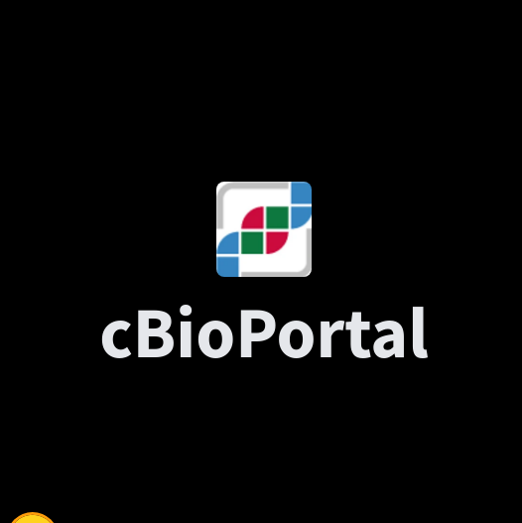
Data Understanding
The dataset is sourced from the MSK-CHORD 2024 clinical-genomic database, comprising over 25,000 tumors from 24,950 patients sequenced via MSK-IMPACT.
The dataset had;
A total of 25040 rows and 53 columns
Columns include Current Age, Fraction Genome Altered, Gleason Score, MSI Score, Mutation Count, Number of Tumor Registry Entries, Overall Survival, Number of Samples per Patient, Sample Coverage, Tumor Mutational Burden (TMB), Tumor Purity etc.

Slide 4
Cleaning and Preprocessing
We filtered dataset to include only pancreatic cancer patients with 3,109 records left.
Dropped irrelevant columns and retained 19 features focused on survival analysis.
Selected Features: Patient ID, Sample ID, Cancer Type, Cancer Type Detailed, Overall Survival (Months), Overall Survival Status, Clinical Summary, Primary Tumor Site Current Age, Sex, Race, Ethnicity, Smoking History, Stage (Highest Recorded), Metastatic Site Tumor Purity, TMB, Mutation Count, Fraction Genome Altered
Identified missing values in 5 key columns:
Clinical Summary, Metastatic Site was filled with "N/A"
Tumor Purity, Mutation Count, Fraction Genome Altered filled with column mean.

Slide 5
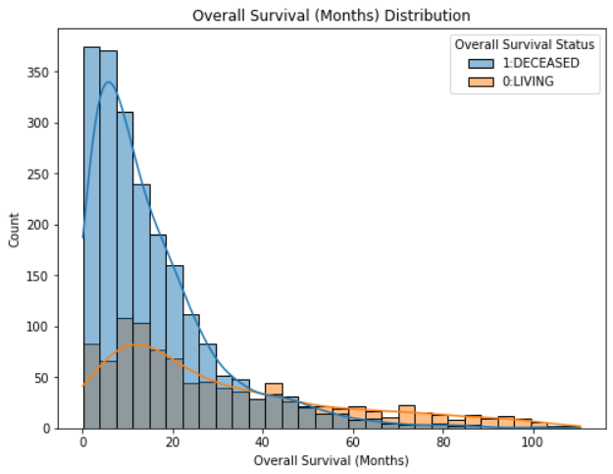
Exploratory Data Analysis (EDA)
Overall Survival Distribution
This chart shows that the majority of deaths are in the first few months of diagnosis. From approximately 0 up to 20 Months.
However, after this period, the number of living is higher than deaths, with some reaching past 60 Months.
Therefore, an average patient has a survival time of 1 Year and 8 months after testing positive for pancreatic cancer.

Slide 6
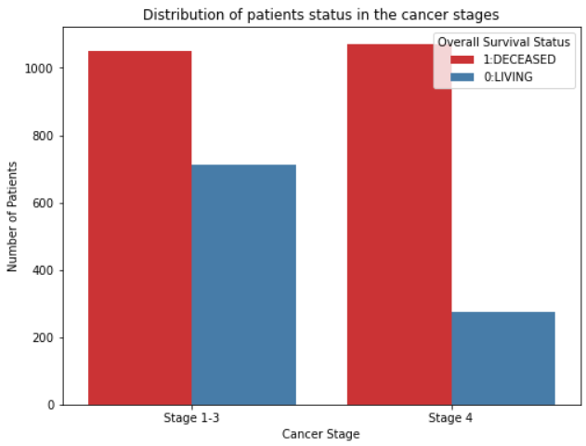
Cancer stage and Survival Status
The bar chart shows that most patients with Stage 1–3 cancer are living, while fewer have died.
A larger number of patients diagnosed at these stages are still alive, indicating that early detection and treatment may lead to higher chances of survival.
It highlights the potential benefit of catching cancer before it progresses to more advanced stages.

Slide 7
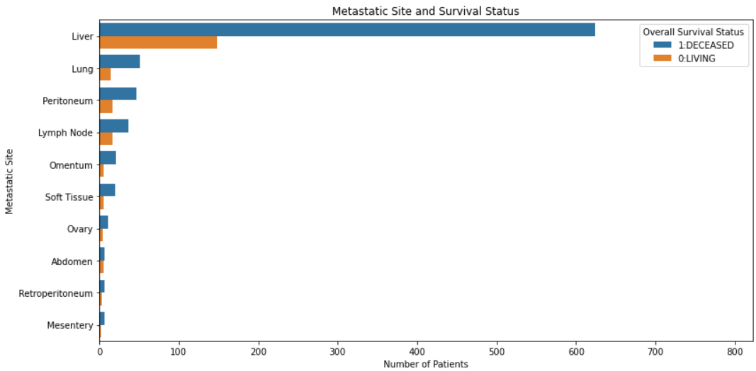
Metastatic Site and Survival Status
This stacked bar chart shows the Top 10 Metastatic Site’s and their link to Survival status.
As you can see, the highest for both survival and death is the Liver, next is the Lungs.
This means the most common area for pancreatic cancer to spread is the Liver.

Slide 8
Model Development
The best-performing model (XGBoost) achieved high recall for deceased patients (0.93) using a tuned threshold.
This demonstrates strong potential to identify patients at higher risk at the point of diagnosis or early treatment.
Model | Precision | Recall | F1-Score
Logistic Regression | 0.67 | 0.43 | 0.52
Random Forest | 0.65 | 0.52 | 0.58
Tuned Random Forest | 0.54 | 0.18 | 0.27
XGBoost | 0.62 | 0.54 | 0.57
Tuned XGBoost | 0.48 | 0.54 | 0.51
Optimal Threshold | 0.77 | 0.49 | 0.60

Slide 9
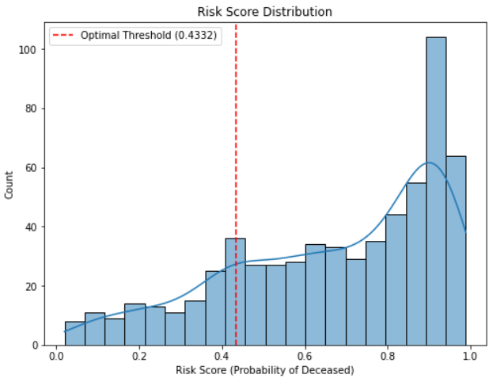
Clinical Utility Summary and Deployment
We assigned each patient a risk score (0 to 1) based on clinical and genomic data to estimate their likelihood of dying from pancreatic cancer. Patients with higher scores were classified as high risk.
At the optimal threshold, the model achieved 80% overall accuracy. It correctly identified 93% of deceased patients (recall) and had 80% precision for high-risk predictions. For living patients, precision was 77%, with a recall of 49%.
This approach enables early identification of high-risk patients who may benefit from aggressive treatment or clinical trials, while low-risk patients can be managed less invasively.

Slide 10

Findings and Recommendations
Key Recommendations:
Enable Early Risk Stratification
Use the model to flag high-risk patients early for faster intervention.
Improve Data Collection on Survivors
Fill the Predictive Gap in Pancreatic Cancer
Outperforms Traditional Risk Tools
Cases:
Enhance Clinical Trial Selection
Optimize Hospital Resource Allocation
Scale to Regional & Low-Resource Hospitals.

Slide 11
Thank you
Sources:
https://www.cbioportal.org/study/summary?id=msk_chord_2024
StreamLit App:
.https://pancreatic-cancer-survival-prediction-j8c9ur8ygcnzdgusq7h7ho.streamlit.app
The Insight Lab:
1. joshua karanja
2. michelle chekwoti
3. myrajoy kiganane
4. christopher katimbwa
5. robert sumaili

