Slide 1

BLASTMAP UNDERGROUND
Complete Underground Drill & Blast Design Solution
Design Smarter. Blast Better. Deliver Results.
BME Presentation — www.bme.co.za www.bme.co.za

Slide 2
UNDERGROUND BLAST DESIGN, REIMAGINED
BLASTMAP UNDERGROUND is a powerful mine planning and blast design solution built specifically for underground mining operations. From development ends and production stopes to shafts and longhole drilling, BLASTMAP UNDERGROUND provides the tools engineers need to design, analyse, and optimize every blast.
BLASTMAP UNDERGROUND | Member of the Omnia Group www.bme.co.za

Slide 3
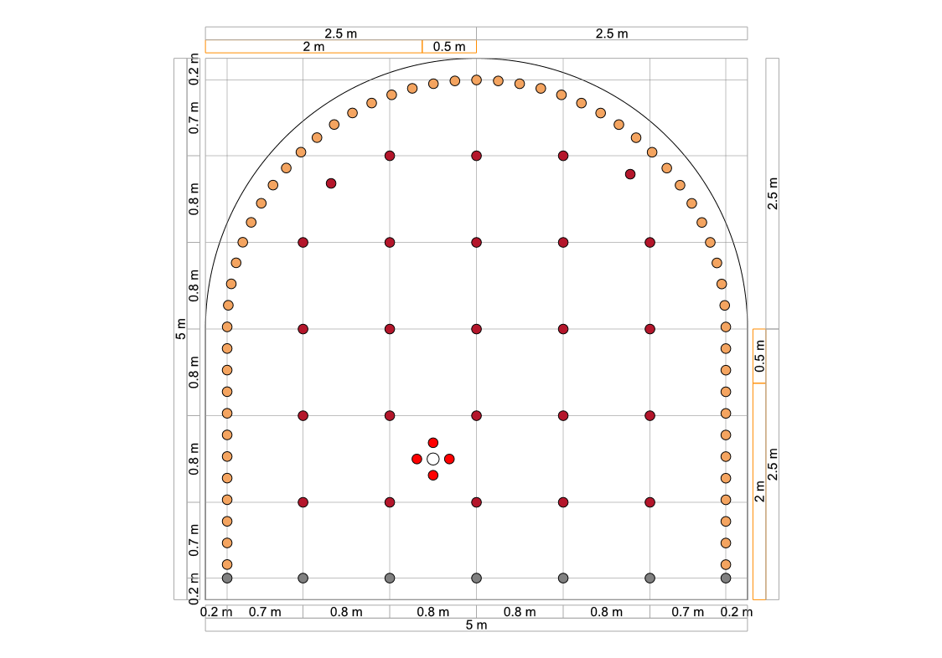
TUNNEL SHAPE DESIGNER
Quickly create and customize tunnel profiles to match your mine's specific development requirements. Design accurate tunnel geometries with confidence and ensure consistent blast layouts throughout your operation.
BLASTMAP UNDERGROUND www.bme.co.za

Slide 4
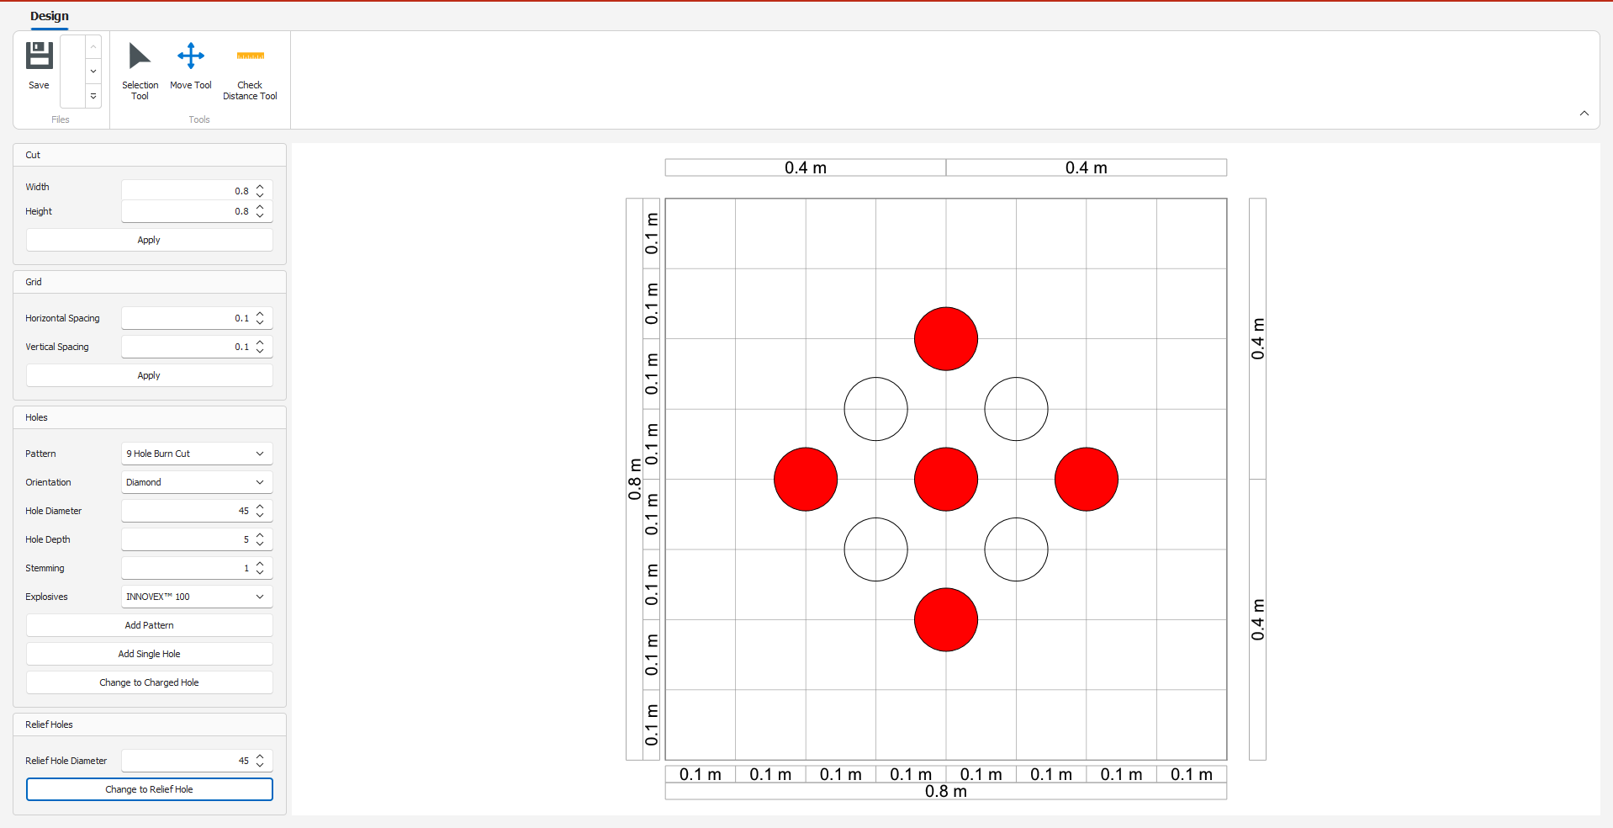
REUSABLE CUT DESIGNER
Save time and standardize designs with the Cut Designer. Create, store, and reuse proven cut patterns, allowing engineers to apply best-practice designs across multiple headings and projects.
BLASTMAP UNDERGROUND www.bme.co.za

Slide 5
Shaft & Ring Design
Built for underground geometry

Slide 6
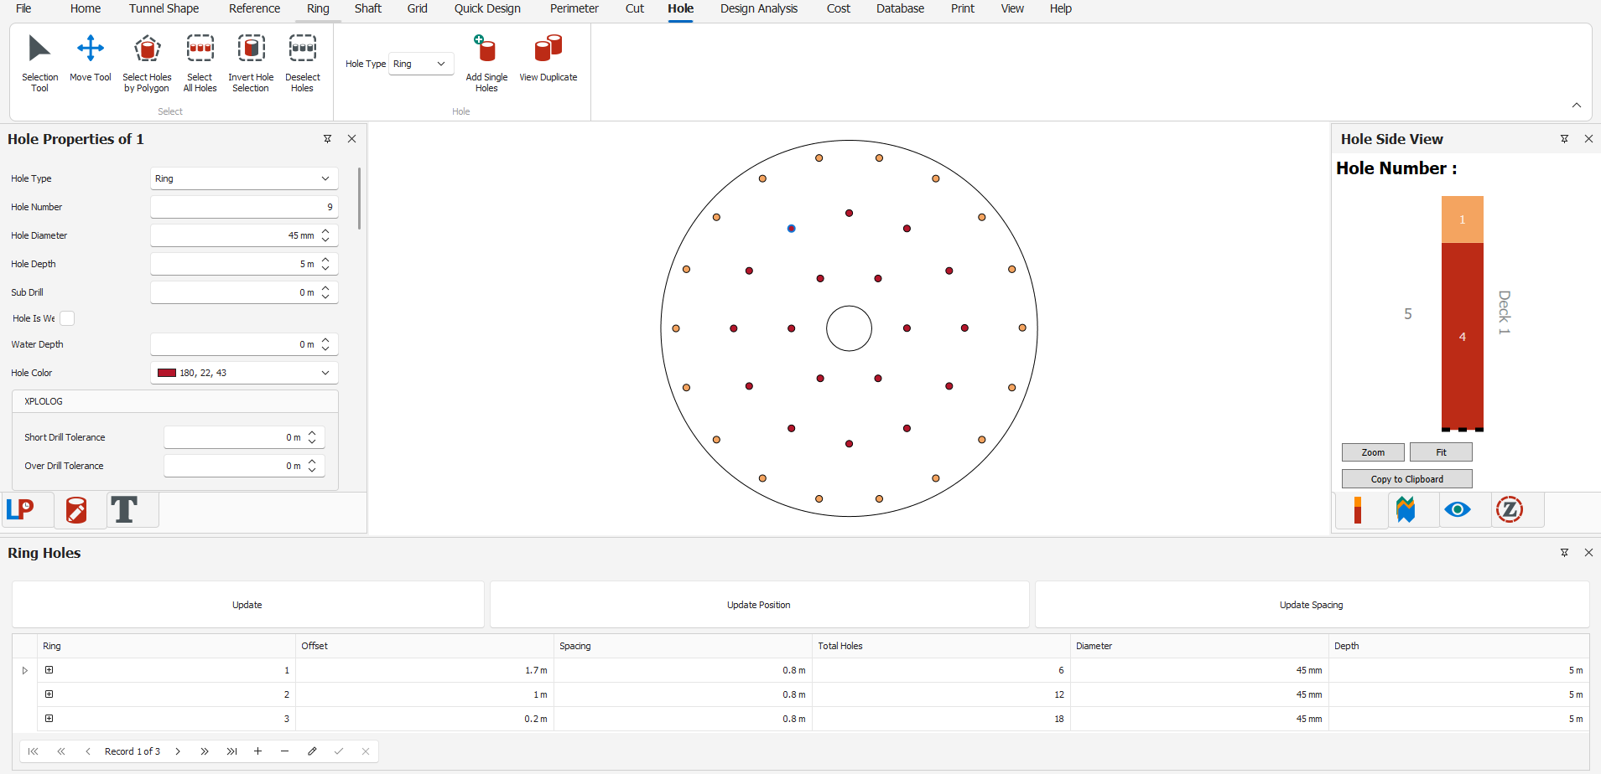
SHAFT DESIGN WITH RINGS
Design shaft blasting patterns efficiently using ring-based layouts. Generate accurate shaft blast designs that improve planning consistency and support safe, productive operations.
BLASTMAP UNDERGROUND www.bme.co.za

Slide 7
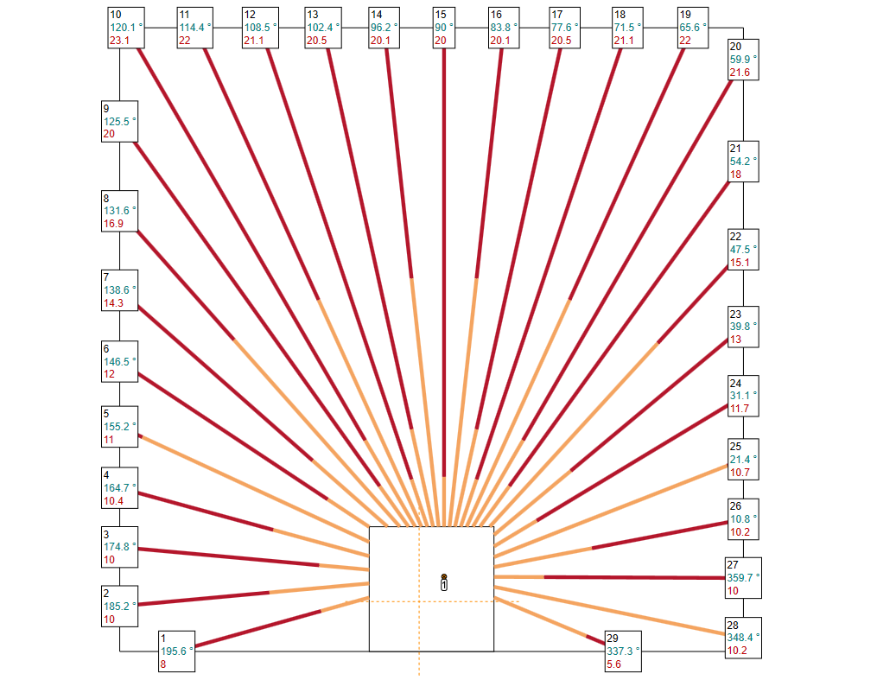
UPHOLE RING DESIGN
Develop and optimize uphole ring patterns for production blasting. Easily manage drilling parameters and ring layouts to maximize blast performance and ore recovery.
BLASTMAP UNDERGROUND www.bme.co.za

Slide 8
Powerful Reporting
Professional output for every blast

Slide 9
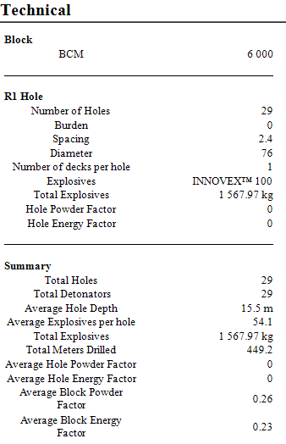
TECHNICAL REPORTS
Generate comprehensive technical reports containing detailed blast design information, drilling parameters, and engineering data for review and auditing purposes.
BLASTMAP UNDERGROUND www.bme.co.za

Slide 10
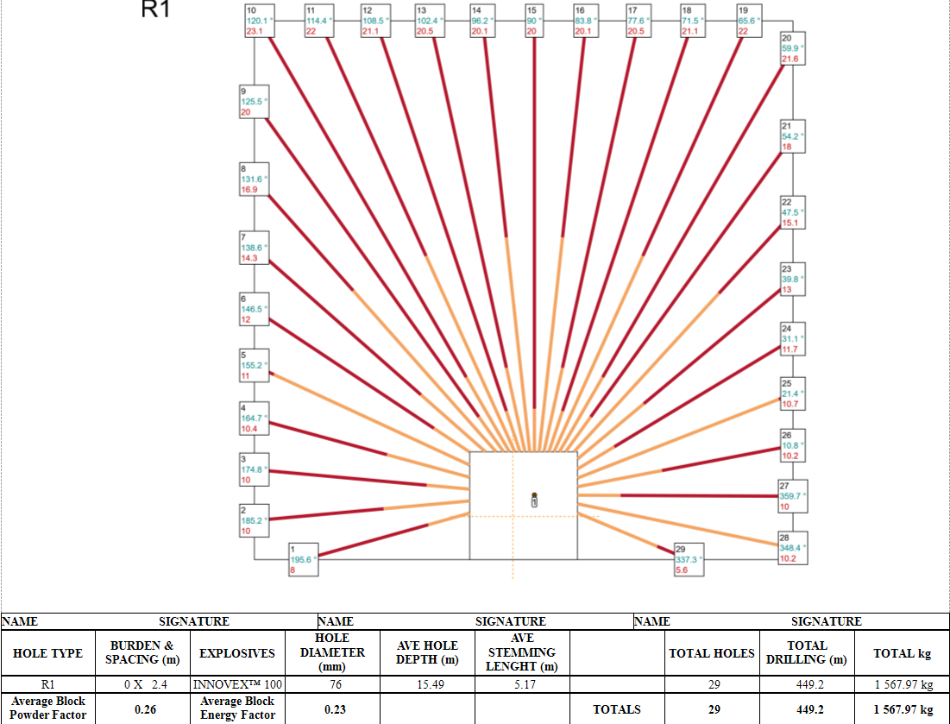
WORKING PLAN REPORTS
Produce clear, practical working plans for field crews, ensuring accurate communication of blast instructions and improving execution underground.
BLASTMAP UNDERGROUND www.bme.co.za

Slide 11
Advanced Blast Analysis
Predict before you fire

Slide 12
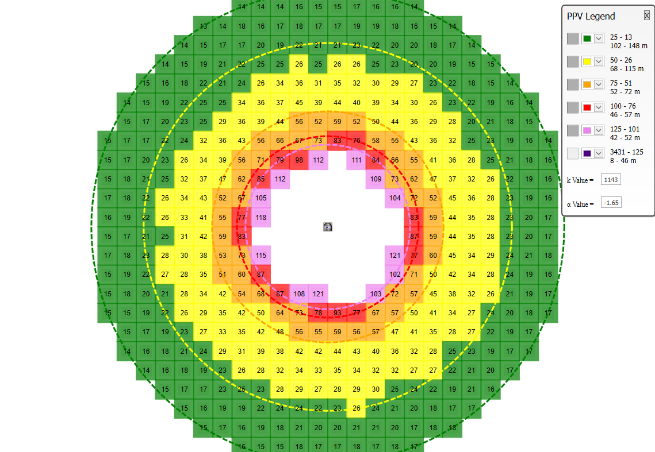
VIBRATION PREDICTION MODEL
Predict blast-induced ground vibrations before firing. Evaluate potential impacts and make informed design adjustments to help maintain compliance and reduce operational risk.
BLASTMAP UNDERGROUND www.bme.co.za

Slide 13
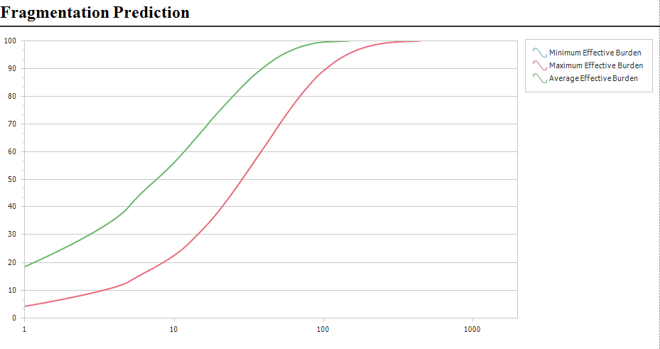
FRAGMENTATION PREDICTION MODEL
Estimate expected rock fragmentation outcomes and optimize blast designs to improve downstream performance, material handling, and overall productivity.
BLASTMAP UNDERGROUND www.bme.co.za

Slide 14
WHY CHOOSE BLASTMAP UNDERGROUND?
Faster blast design workflows
Standardized and reusable design templates
Improved blast quality and consistency
Advanced predictive analysis tools
Comprehensive technical and operational reporting
Designed specifically for underground mining environments
BLASTMAP UNDERGROUND www.bme.co.za

Slide 15
TRANSFORM YOUR UNDERGROUND BLAST PLANNING
BLASTMAP UNDERGROUND combines powerful design tools, advanced analysis capabilities, and professional reporting into a single integrated platform—helping mining operations achieve safer, more efficient, and more predictable blasting results.
BLASTMAP UNDERGROUND | Member of the Omnia Group www.bme.co.za

