Slide 1


Software Design Patterns
Stardew Valley Project Refactoring Report
Group 18
2352495 张竹和 2353018 钱宝强 2351588 谭鹏翀 2351284 李思远

Slide 2




Software Design Patterns
Project Overview
Coupling
Background
Duplication
A Farming Simulation Game featuring planting, ranching, exploration, and NPC interaction.
Existing Issues: High coupling between UI and logic, code duplication, and performance bottlenecks.
Bottleneck
Design patterns
Factory Method, Flyweight, Observer, Command, Facade, Object Pool.

Slide 3

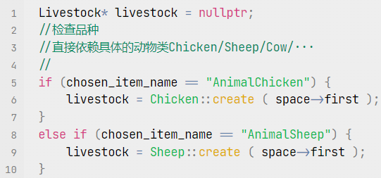
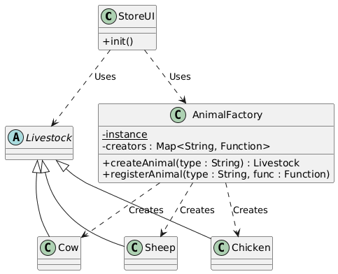
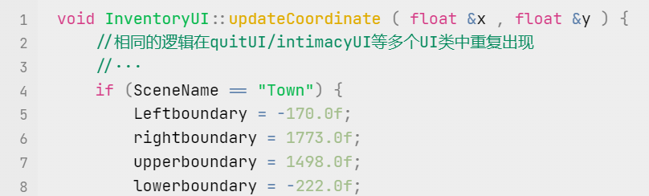
Software Design Patterns
Factory Method
Problem
Solution
Violation of OCP: StoreUI relied on long if-else chains to create different animals.
Hardcoding: Scene boundary coordinates were duplicated across multiple UI classes.
AnimalFactory: Uses a registry map to create animal instances by string keys.
SceneBoundaryFactory: A static factory providing centralized configuration data.
Benefit
Decoupling: UI no longer depends on concrete classes (e.g., Cow, Chicken).
Maintainability: Scene boundaries are managed in one place.

Slide 4

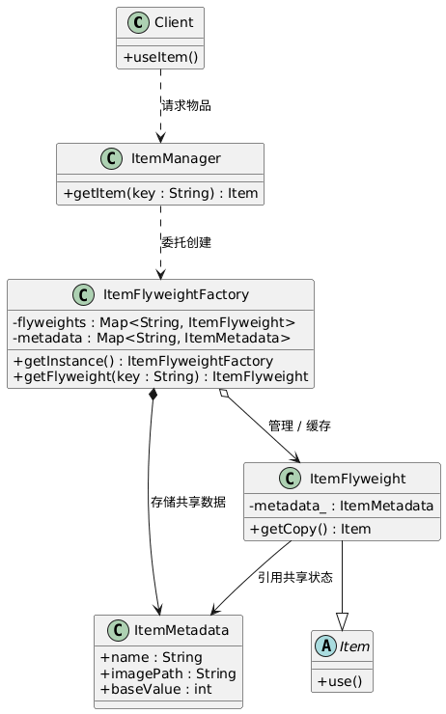
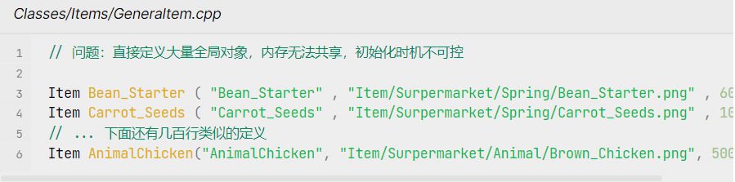
Software Design Patterns
Flyweight Pattern
Problem
Solution
Memory Waste: Hundreds of Item objects were declared globally.
Redundancy: Each item instance stored duplicate data (Name, Icon Path, Price).
Intrinsic State: Extracted shared data into ItemMetadata.
Factory: ItemFlyweightFactory manages shared instances.
Benefit
Memory Optimization: Metadata is stored once per item type, not per instance.
Safe Initialization: Solved the "Static Initialization Order Fiasco".

Slide 5
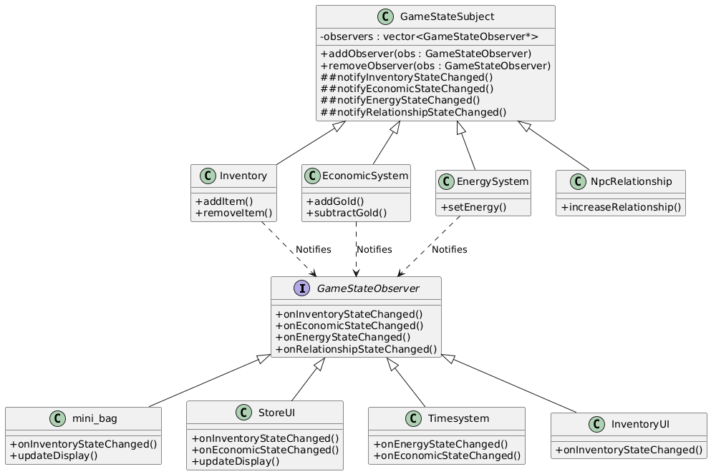

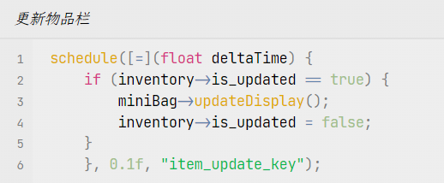
Software Design Patterns
Observer Pattern
Problem
Inefficient Polling: Scene classes checked is_updated flags every frame (0.1s).
Inconsistency: UI components failed to sync data changes (e.g., Gold, Inventory) automatically.
Solution
Subject: Core systems (Inventory, EconomicSystem) inherit GameStateSubject.
Observer: UI components (MiniBag, StoreUI) inherit GameStateObserver.
Benefit
Performance: Removed CPU-intensive polling loops.
Decoupling: Data Logic is separated from View/UI Logic.

Slide 6

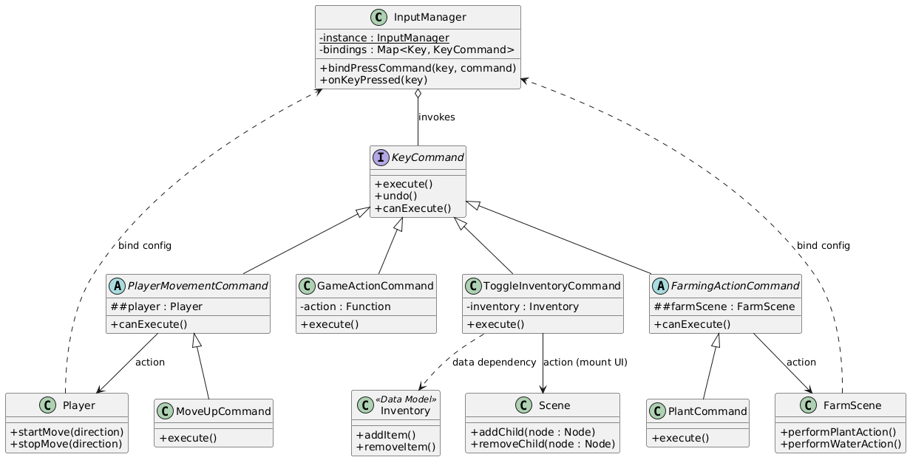
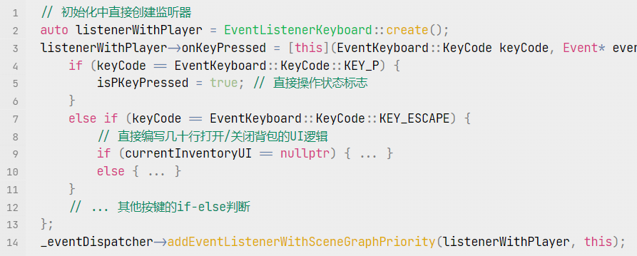
Software Design Patterns
Command Pattern
Problem
Tight Coupling: Input logic mixed with game logic inside Player and Scene classes.
Rigidity: Hardcoded key bindings (e.g., KEY_P for planting) made remapping impossible.
Solution
Invoker: InputManager acts as the input dispatch center.
Command: Encapsulated actions into classes (PlantCommand, MoveCommand).
Benefit
Separation of Concerns: Input handling is separated from business logic.
Extensibility: Easy to add new commands or support custom key bindings.

Slide 7

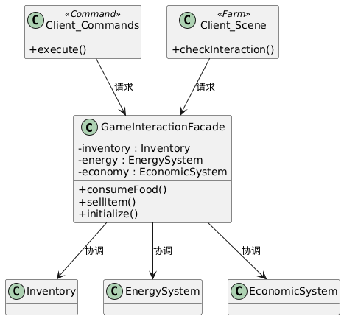
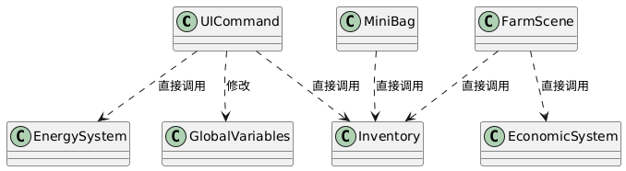
Software Design Patterns
Facade Pattern
Problem
Spaghetti Code: Complex actions (e.g., Eating) required UI to access multiple subsystems (Inventory, Energy, Economy) simultaneously.
Violation of Law of Demeter: UI knew too much about system internals.
Solution
Facade Interface: Created GameInteractionFacade.
Unified API: Provides simple methods like consumeFood() and sellItem().
Benefit
Simplified Client: UI only interacts with the Facade.
Consistency: Centralized validation and state synchronization across systems.

Slide 8
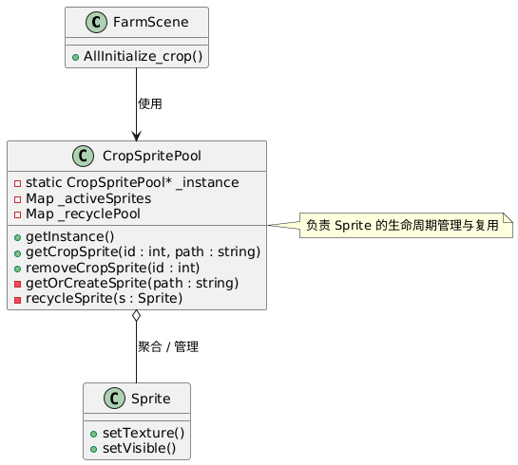
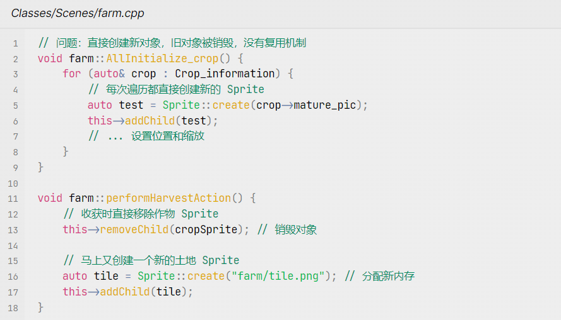
Software Design Patterns
Object Pool Pattern
Problem
Performance Lag: Frequent creation/destruction of Sprite objects during crop growth.
Memory Fragmentation: High frequency of new/delete operations.
Solution
Pool Manager: CropSpritePool maintains a collection of initialized sprites.
Reuse Mechanism: Implemented getOrCreateSprite() (Borrow) and recycleSprite() (Return).
Benefit
FPS Stability: Eliminated instantiation overhead during scene updates.

Slide 9

Software Design Patterns
Summary & AI Tools
AI tools Usage
GitHub Copilot: Code review.
Claude 4.0: Architecture analysis, identifying refactoring opportunities, and providing strategies.
Gemini 3.0: Knowledge comprehension and problem discussion.
Conclusion
Code Quality: Reduced coupling and improved cohesion (SOLID).
Performance: Optimized memory (Flyweight) and rendering (Object Pool).
Maintainability: Replaced hardcoded logic with flexible design patterns.

Slide 10
Thanks
Group 18
2352495 张竹和 2353018 钱宝强 2351588 谭鹏翀 2351284 李思远

