Slide 1
Introduction to WebAssembly
Internal WorkShop - BootCamp
Stefano E. Campanini
Stefano.campanini@tinvention.net

Slide 2
Contents
Javascript today and the JIT
asm.js
Webassembly
  What is ?
  Goals
  Current state and next steps
  Future implications
07/09/2017
Introduction to WebAssembly

Slide 3
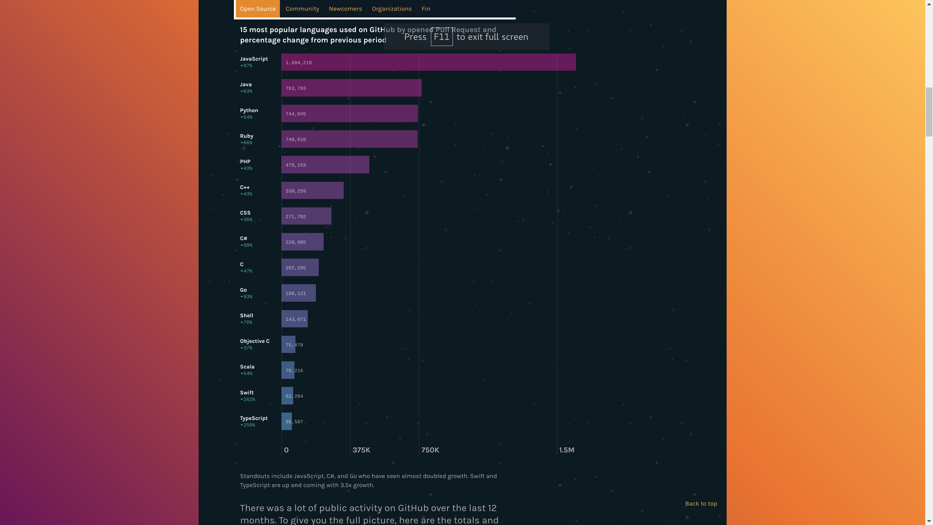
javascript popularity nowadays
2016 , 15 most popular languages
used on GitHub by opened Pull Request and percentage change from previous period.
Source: https://octoverse.github.com/
JavaScript Story
https://auth0.com/blog/a-brief-history-of-javascript/
07/09/2017
Introduction to WebAssembly

Slide 4


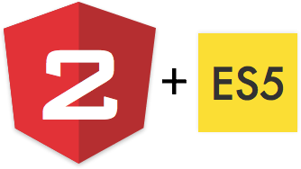

ES5 is «generated»
6 / 7
...
07/09/2017
Introduction to WebAssembly
Notes:
CoffeeScript è un linguaggio di programmazione che si transcompila in JavaScript. Esso aggiunge lo zucchero sintattico ispirato da Ruby, Python e Haskell nel tentativo di accrescere la leggibilità e concisione di JavaScript.[1] Specifiche funzionalità aggiuntive includono la comprensione di lista e la ricerca di corrispondenza.
Il supporto di CoffeeScript è incluso nella versione 3.1 di Ruby on Rails.[2] Nel 2011, Brendan Eich fece riferimento a CoffeeScript come un'influenza nei suoi pensieri sul futuro di JavaScript.[3]
Node versione corrente digerisce al 97% ES6

Slide 5
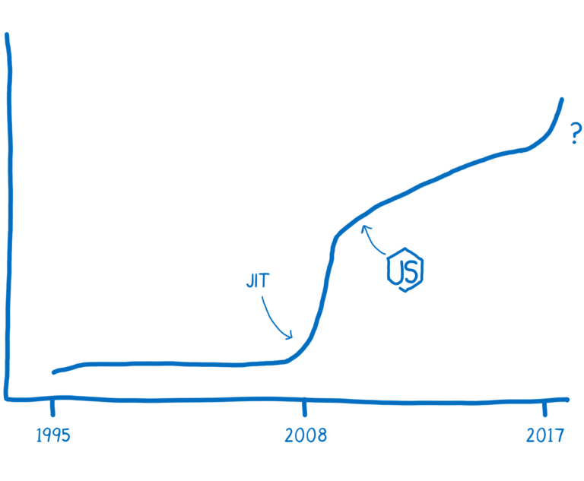
Performance history
JIT makes JavaScript run faster by monitoring the code as it’s running it and sending hot code paths to be optimized.
Even with these improvements, though, the performance of JavaScript can be unpredictable.
Google V8
https://hacks.mozilla.org/2017/02/a-crash-course-in-just-in-time-jit-compilers/
07/09/2017
Introduction to WebAssembly
Notes:
JavaScript was created in 1995. It wasn’t designed to be fast, and for the first decade, it wasn’t fast.
Then the browsers started getting more competitive.
In 2008, a period that people call the performance wars began. Multiple browsers added just-in-time compilers, also called JITs. As JavaScript was running, the JIT could see patterns and make the code run faster based on those patterns.
The introduction of these JITs led to an inflection point in the performance of JavaScript. Execution of JS was 10x faster

Slide 6
asm.js
is an intermediate programming language designed to allow computer software written in languages such as C to be run as, with better perfomaces, standard JavaScript
consists of a strict subset of JavaScript, into which code written in statically-typed languages with manual memory management (such as C) is translated by a source-to-source compiler such as Emscripten.
Firefox was the first web browser to implement asm.js-specific optimizations, starting with version 22.
Optimizatons are also created in other major browser
07/09/2017
Introduction to WebAssembly
Notes:
statically-typed languages with manual memory management

Slide 7
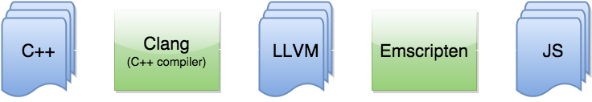
Emscripten
Emscripten takes in C/C++ code, passes it through LLVM, and converts the LLVM-generated code into JavaScript (specifically, Asm.js, a subset of JavaScript).
LLVM is a toolchain that is used to construct, optimize and produce intermediate and/or binary machine code.
07/09/2017
Introduction to WebAssembly
Notes:
help wih common libs, produce webassembly, also from C++

Slide 8
asm.js
asm.js is based on type annotation and linear memory access ( unique buffer object ).
Why it is not enough:
not 64-bit integers ( it is Javascript.... , 64-bit is emulated)
not easy to extend
not a formal standard
not speed garantee
07/09/2017
Introduction to WebAssembly
Notes:
64-bit integersEdit
While most numeric types in js-ctypes are represented by standard JavaScript Number objects, 64-bit integers cannot all be represented accurately by this type. For that reason, 64-bit and pointer-sized C values of numeric types don't get automatically converted to JavaScript numbers. Instead, they're converted to JavaScript objects that you can manipulate using the methods provided by the Int64 and UInt64 objects.
Note: These 64-bit integer types are intentionally low on features, so that when JavaScript adds a "big number" type, we can easily upgrade to support that properly.

Slide 9
Massive: The asm.js Benchmark
Massive is a benchmark that measures asm.js performance specifically. It contains several large, real-world codebases: Poppler, SQLite, Lua and Box2D;
Massive therefore tests, in addition to throughput, how long it takes the browser to load a large codebase, and how responsive it is while doing so. It also tests how consistent performance is.
https://github.com/kripken/Massive
07/09/2017
Introduction to WebAssembly

Slide 10
A “bytecode” for the web
WebAssembly or wasm is a new portable, size- and load-time-efficient format suitable for compilation to the web.
C
LLVM Optimizer
x86
C++
C++
Rust
IR
.wasm
Java ?
ARM
...
Front-end
Wasm Back-end
Browser vm
07/09/2017
Introduction to WebAssembly
Notes:
wasm is a new standard for the web, an improvement to JavaScript. It’s binary byte-code compiled from a system level language, which runs on the browser to provide near native performance ,decrease size and module load time.
In a nutshell wasm is going to change the way we use the web. It’s going to open new a frontier in web development. Imagine running a heavy software or playing a game on the browser all over on the internet

Slide 11
Web Assembly
it is efficient and fast : Wasm byte-code is designed to be encoded in a size- and load-time-efficient binary format. WebAssembly aims to execute at native speed by taking advantage of common hardware capabilities
it is safe : Wasm describes a memory-safe, sandboxed execution environment that may even be implemented inside existing JavaScript virtual machines.
it is open and debuggable : Wasm is designed to be pretty-printed in a textual format for debugging, testing, experimenting, optimising, learning, teaching, and writing programs by hand.
07/09/2017
Introduction to WebAssembly

Slide 12
Web Assembly
it is part of the open web platform : Wasm is designed to maintain the version less, feature-tested, and backwards-compatible nature of the web. WebAssembly modules will be able to call into and out of the JavaScript context and access browser functionality through the same Web APIs accessible from JavaScript.
it is currently being designed as an open standard by a W3C Community Group, created two years ago, that includes representatives from all major browsers. Dev activities on github .
Let’s check current compatibilty:
https://developer.mozilla.org/en-US/docs/WebAssembly#Browser_compatibility
07/09/2017
Introduction to WebAssembly

Slide 13
Web Assembly vs. asm.js
Webassembly vs. asm js
Smaller, in size
Faster for parsing and loading
Easy to be extended
Based on a formal and open standard
07/09/2017
Introduction to WebAssembly

Slide 14
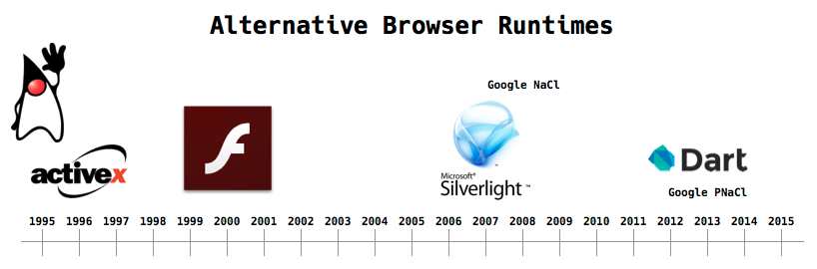
Similar past initiatives
Source: http://nickdesaulniers.github.io/wasm-fowa/slides/#/7
Goodbye PNaCl, Hello WebAssembly!
Tuesday, May 30, 2017
“Given the momentum of cross-browser support, we plan to focus our native code efforts on WebAssembly going forward. We will remove support for PNaCl in the first quarter of 2018 everywhere except inside Chrome Apps and Extensions.”
Source: https://blog.chromium.org/2017/05/goodbye-pnacl-hello-webassembly.html
07/09/2017
Introduction to WebAssembly

Slide 15
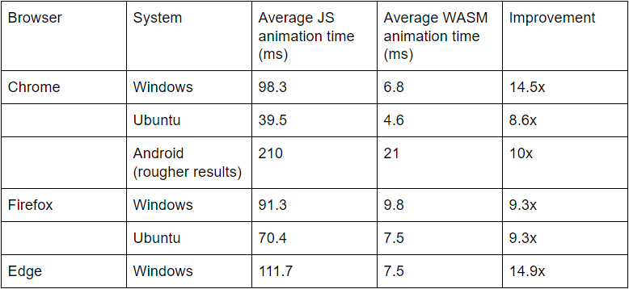
WASM is really fast, right?
Blog entry by Kamaron Peterson of may 2017
  Code details https://github.com/sessamekesh/wasm-3d-animation-demo
  Running Demohttp://aws-website-webassemblyskeletalanimation-ffaza.s3-website-us-east-1.amazonaws.com/
3D animation
JS vs. Wasm
Source: https://www.lucidchart.com/techblog/2017/05/16/webassembly-overview-so-fast-so-fun-sorta-difficult/
07/09/2017
Introduction to WebAssembly

Slide 16
WebAssembly State - MVP
On February 28, the four major browsers announced their consensus that the MVP ( Minimum Viable Product) of WebAssembly is complete.
This provides a stable core that browsers can ship. This core doesn’t contain all of the features that the community group is planning, but it does provide enough to make WebAssembly fast and usable.
With Emscripten, you can compile the same app to both WebAssembly and asm.js for old browser support
07/09/2017
Introduction to WebAssembly

Slide 17
MVP - goals
The MVP will contain features which are available today in modern web browsers and which perform well even on mobile devices, which leads to roughly the same functionality as asm.js.
Briefly:
  Define the units of code in WebAssembly “modules”
  The instructions for the structured stack machine
  The binary format
  The text format, which is designed to be read and written when using tools (e.g., assemblers, debuggers, profilers)
  Different Execution environments ( no only web browser)
07/09/2017
Introduction to WebAssembly

Slide 18
Some demos
Video Editor
  https://d2jta7o2zej4pf.cloudfront.net/
Epic Zen Garden , Epic Games Inc. demo for Metal API ( rendering engine written C++ )
  https://s3.amazonaws.com/mozilla-games/ZenGarden/EpicZenGarden.html
BananaBread Game
  https://kripken.github.io/BananaBread/cube2/bb.html
07/09/2017
Introduction to WebAssembly

Slide 19
Post-MVP - Performance oriented
Performance oriented:
Faster function calls between JS and WebAssembly
  today it is slow, two steps..
Working directly with the DOM
  Now you have to call Javascript function…
Multithreading
  shared memory via JavaScript’s new SharedArrayBuffer
Single instruction, multiple data (SIMD)
  VR applications, multimedia, ...
Exception handling
  Now for C++ via Emscripten it is emulated
07/09/2017
Introduction to WebAssembly
Notes:
SIMD
If you read other posts or watch talks about WebAssembly, you may hear about SIMD support. The acronym stands for single instruction, multiple data. It’s another way of running things in parallel.
SIMD makes it possible to take a large data structure, like a vector of different numbers, and apply the same instruction to different parts at the same time. In this way, it can drastically speed up the kinds of complex computations you need for games or VR.
This is not too important for the average web app developer. But it is very important to developers working with multimedia, such as game developers.

Slide 20
Post-MVP - Dev oriented
Easy development oriented:
First-class source-level developer tools.
  improve tooling support so that developers can debug their source code.
Garbage collection.
  The idea of this future feature is to give WebAssembly first-class access to the builtin GC with a set of low-level GC primitive types and operations. This in future can facilitate to have sources in languages such as C# or Java.
ES Module integration.
  Browsers are currently adding support for loading JavaScript modules using the script tag. Once this feature is added, a tag like <script src=url type="module"> could work even if url points to a WebAssembly module
07/09/2017
Introduction to WebAssembly
Notes:
SIMD
If you read other posts or watch talks about WebAssembly, you may hear about SIMD support. The acronym stands for single instruction, multiple data. It’s another way of running things in parallel.
SIMD makes it possible to take a large data structure, like a vector of different numbers, and apply the same instruction to different parts at the same time. In this way, it can drastically speed up the kinds of complex computations you need for games or VR.
This is not too important for the average web app developer. But it is very important to developers working with multimedia, such as game developers.

Slide 21
Do We use WebAassembly ?
Today is harder than current ways for traditional Web applications, but if you have performance needs….

Slide 22
Js and Wasm ?
The more probable and near scenario is that Javascript and WebAssembly will be used toghether.
JS Libs/framwroks/modules will be written in C++ and distributed as wasm modulkes, starting from smallest and most used. JS will be used as glue-code orchestrating wasm modules.
Real example:
https://github.com/shamadee/web-dsp
07/09/2017
Introduction to WebAssembly

Slide 23
Wasm Implications can be exciting
WebAssembly will be used starting where it bring considerable advantage, es:
Media:
  Virtual Reality, Games,Live Video Augmentation, Image/Video/Audio Editing, …
CAD Systems
64 bit math libs,
encryption, compression, password store,
libraries already written in C
  Es. DICOM (https://github.com/jodogne/wasm-dicom-parser )
May be e new way to develop and distribute native mobile apps, in a portable manner ? bypassing app stores ?
07/09/2017
Introduction to WebAssembly

Slide 24

Questions XOR Beer ?
07/09/2017
Introduction to WebAssembly

Slide 25
Ref & links
http://kripken.github.io/mloc_emscripten_talk/#/35
ttp://xmlvm.org/html5/
https://rsms.me/wasm-intro
http://kripken.github.io/mloc_emscripten_talk/#/5
http://voidcanvas.com/will-javascript-die-due-to-webassembly/
http://www.hanselman.com/blog/JavaScriptIsWebAssemblyLanguageAndThatsOK.aspx
https://webassembly.github.io/spec/_download/WebAssembly.pdf
https://hoverbear.org/2017/04/06/the-path-to-rust-on-the-web/
https://egghead.io/courses/introduction-to-webassembly
07/09/2017
Introduction to WebAssembly

Slide 26
Ref & links
http://kripken.github.io/mloc_emscripten_talk/llvm.html#/11
https://johnresig.com/blog/asmjs-javascript-compile-target/ https://kripken.github.io/mloc_emscripten_talk/cppcon.html#/3
https://www.lucidchart.com/techblog/2017/05/16/webassembly-overview-so-fast-so-fun-sorta-difficult/
07/09/2017
Introduction to WebAssembly

