Slide 1

Stefano E. Campanini
Stefano.campanini@tinvention.net

Slide 2

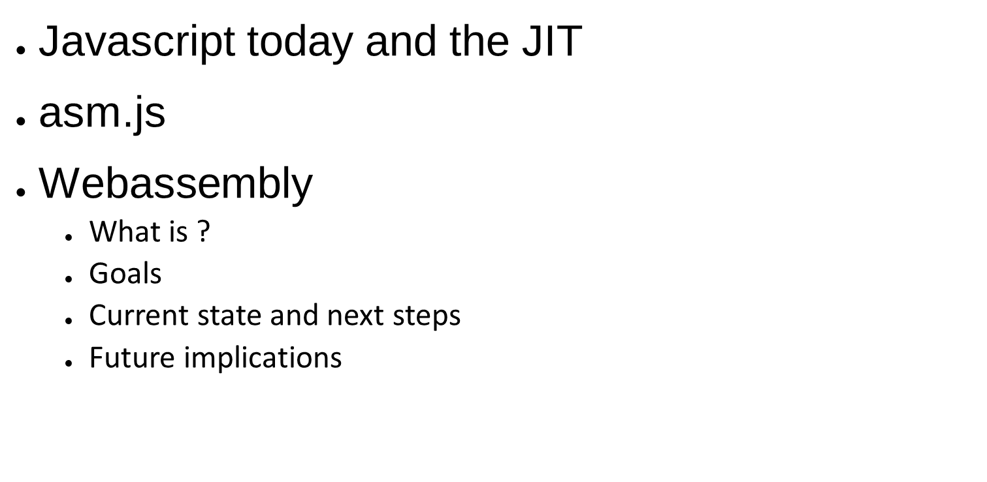
Introduction to WebAssembly

Slide 3

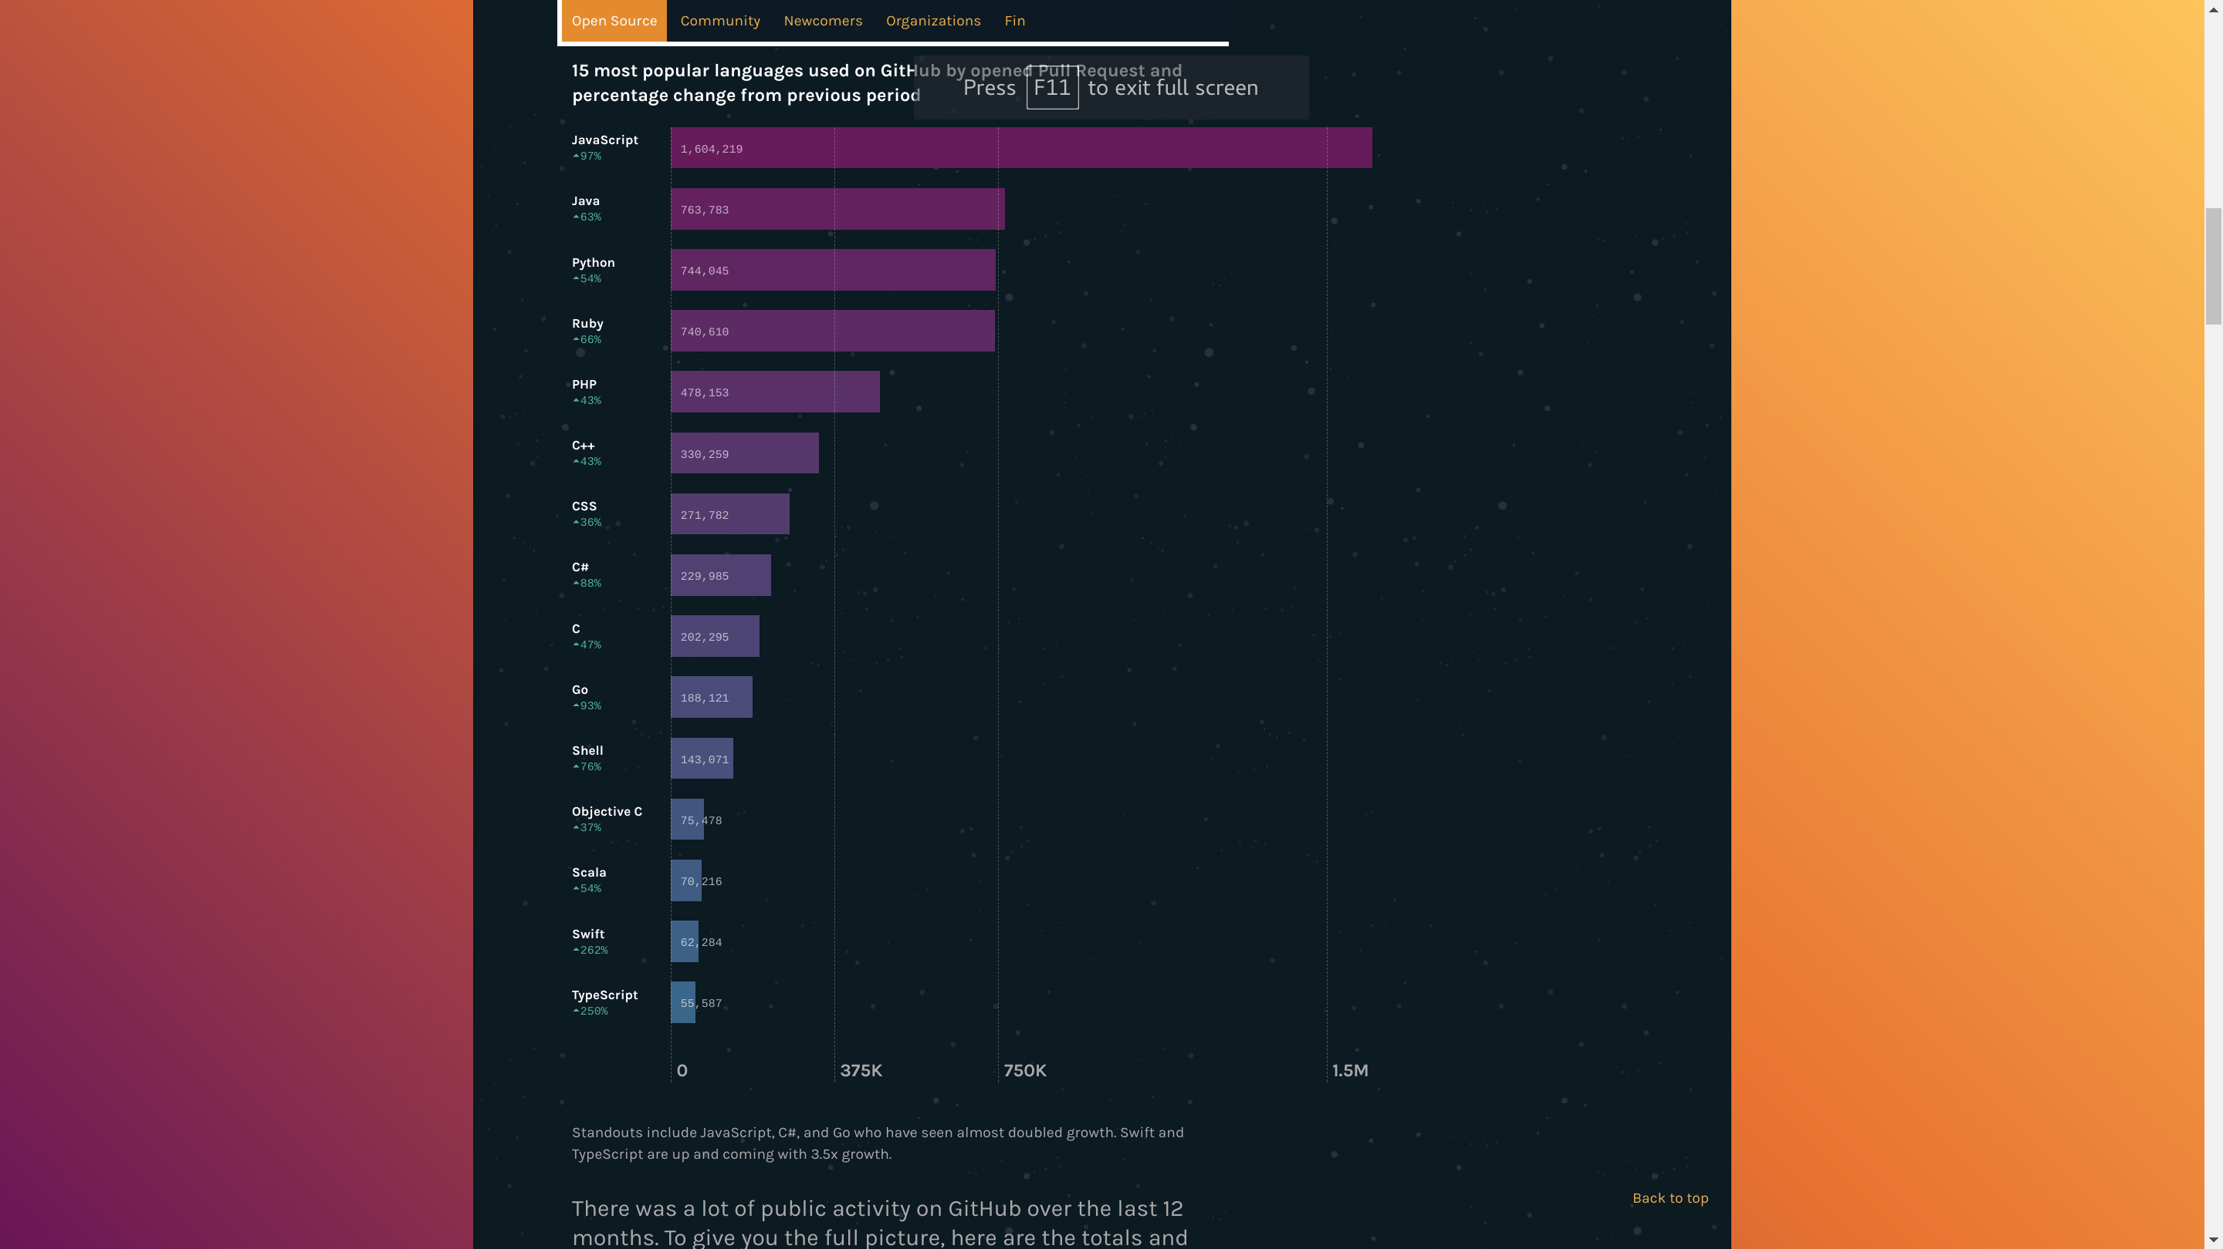
2016 , 15 most popular languages
used on GitHub by opened Pull Request and percentage change from previous period.
Source: https://octoverse.github.com/
JavaScript Story
https://auth0.com/blog/a-brief-history-of-javascript/
Introduction to WebAssembly

Slide 4





6 / 7
...
Introduction to WebAssembly
Notes:
CoffeeScript è un linguaggio di programmazione che si transcompila in JavaScript. Esso aggiunge lo zucchero sintattico ispirato da Ruby, Python e Haskell nel tentativo di accrescere la leggibilità e concisione di JavaScript.[1] Specifiche funzionalità aggiuntive includono la comprensione di lista e la ricerca di corrispondenza.
Il supporto di CoffeeScript è incluso nella versione 3.1 di Ruby on Rails.[2] Nel 2011, Brendan Eich fece riferimento a CoffeeScript come un'influenza nei suoi pensieri sul futuro di JavaScript.[3]
Node versione corrente digerisce al 97% ES6

Slide 5

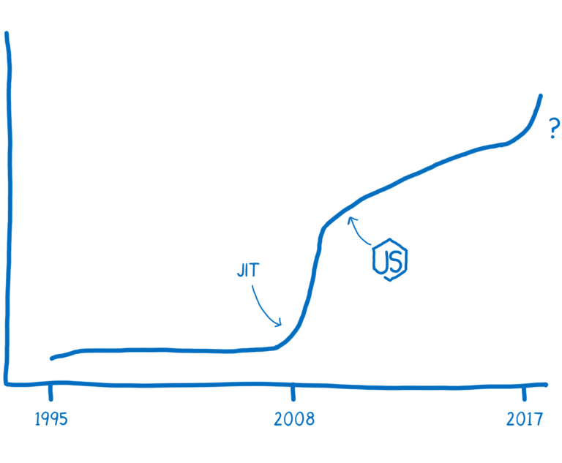
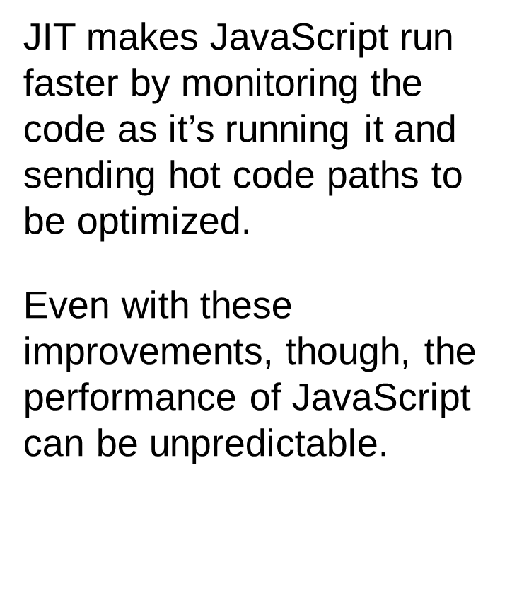
Google V8
https://hacks.mozilla.org/2017/02/a-crash-course-in-just-in-time-jit-compilers/
Introduction to WebAssembly
Notes:
JavaScript was created in 1995. It wasn’t designed to be fast, and for the first decade, it wasn’t fast.
Then the browsers started getting more competitive.
In 2008, a period that people call the performance wars began. Multiple browsers added just-in-time compilers, also called JITs. As JavaScript was running, the JIT could see patterns and make the code run faster based on those patterns.
The introduction of these JITs led to an inflection point in the performance of JavaScript. Execution of JS was 10x faster

Slide 6

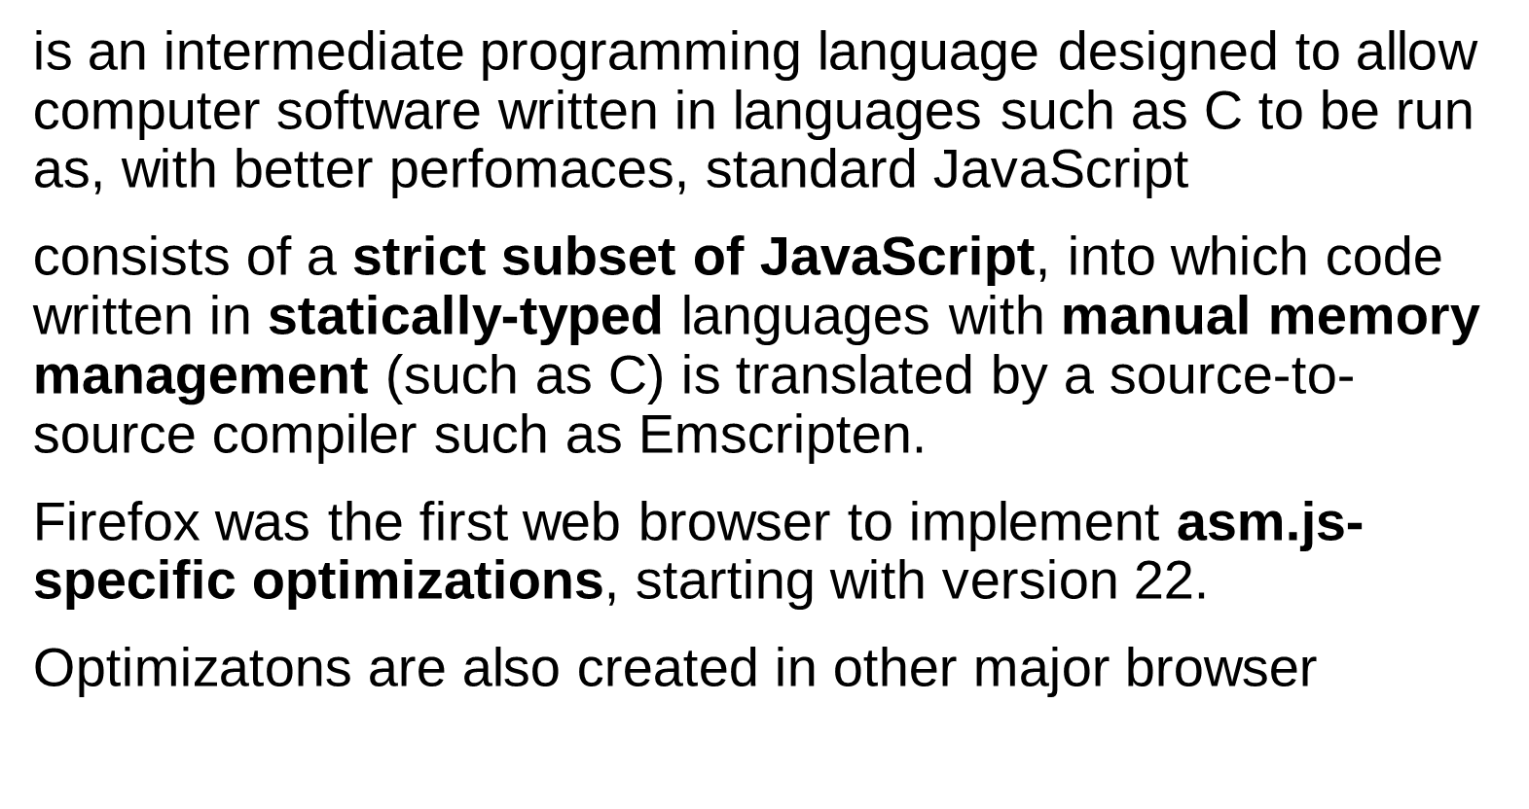
Introduction to WebAssembly
Notes:
statically-typed languages with manual memory management

Slide 7

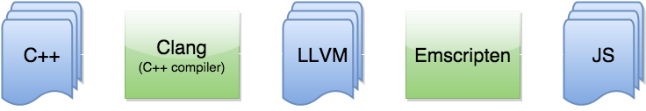
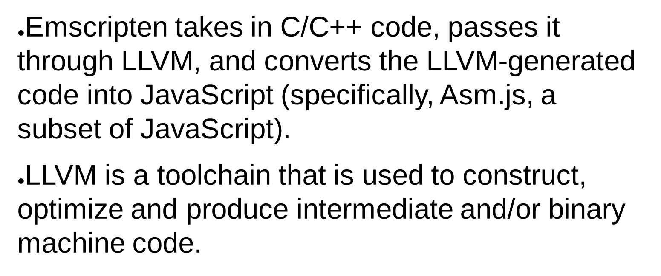
Introduction to WebAssembly
Notes:
help wih common libs, produce webassembly, also from C++

Slide 8
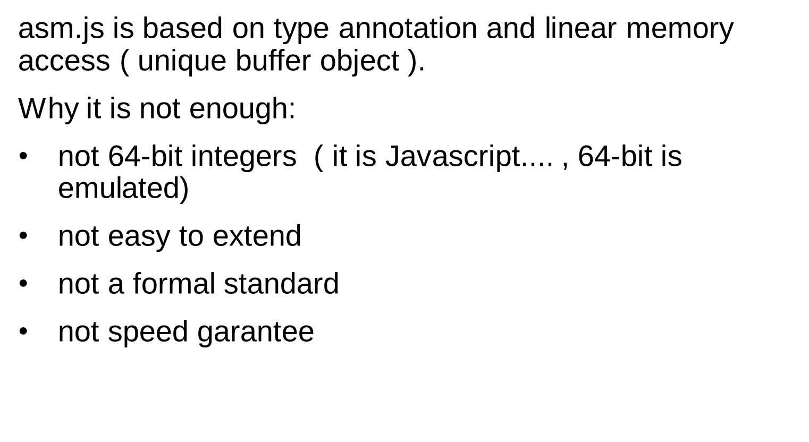
Introduction to WebAssembly
Notes:
64-bit integersEdit
While most numeric types in js-ctypes are represented by standard JavaScript Number objects, 64-bit integers cannot all be represented accurately by this type. For that reason, 64-bit and pointer-sized C values of numeric types don't get automatically converted to JavaScript numbers. Instead, they're converted to JavaScript objects that you can manipulate using the methods provided by the Int64 and UInt64 objects.
Note: These 64-bit integer types are intentionally low on features, so that when JavaScript adds a "big number" type, we can easily upgrade to support that properly.

Slide 9

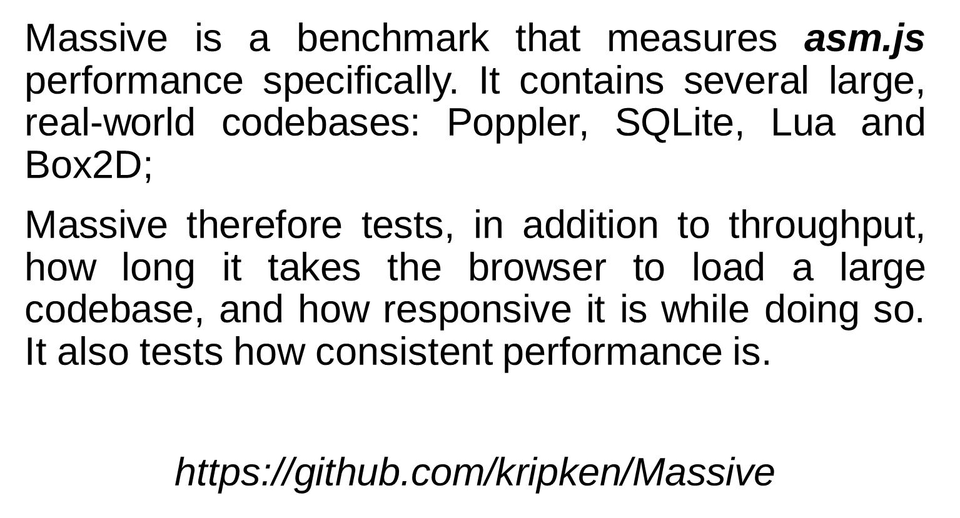
Introduction to WebAssembly

Slide 10

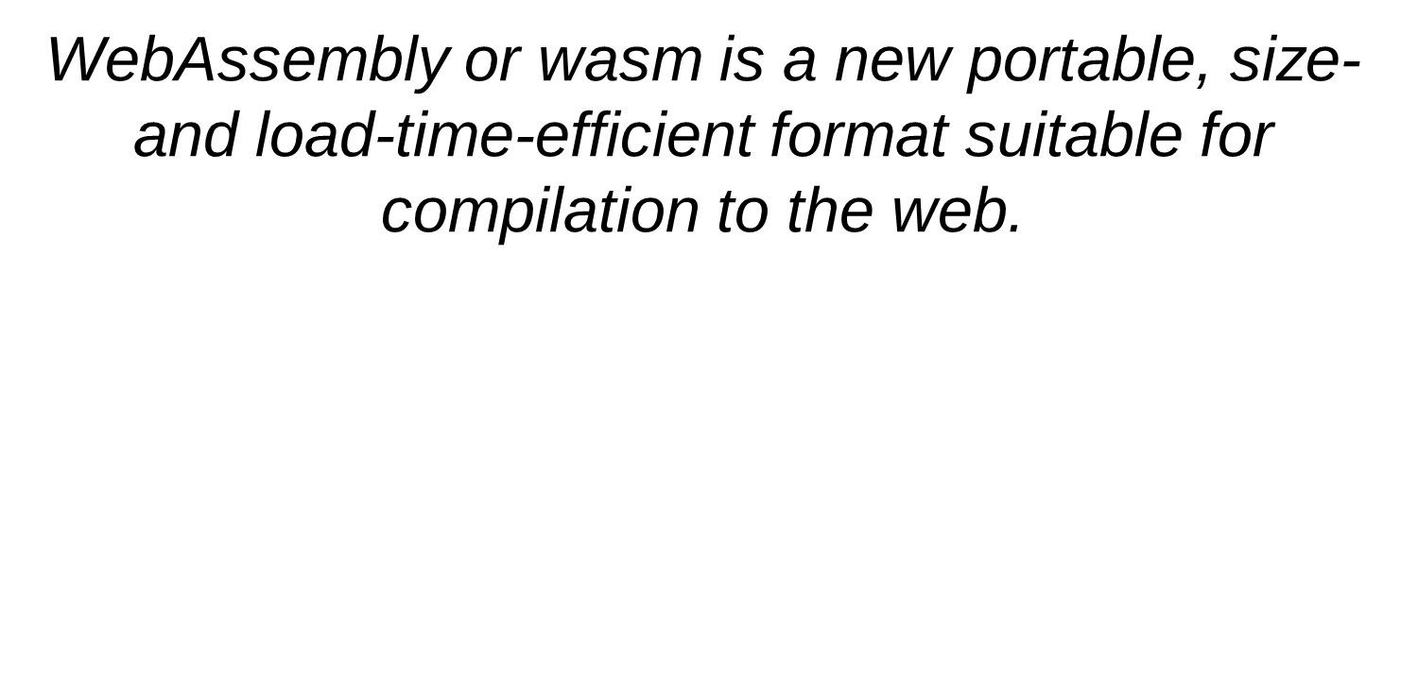
C
LLVM Optimizer
x86
C++
C++
Rust
IR
.wasm
Java ?
ARM
...
Front-end
Wasm Back-end
Browser vm
Introduction to WebAssembly
Notes:
wasm is a new standard for the web, an improvement to JavaScript. It’s binary byte-code compiled from a system level language, which runs on the browser to provide near native performance ,decrease size and module load time.
In a nutshell wasm is going to change the way we use the web. It’s going to open new a frontier in web development. Imagine running a heavy software or playing a game on the browser all over on the internet

Slide 11

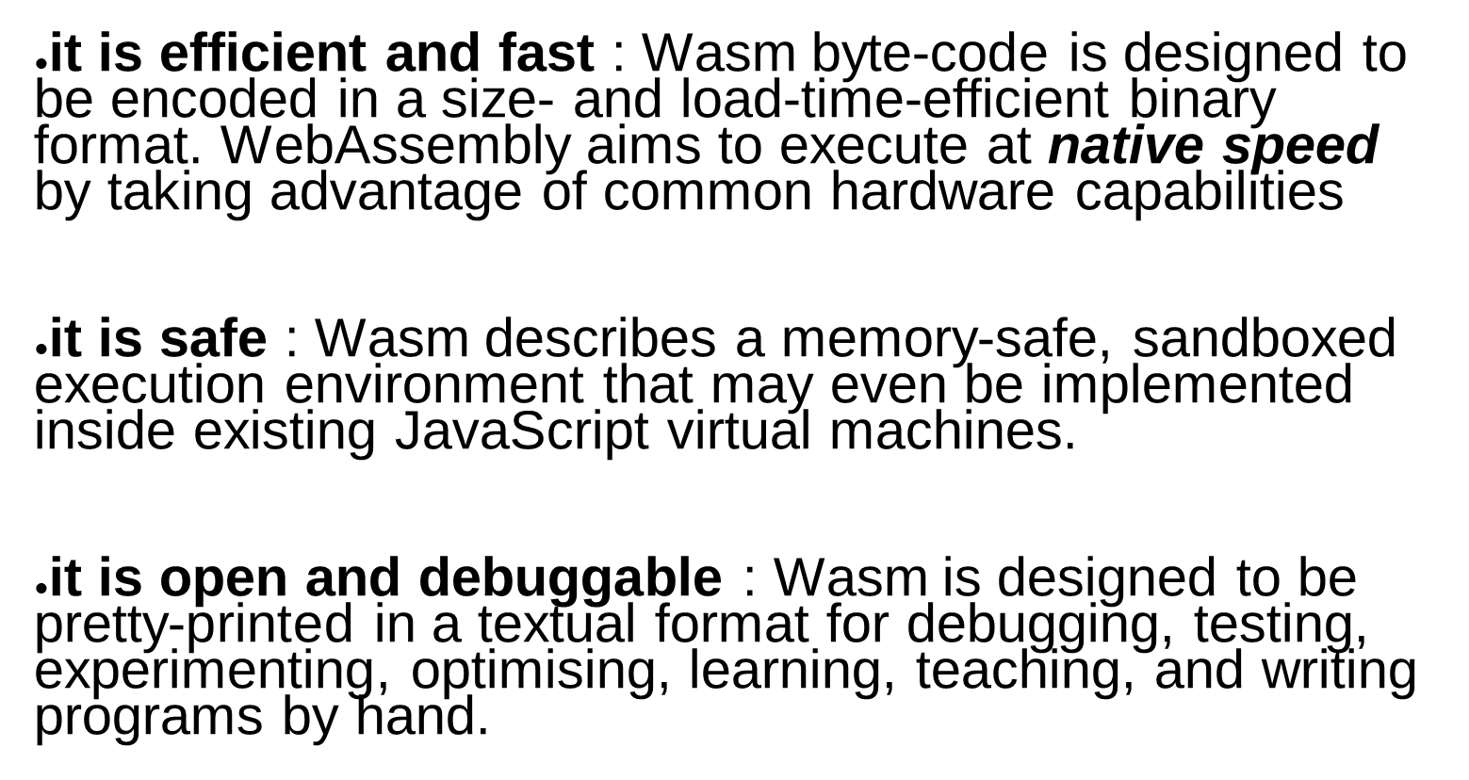
Introduction to WebAssembly

Slide 12
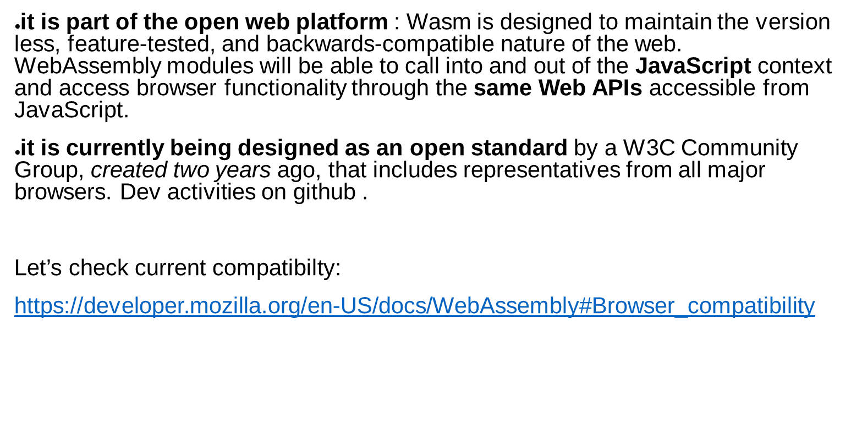
Introduction to WebAssembly

Slide 13

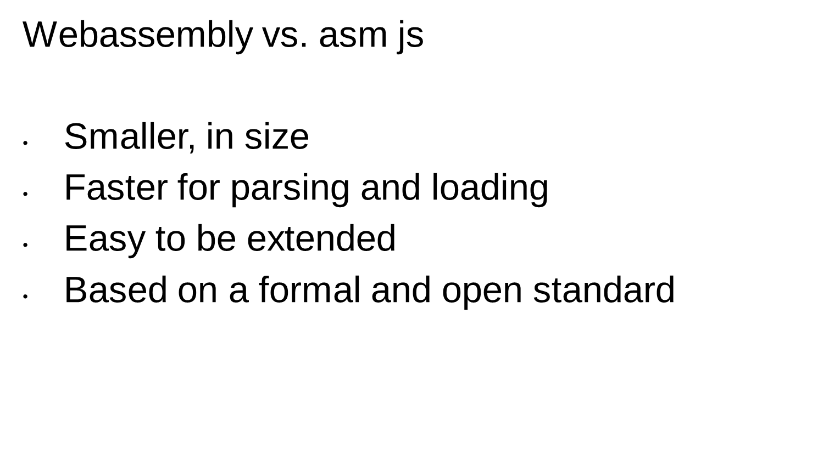
Introduction to WebAssembly

Slide 14

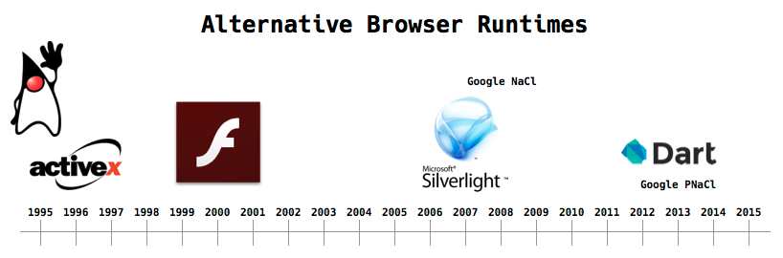
Source: http://nickdesaulniers.github.io/wasm-fowa/slides/#/7
Goodbye PNaCl, Hello WebAssembly!
Tuesday, May 30, 2017
“Given the momentum of cross-browser support, we plan to focus our native code efforts on WebAssembly going forward. We will remove support for PNaCl in the first quarter of 2018 everywhere except inside Chrome Apps and Extensions.”
Source: https://blog.chromium.org/2017/05/goodbye-pnacl-hello-webassembly.html
Introduction to WebAssembly

Slide 15


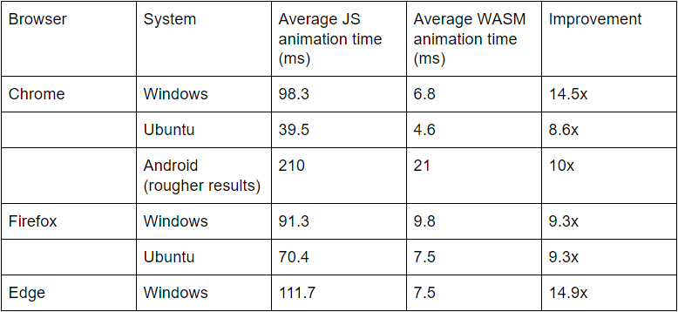
3D animation
JS vs. Wasm
Source: https://www.lucidchart.com/techblog/2017/05/16/webassembly-overview-so-fast-so-fun-sorta-difficult/
Introduction to WebAssembly

Slide 16

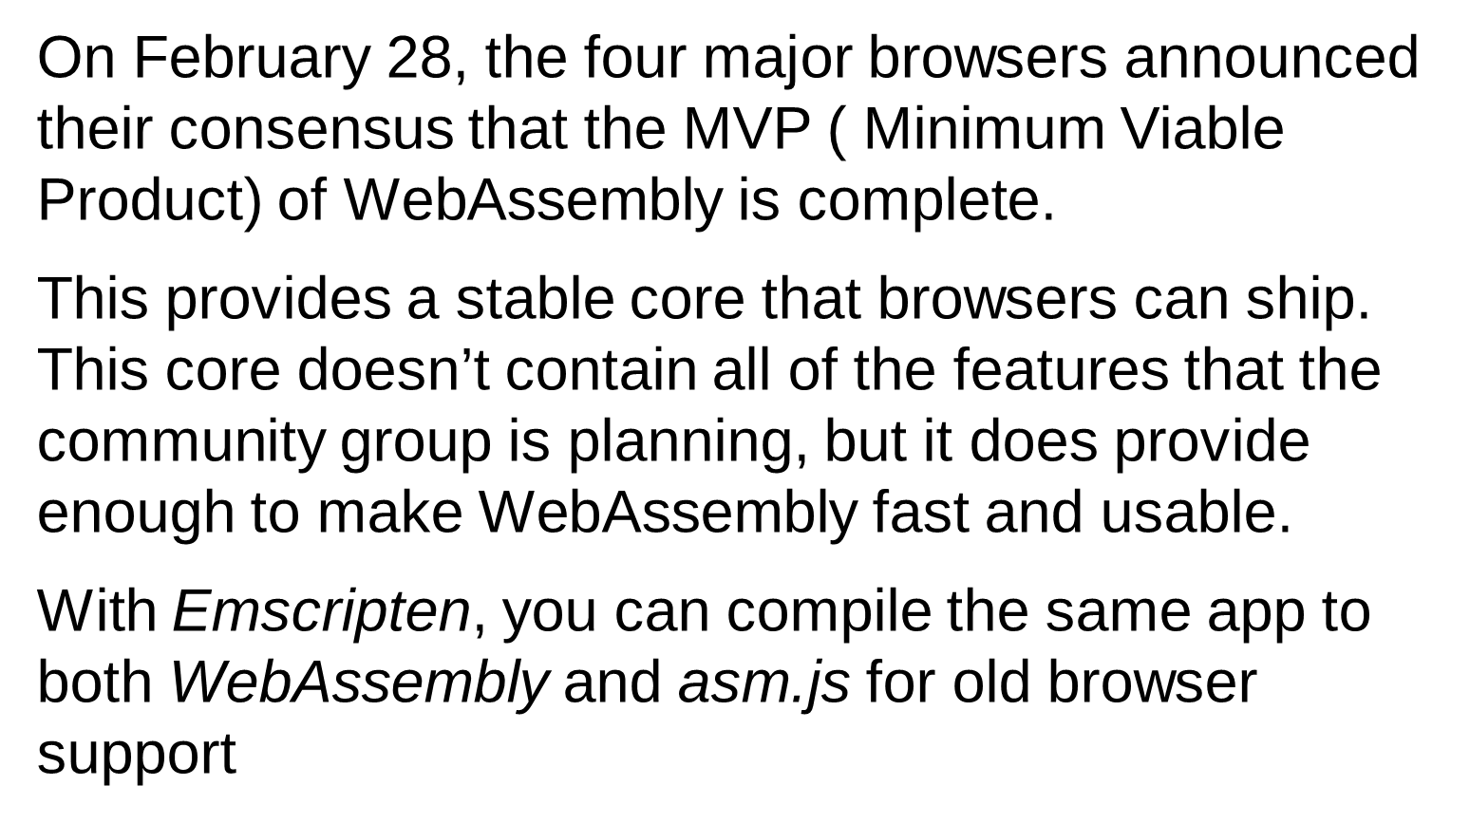
Introduction to WebAssembly

Slide 17

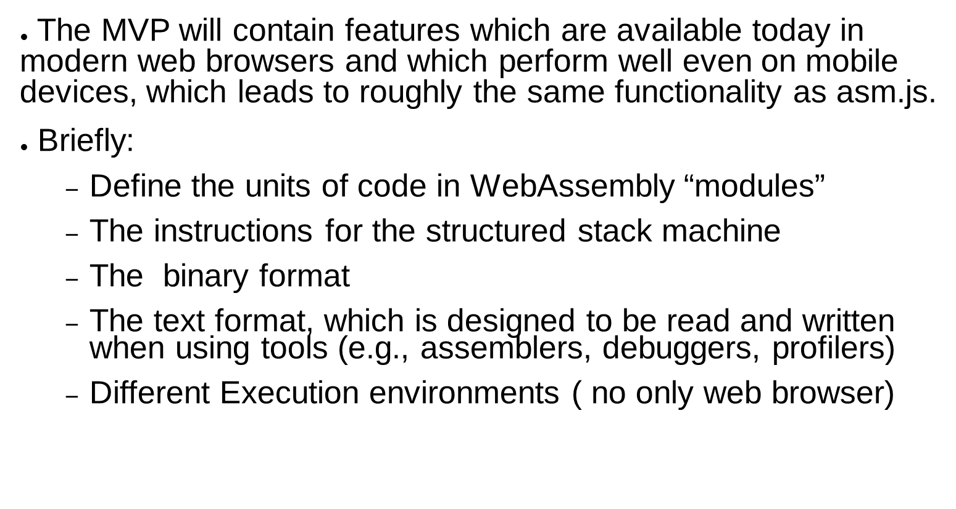
Introduction to WebAssembly

Slide 18

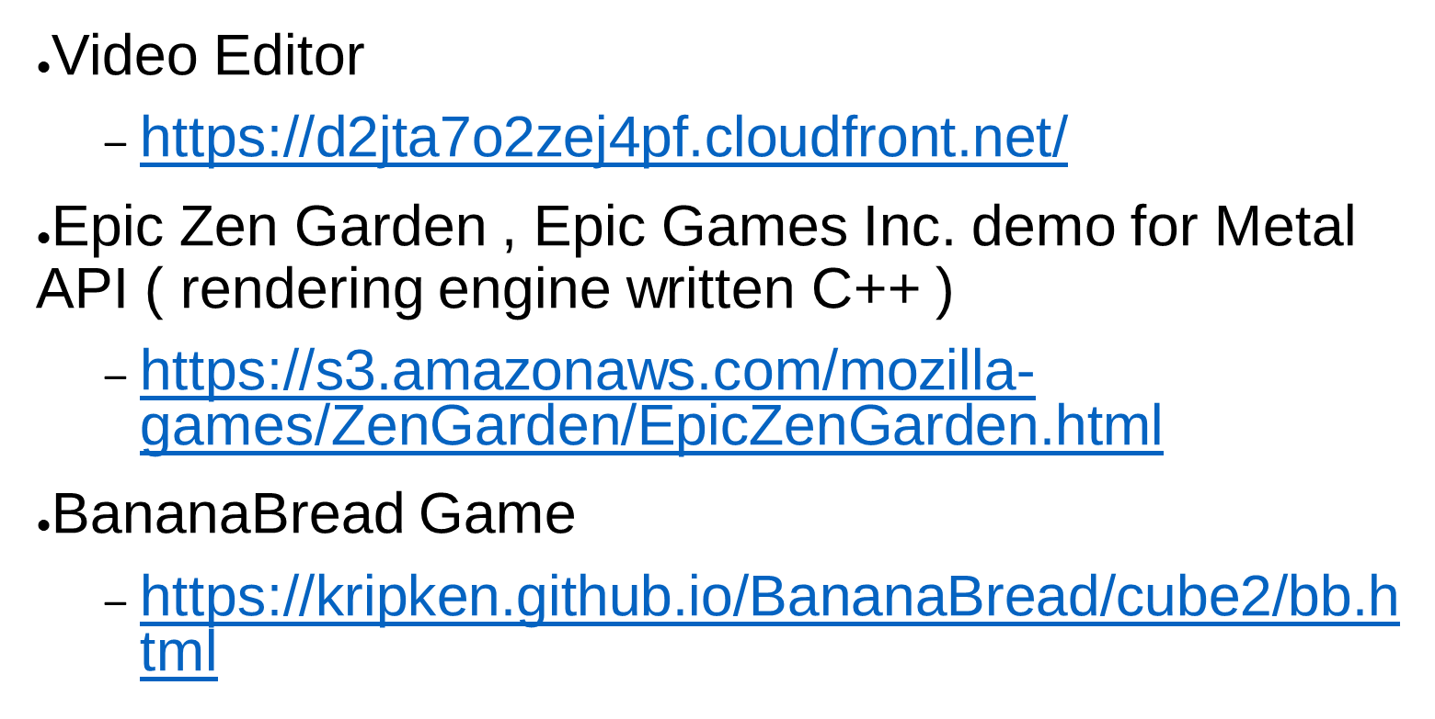
Introduction to WebAssembly

Slide 19

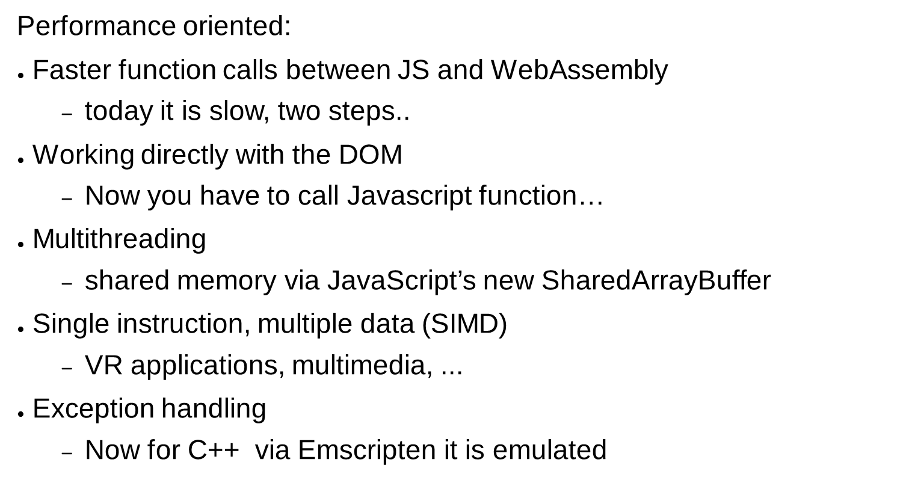
Introduction to WebAssembly
Notes:
SIMD
If you read other posts or watch talks about WebAssembly, you may hear about SIMD support. The acronym stands for single instruction, multiple data. It’s another way of running things in parallel.
SIMD makes it possible to take a large data structure, like a vector of different numbers, and apply the same instruction to different parts at the same time. In this way, it can drastically speed up the kinds of complex computations you need for games or VR.
This is not too important for the average web app developer. But it is very important to developers working with multimedia, such as game developers.

Slide 20

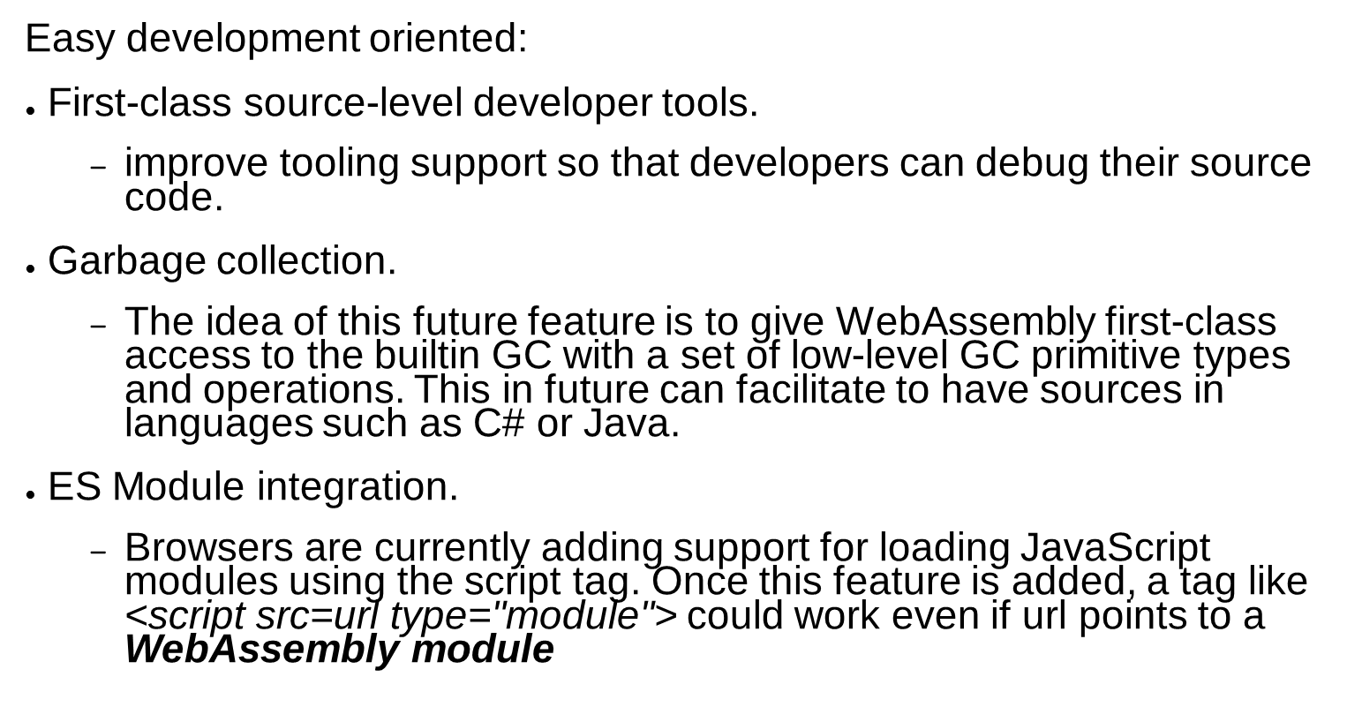
Introduction to WebAssembly
Notes:
SIMD
If you read other posts or watch talks about WebAssembly, you may hear about SIMD support. The acronym stands for single instruction, multiple data. It’s another way of running things in parallel.
SIMD makes it possible to take a large data structure, like a vector of different numbers, and apply the same instruction to different parts at the same time. In this way, it can drastically speed up the kinds of complex computations you need for games or VR.
This is not too important for the average web app developer. But it is very important to developers working with multimedia, such as game developers.

Slide 21



Slide 22

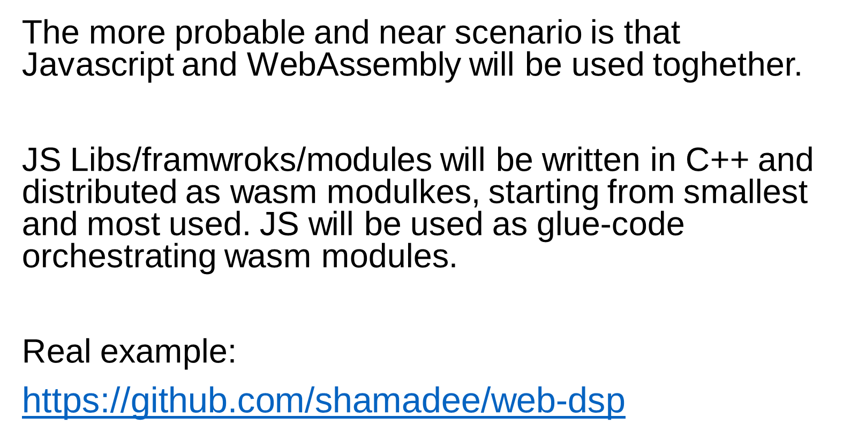
Introduction to WebAssembly

Slide 23

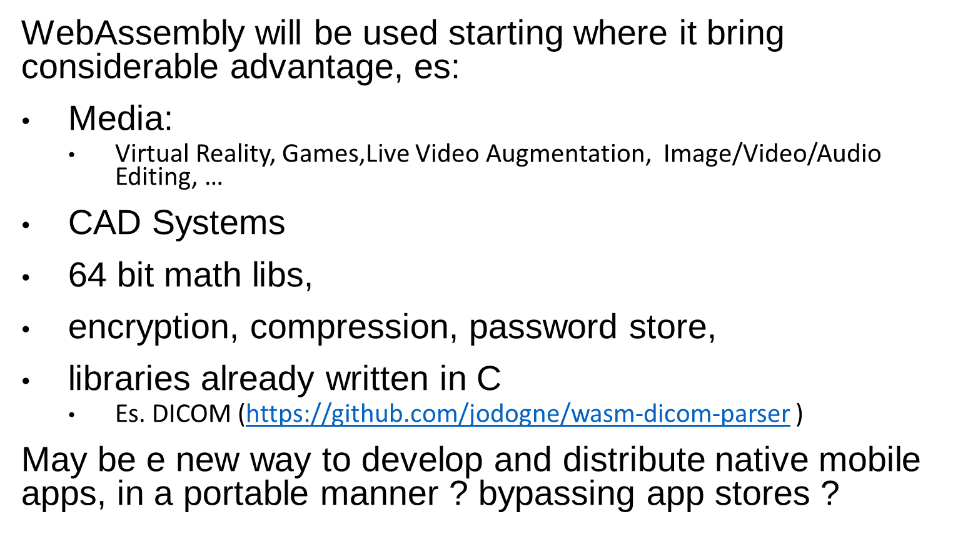
Introduction to WebAssembly

Slide 24


Introduction to WebAssembly

Slide 25

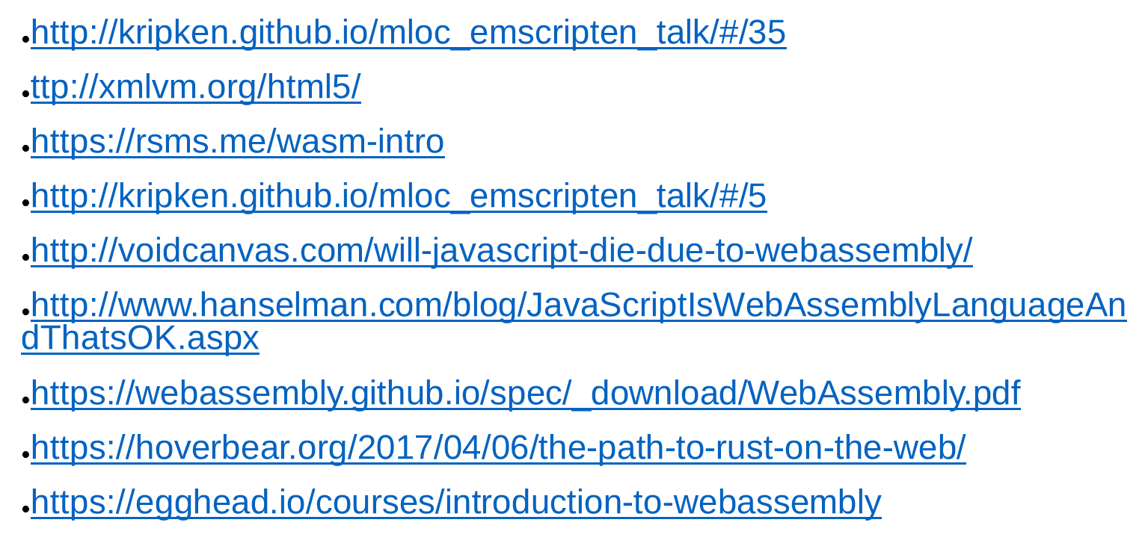
Introduction to WebAssembly

Slide 26
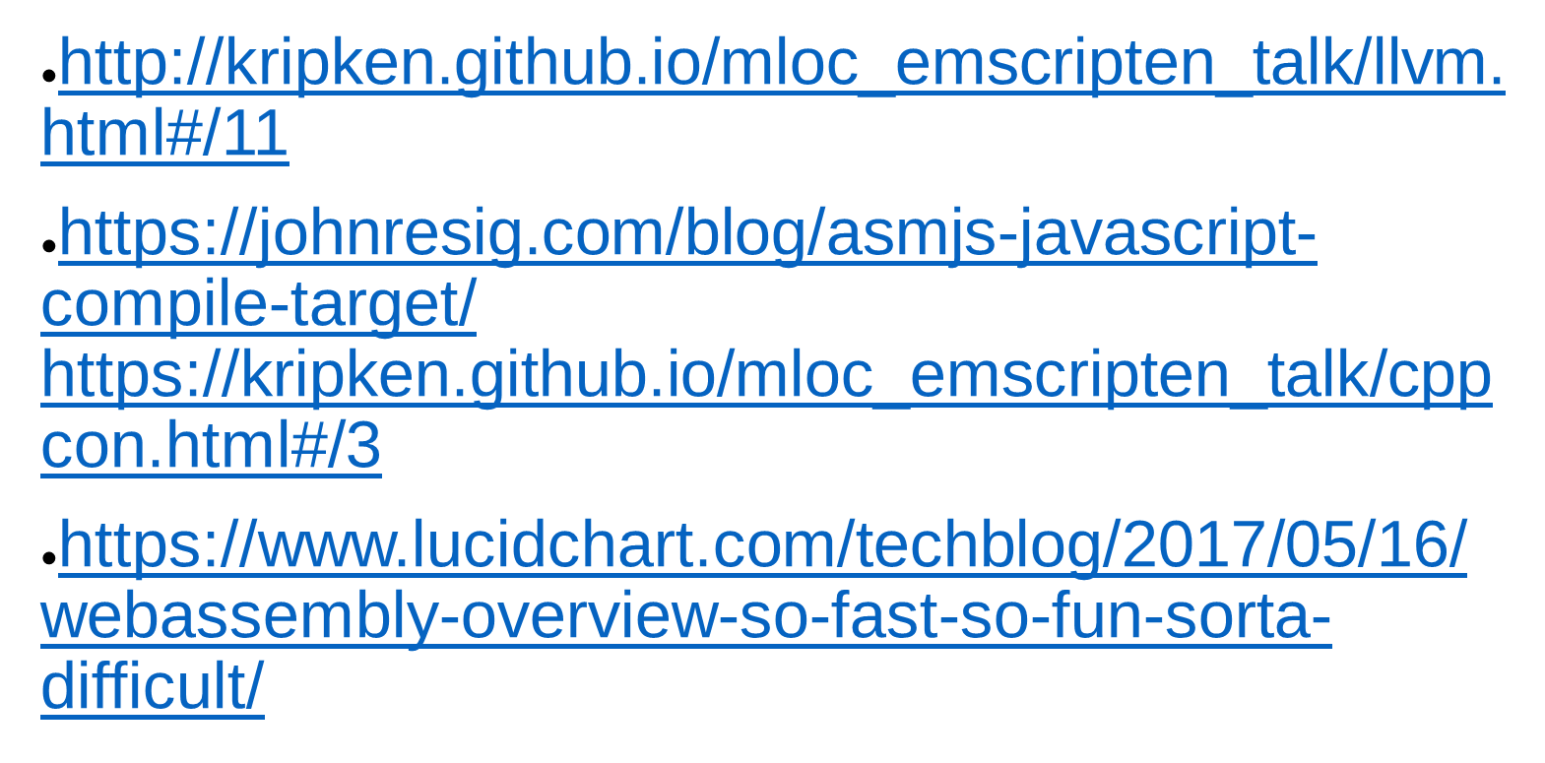
Introduction to WebAssembly

