Slide 1


WebSockets with Spring
Internal WorkShop - BootCamp

Slide 2
Contents
TBC

Slide 3
(almost) Real-Time Web
Users Web GUIs need to be notified ( updated ) in case of a server side event ( change server side state)
  es. a new Email is received, FB new comment, auction new offer, …
Update frequency is a key aspect
Event/Message Driven paradigms fit well on describe this context.
  Message Driven, Event Driven ,...
  Reactive Programming, SOA, Time-driven programming (RTC), ...
Notes:
A message is an item of data that is sent to a specific destination. An event is a signal emitted by a component upon reaching a given state. In a message-driven system addressable recipients await the arrival of messages and react to them, otherwise lying dormant. In an event-driven system notification listeners are attached to the sources of events such that they are invoked when the event is emitted. This means that an event-driven system focuses on addressable event sources while a message-driven system concentrates on addressable recipients. A message can contain an encoded event as its payload.
Real-time computing
From Wikipedia, the free encyclopedia
This article includes a list of references, but its sources remain unclear because it has insufficient inline citations. Please help to improve this article by introducing more precise citations. (April 2014) (Learn how and when to remove this template message)
In computer science, real-time computing (RTC), or reactive computing describes hardware and software systems subject to a "real-time constraint", for example from event to system response.[1] Real-time programs must guarantee response within specified time constraints, often referred to as "deadlines".[2] The correctness of these types of systems depends on their temporal aspects as well as their functional aspects. Real-time responses are often understood to be in the order of milliseconds, and sometimes microseconds. A system not specified as operating in real time cannot usually guarantee a response within any timeframe, although actual or expected response times may be given.
A real-time system has been described as one which "controls an environment by receiving data, processing them, and returning the results sufficiently quickly to affect the environment at that time."[3] The term "real-time" is also used in simulation to mean that the simulation's clock runs at the same speed as a real clock, and in process control and enterprise systems to mean "without significant delay".

Slide 4
Comet
Comet is a web application model in which a long-held HTTP request allows a web server to push data to a browser, without the browser explicitly requesting it.
Comet is known by several other names, including: Ajax Push, Reverse Ajax, Two-way-web,HTTP Streaming, and HTTP server push, ...
Notes:
Comet is a web application model in which a long-held HTTP request allows a web server to push data to a browser, without the browser explicitly requesting it

Slide 5
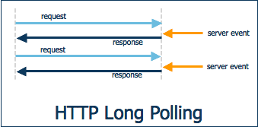
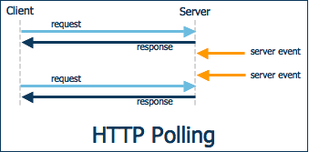
Polling Techniques
Waste of Requests also without server side changes
Each request is new, HTTP handshake,…
Not scalable
Need to manage reconnection,..
It reduces the use of resources, less http new requests, but same has same disadvantages of polling…
Need to manage reconnection,..
Not possible for firewall / web servers t distinguish between long polling connection and slow connections ...
Others: HTTP Streaming, Server-sent events

Slide 6
Polling Techniques
Waste of Requests also without server side changes
Each request is new, HTTP handshake,…
Not scalable
Need to manage reconnection,..
It reduces the use of resources, less http new requests, but same has same disadvantages of polling…
Need to manage reconnection,..
Not possible for firewall / web servers t distinguish between long polling connection and slow connections ...
Others: HTTP Streaming, Server-sent events

Slide 7
Web socket :: What is ?
WebSocket is a protocol, providing full-duplex communication channels over a single TCP connection.
The WebSocket protocol was standardized by the IETF as RFC 6455 in 2011, and the WebSocket API in Web IDL is being standardized by the W3C.
WebSocket is designed to be implemented in web browsers and web servers, but it can be used by any client or server application.
The WebSocket Protocol is an independent TCP-based protocol. Its only relationship to HTTP is that its handshake is interpreted by HTTP servers as an Upgrade request.
The url scheme are “ws:// or wss://” , default ports are the same of HTTP

Slide 8
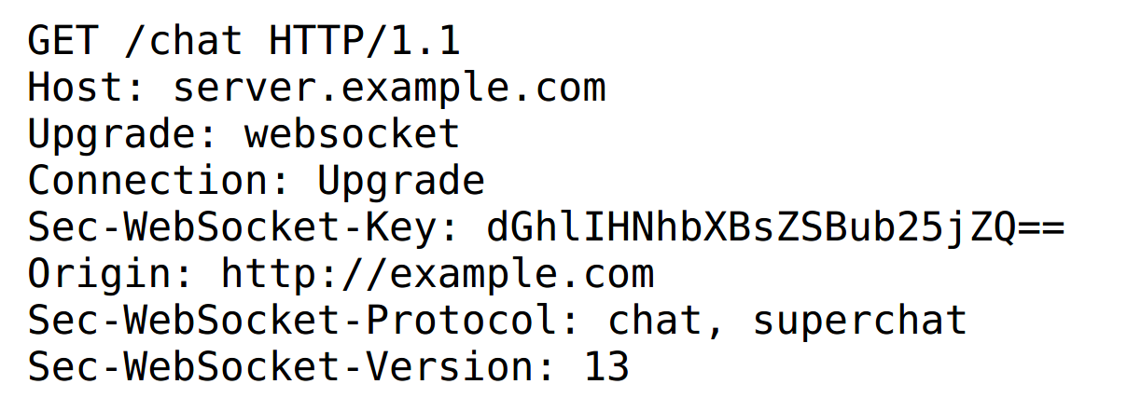
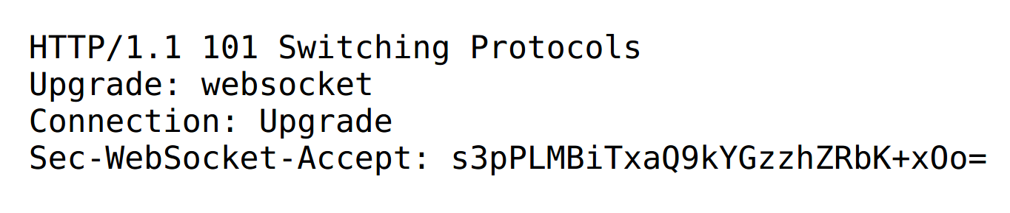
Protocol handshake

Slide 9
Subprotocol
It does not define any application protocol
It is at too low level, applications need to understand the meaning of the messages.
A sub-protocol can be negotiated during hand-shake.
  STOMP, WAMP, XMPP, ..
Spring supports STOMP

Slide 10
STOMP
Simple (or Streaming) Text Oriented Message Protocol (STOMP), formerly known as TTMP, is a simple text-based protocol, designed for working with message-oriented middleware (MOM).
The protocol is similar to HTTP, and works over TCP using commands like: CONNECT, SEND, SUBSCRIBE, UNSUBSCRIBE, ...
Communication is through a frame consisting of a number of lines. The first line contains the command, followed by headers in the form <key>: <value> (one per line), followed by a blank line and then the body content, ending in a null character.

Slide 11
Spring WebSocket with STOMP
It is a event driven message architecture
Compatible with JSR 356: JavaTM API for WebSocket
Destinations can be:
  Message Controllers ( application )
  Message Brokers
    Simple
      In memory, built-in
    Replay
      Better for scaling, RabbitMQ, ActiveMQ, ...
  A specific user/client

Slide 12
SockJS
SockJS is a browser JavaScript library that provides a WebSocket-like object. SockJS gives you a coherent, cross-browser, Javascript API which creates a low latency, full duplex, cross-domain communication channel between the browser and the web server.
Under the hood SockJS tries to use native WebSockets first. If that fails it can use a variety of browser-specific transport protocols and presents them through WebSocket-like abstractions.
SockJS is intended to work for all modern browsers and in environments which don't support the WebSocket protocol -- for example, behind restrictive corporate proxies.
SockJS-client does require a server counterpart
Spring has out-of-box server side support .

Slide 13
Hello World – Chat Example
HWCE

Slide 14
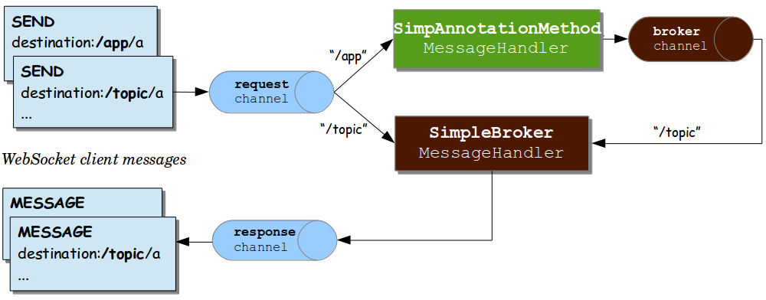
STOMP Over WebSocket Messaging Architecture

Slide 15
HWCE :: WebSocketConfig :: SS
Server side
/app => MessageController “mapped” methods
  /message , onSend save and send to broker
  /init/messages , onSubcribe send saved msgs directly

Slide 16
HWCE :: Client Side Config
Connect
var socketRT = new SockJS('/hello-world-websocket');
stompClientRT = Stomp.over(socketRT);
stompClientRT.connect({}, function (frame) { ..} ...
Subscriptions and sends
stompClientRT.subscribe('/topic/messages' ..
stompClientRT.send("/app/message", {},
JSON.stringify( { … } ...
stompClientRT.subscribe('/user/init/messages' ...

Slide 17
HWCE
Demo and Code !!

Slide 18

Questions or Beer ?

