Slide 1
Weakly supervised learning label noise and correction
Xia, Tianyi (Presenter)
An, Qu Fei
Guo, Yicheng
Lin, Hongxu
Auld-Griffith, Nicolette

Slide 2
Model I: Convolutional Neural Network
Convolutional Neural Network (CNN) is a regularized unidirectional neural network that self selects features. It is inspired by the biological features of animals, specifically the visual vortex in that neurons only respond to stimuli in a given region. It includes the input layer, hidden layers, and the output layer.
Layers of a CNN
Input
Conv 1
Pool 1
Conv 2
Pool 2
Conv 3
Flatten
Dense 1
Dense 2
Output

Slide 3
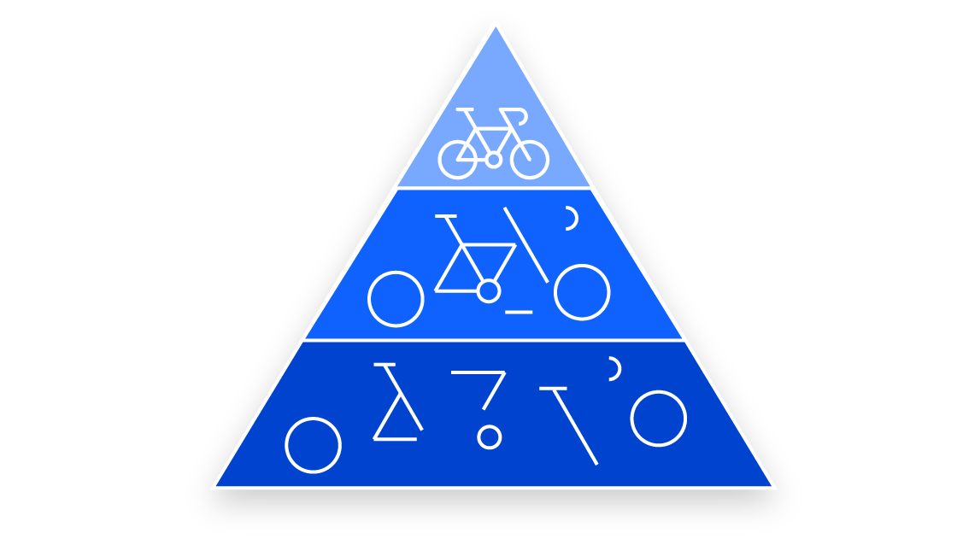
Convolution Layers
The convolution layer takes in the input data, and abstract it into a feature map. In the case of images, this converts the original image into a series of numerical values. Convolution layers can be followed by additional convolution layers, turning the model into a hierarchical model.
Breakdown of a Bicycle

Slide 4
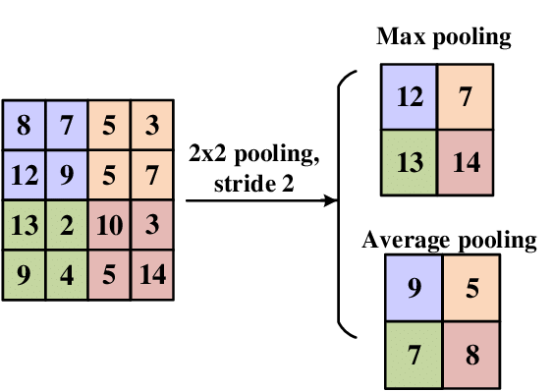
Pooling Layers
Pooling layers are also known as down sampling layers. The purpose of these layers is to reduce the dimension of the data. This is necessary to reduce the complexity of the model as well as preventing overfitting. Popular pooling methods are maximum and average.
2 Types of Pooling Methods

Slide 5
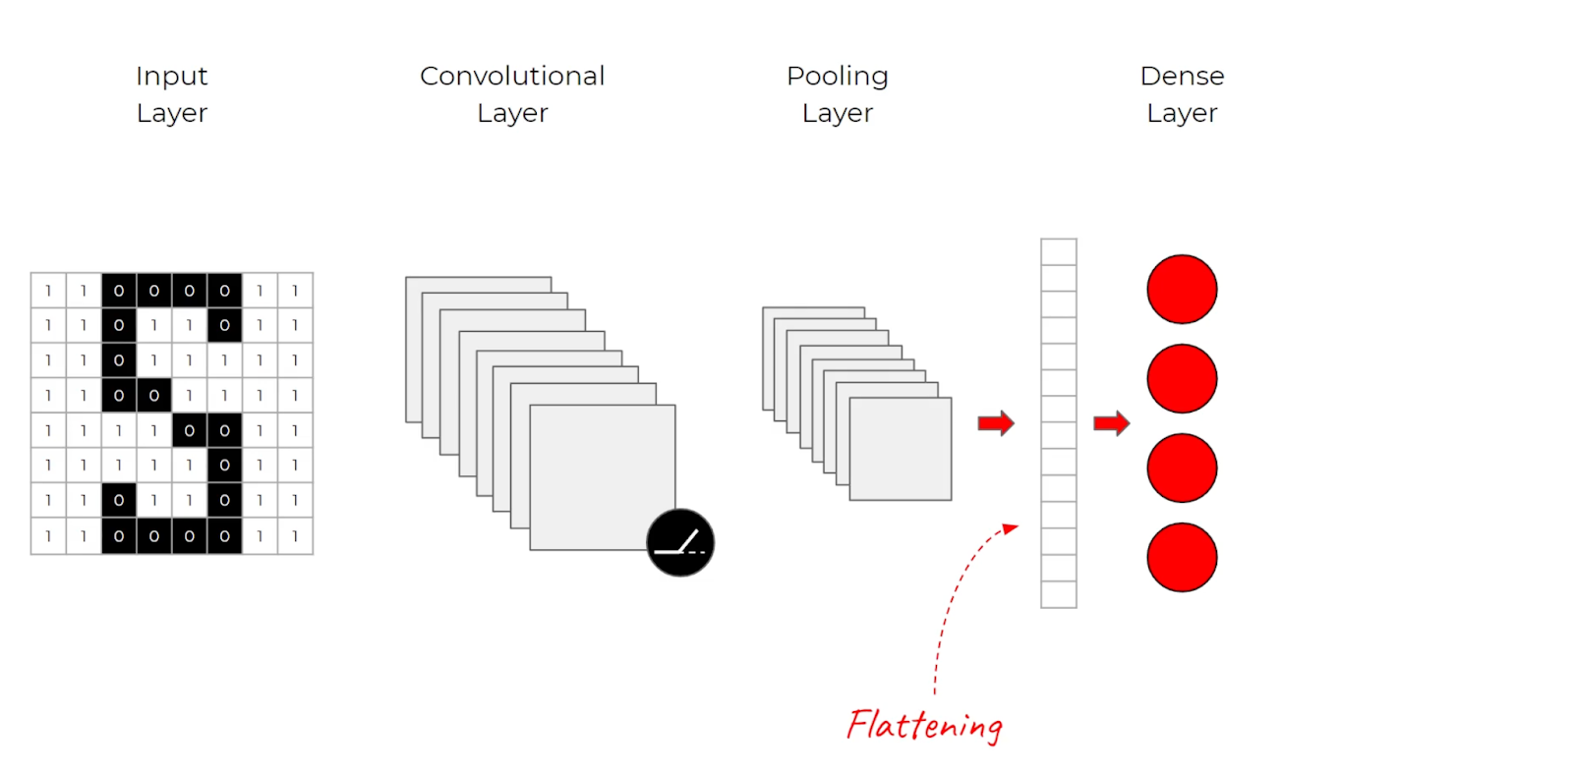
Flatten & Dense
The flatten layer converts the feature map received into a format that is understood by the dense layer. A dense layer converts the result of the previous layers into the final classification that is required by the original problem.
Flatten and Dense Layer

Slide 6
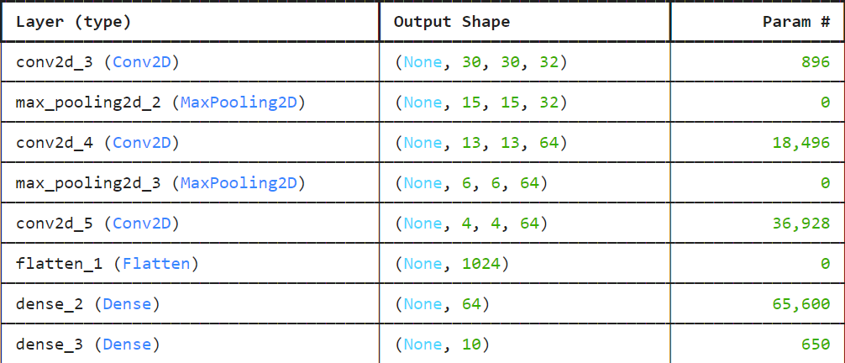
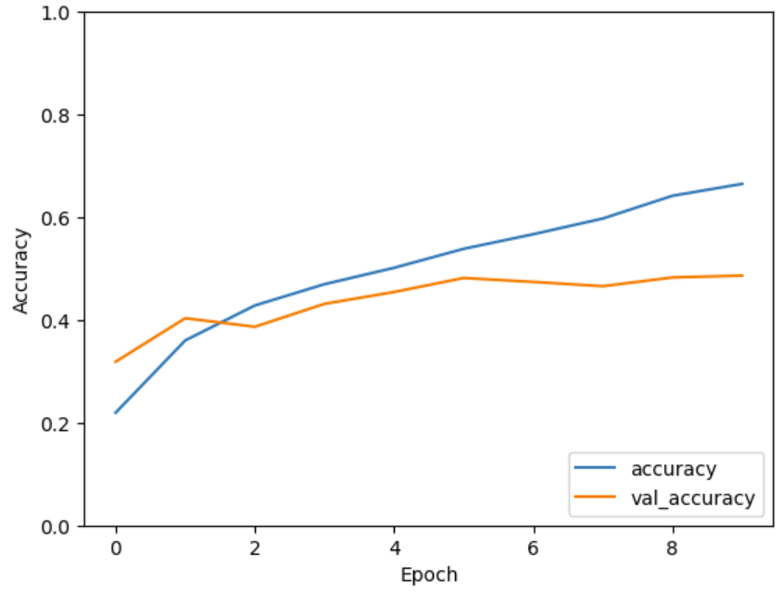
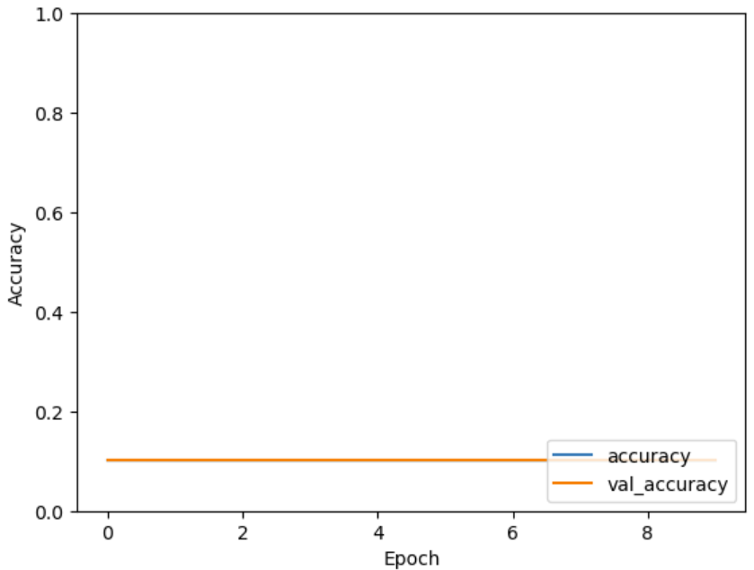
Model I On clean and noisy labels
Accuracy: 0.48633334040641785
On clean labels
Accuracy: 0.10159999877214432
On noisy labels

Slide 7
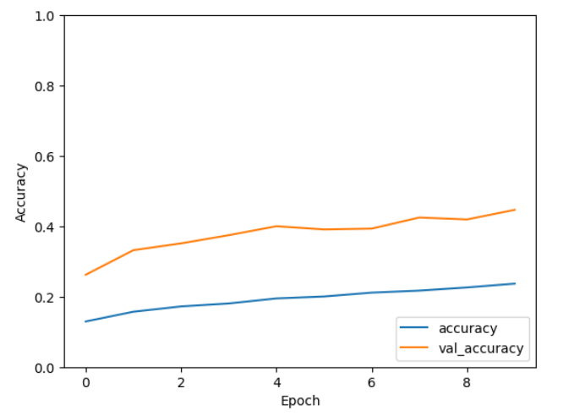
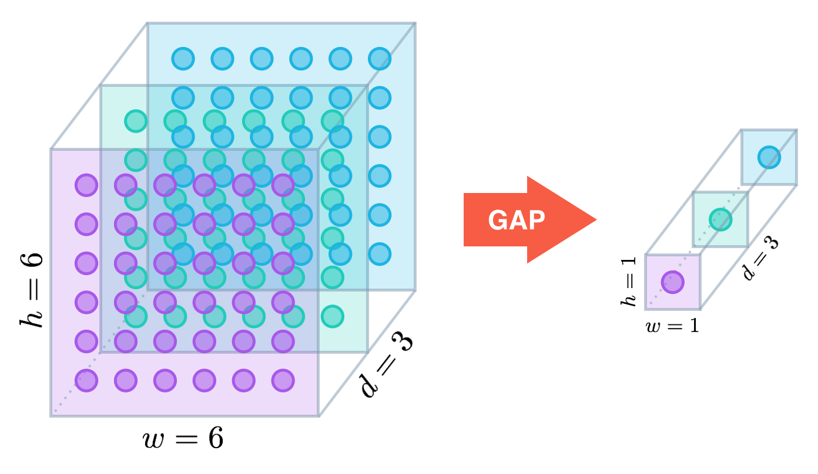
Global Average Pooling
The function of GAP is to reduce the number of parameters in the model, improve the generalization ability of the model, and to a certain extent, it can replace the fully connected layer. By using GAP, the last few layers of a convolutional neural network can be replaced with a global average pooling layer and/or a 1x1 convolutional layer, simplifying the model structure and improving the performance of the model.
GAP diagram
Accuracy: 0.44670000672340393

Slide 8
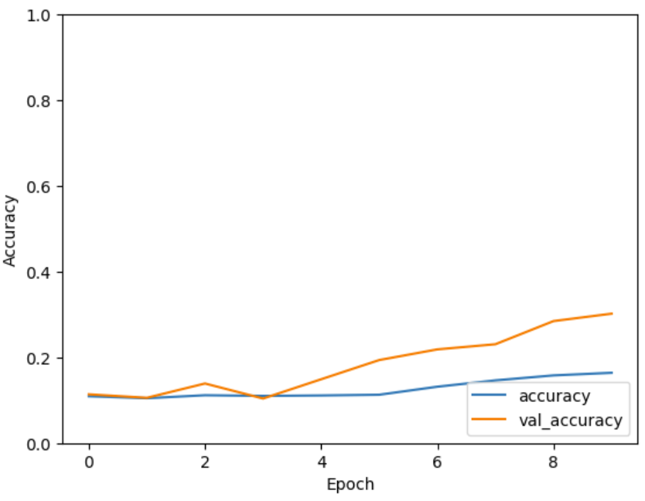
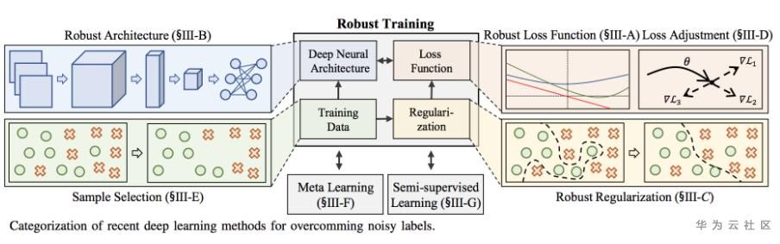
Robust Loss
The robust loss function, by introducing robustness as a continuous parameter, enables the generalization of algorithms around minimizing losses, where the robustness of losses automatically ADAPTS itself during training, thereby improving the performance of learn-based tasks.
Robust Loss diagram
Accuracy: 0.3018999993801117

Slide 9
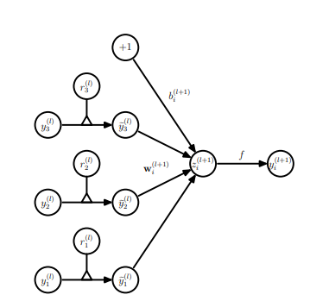
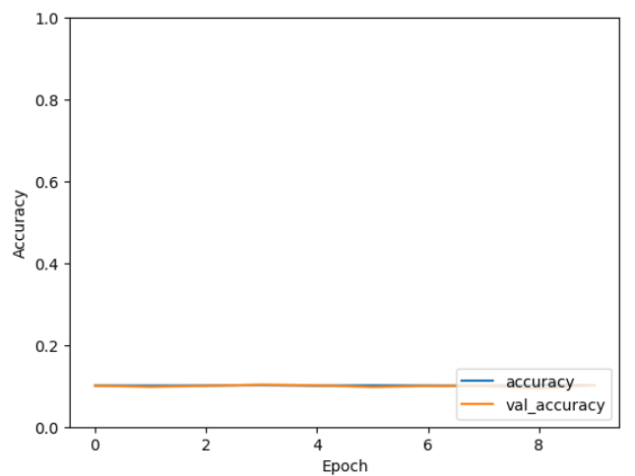
Noise Layer
In deep learning, the noise layer is not a standard component, but it can be added to the neural network to introduce additional randomness or perturbation that improves aspects of the model.
Noise Layer diagram
Accuracy: 0.09989999979734421

Slide 10
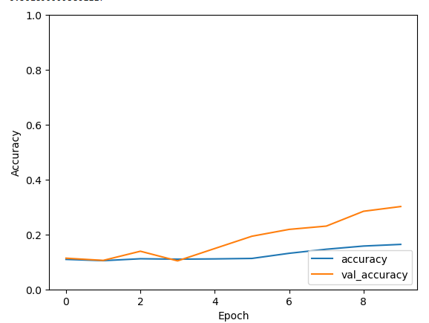

Conclusion
Method | Accuracy
Model I on clean labels | 0.48633
Model I on noisy labels | 0.10159
GlobalAveragePooling | 0.44670
Robust Loss | 0.30189
Noise Layer | 0.09989
Global Average Pooling
Robust Loss
Noise Layer
Model I on noisy labels

