Slide 1
Arduino
Prepared by: Soe Lin Myat

Slide 2
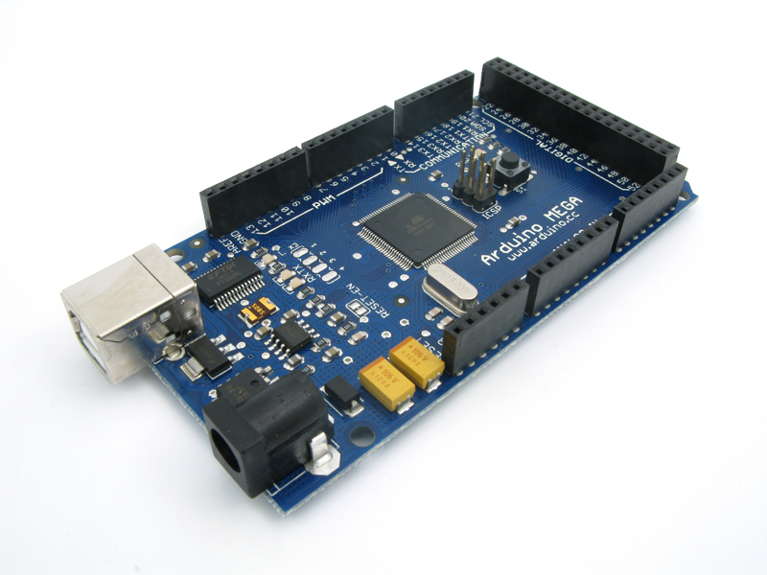
Arduino
an open-source electronics prototyping platform

Slide 3
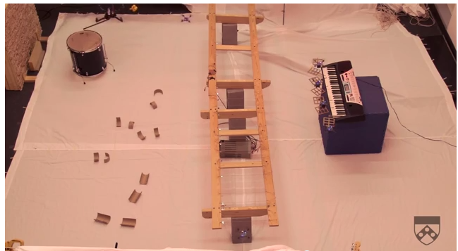
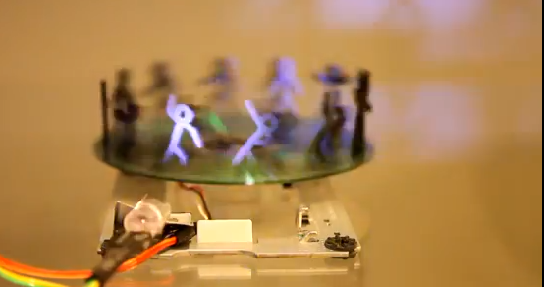
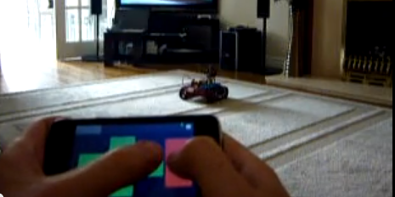

Slide 4
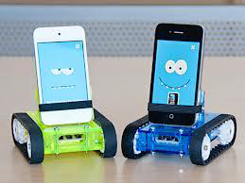
Physical Computing
Intelligent behavior is simply controlling actions in response to stimuli

Slide 5
Sense and control
Sensors
Actuators (motors)
Controllers

Slide 6
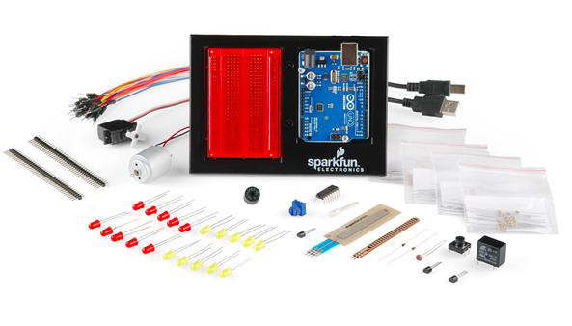
Arduino

Slide 7
Arduino
Open-source
Cheap (~SGD 40)
Easy-to-use
http://arduino.cc/

Slide 8
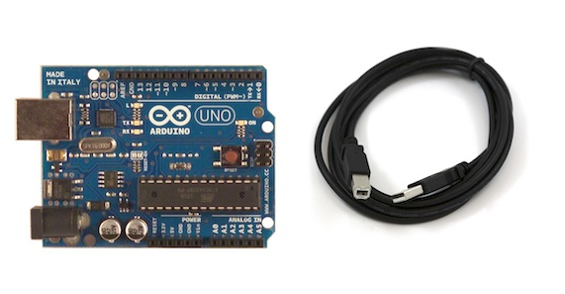

Slide 9
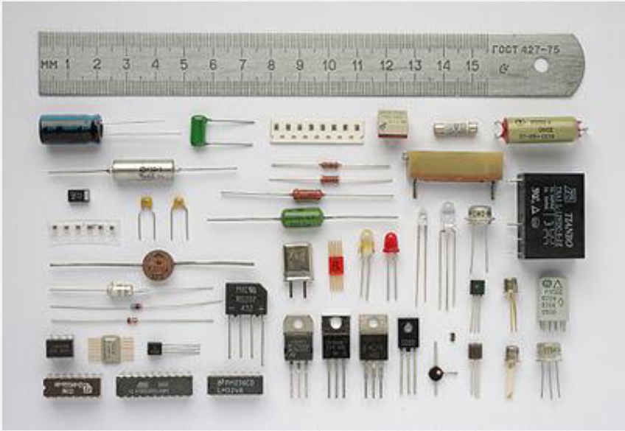

Slide 10
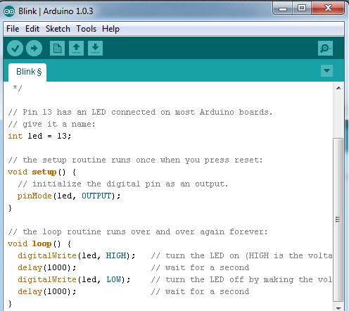

Slide 11
DIY 1: Blink
Blink LED

Slide 12
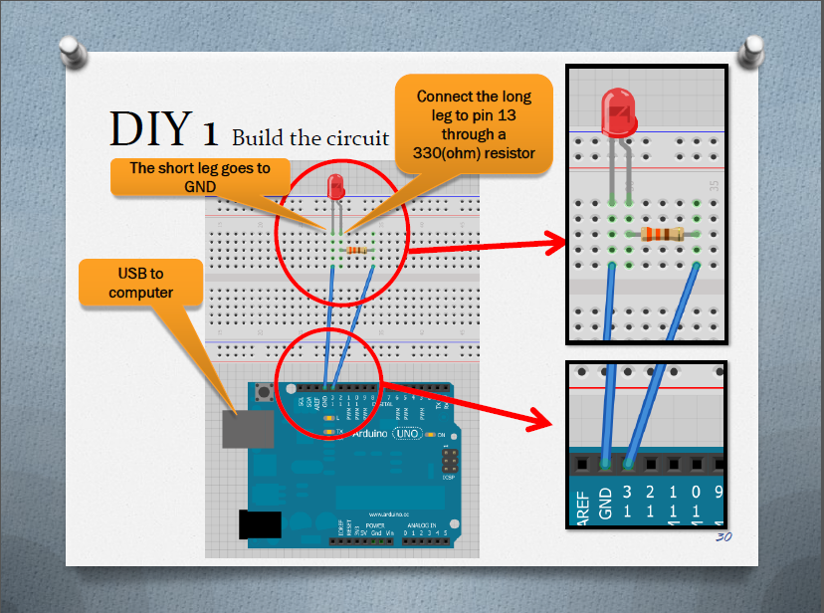

Slide 13
/* Blink Turns on an LED on for one second, then off for one second, repeatedly. This example code is in the public domain. */
// Pin 13 has an LED connected on most Arduino boards.
// give it a name:
int led = 13;
// the setup routine runs once when you press reset:
void setup() {
// initialize the digital pin as an output.
pinMode(led, OUTPUT);
}
// the loop routine runs over and over again forever:
void loop() {
digitalWrite(led, HIGH); // turn the LED on (HIGH is the voltage level)
delay(1000); // wait for a second
digitalWrite(led, LOW); // turn the LED off by making the voltage LOW
delay(1000); // wait for a second
}

Slide 14
Making 2 LED blink alternatively

Slide 16
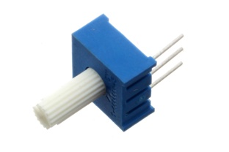
DIY2: Led dimming with potentiometer
Read an analog input pin, map the result, and then use that data to dim or brighten an LED.
http://arduino.cc/en/Tutorial/AnalogInOutSerial

Slide 17
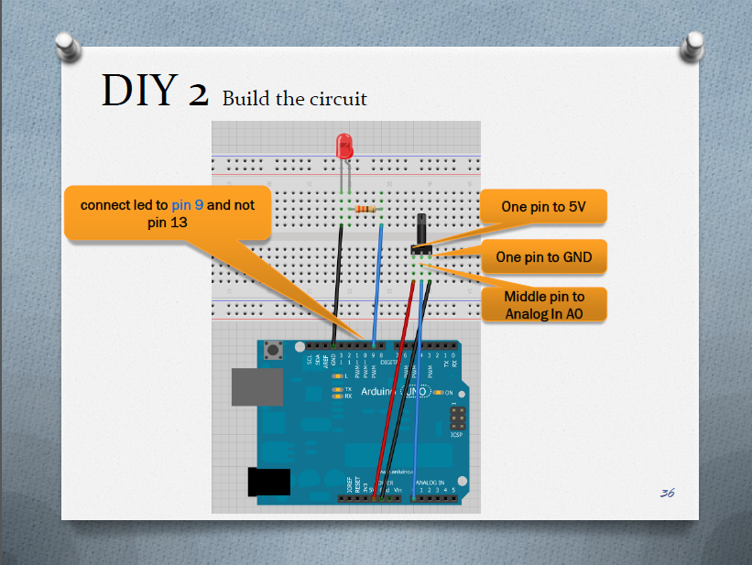

Slide 18
const int pot= A0;
const int led = 9;
int sensorValue = 0;
int outputValue = 0;
void setup() {
// initialize serial communications at 9600 bps:
Serial.begin(9600);
}
void loop() {
int sensorValue = analogRead(pot);
float outputValue = sensorValue/1023.0 *255.0;
//int outputValue = map(pot, 0, 1023, 0, 255);
analogWrite(led, outputValue);
delay(2);
}

Slide 19
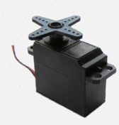
DIY3: Servo
Control the position of a RC (hobby) servo motor with your Arduino and a potentiometer.
http://arduino.cc/en/Tutorial/Knob

Slide 20
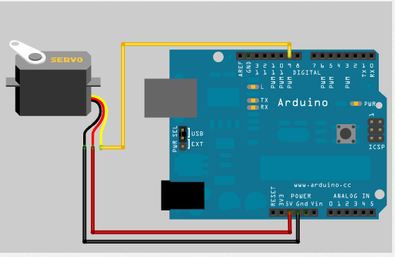

Slide 21
/* Blink Turns on an LED on for one second, then off for one second, repeatedly. This example code is in the public domain. */
// Pin 13 has an LED connected on most Arduino boards.
// give it a name:
#include <Servo.h>
Servo myservo;
int potpin = A0; // analog pin used to connect the potentiometer
int val; // variable to read the value from the analog pin
void setup()
{
myservo.attach(9); // attaches the servo on pin 9 to the servo object
}
void loop()
{
val = analogRead(potpin); // reads the value of the potentiometer (value between 0 and 1023)
val = map(val, 0, 1023, 0, 179); // scale it to use it with the servo (value between 0 and 180)
//float pos = val/1023.0 *255.0;
//myservo.write(pos);
// sets the servo position according to the scaled value
myservo.write(val);
delay(60); // waits for the servo to get there
}

Slide 22
DIY4: Photo Resistor
Your finger can block light reaching the light sensor
Include the light sensor to control servo movements.

Slide 23
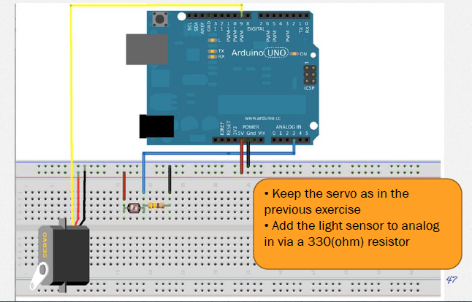

Slide 24
#include <Servo.h>
Servo myservo;
int pos = 0;
void setup()
{
myservo.attach(9);
pinMode(A3, INPUT);
}
void loop()
{
pos = analogRead(A3);
pos = map(pos, 0, 1023, 0, 360 );
myservo.write(pos);
delay(15);
}

Slide 25
Let creativity flows
http://arduino.cc/en/Tutorial/HomePage

