Slide 1
ArduinoWorkshop
by Zhang Yiwen

Slide 2
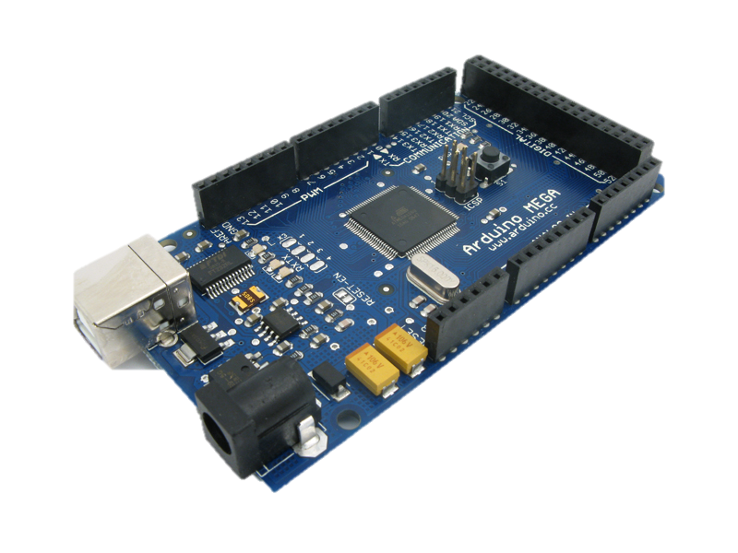
an open-source electronics prototyping platform

Slide 3
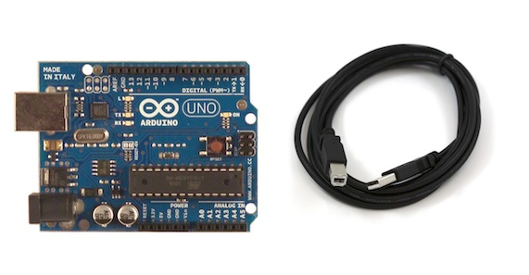

Slide 4
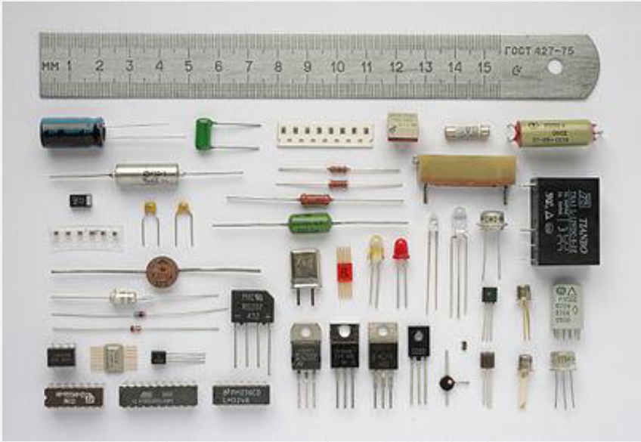

Slide 5
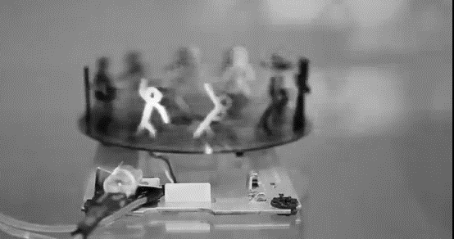

Slide 6
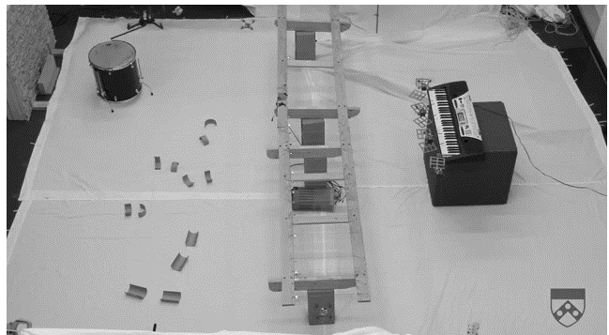

Slide 7
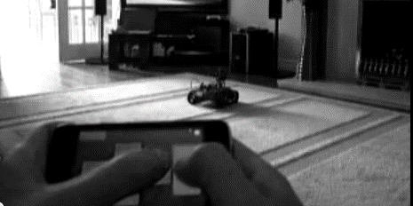

Slide 8
void setup()
C++
void loop()

Slide 9
int led = 13;
void setup() {
pinMode(led, OUTPUT);
}
void loop() {
digitalWrite(led, HIGH);
delay(1000);
digitalWrite(led, LOW);
delay(1000)
};

Slide 10
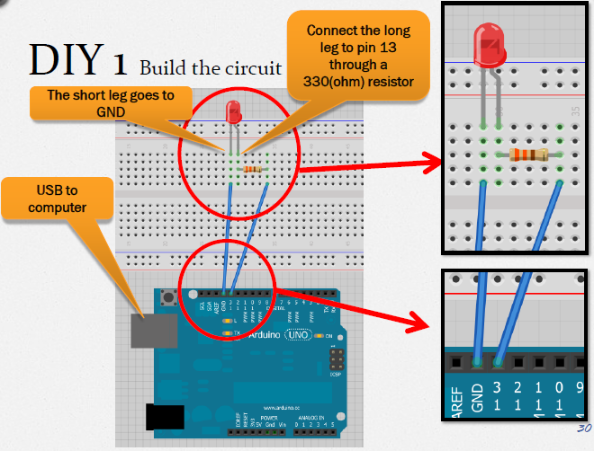
int led = 13;
void setup() {
pinMode(led, OUTPUT);
}
void loop() {
digitalWrite(led, HIGH);
delay(1000);
digitalWrite(led, LOW);
delay(1000)
};

Slide 11
analogRead(input)
..and there is light
analogWrite(output, value)

Slide 12
ArduinoWorkshop
Thank you.

