Slide 1
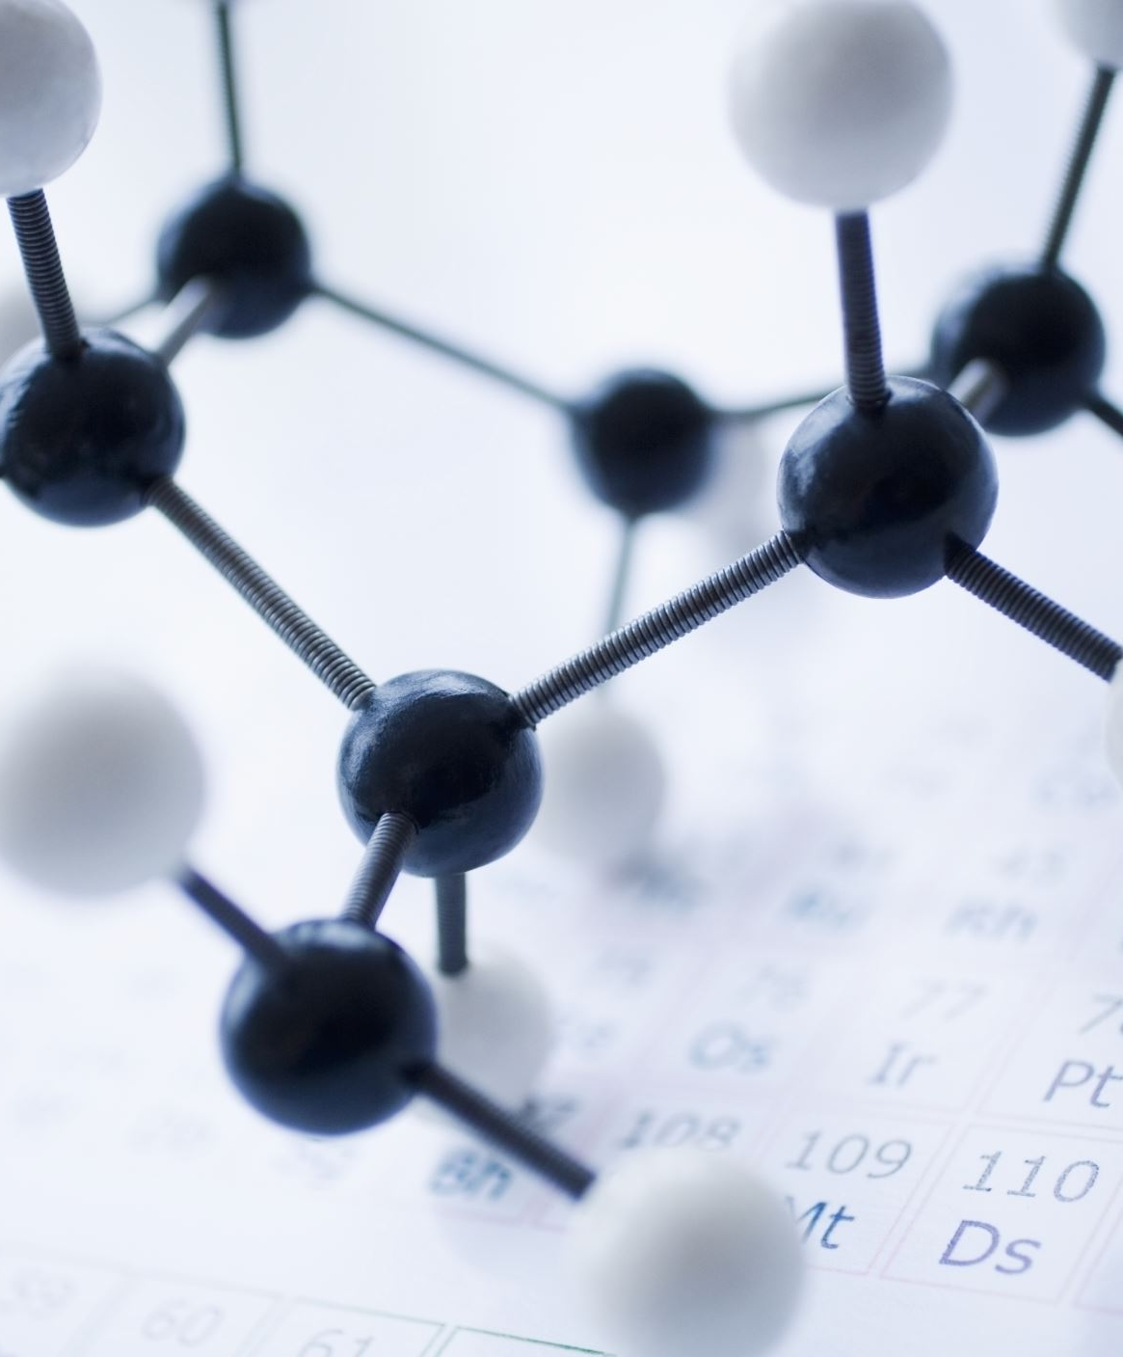
DepthFM: Fast Generative Monocular Depth Estimation with Flow Matching
Authors: Ming Gui, Johannes Schusterbauer, Ulrich Prestel, Pingchuan Ma, Dmytro Kotovenko, Olga Grebenkova, Stefan Andreas Baumann, Tao Hu, Björn Ommer

Slide 2
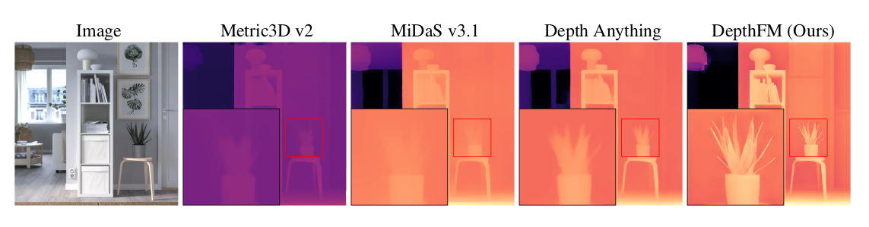
Introduction and Motivation
Monocular Depth Estimation: Importance for 3D scene understanding.
Applications: Robotics, autonomous driving, visual synthesis.
Challenges: Blurry artifacts (discriminative methods) and slow sampling (generative methods).
DepthFM: A new approach using Flow Matching for faster and more accurate depth estimation.

Slide 3
Related Work
Discriminative Methods (e.g., MiDaS, Depth Anything, Metric3D)
Learn depth from labeled datasets but struggle with fine details
Generative Diffusion-based Methods (e.g., Marigold, GeoWizard)
High visual fidelity but suffer from slow inference
Flow Matching (FM)
Alternative to diffusion models with faster, straighter sampling trajectories
Proposed solution: Direct image-to-depth transport

Slide 4
Innovations of DepthFM
Flow Matching for Depth Estimation: Direct transport from image to depth.
Leveraging Pre-trained Models: Image prior (SD2.1) and discriminative depth prior (Metric3D v2).
Data Efficiency: Combines generative and discriminative strengths for better performance with less data.

Slide 5
Flow Matching Approach
Flow Matching (FM) creates a direct transport between image and depth data.
Unlike diffusion models that start from noise, FM starts directly from the image features.
This approach results in a straight path from the image to the depth map, minimizing computational cost.
Key Idea: Use a vector field to guide the transformation, making it efficient and accurate.
Why It’s Better: Faster inference, sharper depth maps, and fewer intermediate steps.
Real-Life Analogy: Instead of taking a long, winding path, FM takes a straight road from start to finish.

Slide 6
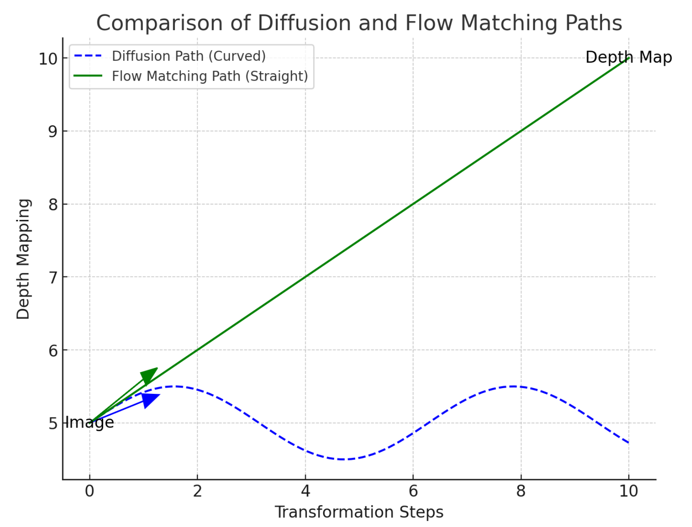
Flow Matching Approach
Diffusion Models (Blue Dashed Line):
Start from pure noise and follow a curved, winding path to the depth map.
Computationally expensive and time-consuming.
Require multiple iterative steps for gradual denoising.
Flow Matching (Green Solid Line):
Directly connects image features to depth map using a straight path.
Faster and more efficient as it avoids unnecessary intermediate steps.
Does not involve complex denoising processes.

Slide 7
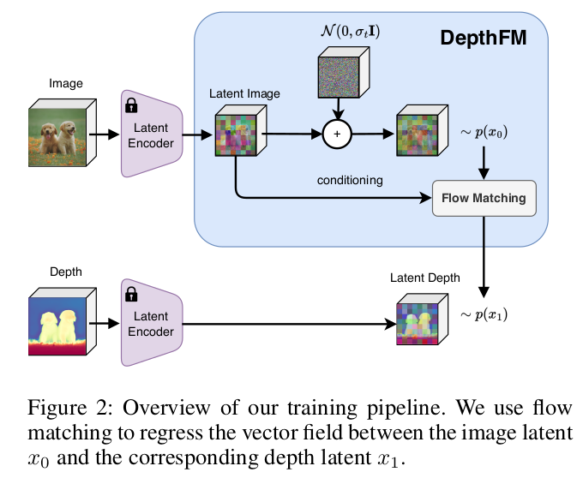
Architecture
Input: An image and its corresponding depth map.
Latent Encoding: Converts both image and depth into latent representations.
Noise Addition: Adds Gaussian noise to the latent image to improve robustness.

Slide 8
Architecture
Flow Matching:
Learns a vector field to map latent image features to latent depth features.
Uses a direct transport approach to connect image and depth representations efficiently.
Output: Decoded depth map with high accuracy and fidelity.

Slide 9
Architecture
Key Points:
Direct mapping from image to depth without intermediate denoising.
Efficient and fast due to straight path transformation.
Robust against input noise, thanks to noise augmentation.
Diagram: DepthFM Training Pipeline (showing flow from image to depth via latent space).

Slide 10
Data Efficiency Techniques
Leveraging External Knowledge
Pre-trained diffusion model (Stable Diffusion 2.1) for image priors
Pre-trained discriminative model for depth priors
Dual Knowledge Transfer
Fine-tuning with diffusion models speeds up training
Discriminative model improves depth accuracy with minimal data

Slide 11
Using Pre-trained Models in DepthFM
Pre-trained Image Diffusion Model (Image Prior)
Model Used: Stable Diffusion 2.1 (SD2.1)
Purpose: To provide a strong image prior for depth estimation.
Leverages rich visual knowledge from large datasets.
Captures fine-grained visual details efficiently.
How It’s Used:
Fine-tuned with the Flow Matching objective.
Transfers visual understanding to depth estimation.
Benefit:
Speeds up training and enhances generalization.

Slide 12
Pre-trained Discriminative Depth Estimation Model (Depth Prior)
Model Used: Metric3D v2
Purpose: To provide a strong depth prior and enhance data efficiency.
Use:
Provides accurate depth predictions from large annotated datasets.
Generates high-quality synthetic depth-image pairs.
How It’s Used:
Acts as a teacher model to generate synthetic data.
Fine-tunes DepthFM using generated pseudo-depth pairs.
Benefit:
Increases robustness and accuracy with limited labeled data.

Slide 13
Experimental Setup
Training Data
Synthetic datasets: Hypersim, Virtual KITTI
Discriminative samples from Unsplash dataset
Evaluation Datasets
NYUv2, KITTI, ETH3D, ScanNet, DIODE
Metrics
Absolute Mean Relative Error (RelAbs)
Accuracy δ1 (percentage of pixels satisfying depth accuracy threshold)

Slide 14
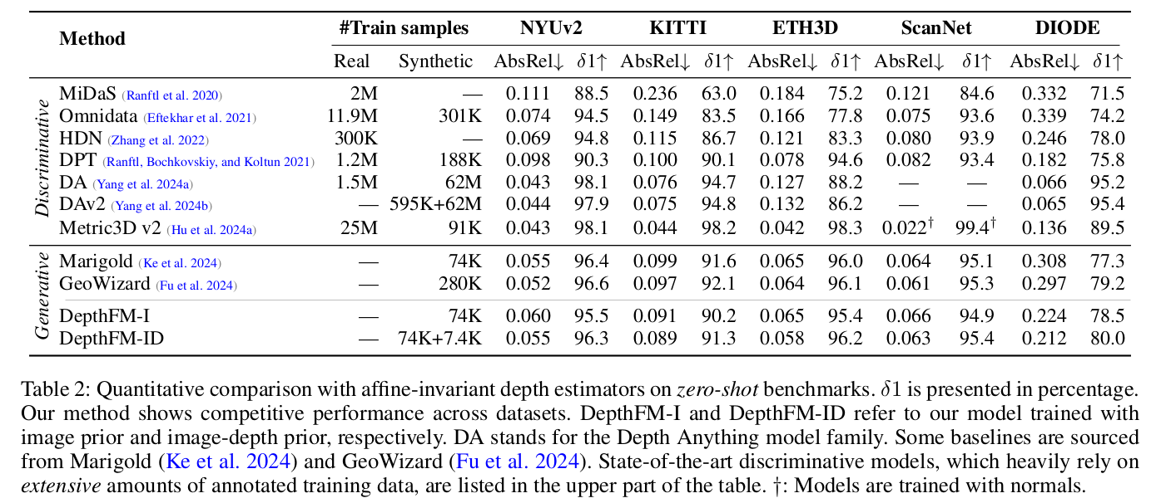
Results

Slide 15
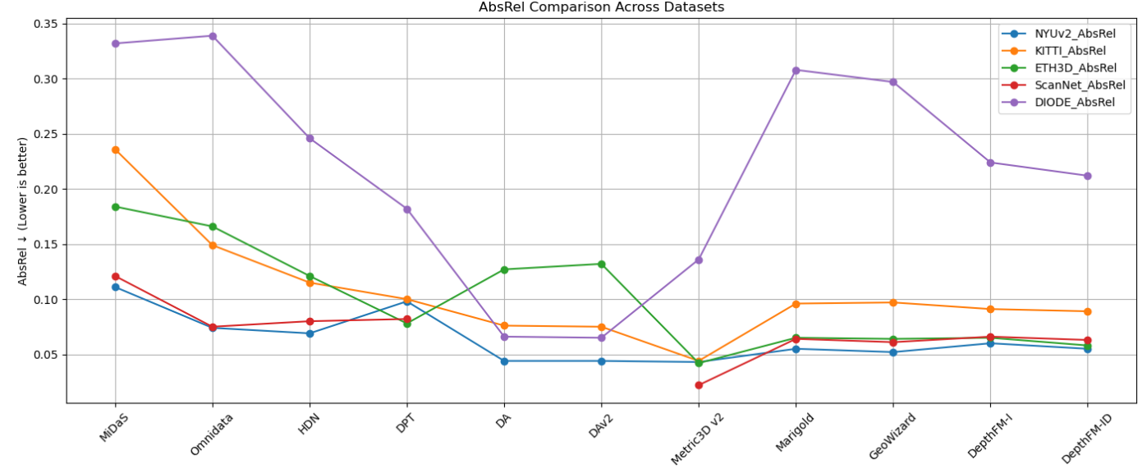
Absolute Mean Relative Error (RelAbs)

Slide 16
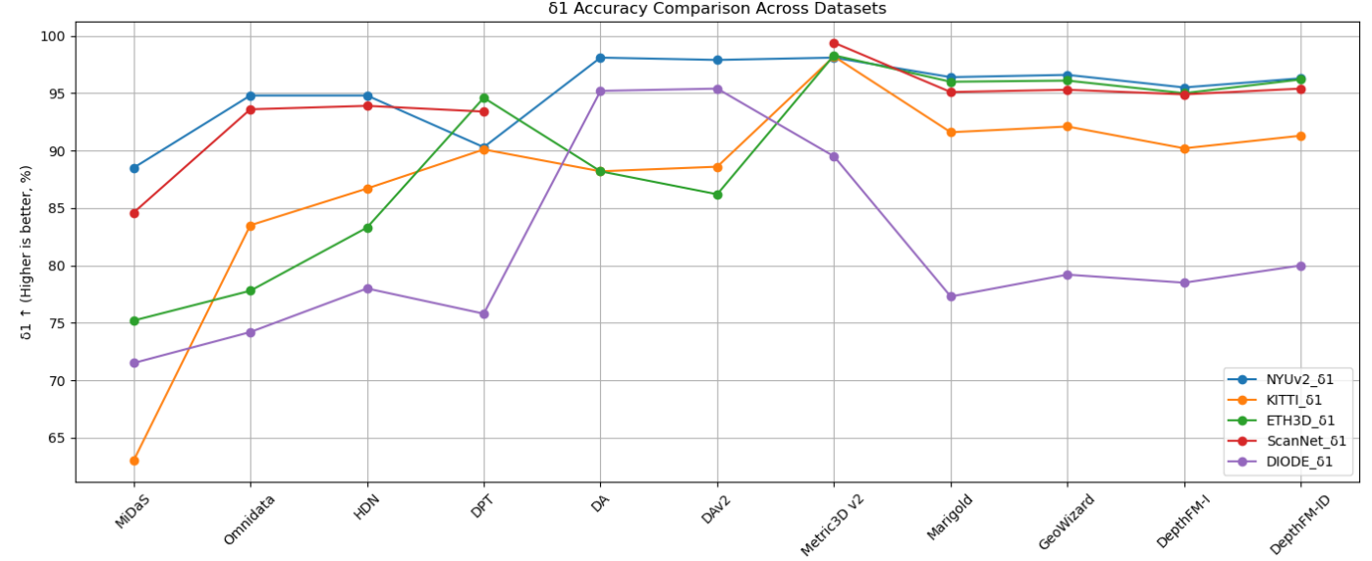
Accuracy δ1 (percentage of pixels satisfying depth accuracy threshold)

Slide 17
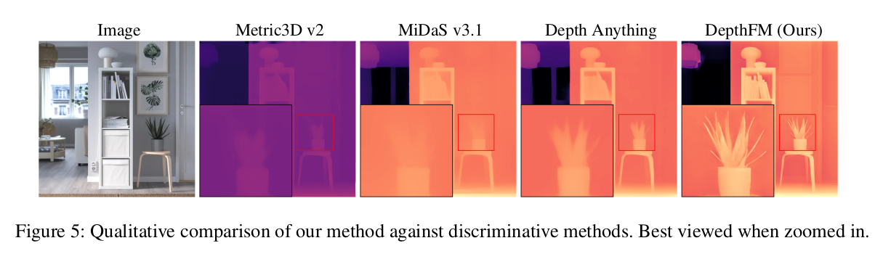
Results - Comparison with Discriminative Models

Slide 18
Ablation Studies
Direct Image-to-Depth Transport
More effective than starting from Gaussian noise
Impact of Image and Depth Prior
Both contribute to improved accuracy and efficiency
Noise Augmentation Strategy
Improves robustness without degrading accuracy

Slide 19
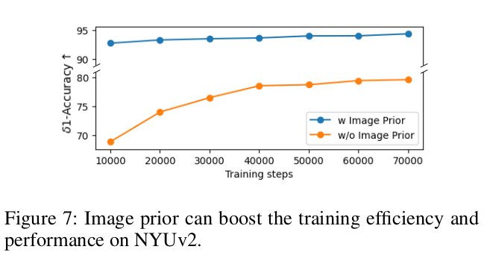
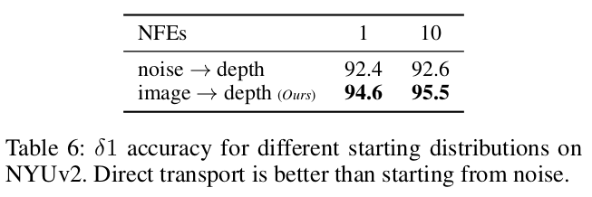
Ablation Studies
These results clearly show that combining image prior knowledge with direct transport leads to faster convergence and better performance, making DepthFM more efficient and accurate than traditional methods.

Slide 20
Conclusion
DepthFM introduces Flow Matching for monocular depth estimation
Improves speed, efficiency, and accuracy over existing methods
Leverages external knowledge for minimal training data dependency
State-of-the-art zero-shot performance on multiple benchmarks
Future Work: Extend to real-time applications in robotics and AR/VR

