Slide 1

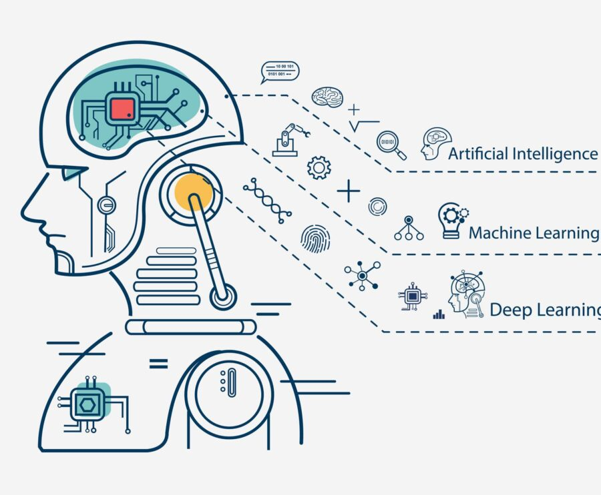

Foundations of Applied Machine Learning: An End-to-End ML project
Presented: Tipu Sultan
Advisor: Dr. Madi Babaiasl

Slide 2
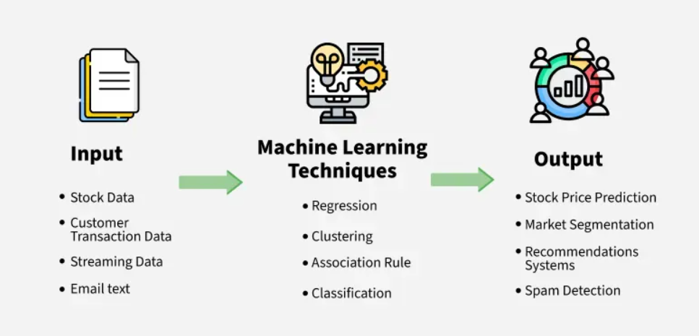
What is Machine Learning?
Notes:
Imagine you want a computer to tell whether a fruit is an apple or an orange.
Traditional Programming
You write rules:
If color is red and round → Apple.
If color is orange and round → Orange.
➝ You must hand-code all rules.
Machine Learning
Instead of writing rules, you give the computer lots of examples:
Apples (features: red, round, small).
Oranges (features: orange, round, bigger).
The computer learns patterns from data.
Later, when you show a new fruit, it can predict whether it’s an apple or an orange.
Machine Learning is like teaching a child. You don’t explain every rule; instead, you show many examples until they can recognize the pattern on their own

Slide 3
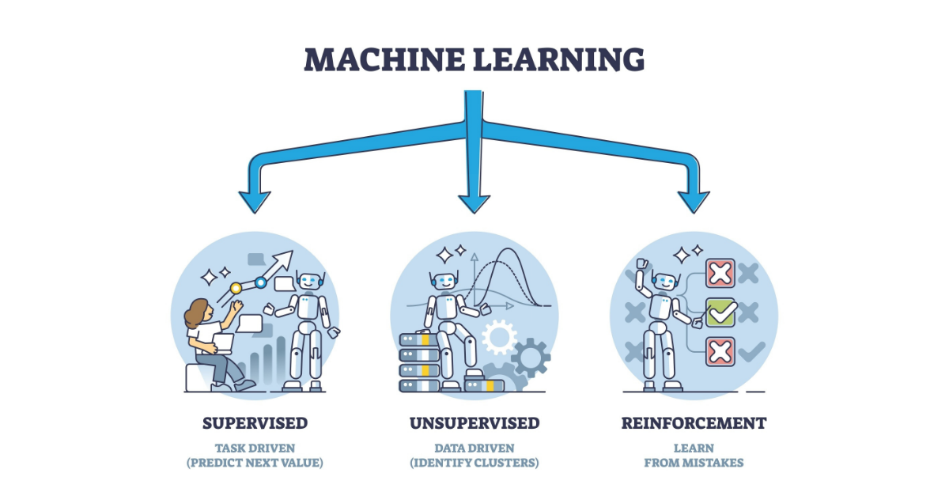
Types of Machine Learning
Notes:
✅ Supervised Learning
Definition: The model learns from a dataset that already has inputs (features) and correct outputs (labels).
Goal: Predict the output for new data.
Example: Predicting student exam scores from study hours and attendance (you already know past students’ scores).
🔍 Unsupervised Learning
Definition: The model is given only inputs (features) without labels. It tries to find patterns or groups in the data.
Goal: Discover hidden structures in data.
Example: Grouping students into clusters based on study habits (without knowing their scores).
🎮 Reinforcement Learning
Definition: The model (called an agent) learns by interacting with an environment. It takes actions and receives rewards or penalties.
Goal: Learn a strategy (policy) to maximize rewards over time.
Example: A self-driving car learning to drive by receiving rewards for staying on the road and penalties for crashing.

Slide 4
ML in Everyday Life
Recommendations (videos, music, shopping)
Spam & fraud detection (email, banking)
Maps & ETA (traffic prediction, routing)
Medical decision support (triage, risk scoring)
Personalization (feeds, ads, search)
Notes:
✅ Supervised Learning
Definition: The model learns from a dataset that already has inputs (features) and correct outputs (labels).
Goal: Predict the output for new data.
Example: Predicting student exam scores from study hours and attendance (you already know past students’ scores).
🔍 Unsupervised Learning
Definition: The model is given only inputs (features) without labels. It tries to find patterns or groups in the data.
Goal: Discover hidden structures in data.
Example: Grouping students into clusters based on study habits (without knowing their scores).
🎮 Reinforcement Learning
Definition: The model (called an agent) learns by interacting with an environment. It takes actions and receives rewards or penalties.
Goal: Learn a strategy (policy) to maximize rewards over time.
Example: A self-driving car learning to drive by receiving rewards for staying on the road and penalties for crashing.

Slide 5
Why This Workshop?
You will be able to…
Explain the ML lifecycle.
Run the full pipeline
(Data Collection → Data Preparation → Model Training →
Evaluation → Prediction)
Compare models and read MAE / RMSE / R²
Save a model and use it on new data
Notes:
By the end, you’ll know the workflow, have a working notebook, and understand how to judge when a model is ‘good enough.’ We’ll stay practical—no deep learning or cloud ops today.

Slide 6
The End-to-End ML Workflow
Data quality → shape, types, missing values
EDA → distributions, relationships, simple visuals
Split → train/test to prevent data leakage
Feature prep → encode categoricals, scale numerics
Modeling → baseline → linear → tree/ensemble
Metrics → MAE, RMSE, R²
Interpret → importances/coefficients, caveats
Save → persist the pipeline; reuse on new data
Notes:
By the end, you’ll know the workflow, have a working notebook, and understand how to judge when a model is ‘good enough.’ We’ll stay practical—no deep learning or cloud ops today.

Slide 7
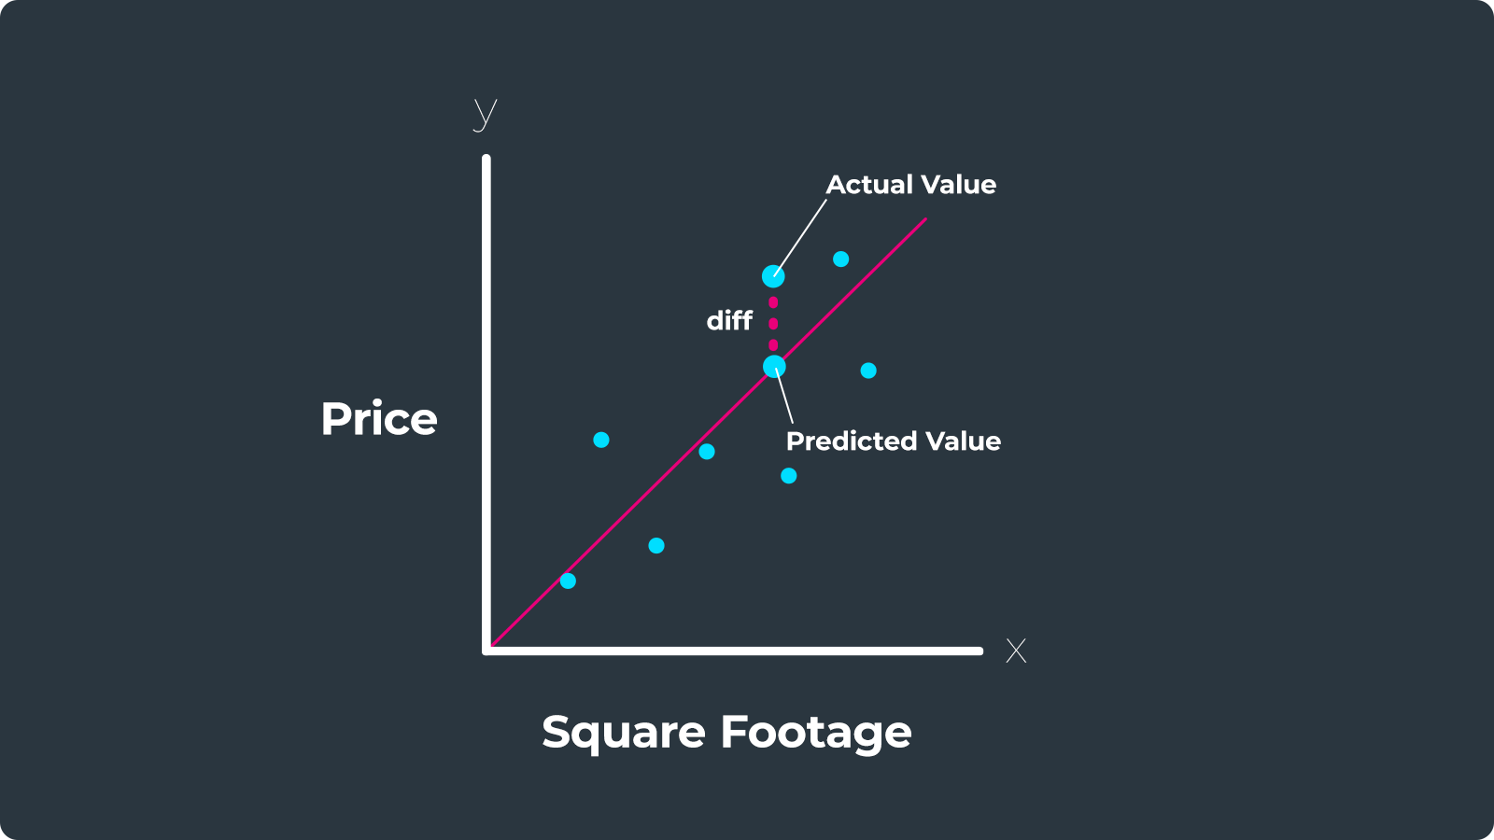
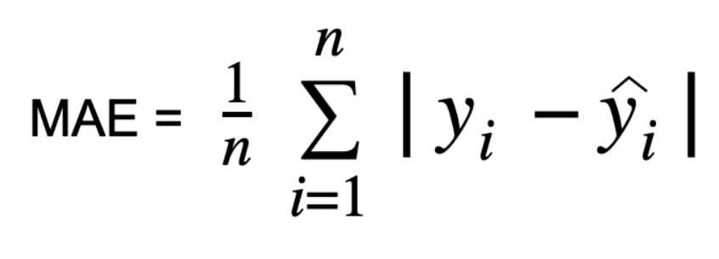
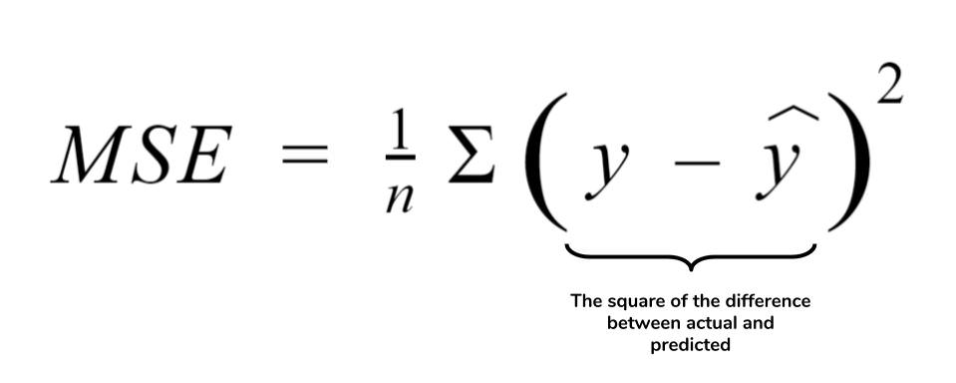
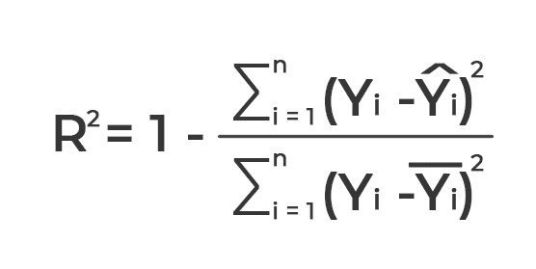
MAE, RMSE, R²
Lower MAE/RMSE is better; higher R² is better
Notes:
By the end, you’ll know the workflow, have a working notebook, and understand how to judge when a model is ‘good enough.’ We’ll stay practical—no deep learning or cloud ops today.

Slide 8
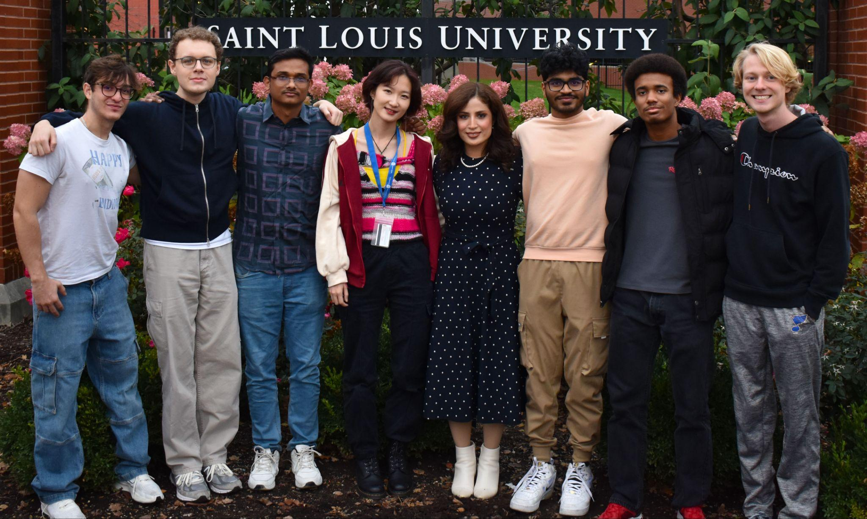

Thank you
Presented by:

