Slide 1

CISC 5352: Machine Learning - Finance
Machine Learning Enhanced Pair Trading Strategy
Arna Sadia
Manali Chordia
Tipu Sultan
Rajeshwar Vempaty

Slide 2
Process
Data Preparation
Pair Selection
Regression Analysis
Import data
Calculate returns
Correlation Analysis
Sliding Window
Integration of ML
Plot Pair Stocks
Linear Regression
Cumulative P&L
LSTM Forecasting
Hyperparameter
Training & Testing
Results & Analysis
Performance Metrics
Trading Strategy

Slide 3
Data Preparation
Load Stock prices
CVX : Chevron corporation
FDX : FedEx corporation
INFY : Infosys Limited
JPM : JP Morgan Chase & Co
LMT : Lockheed Martin Corporation
TGT : Target Corporation
V : Visa Inc
WMT : Walmart Inc
CRM : Salesforce.com, Inc.
BLK : BlackRock, Inc
9/20/2021 | 857.27 | 258.22 | 94.78 | 250.8 | 22.76 | 152.96 | 338.46 | 242.14 | 220.05 | 142.74
9/21/2021 | 845.24 | 257.97 | 94.85 | 252.07 | 23.12 | 152.98 | 336.05 | 241.31 | 220.17 | 143.02
9/22/2021 | 851.05 | 259.17 | 97.64 | 229.08 | 23.27 | 155.91 | 341.73 | 241.77 | 222.75 | 142.69
9/23/2021 | 876.17 | 277.86 | 100.06 | 228.92 | 23.73 | 161.18 | 344.2 | 242.67 | 228.31 | 142.77
9/24/2021 | 874.62 | 285.63 | 100.6 | 226.64 | 23.68 | 163.04 | 349.52 | 241.44 | 231.59 | 143.17
9/27/2021 | 875.47 | 279.68 | 102.97 | 226.51 | 22.9 | 166.98 | 353.36 | 238.58 | 229.6 | 142.25
9/28/2021 | 860.57 | 272.28 | 103.36 | 222.4 | 22.09 | 166.08 | 352.15 | 233.44 | 225.56 | 140.5
9/29/2021 | 856.57 | 270.5 | 103.33 | 221.09 | 22.48 | 165.95 | 350.29 | 235.85 | 226.68 | 140.44
9/30/2021 | 838.66 | 271.22 | 101.45 | 219.29 | 22.25 | 163.69 | 345.1 | 228.77 | 222.75 | 139.38
10/1/2021 | 841.89 | 275.26 | 104.33 | 222.53 | 22.33 | 167.13 | 347.8 | 228.42 | 230.46 | 137.05
10/4/2021 | 825.56 | 270.86 | 104.72 | 217.87 | 22.15 | 166.95 | 345.99 | 225.89 | 224.73 | 135.73
10/5/2021 | 838.78 | 271.77 | 105.86 | 224.27 | 22.75 | 168.66 | 347.75 | 227.56 | 224.28 | 136.62
10/6/2021 | 837.55 | 275.27 | 104.93 | 224.2 | 22.45 | 169.02 | 349.99 | 226.83 | 226.51 | 137.62
10/7/2021 | 842.35 | 274.58 | 105.68 | 222.95 | 22.77 | 170.09 | 351.78 | 229.82 | 230.55 | 139.24
10/8/2021 | 844.4 | 272.48 | 108.05 | 223.44 | 21.93 | 170.22 | 353.75 | 228.9 | 230.27 | 139.66
10/11/2021 | 839.73 | 273.75 | 107.13 | 219.82 | 21.82 | 166.64 | 357.08 | 228.72 | 225.11 | 139.53
* List of stocks selected, downloaded historical data for 2 years starting from 09/19/2021 to 09/20/2023

Slide 4
Pair Selection
Calculate Stock Returns
Calculate Correlation for all the Stock returns and create a heatmap
Identify highest correlation pair.
The highest correlation in returns is 0.666815 between JPM and BLK.

Slide 5
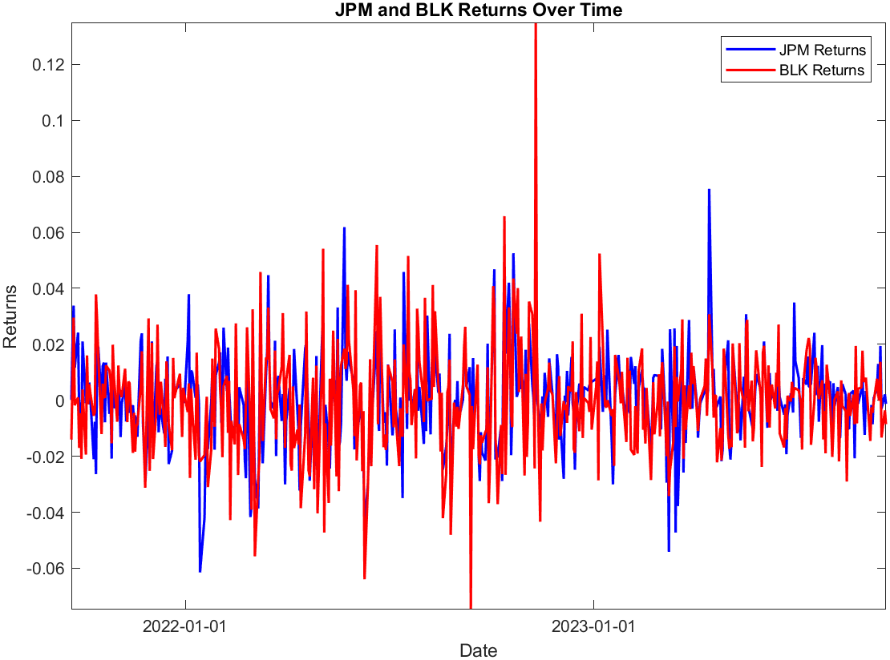
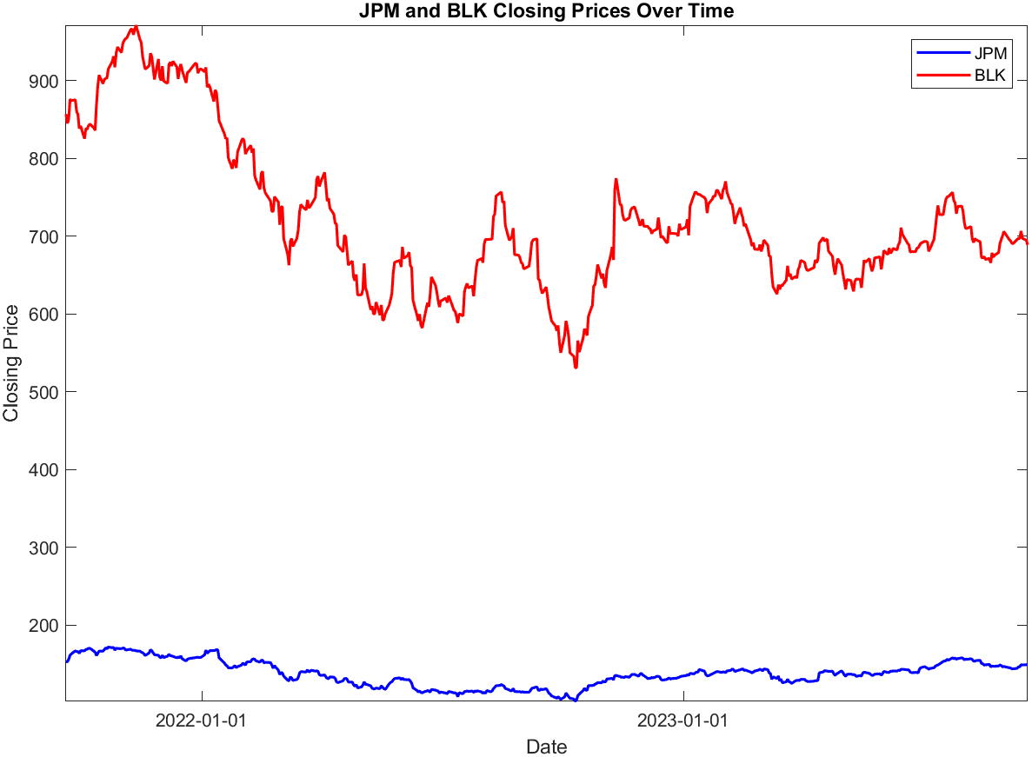
JPM & BLK – Returns & Closing Price

Slide 6
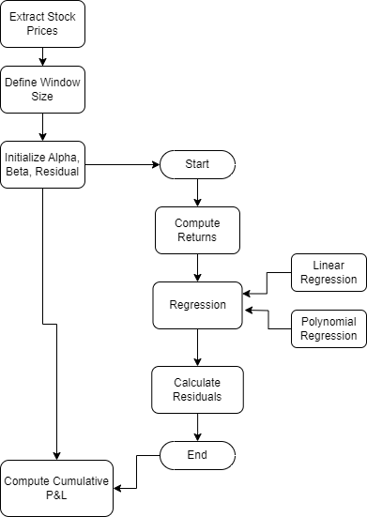
Sliding Window
Extract stock price data for JPM and BLK from the dataset.
Set the window size M to 60. This means each window will include 60 data points (e.g., 60 days of stock prices).
Initialize vectors alpha, beta, and residuals to store the coefficients and residuals of the regression for each window.
Regression on returns
Calculate Residuals
Calculate Cumulative P&L, by summing up residuals.

Slide 7
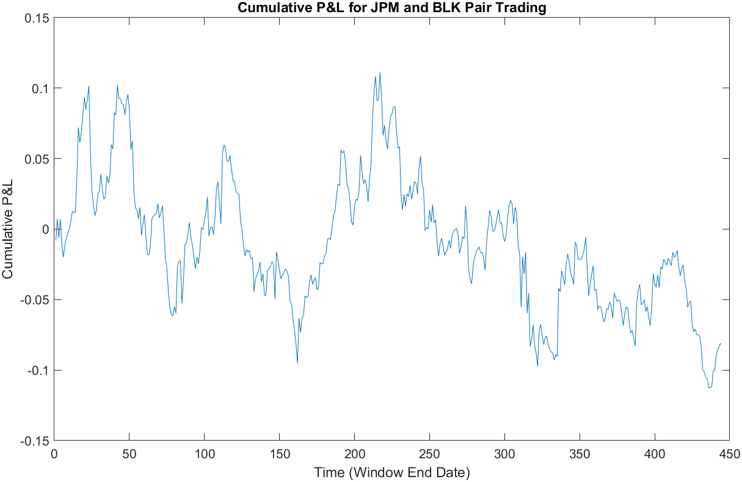
Cumulative Profit Loss - Linear Regression
This plot shows the Cumulative Profit & Loss for JPM and BLK, calculated through Linear Regression.
It ranges from 10% to -10% through the period.

Slide 8
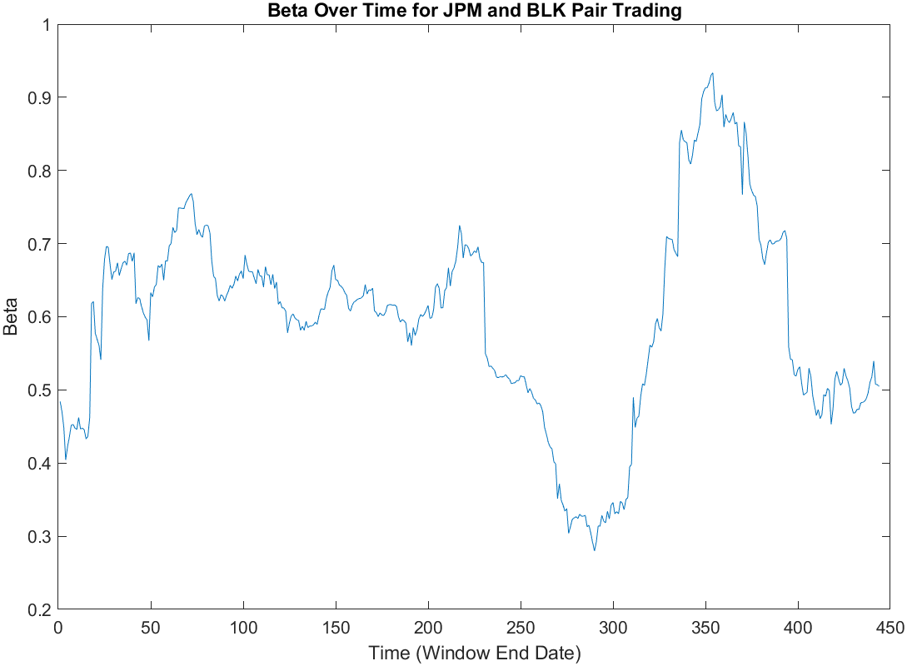
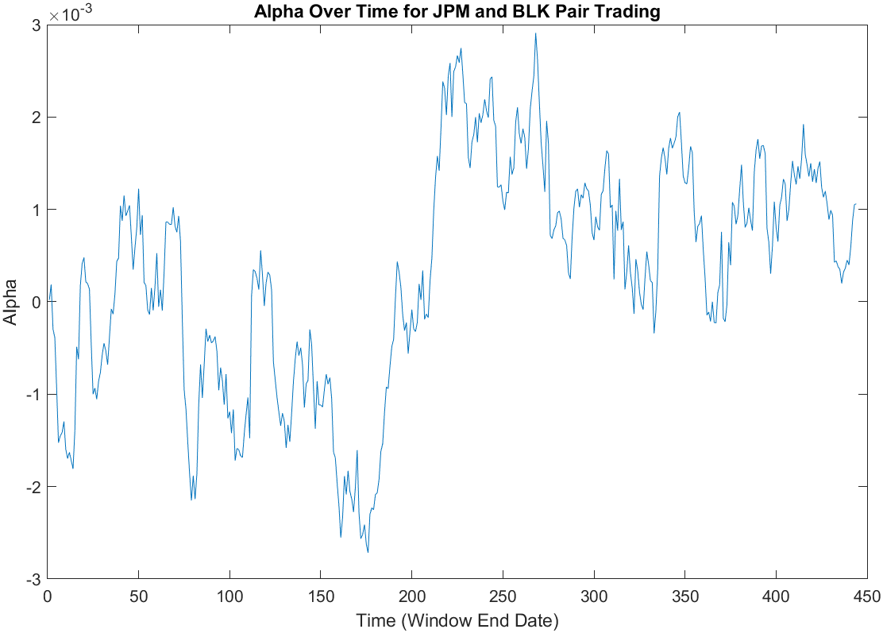
Alpha & Beta - Linear Regression

Slide 9
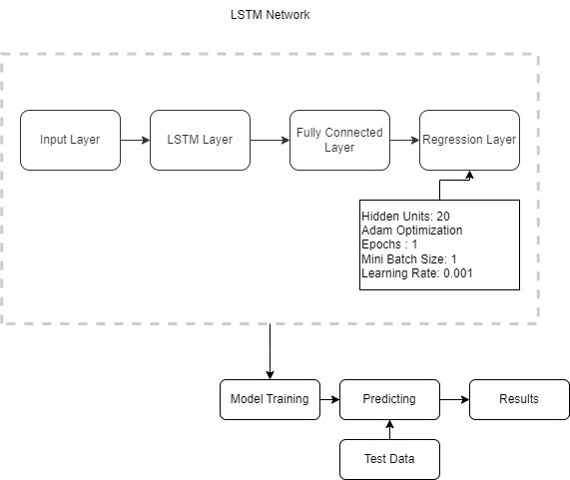
LSTM Network – Basic
Split the cumulative profit loss into Train (~344 Obs) and Test (~100 Obs)
Reshape the data into row vector.
Defining LSTM Network Architecture.
Pass parameters to the LSTM, train the model

Slide 10
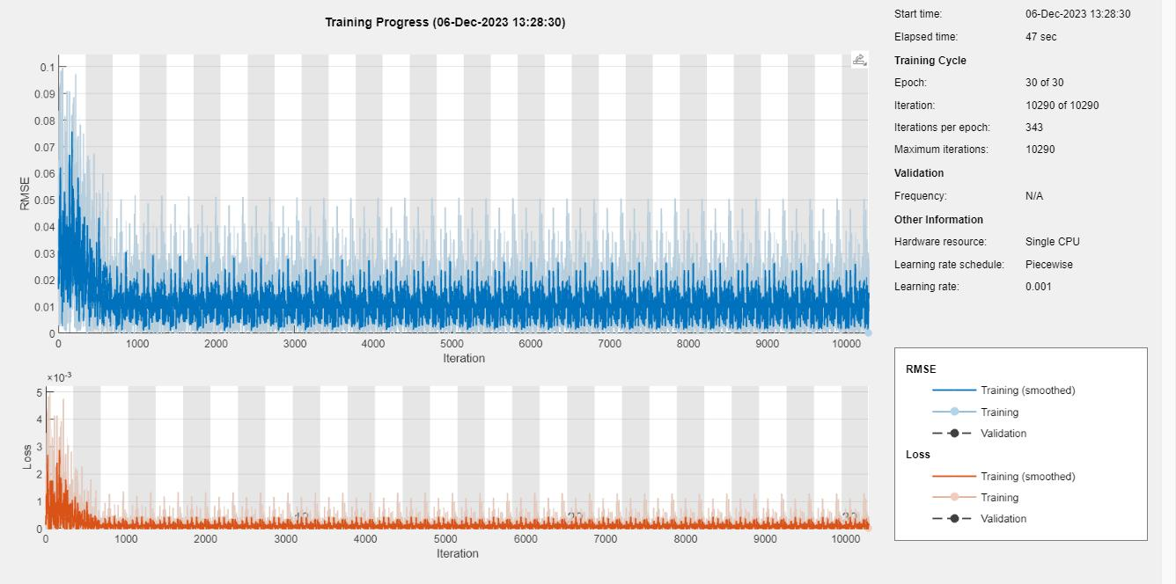
LSTM Network – Training Progress

Slide 11
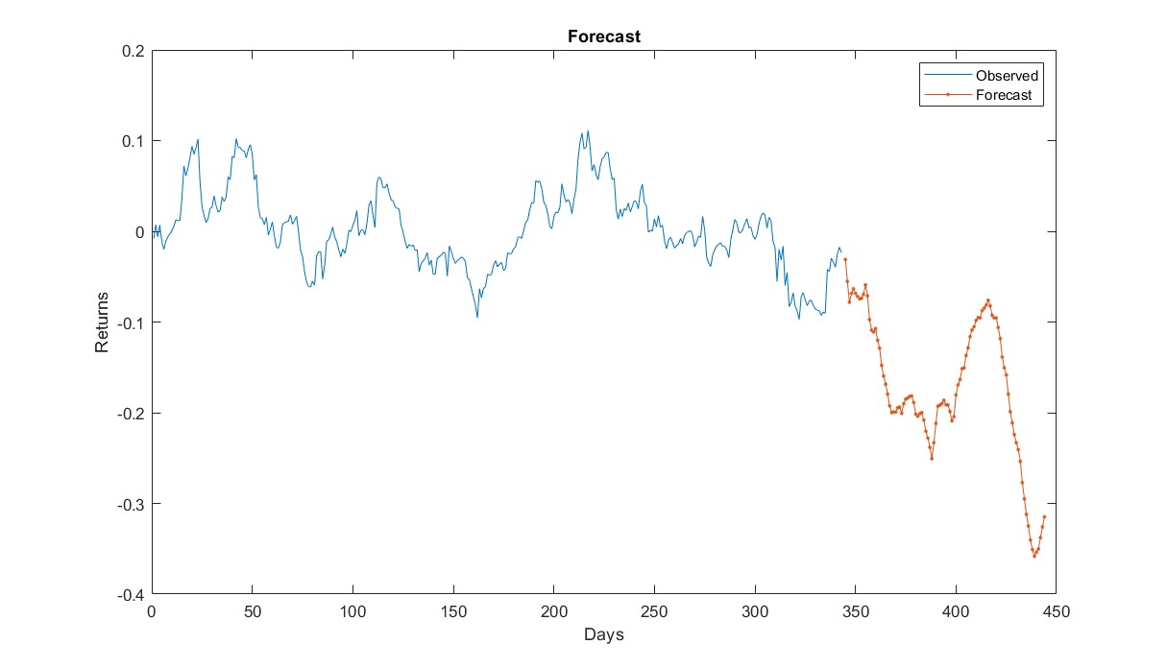
Forecasting - Test Data
Using the trained model, we predict/forecast on the unknow cumulativePL for 100 days.
Plot shows the forecasted values for a period of 100 days along with trained data.

Slide 12
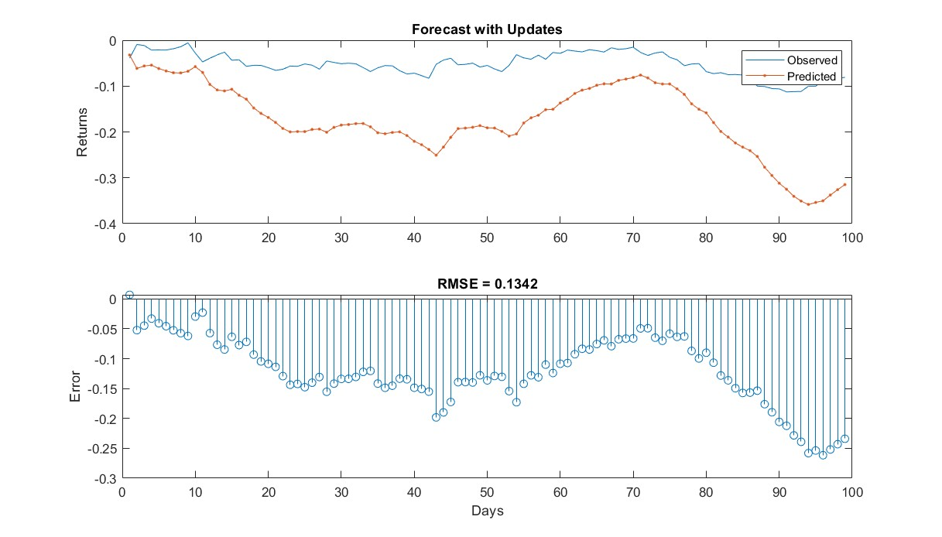
Comparing Forecasted & Actual Test Data
The plot shows how did our basic LSTM model forecasted/predicted the test dataset.
Test RMSE: 0.1342
Model forecasted good but can still perform better, for this we will hyper-tune the parameters and then train our model with best parameters.

Slide 13
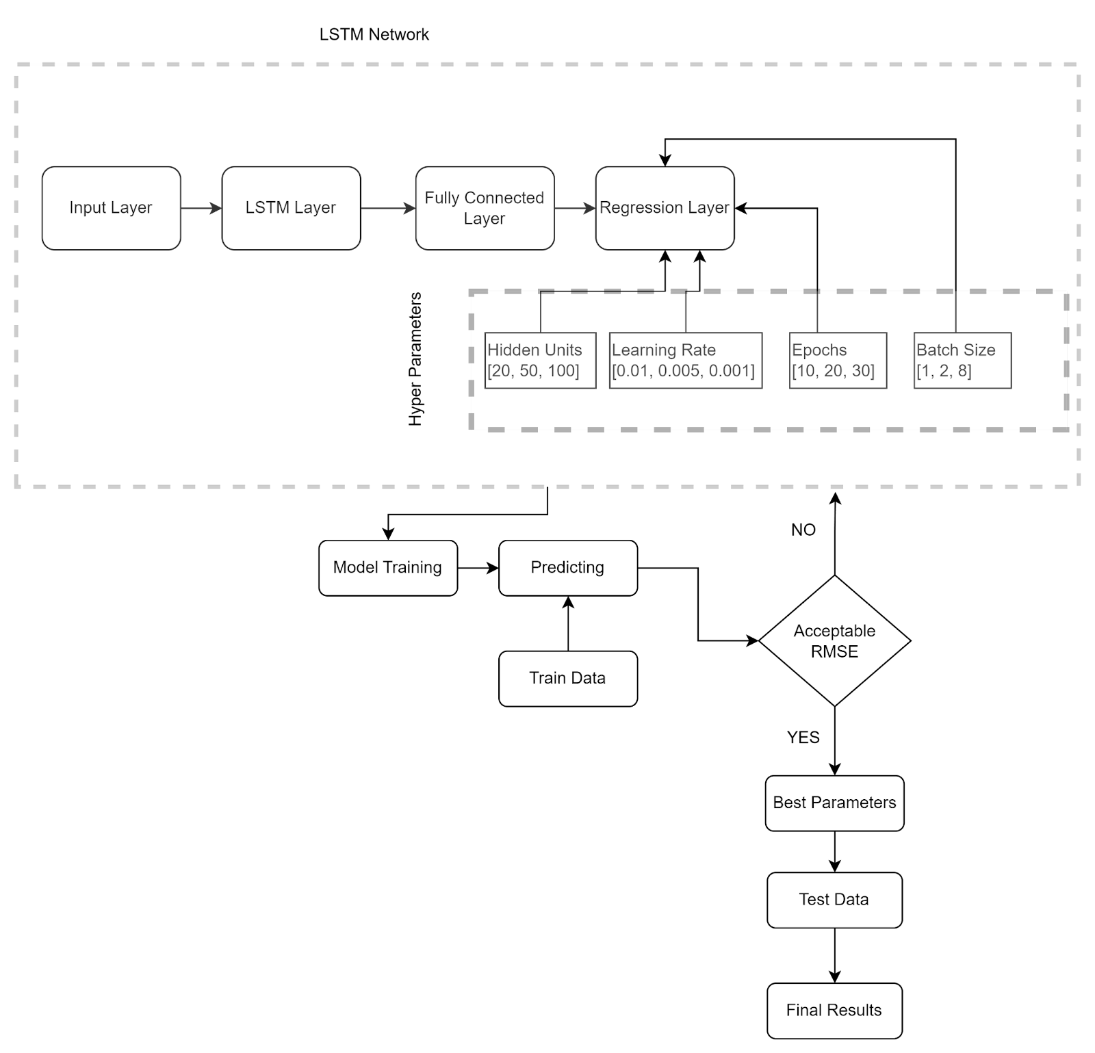
LSTM Network : Hyper Tuned (Linear Regression)
Define LSTM Architecture
Passing the hyper parameters
Parameters:
1. Hidden Units Options [20, 50, 100]
2. Learning Rate Options [0.01, 0.005, 0.001]
3. Epoch Options [10, 20, 30]
4. Batch Size Options [1, 2, 8]

Slide 14
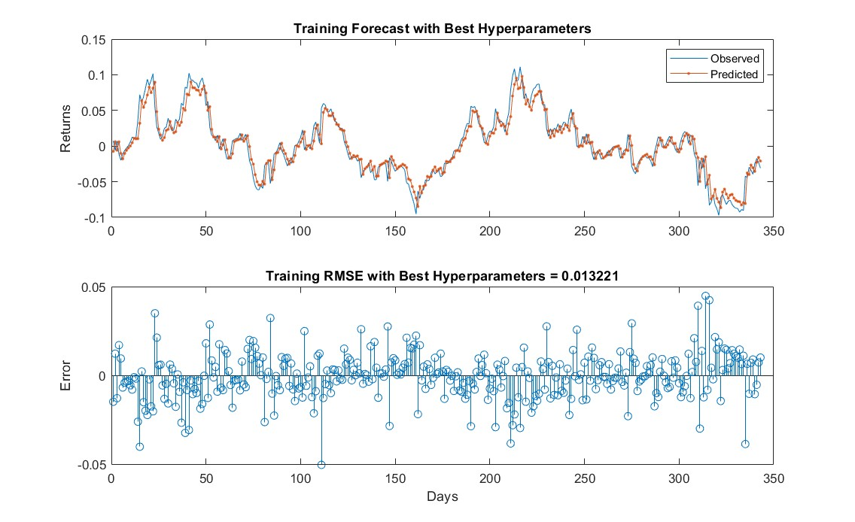
LSTM Hyper tuned – Train Data (Linear Regression)
Using the model trained with best parameters, we predict on the train dataset.
Plot shows how our hyper tuned model predicted the training dataset.
Train RMSE : 0.0132

Slide 15
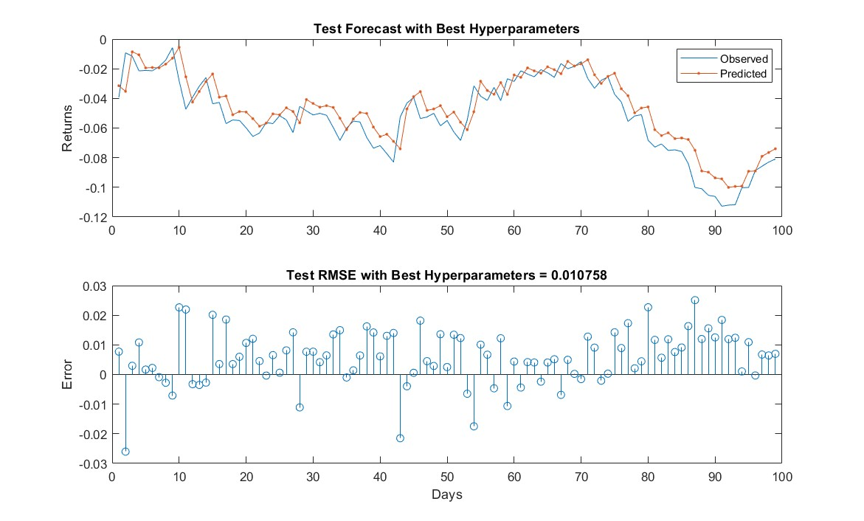
LSTM Hyper Tuned – Test Data (Linear Regression)
Predicting on Test data using hyper-tuned model.
Looking at the plot, model performed better than basic LSTM.
Test RMSE: 0.01075

Slide 16
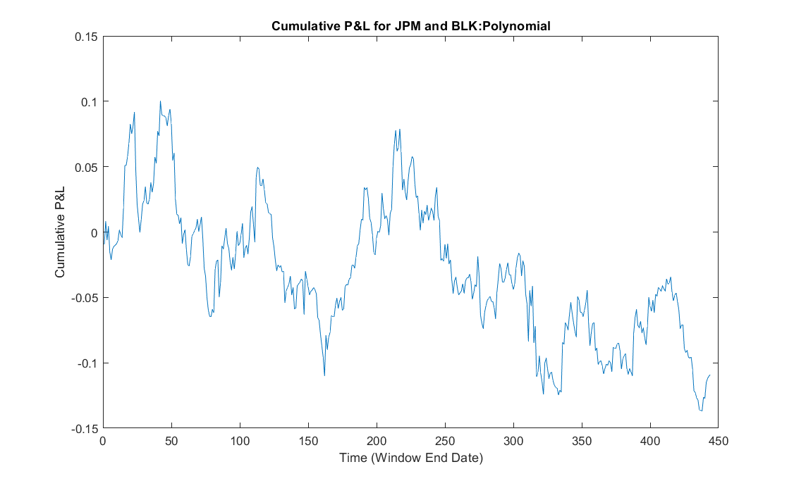
Cumulative Profit Loss - Polynomial
This plot shows the Cumulative Profit Loss for JPM and BLK, calculated through Polynomial Regression.
It ranges from 10% to -10% through the period.

Slide 17
LSTM Network – Polynomial
Define LSTM Network.
Pass the parameters.
Train the model

Slide 18
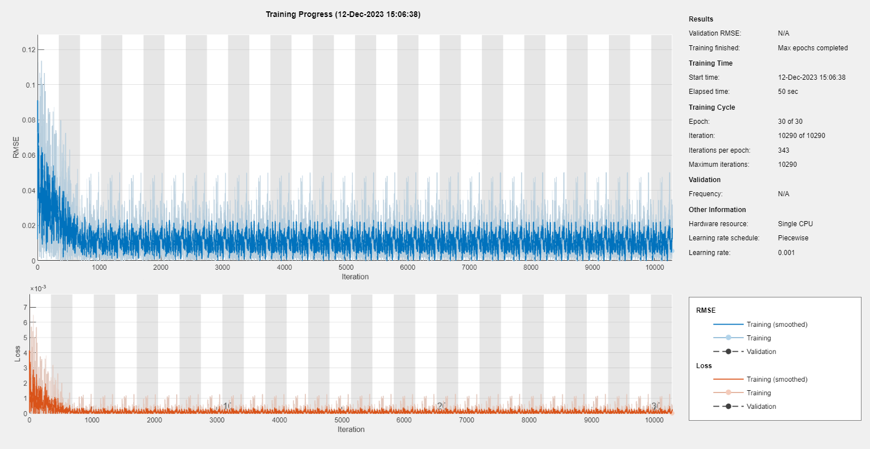
LSTM Network – Training Progress (Polynomial)

Slide 19
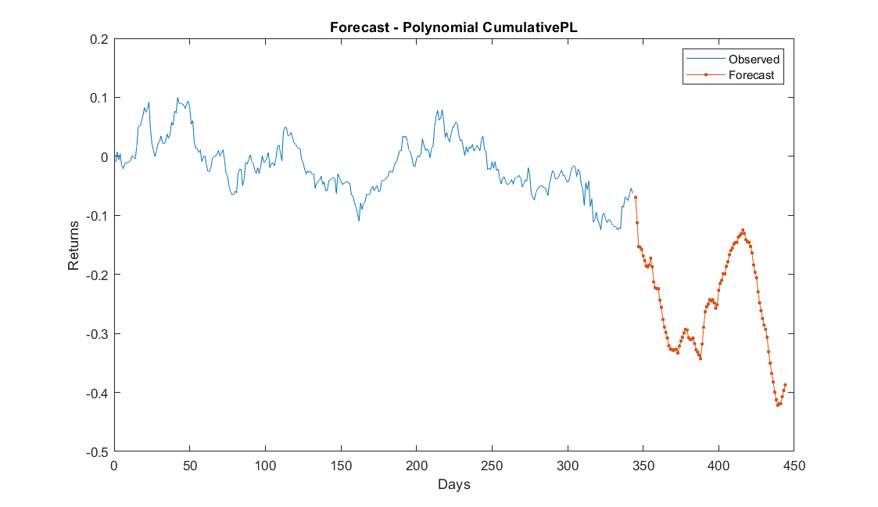
Forecasting (Polynomial)
Using the trained model, we predict/forecast on the unknow cumulativePL for 100 days.
Plot shows the forecasted values for a period of 100 days along with trained data.

Slide 20
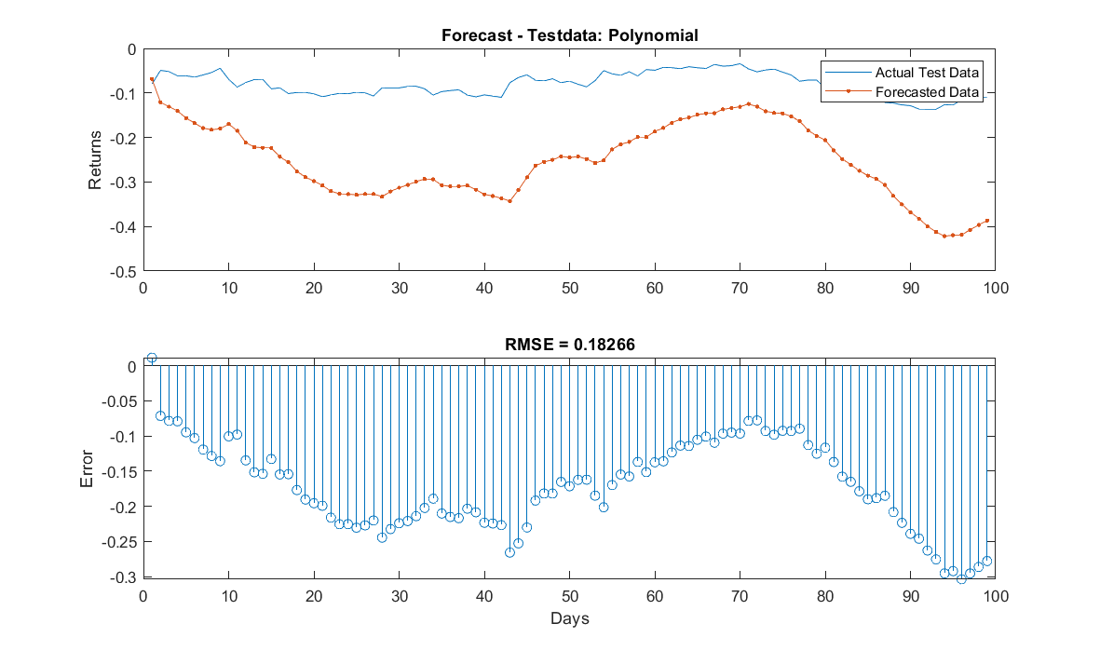
Comparing Forecasted & Actual Test Data
The plot shows how did our basic LSTM model forecasted/predicted the test dataset.
Model has forecasted poorly.
Test RMSE: 0.1826
Model forecasted good but can still perform better, for this we will hyper-tune the parameters and then train our model with best parameters.

Slide 21
LSTM Network : Hyper Tuned (Polynomial)
Parameters:
1. Hidden Units Options [20, 50, 100]
2. Learning Rate Options [0.01, 0.005, 0.001]
3. Epoch Options [10, 20, 30]
4. Batch Size Options [1, 2, 8]

Slide 22
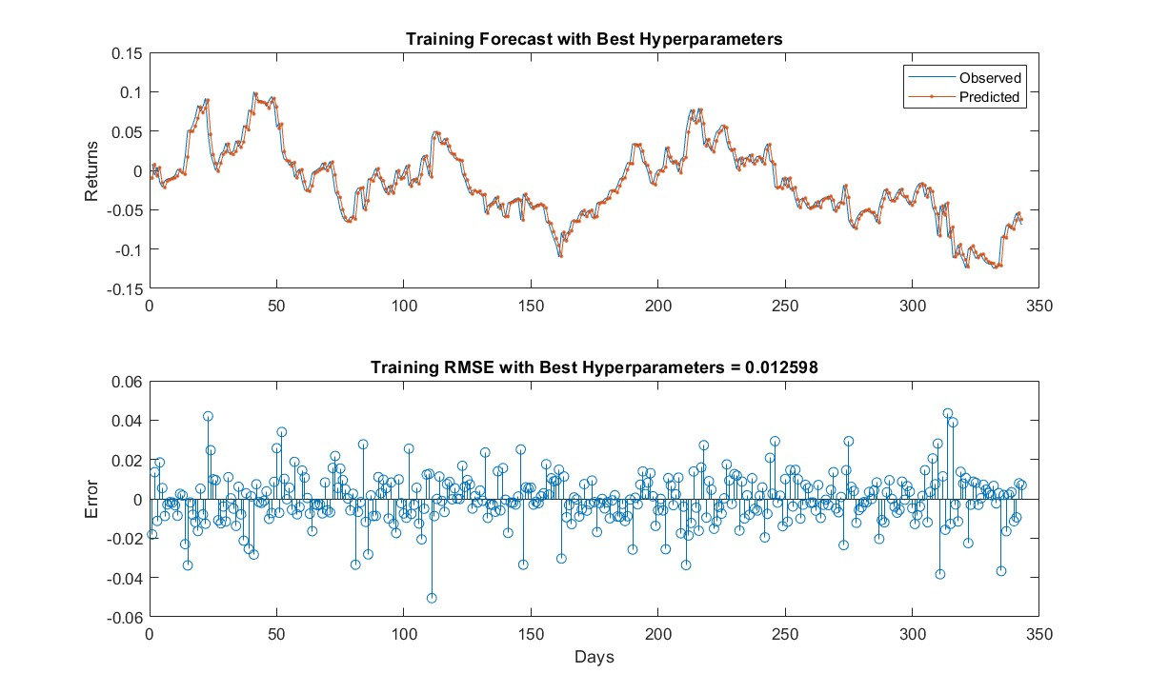
LSTM Hyper tuned – Train Data (Polynomial)
Best Parameters:
Best hidden units: 50
Best learning rate: 0.010000
Best epochs: 20
Best mini-batch size: 1
Using the model trained with best parameters, we predict on the train dataset.
Plot shows how our hypertuned model predicted the training dataset.
Train RMSE : 0.012598

Slide 23
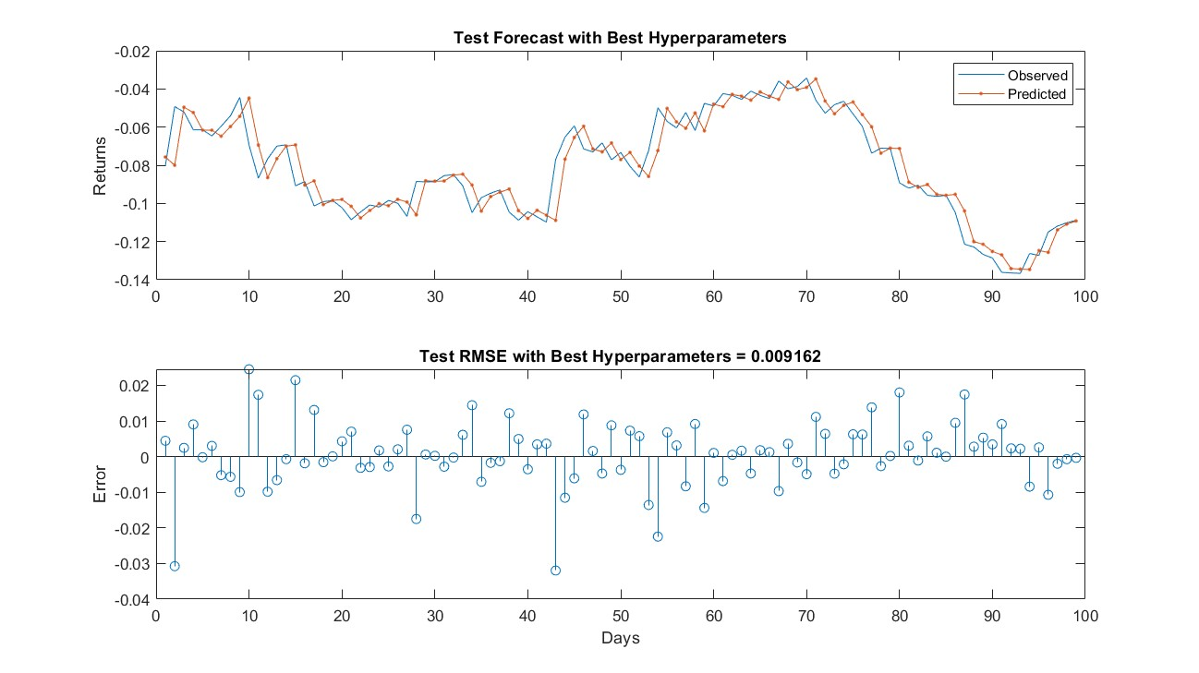
LSTM Hyper Tuned – Test Data (Polynomial)
Predicting on Test data using hyper-tuned model.
Looking at the plot, model performed better than basic LSTM.
Test RMSE: 0.009162

Slide 24
Results
From the outcome of the results, we can see that
LSTM – Hyper Tuned model performed better for Linear & Polynomial Regression Cumulative P&L
Cumulative P&L – Polynomial got better results with a RMSE of 0.009

Slide 25
Conclusion
We calculated Cumulative Profit & Loss of two pairs of stock using two different regression’s by giving a sliding window for 60 days.
Linear Regression
Polynomial Regression
Trained the Cumulative P&L with Basic LSTM, didn’t get better prediction on test data.
Retrained the Cumulative P&L by passing Hyper parameters It significantly enhanced the performance on the test data.
Future-work:
We will try to implement a pair trading strategy of the cumulative P&L which our best model predicted.

