Slide 1
Algorithmic Fairness Hackathon D3A Conference
Tibor V. Varga & Adrian G. Zucco Section of Epidemiology Department of Public Health University of Copenhagen
2 Feb 2024

Slide 2

While the definition of fairness is an ABSTRACT theoretical debate…
…we are facing VERY REAL problems that we want to resolve fairly.

Slide 3
Bias trickles down
ALGORITHM
OUTPUT 1
SOCIETY
(BIG) DATA
OUTPUT 2
…and the bigger the data, the more confident we might be in a potentially biased solution (see: LLMs…)

Slide 4
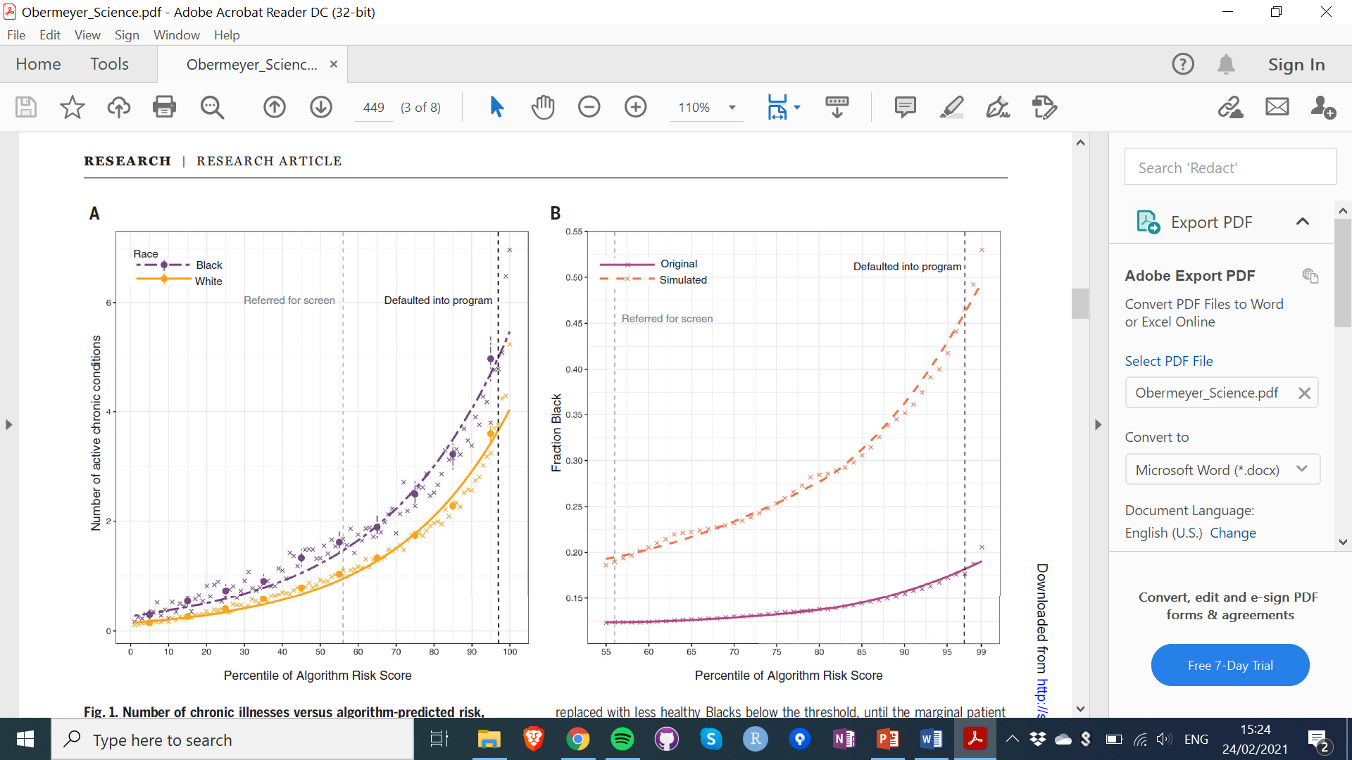
Healthcare algorithm to prioritize individuals for screening and preventive intervention
The algorithm used healthcare expenditure as a proxy for healthcare needs
Obermeyer Z, Science, 2019
Notes:
https://science.sciencemag.org/content/sci/366/6464/447.full.pdf?casa_token=JR6_PPhrfHMAAAAA:1piJcC_NwVBmj0RZndvb9g7rUqruqpDr-x8zognXjAki6D80nyi59f2f4jukJoh16tN5rA7F6_zP9lY

Slide 5
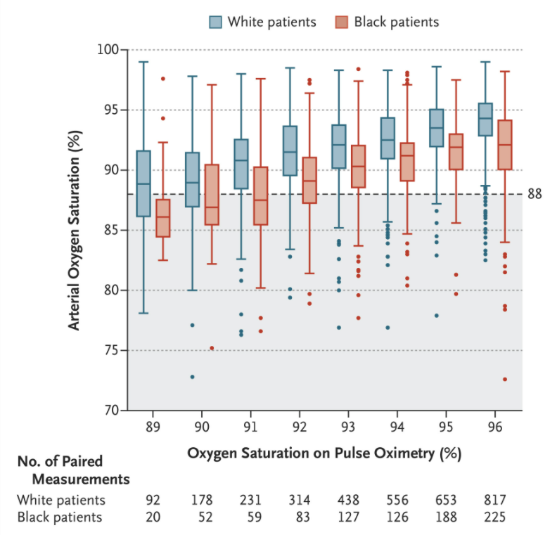
Pulse oximetry is the most common method to measure oxygen saturation
The device leaves hypoxemia undetected in proportionally more Blacks vs Whites
Sjoding MW, et al. New England Journal of Medicine, 2020.
Notes:
https://www.nejm.org/doi/full/10.1056/NEJMc2029240

Slide 6
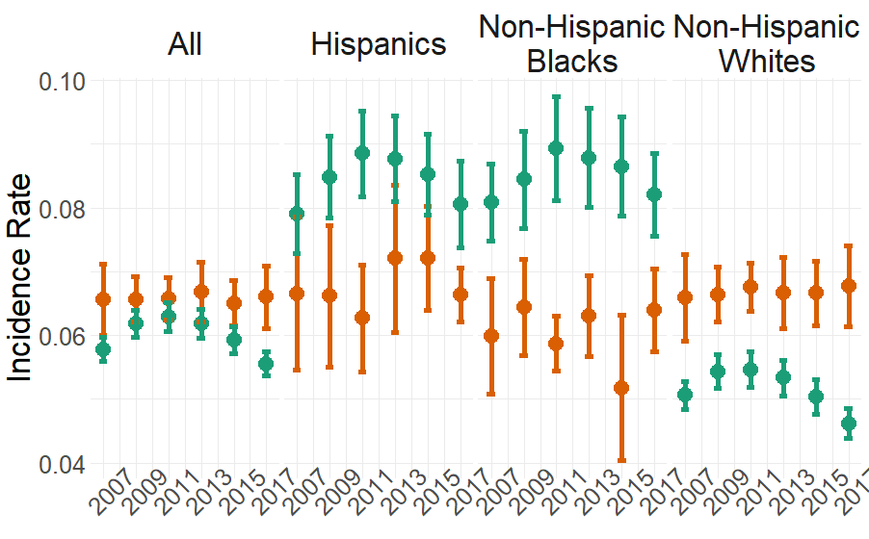
Clinical prediction algorithm for type 2 diabetes that prioritizes individuals for preventive intervention
The algorithm overestimates risk for whites and underestimates risk for blacks and hispanics
Comparison of predicted incidences by the Framingham Offspring Risk Score type 2 diabetes prediction algorithm (orange), and real-life incidences (green). This landmark risk score performs reasonably well on average but underestimates risk for Hispanics and Blacks, and overestimates risk for Whites.
Cronje HT, et al. PLoS Global Public Health, 2023.
Notes:
https://www.nejm.org/doi/full/10.1056/NEJMc2029240

Slide 7
“If Black and White women were screened biennially from age 50 to 74 years, there would be an excess of¨3.29 deaths among Black women […] In contrast, if biennial screening was initiated in Black women beginning at age 40 years, deaths would decrease by 1.88 per 1000 women […] removing 57% of the racial disparity”
Chapman, CH, et al. Annals of internal medicine, 2021
Notes:
Expectations for ML
Remove human bias

Slide 8
GROUP FAIRNESS
All subgroups should be treated similarly
All subgroups should get the same benefits

Slide 9
Important metrics based on the CONFUSION MATRIX
Actually positive
Actually negative
TP
FP
Predicted positive
FN
TN
Predicted negative

Slide 10
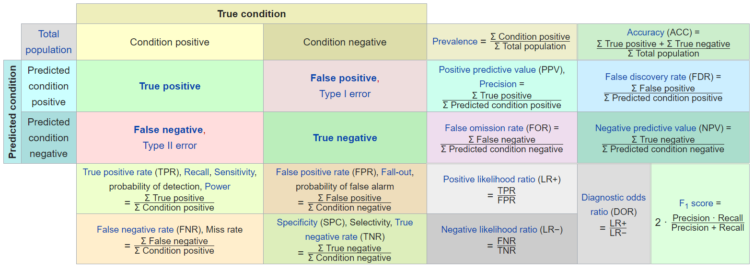
Notes:
https://en.wikipedia.org/wiki/Confusion_matrix

Slide 11
Important to think about primary benefit and primary harm

Slide 12
Equalized Odds
Equality of Opportunity
Should satisfy:
Pr(C = 1 | Y = 1, A = O) = Pr(C = 1 | Y = 1, A = 1)
- sensitivity
Pr(C = 1 | Y = 0, A = O) = Pr(C = 1 | Y = 0, A = 1)
- FPR
Notes:
Separation, Positive Rate Parity
Sensitivity (TP / all actually positives)
Precision (TP / all predicted positives)
https://towardsdatascience.com/a-tutorial-on-fairness-in-machine-learning-3ff8ba1040cb
https://www2.cs.duke.edu/courses/fall18/compsci590.1/lectures/FairML2.pdf

Slide 13
Predictive Rate Parity
Should satisfy:
Pr(Y = 1 | C = 1, A = O) = Pr(Y = 1 | C = 1, A = 1)
- precision
Pr(Y = 1 | C = 0, A = O) = Pr(Y = 1 | C = 0, A = 1)
- FDR
Notes:
Sufficiency
Sensitivity (TP / all actually positives)
Precision (TP / all predicted positives)
https://towardsdatascience.com/a-tutorial-on-fairness-in-machine-learning-3ff8ba1040cb
https://www2.cs.duke.edu/courses/fall18/compsci590.1/lectures/FairML2.pdf

Slide 14
But what can you do?
PREPROCESSING
E.g. Modify training data, resampling
OPTIMIZATION
E.g. Constraints, regularization
POSTPROCESSING
E.g. Modifying models or outcomes

