Slide 1
>How to develop >an r package
>Tibor V Varga (joint postdoc @ KU/LU)
>21 Feb 2019

Slide 2
Disclaimer
I am NOT a:
Computer scientist
Programmer
Statistician
MAYBE I am a:
Bioinformatician?
Data scientist?
I am DEFINITELY a:
Biologist
Nutrition/food scientist
Medical scientist
Epidemiologist

Slide 3

Coding history
First steps in SAS in 2011, used it for 1 project
Switched to STATA in 2012, used it throughout PhD
Started using R for projects from 2017
Starting Python from the end of 2018 (for NN)
WHY THE CHANGE?
R IS SUPER-VERSATILE, OPEN-SOURCE,
WITH A LARGE SUPPORT SYSTEM,
OFFERS FLEXIBLE PLOTTING,
AND THERE ARE SO MANY PACKAGES!

Slide 4
My context
Developed an R package that helps with missing data
Working with epidemiological datasets
In general, working with supervised / non-supervised ML problems, eg. prediction, classification, clustering, etc.
No support in cleaning data
No clear guidelines on HOW to clean or analyze data

Slide 5
All you need is:
A problem
A solution / a plan to help
Intermediate coding skills
Time
Enthusiasm

Slide 6
In my case:
A problem – missing data is a pain in the ass
A solution / a plan to help – there are tons of solutions, but no clear way to compare them in a structured framework
Intermediate coding skills – I am OK in R and want to improve
Time – Already spent a lot of time on the problem
Enthusiasm – I have never done it before and want to learn more R

Slide 7
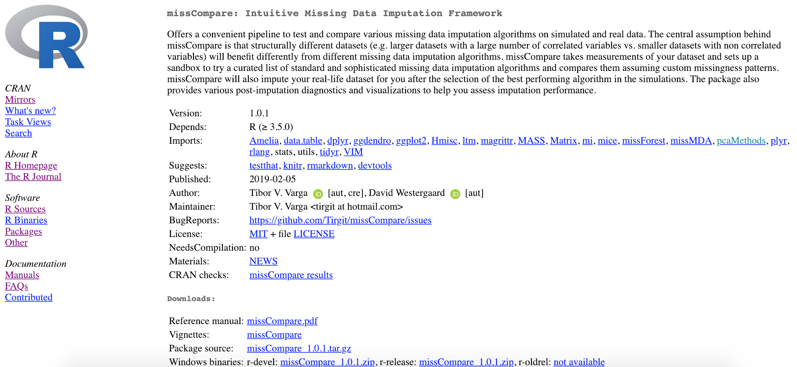
missCompare

Slide 8
What the package is about:
Missing data handling from start to finish
Comparison of methods
Visualization, diagnostics
--------------------------------------------
Loads of expertise
Good practices in documentation
Getting to know lots of tools

Slide 9
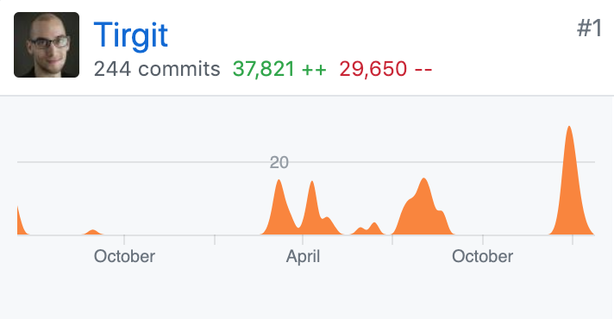
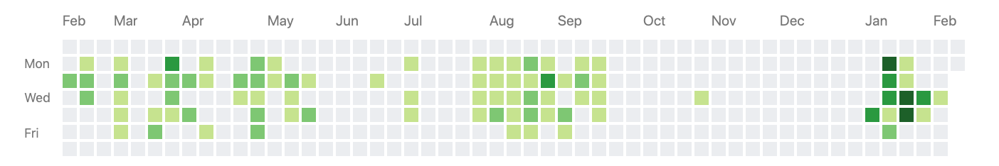
Total time commitment
PHASE 1 – Ideas
PHASE 2 – Bulk of the work
PHASE 3 – Last push

Slide 10
Total time commitment
Estimated total time: one-two months full time

Slide 11
How do you start? You start writing…
> |
>
>
>
>
>
>
>
>
>
>
>
>
>
>

Slide 12
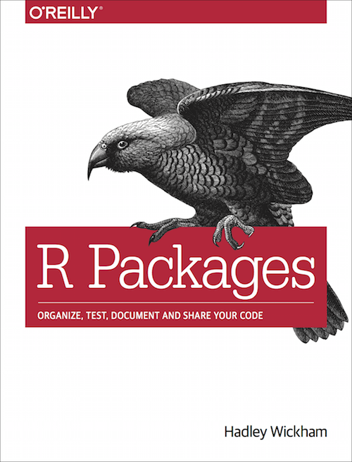
But to make it into a package.. You start reading…
Freely available at:
http://r-pkgs.had.co.nz/
“R packages should be the easiest way to share code.”

Slide 13
R - Must have / useful to have:
version control (git / GitHub)
>install.packages(”devtools”)
>install.packages(”roxygen2”)
>install.packages(”rmarkdown”)
>install.packages(”knitr”)
>install.packages(”testthat”)
Travis CI – continuous integration service
Packrat – dependency system, install.packages(”packrat”)
RStudio + newest version of R

Slide 14
Code
It should work
Start with function writing
Create empty files for planned functions
Create project flowchart
Understand relations between functions
You can think about elegance / beauty when it works
Many guidelines in the R Packages book

Slide 15
Documentation
Arguably as important as your codes
Use roxygen2 for automatization of documentation
Each script will start with lines #’ for documentation
Automatically updated man .Rd files
Contains:
Name, description (short), detais (long)
Input parameters, outputs
Examples

Slide 16
Vignettes
Very important!
Long-format tutorial, explanation of what your package does
Browse vignettes for all installed packages:
>vignette()
Go crazy here, there are no details too small!

Slide 17
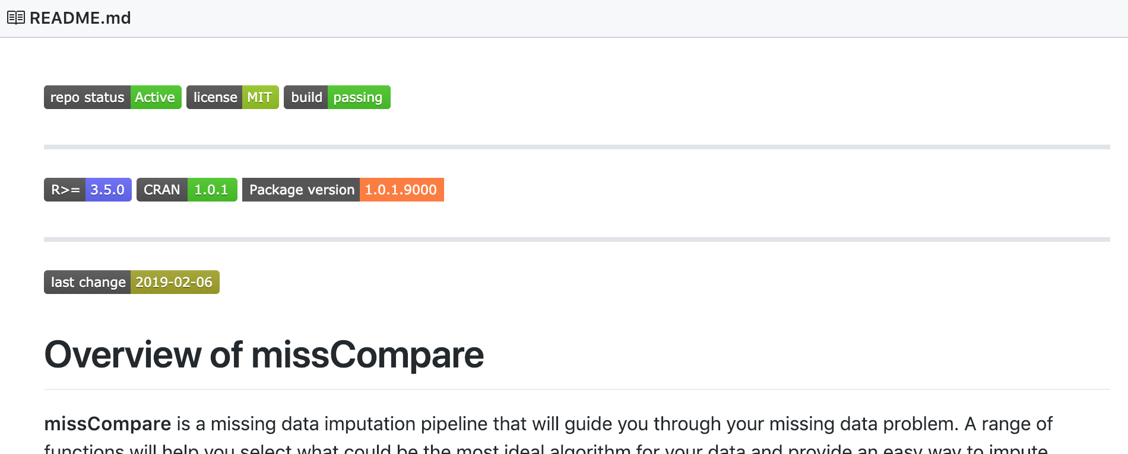
Readme
Important!! – this shows up immediately on your GitHub page
In terms of sequence, you will have this first, but…
Later, you should just shorten your VIGNETTE!
Include fancy
badges using
package:
badgecreatr

Slide 18
Data
Use quickly made matrices, dataframes or other objects
Use specific datasets from other packages or widely known datasets
You might want to publish your own data to make your point (I needed that!)
Or your package IS a collection of datasets
For testing and checks, I initially used an established dataset

Slide 19
Testing
“It’s not that you don’t test your code, it’s that you don’t automate your tests.”
Use testthat functions / write own testing functions
One script – one context, one test – one expectation
context(”Cleaning")
test_that("error if strings present", {
testthat::expect_error(clean(small))
})
test_that("message for numeric conversion", {
testthat::expect_message(clean(small))
})
test_that("equal dims", {
expect_equal(dim(small), dim(cleaned))
})

Slide 20
Checks
devtools helps you to set up structure
And with CHECKS!
You should check in: macOS / Windows / Linux
>R CMD CHECK for macOS
>devtools::win_devel() for Windows R developer version
>devtools::win_release() for Windows R release version
Push to GitHub for check using Travis CI in Ubuntu Linux

Slide 21
Checks
Checks MANY things!
ERROR
WARNING
NOTE
There cannot be ERRORs and WARNINGs
You should eliminate all NOTEs too, but sometimes it is not possible – you can explain why there are NOTEs in cran-comments.Rd file

Slide 22
CRAN submission
CRAN = The Comprehensive R Archive Network
Pronounced as: SEE-RAN
Check CRAN Task Views (39 topics)
Submission to CRAN vs having it on GitHub?
Submission to CRAN vs Bioconductor?
https://cran.r-project.org/index.html

Slide 23
CRAN submission
Submit manually by uploading a compressed version
Or in R, using devtools::release() – EASIER!
Will ask you lots of questions:
Does it contain x, y, z files?
Have you checked it in Windows etc?
Have you run a spell checker?
Have you checked it in your local environment?
Have you ….?
pro-tip: you can also write your OWN questions to be asked!
SUBMIT - After this: you wait a couple of days for comments
And resubmit

Slide 24
What happens post-submission?
It is NOT over!
You need to update and continue to develop
Compatibility, reverse depedencies!
Communication with other developers
If you don’t maintain – the package will be archived!
New version every quarter year?

Slide 25
OVERALL
A problem
A solution / a plan to help
Intermediate coding skills
Time
Enthusiasm
Don’t re-invent the wheel – check if there are similar tools!
Is the package really needed, do you predict value?
What are the completely new functionalities?

Slide 26
PRO / CONTRA
Helping others
Implementing new ideas
Professional / career development
Contributing to open source community
CRAN submission is difficult
Continuously resolving bugs / issues
Updating package (otherwise it will be archived)
Time-consuming task

Slide 27
Resources
http://r-pkgs.had.co.nz/
https://kbroman.org/pkg_primer/
https://hilaryparker.com/2014/04/29/writing-an-r-package-from-scratch/
https://www.analyticsvidhya.com/blog/2017/03/create-packages-r-cran-github/
http://tinyheero.github.io/jekyll/update/2015/07/26/making-your-first-R-package.html
https://www.datacamp.com/courses/developing-r-packages

