Slide 1
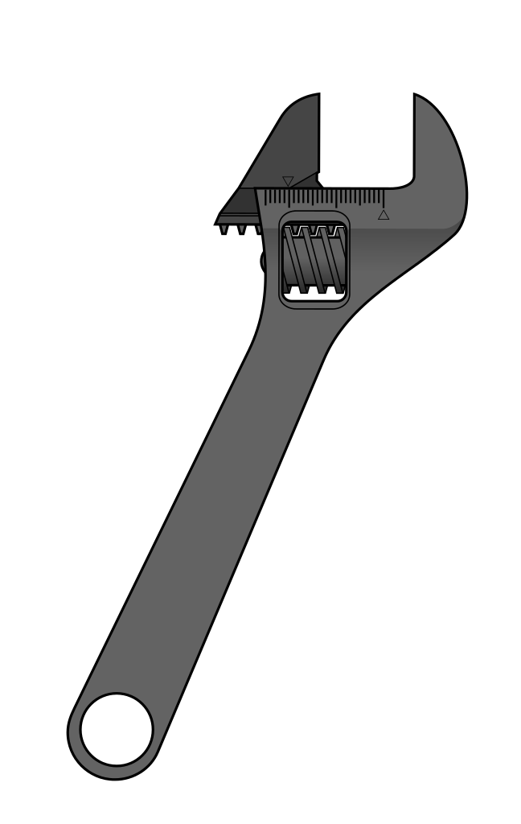
UNFAIL
FROM FAILURE
TO KNOWLEDGE

