Slide 1
Web application Testing
www.onlysport.ro
FINAL PROJECT

Slide 2
App description:
www.onlysport.ro
Web application
Online store for street and sport shoes
International shipping

Slide 3
Testing approach
I planned my testing activities to cover different aspects of the software.
I have identified the key user functionalities, features and interactions that need to be thoroughly tested. My goal is to make sure the software works as intended, is easy to use, and meets the expectations of our users.
To design my test cases, I relied on my understanding of the software and its expected behavior.
During the test execution phase, I ran these test cases and observed the actual behavior of the software. I compared the observed results to my expectations to identify any discrepancies or problems.
A compatibility test was also performed, to check if the application responds properly on different operating systems: Windows, iOS

Slide 4
Tools Used
Different tools were used to test the application, such as:
Excel documents
Xmind documents
Word document
PowerPoint document
Mantis bug tracker
Snipping tool: Paint

Slide 5
Testing types
Smoke testing
Exploratory testing
Compatibility testing
UI testing
Usability testing
Functional testing

Slide 6
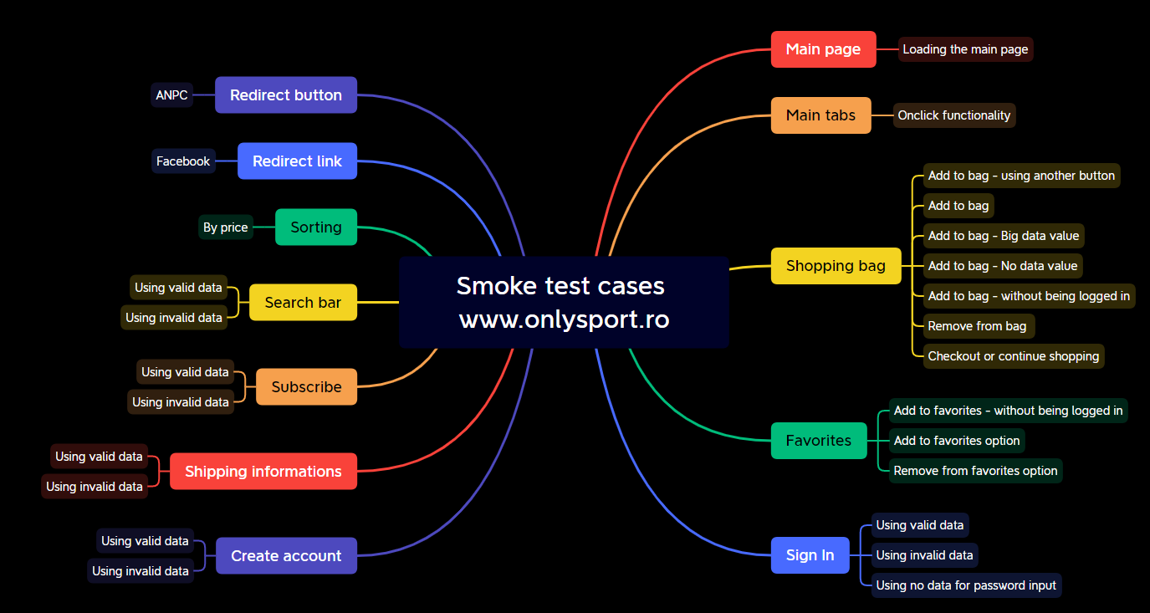
Test Cases Overview

Slide 7
Bugs overview

Slide 8
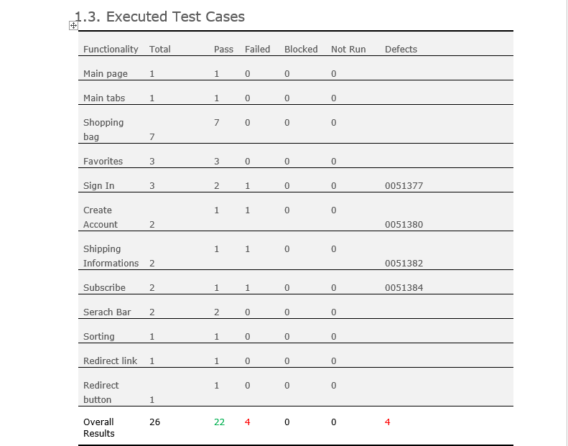
Test Cases Results

Slide 9
Conclusions
26 Test Cases were executed: 22 passed and 4 failed
4 bugs identified:1 major and 3 normal
All bugs were identified by performing Smoke Testing
Data type used during testing: Blank, Valid, Invalid, Big Data, Onclick
Fixing at least the major severity bugs is recommended

Slide 10
Lessons learned
Importance of Test Planning: Proper test planning is crucial to ensure thorough coverage of the system.
Early Bug Detection with Smoke Testing: Smoke testing serves as a quick initial check to identify major issues.
Importance of Test Data Variety: Testing with different types of data, including blank, valid, invalid, big data, and on click, helps uncover various scenarios and ensure the system handles them correctly.
Continuous Improvement: The testing process should be a learning experience, and lessons learned from each testing cycle should be documented and incorporated into future testing efforts.

Slide 11
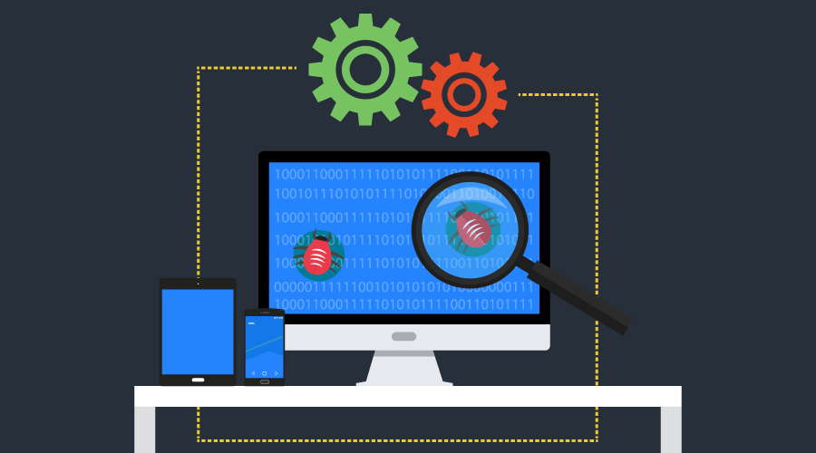
THANK YOU!

