Slide 1
LabVault
Laboratory Equipment Lifecycle & Maintenance Platform
Complete Project Presentation (Assignments 1 & 2 Combined)
What is LabVault?
A modern web application for universities and research labs to track equipment, approve student loan requests, log maintenance repairs, schedule calibrations, and send automated email alerts.
Tech Stack: Next.js 14 App Router | TypeScript | PostgreSQL + Prisma ORM | Faker.js | Resend & React Email | RBAC

Slide 2
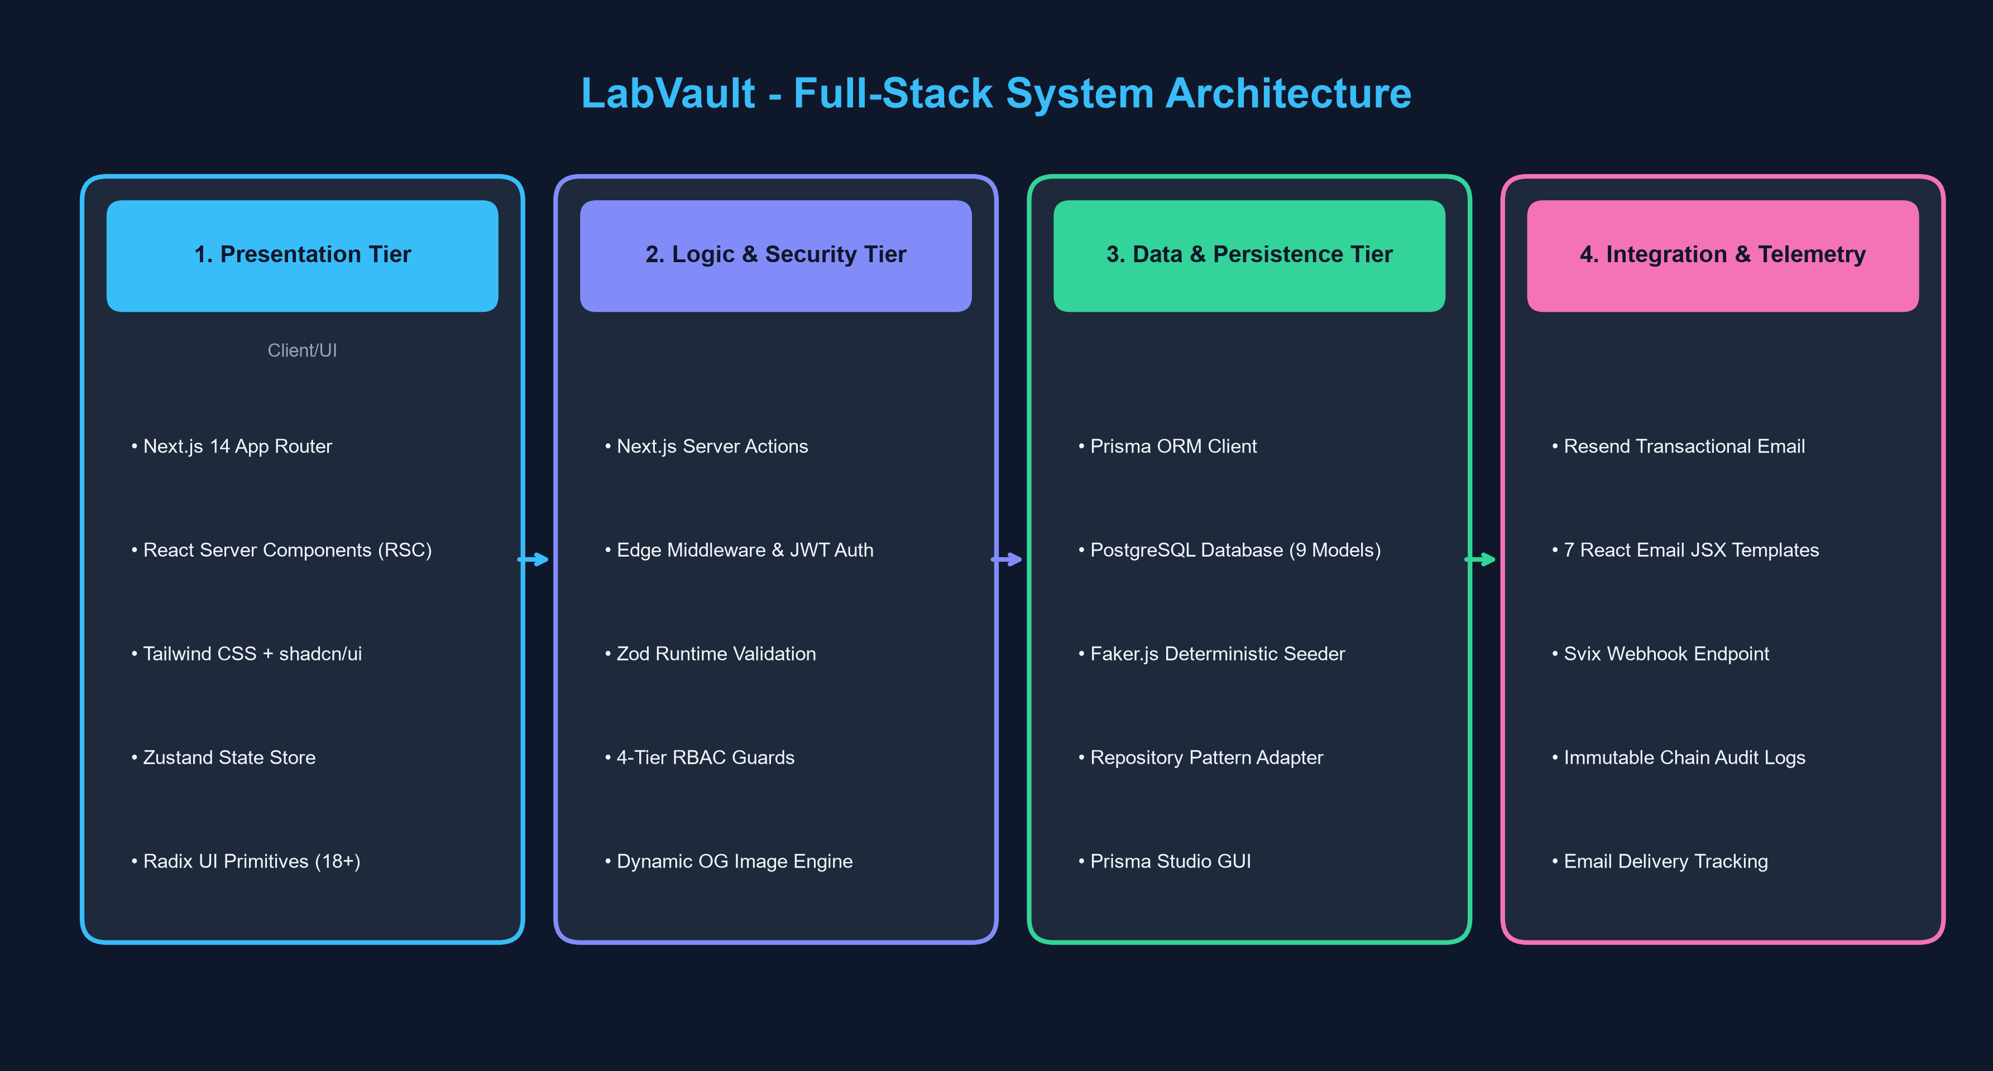
System Architecture & Core Technology Stack
Architecture Highlights
• Presentation (Frontend):
Next.js 14 App Router, React Server Components (RSC), Tailwind CSS, shadcn/ui, and Radix UI primitives.
• Logic & State:
Server Actions for safe database changes, Zustand for instant client role switching, Zod for validation.
• Persistence (Backend):
PostgreSQL database managed by Prisma ORM with 9 relational models and 30+ indexes.
• Email & Notifications:
Resend API with 7 React Email templates, plus Svix webhooks for real-time delivery tracking.

Slide 3
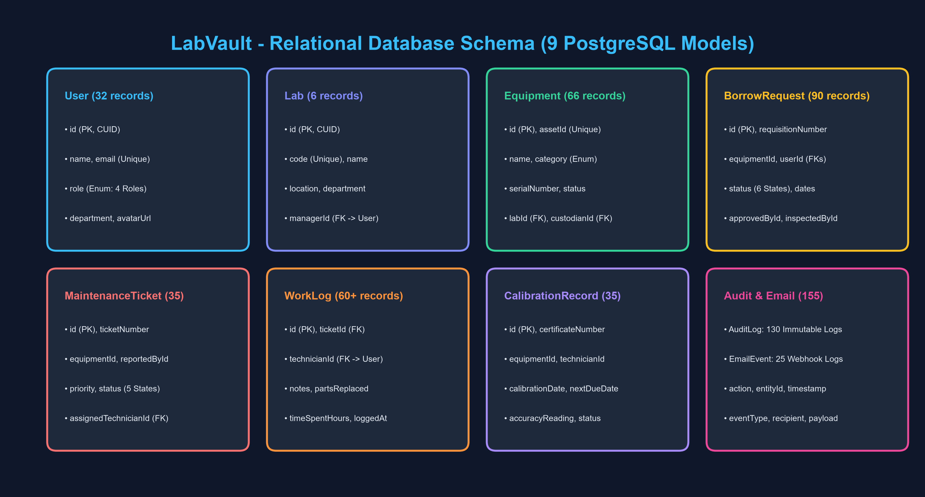
Relational Database (Prisma) & Faker.js Seeding (Topic 4)
Database & Seeding Summary
• 9 Relational Tables:
Users, Labs, Equipment, Borrow Requests, Maintenance Tickets, Work Logs, Calibrations, Audit Logs, Email Events.
• Reproducible Seeding:
faker.seed(123456) generates exact realistic data every time using 'npm run db:seed'.
• Populated Academic Data:
32 multi-role users, 6 labs, 66 equipment items, 90 borrow requests, 35 work orders, 130 audit events.
• Visual Management:
Prisma Studio runs locally at http://localhost:5555 for instant web-based database browsing.

Slide 4
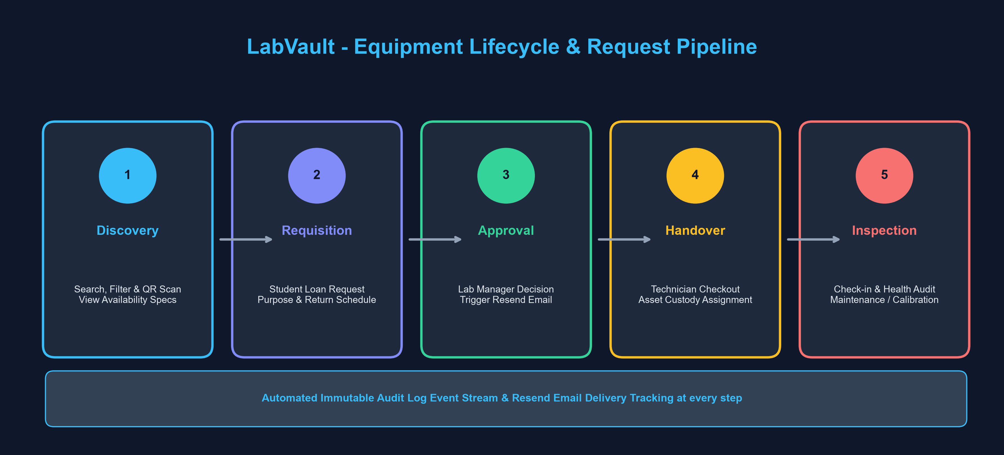
Equipment Lifecycle Workflow & Resend Email (Topic 5)
7 React Email Templates
• Borrow Approved & Rejected notifications
• 24-Hour Return Due reminders
• Maintenance assigned & completed
• Calibration warning & Critical failures
Resend SDK & Webhook
• Pre-built JSX email design system
• Local simulation mode for development
• Svix cryptographic webhook security
• Sent, Delivered & Bounced tracking
4-Tier Security (RBAC)
• Student: Search catalog & request loans
• Technician: Checkouts, logs, calibrations
• Lab Manager: Approvals & ticket assignments
• Admin: Full audit log & system settings

Slide 5
Project Verification, Quality & Submission Summary
Build & Type Safety
• next build: Exit Code 0 (13 static pages, 8 APIs)
• tsc --noEmit: 0 TypeScript errors across codebase
• Edge Middleware (32.5 kB) for fast role security
• Lightweight bundles (< 95 kB initial client JS)
Complete Problem Solved
• Eliminates paper logs and lost lab equipment
• Transparent real-time chain-of-custody tracking
• Automatic email reminders prevent late returns
• ISO-17025 calibration tracking ensures safety
How to Test & Run
• 1. Database: PostgreSQL running on port 5432
• 2. Migrate: npx prisma migrate dev --name init
• 3. Seed: npm run db:seed (Faker.js)
• 4. Start: npm run dev -> http://localhost:3000
• 5. Database GUI: npx prisma studio (port 5555)

