Slide 1

WebSocket

Slide 2
WebSocket :
WebSocket is a communication protocol that provides full-duplex, bidirectional communication channels over a single TCP connection. It is commonly used for real-time web applications, enabling the server and the client to exchange data in a low-latency and efficient manner. In Python, you can work with WebSockets using various libraries. One popular library for WebSocket communication in Python is websockets.

Slide 3
It was standardized in RFC 6455 and is designed to overcome some of the limitations of traditional HTTP communication.

Slide 4
Characteristics and
Features of WebSocket :

Slide 5
Full-Duplex Communication :
WebSocket allows both the client and server to send data to each other independently, in a full-duplex manner. This means they can send and receive data simultaneously, making it ideal for real-time communication.

Slide 6
Low latency :
WebSocket is well-suited for applications that require low-latency communication, such as online games, chat applications, and live data updates. The connection is persistent, reducing the overhead of establishing new connections for each exchange.

Slide 7
Efficient :
Unlike traditional HTTP, WebSocket does not require a new connection to be established for each data exchange. This reduces the overhead of handshaking and headers, making it more efficient for small, frequent messages.

Slide 8
Simple Handshake :
WebSocket uses a simple handshake process to establish the connection. This handshake is similar to an HTTP upgrade request and response, and it allows the server and client to agree to switch to the WebSocket protocol.

Slide 9
Standardised Protocol :
WebSocket is a standardized protocol, and it has client and server libraries available for various programming languages. This makes it easy to implement WebSocket communication in applications.

Slide 10
Message-Based :
WebSocket operates in a message-based model, allowing data to be sent and received in discrete units (messages). This simplifies data framing and handling for applications.

Slide 11
Bidirectional :
WebSocket can be used for bidirectional communication, meaning that both the server and client can initiate data exchanges at any time. This enables interactive applications where the server can push updates to the client as soon as they are available.

Slide 12
Secure :
WebSocket can use the same security mechanisms as HTTPS, including TLS/SSL encryption, to secure the communication.

Slide 13
Versatility :
WebSocket is not tied to a specific application domain and can be used in a wide range of applications, including web applications, online games, financial platforms, IoT, chat applications, and more.

Slide 14
websockets :
websockets is a library for building WebSocket servers and clients in Python with a focus on correctness, simplicity, robustness, and performance.

Slide 15
Installation :
You can install the websockets library using pip:
pip install websockets

Slide 16
Lets understand by an example
Client :
https://github.com/Tirth-v/pyLearnings/blob/3fdea9e13d56b0150fc99f2ca8bc9de47f2d383c/WebSocket/client.py
Server:
https://github.com/Tirth-v/pyLearnings/blob/3fdea9e13d56b0150fc99f2ca8bc9de47f2d383c/WebSocket/server.py

Slide 17
Asyncio :
asyncio is a Python library that provides support for asynchronous programming. It allows you to write concurrent code using asynchronous I/O operations, coroutines, and event loops. Asynchronous programming is a technique used to handle I/O-bound and high-concurrency operations without blocking the execution of the program. This can be particularly useful for building scalable and responsive network services, web applications, and other tasks where you want to perform multiple operations concurrently without waiting for each one to complete before starting the next.

Slide 18
Key components of asyncio include:
Event Loop
Coroutines
Tasks
Futures

Slide 19
Event Loop :
The event loop is the core of asyncio. It manages and schedules asynchronous tasks, ensuring they run concurrently and efficiently without blocking the program. The event loop can manage I/O operations, timers, and other asynchronous tasks.

Slide 20
Coroutines :
Coroutines are functions that can yield control back to the event loop, allowing other tasks to run in the meantime. They are defined using the async and await keywords. Coroutines can be paused and resumed, making them suitable for handling I/O-bound operations without blocking.

Slide 21
Tasks :
In asyncio, tasks are used to manage and schedule coroutines for execution within the event loop. You can create tasks to run coroutines concurrently.

Slide 22
Futures :
Futures are objects that represent the result of an asynchronous operation. They allow you to obtain the result of a coroutine or an asynchronous function once it's complete.

Slide 23
asyncio is commonly used for building asynchronous network servers, web frameworks, and any application where handling many I/O operations efficiently is critical. It is especially useful in cases where waiting for I/O operations to complete can lead to significant performance bottlenecks.

Slide 24
Coroutines :
A coroutine is a specialized version of a Python function that allows for cooperative multitasking, also known as concurrency. Coroutines are used for asynchronous programming and are defined using the async and await keywords. They are a fundamental concept in Python asyncio library and are commonly employed for handling I/O-bound operations without blocking the execution of a program.

Slide 25
Async function :
Coroutines are defined as asynchronous functions using the async keyword before the def keyword. For example:
async def my_coroutine():

Slide 26
Await keyword :
Inside a coroutine, you can use the await keyword to yield control back to the event loop, allowing other tasks to run while waiting for asynchronous I/O operations to complete. For example, you can use await with functions that perform I/O operations like file reading, network communication, or database queries.

Slide 27
Non-blocking:
Coroutines are non-blocking, which means they don't stop the entire program's execution when waiting for I/O or other tasks. They can be paused and resumed, allowing multiple coroutines to run concurrently within the same event loop.

Slide 28
Example :
import asyncio
async def greet(name):
print(f"Hello, {name}!")
await asyncio.sleep(1)
print(f"Goodbye, {name}!")
async def main():
await greet("Alice")
await greet("Bob")
asyncio.run(main())

Slide 29
In this example, the greet coroutine uses await to pause execution during the asyncio.sleep call, allowing other tasks to run concurrently. The main coroutine sequentially awaits two greet calls, resulting in interleaved output as both greetings and farewells are printed.
Coroutines are a powerful tool for handling concurrency and asynchronous programming in Python. They are commonly used in scenarios where you want to efficiently manage I/O-bound tasks, such as network requests, database queries, or reading/writing files, without blocking the entire program.

Slide 30
Use-case of WebSocket :
WebSocket is a communication protocol that allows bidirectional, real-time data exchange between a client and a server over a single, long-lived connection. WebSocket is commonly used in various applications, and Python provides libraries like websockets and websockets-client to work with WebSocket communications. Here are some common use cases for WebSocket in Python:

Slide 31
Real-Time Chat Application :
WebSocket is often used to build real-time chat applications, where users can exchange messages and receive updates instantly. WebSocket allows for efficient communication between clients and the chat server without the need for constant polling.

Slide 32
Online Gaming :
Multiplayer online games often use WebSocket for real-time game updates, player interactions, and data synchronization. This enables fast and responsive gameplay experiences.

Slide 33
Live Updates and Notifications :
WebSocket can be used to push real-time updates and notifications to clients, such as social media notifications, news updates, or live sports scores.

Slide 34
Collaborative Tools :
Applications that require real-time collaboration, like collaborative document editing, project management, or code collaboration platforms, can benefit from WebSocket for instant updates across users.

Slide 35
Financial Dashboards :
WebSocket is used in financial applications to provide real-time stock market data, currency exchange rates, and trading updates.

Slide 36
IoT :
WebSocket can be used to collect and transmit real-time data from IoT devices to a central server or between devices in an IoT network.

Slide 37
Remote Control and Monitoring :
WebSocket can facilitate real-time remote control and monitoring of devices, such as remote desktop applications or home automation systems.

Slide 38
Live Streaming and Webinars :
WebSocket can be used to support live streaming, webinars, and video conferencing, allowing for real-time interactions and updates between presenters and participants.

Slide 39
Distributed Systems :
WebSocket can be used as a communication channel between microservices or components in distributed systems to exchange data and status updates.

Slide 40
Monitoring and Logging :
WebSocket can be employed for real-time monitoring and logging of system events, errors, and performance metrics.

Slide 41
Dashboard and Control Panel :
Web-based dashboards and control panels that display real-time data, such as system health, server statistics, or traffic analytics, can use WebSocket to keep data up to date.

Slide 42
Live-Sports Updates :
Sports-related applications use WebSocket to deliver real-time scores, updates, and commentary to fans during live games and events.

Slide 43
How to use :
To use WebSockets in Python, you can use the websockets library, which provides a straightforward way to create WebSocket servers and clients. Here's a step-by-step guide on how to use websockets to set up a simple WebSocket server and client:

Slide 44
Creating a websocket server :
To create a WebSocket server, you need to define a coroutine function that will handle incoming WebSocket connections.

Slide 45
Creating a WebSocket client :
You can create a WebSocket client to connect to the server you just created.
This WebSocket client connects to the server, sends messages, and receives responses.

Slide 46
Running the server and client :
First, start the WebSocket server in one terminal.
Then, run the WebSocket client in another terminal.
Enter messages in the client to send to the server, and you will see the server echoing them back.

Slide 47
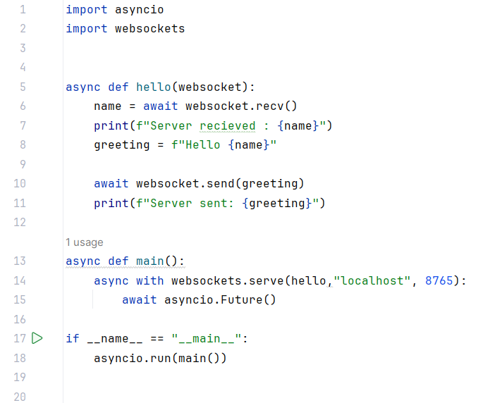
Server :

Slide 48
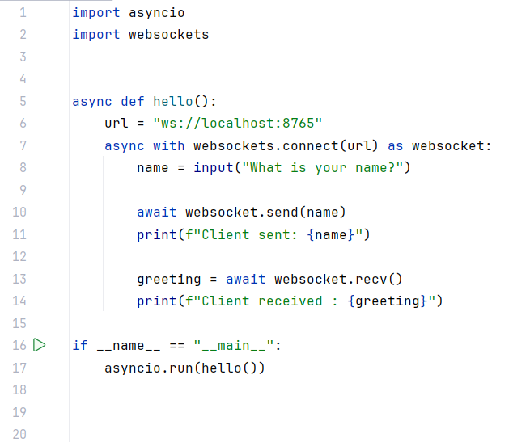
Client :

Slide 49
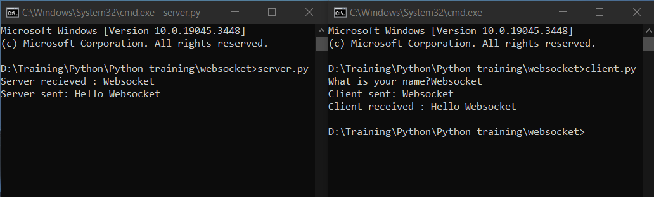
Output :

Slide 50
Thank You

