Slide 1

Explainable AI–Driven Feature Engineering Framework for Accurate Detection of False Data Injection Attacks in Smart Grids
Under the guidance of Dr. Kshirasagar Naik, Dr. Marzia Zaman,
Dr. Darshana Upadhyay​
Date : 26th March 2026
Tirth Patel,21176699​ Meng ECE.​

Slide 2

OUTLINE
Introduction
Objectives
Literature Survey
Dataset
Conclusion and Future Work
Experiments
Experimental Results
Challenges

Slide 3
INTRODUCTION

Slide 4
​
Smart grids rely on SCADA systems for real-time monitoring of power systems.
These systems collect large volumes of sensor data such as voltage, current, and phase angle.
Due to their critical nature, smart grids are vulnerable to cyber-attacks.
One major attack is False Data Injection (FDI), where attackers manipulate sensor readings.
Machine learning can help detect such attacks by learning hidden patterns in the data.
INTRODUCTION

Slide 5
FDI Attack Impact
Sensor Data
Attacker Inject False Data
Control Center
Wrong Decision
System Blackout
​

Slide 6
Traditional detection methods rely on fixed rules and thresholds
These methods fail against stealthy and intelligent attacks
Machine Learning Provides:
Ability to learn hidden patterns from large SCADA datasets
Detection of subtle anomalies that are not visible to humans
Capability to identify previously unseen attack behaviors
Scalability to handle high-dimensional sensor data
Why Machine Learning For FDI Detection
​

Slide 7
Need For Improvement
High Feature Dimensionality
SCADA systems generate large numbers of features
Many features are redundant or highly correlated
Lack of Explainability
Most models act as black boxes
Difficult to understand which features influence decisions
Lack of Optimization
No systematic way to select optimal feature subset
Models may use unnecessary features
Increases computational cost and model complexity
Limits trust in real-world deployment
Leads to inefficiency without performance gain
​

Slide 8
INTRODUCTION
Problem: Machine learning models often work like a “black box,” meaning we don’t clearly understand how they make decisions. This becomes a problem when we need to trust the model, especially in critical applications.
Limitations: Traditional models focus mainly on accuracy but ignore explainability, so we don’t know which features actually matter. Feature selection methods like WFI or SHAP individually may miss important relationships between features.
Solution: Using explainable and data-driven techniques can help identify key features and their relationships. This can improve both model performance and interpretability for better decision-making.
8

Slide 9
Key Challenges in Detecting FDI Attacks
Black-Box Models
More feature Higher risk of overfitting and noise
Traditional methods fail to capture relationships between features.
Ignored Feature Interactions
Redundant & Correlated Features
Many SCADA features carry similar information, increasing redundancy.
High Dimensional Scada Data
Models lack transparency, making it difficult to understand decision-making.

Slide 10
OBJECTIVES
10

Slide 11
Objectives
Develop an effective machine-learning framework to detect False Data Injection (FDI) attacks in smart-grid systems
Identify and rank important features using explainable methods such as SHAP and Random Forest–based Weighted Feature Importance (WFI).
Select the most relevant subset of features by analyzing common features between SHAP and WFI rankings.
Derive new features using correlation-based techniques (PCC) to capture relationships between important features.
Train and evaluate a Random Forest model using selected and derived features for accurate attack detection.
11

Slide 12
Primary Objectives
Detect FDI attacks with high accuracy
Improve model efficiency for faster detection
Reduce number of features to remove redundancy
12

Slide 13
Advanced Objectives
Use SHAP to explain model decisions
Compare SHAP and WFI methods
Find optimal number of features
13

Slide 14
Extended Goals
Remove correlated features using correlation pruning
Create new features using feature interactions.
Improve model robustness and reliability
14

Slide 15
LITERATURE SURVEY
15

Slide 16
Ref No. | Paper Title | Year | Dataset | Methodology | Results
[1] | A Hybrid Explainable AI for DDoS Attacks Detection in Industrial IoT Networks | 2026 | HL-IoT ToN-IoT Edge-IIoTSet | Developed a hybrid XAI-based framework combining SHAP and LIME for feature selection, followed by a feedforward DNN and SHAP-based neuron pruning to detect DDoS attacks in IIoT networks. | Achieved over 94% accuracy while reducing model complexity and improving computational efficiency through pruning.
[2] | Efficient XAI-Based Federated Learning Approach for Accurate Detection of False Data in Smart Grid | 2025 | Irish Smart Energy Trial (ISET) Pakistan Residential Electricity Consumption | Proposed an XAI-driven federated learning model trained on explanation-based features instead of raw data to improve false data detection while reducing communication overhead | Improved detection accuracy by over 14%, reduced false alarms by 82%, and decreased communication rounds by more than 80%.
[3] | Explainable AI-Enhanced Detection of Cyber Attacks on AGC Systems with Varying RES Penetration | 2025 | Simulated AGC system data | Evaluated multiple ML models including CNN and Bagged Trees on AGC system data under varying renewable energy penetration, with SHAP used for interpretability. | CNN achieved the highest detection performance, followed by Bagged Trees, with strong accuracy and improved model transparency using SHAP.
[4] | Explainable Ensemble-Based Detection of Cyber Attacks on Internet of Medical Things | 2023 | WUSTL-EHMS-2020 | Built a voting ensemble model combining RF, DT, SVM, and XGBoost using network-flow features, with SHAP applied for explainability in IoMT attack detection. | Achieved over 99% accuracy and F1-score, demonstrating highly effective and reliable intrusion detection.
[5] | Explainable Machine Learning-based False Data Injection Classification Framework for AVs | 2025 | IIoT-based dataset | Used an unsupervised autoencoder framework to learn normal microgrid patterns via reconstruction error. Integrated into a real-time web platform for anomaly detection and alerts. | Random Forest achieved the highest performance with approximately 99% accuracy and improved explainability.
16

Slide 17
DATASETS
17

Slide 18
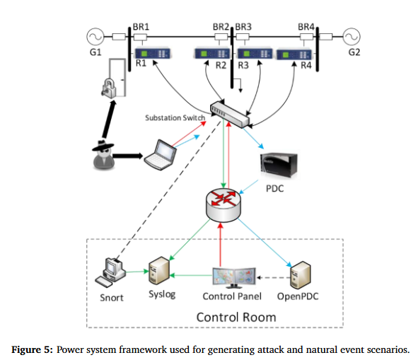
ORNL :
Descriptions: High-resolution SCADA telemetry containing voltage, current, and phase-angle measurements
Size: 117 columns, 13141 measurements (10,513 Train, 2628 Test)
Preprocessing: Normalized to [0,1] ; statistical features (mean, variance, skewness, kurtosis) computed for hybrid feature-engineering.
18

Slide 19
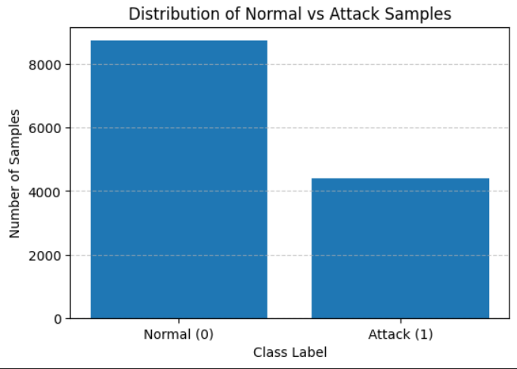
ORNL :
Feature Types:
Voltage
Current
Phase Angle
Grid Region : R1, R2, R3, R4
Labels:
Normal(0)
Attack (1)
19

Slide 20
Experiments
20

Slide 21
Experiments
Experiment 1: Baseline model using all features
Experiment 2: SHAP-based feature reduction
Experiment 3: Cross-validation for model reliability
Experiment 4: Correlation-based feature pruning
Experiment 5: Optimal feature count detection
Experiment 6: SHAP vs WFI comparison
Experiment 7: Derived feature generation (feature interactions)
Final: Key Insight from Experiments
2026-03-26
21

Slide 22
Experiment 1: Baseline Model
Train Random Forest model using all available features (116)
No feature selection or optimization applied
Establish baseline performance for comparison
Acts as reference for all further experiments
2026-03-26
22

Slide 23
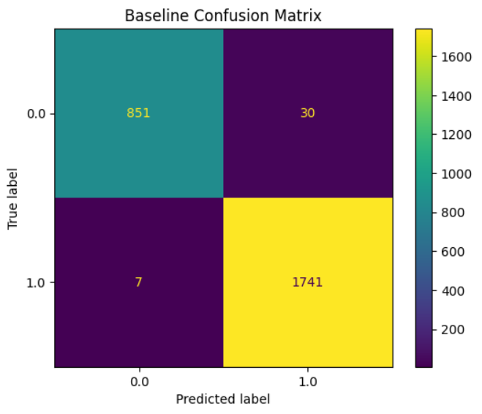
Experiment 1: Baseline Model
Accuracy: 98.59%
F1-Score: 98.94%
ROC-AUC: 0.9983
Precision: 0.9836
Recall: 0.9954
Disadvantage
High performance but uses all features
May include redundant and unnecessary features
2026-03-26
23

Slide 24

Experiment 2 — SHAP Feature Reduction
Why SHAP (SHapley Additive exPlanations) ?
Baseline model uses all 116 features.
Many features may be redundant or irrelevant
Need to identify most important features
SHAP (SHapley Additive exPlanations):
Explains model decisions
Assigns importance to each feature
2026-03-26
24

Slide 25
Experiment 2 — SHAP Feature Reduction
How I used SHAP ?
Compute SHAP values using trained Random Forest
Rank features based on importance
Select top features:
10, 20, 30, 40, 60
Train model using reduced feature sets
Compare performance with baseline
Num of features | Accuracy | F1-Score | ROC_AUC
10 | 0.944 | 0.944 | 0.984
20 | 0.956 | 0.956 | 0.990
30 | 0.977 | 0.977 | 0.996
40 | 0.980 | 0.980 | 0.997
60 | 0.983 | 0.983 | 0.997
2026-03-26
25

Slide 26
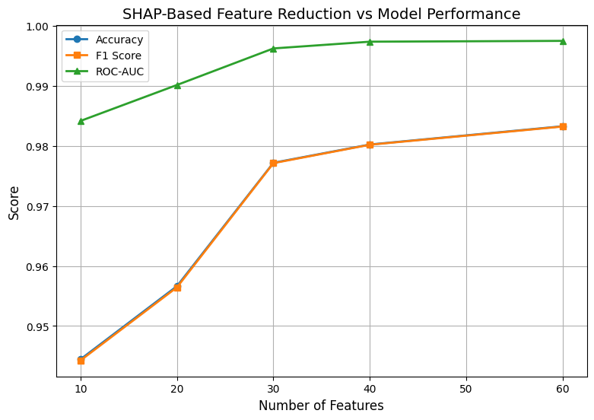
Experiment 2 — Results
Performance improves significantly up to ~30–40 features
After 40 features, improvement becomes minimal
Using only 40 features achieves near-baseline performance
2026-03-26
26

Slide 27
Experiment 3 — Cross Validation
Why Cross Validation?
Previous results are based on a single train-test split
Performance may vary depending on data split
Need to ensure results are reliable and consistent
Use 5-Fold Stratified Cross Validation:
Data split into 5 parts
Each part used as test once
Average performance is computed
Fold 1
Fold 2
Fold 3
Fold 4
Fold 5
2026-03-26
27

Slide 28
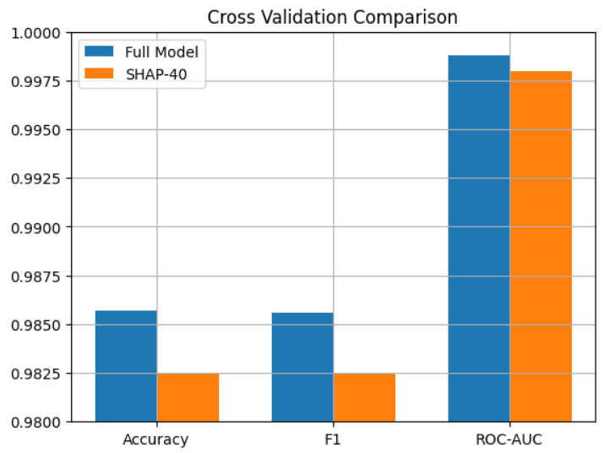
Experiment 3 — Results
1. Full Model (116 Features)
Accuracy: 98.57% ± 0.27%
F1 Score: 98.56% ± 0.27%
ROC-AUC: 0.9988 ± 0.0003
2. SHAP Top-40 Model
Accuracy: 98.25% ± 0.24%
F1 Score: 98.25% ± 0.24%
ROC-AUC: 0.9980 ± 0.0004
2026-03-26
28

Slide 29
Experiment 4 — Correlation Pruning
Many SCADA features are highly correlated
Correlated features carry similar information
Leads to redundancy and unnecessary complexity
Idea:
Identify highly correlated features (> 0.9)
Remove redundant features
Retain only unique information
2026-03-26
29

Slide 30
Experiment 4 — Correlation Analysis
Found 454 highly correlated feature pairs (> 0.9)
Indicates significant redundancy in SCADA data
Feature reduction:
Original features: 116
After pruning: 51
Removed features: 65
2026-03-26
30

Slide 31
Experiment 4 — Results
Large number of correlated features removed Indicates significant redundancy in SCADA data
Feature count reduced significantly
Performance:
Accuracy: 97.66% ± 0.32%
F1 Score: 97.65% ± 0.32%
ROC-AUC: 0.9974 ± 0.0008
Slight drop in performance observed
2026-03-26
31

Slide 32
Experiment 5 — Optimal Feature Count
Previous experiments show performance improves with more features
However, after a point, improvement becomes minimal
Problem:
How many features are actually needed?
Idea:
Rank features using SHAP importance
Select top-k features (k = 5 to 100)
Train model for each feature subset
Evaluate performance using ROC-AUC
Compute improvement between consecutive feature sizes
Identify point where improvement becomes negligible
Extends SHAP analysis by automatically identifying optimal feature count
2026-03-26
32

Slide 33
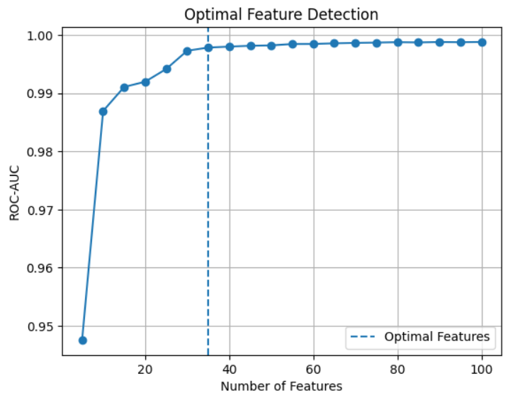
Experiment 5 — Results
Performance increases rapidly up to ~30–40 features
After that, improvement becomes very small
Optimal number of features: 35
Using more features does not significantly improve performance
2026-03-26
33

Slide 34
Experiment 6 — SHAP vs WFI
Multiple feature selection methods exist
Need to identify the most effective approach
Methods compared:
SHAP (Explainable AI-based)
WFI (Feature Importance from Random Forest)
Goal:
Compare performance and feature selection quality
2026-03-26
34

Slide 35
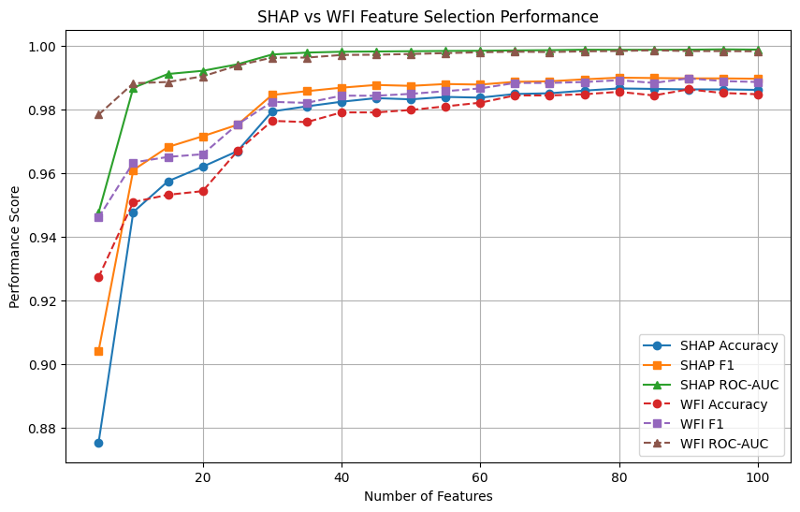
Experiment 6 — Performance Comparison
Both methods improve performance with feature selection
SHAP shows more stable and consistent performance
WFI performance varies more with feature size
2026-03-26
35

Slide 36
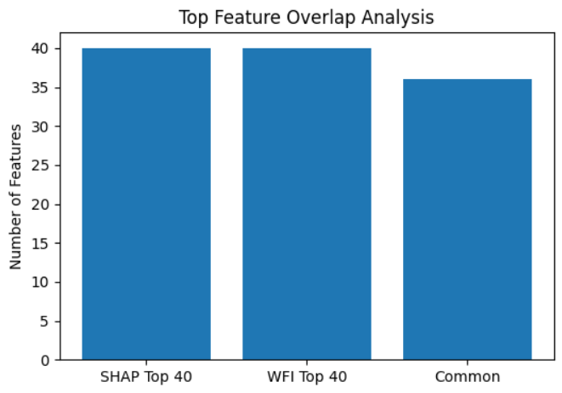
Experiment 6 — Common Feature Intersection
Selected top features from SHAP and WFI
Identified common (overlapping) features
Common features represent:
Strong and reliable predictors
Agreement between both methods
Model trained using common features
Achieved high performance with fewer features
2026-03-26
36

Slide 37
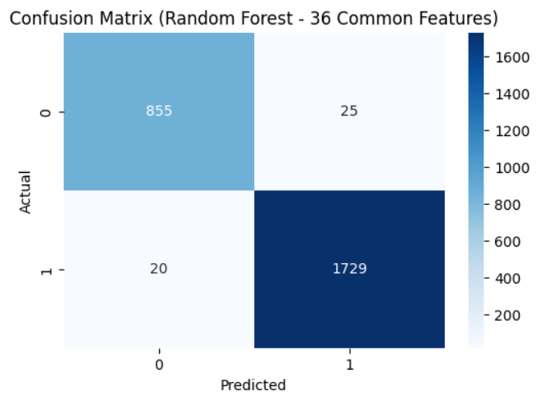
Experiment 6 — Result
SHAP and WFI show high agreement in feature importance rankings
Strong correlation observed between methods (0.95 correlation)
36 common features identified from Top 40 SHAP and Top 40 WFI selections
Model trained on common features achieves 98.28% accuracy
2026-03-26
37

Slide 38
Experiment 7 — Derived Features
Previous methods select important individual features
However, they do not capture relationships between features
In power systems:
Sensor measurements are interdependent
Attacks often affect multiple variables simultaneously
Idea:
Generate new features using interactions between important features
2026-03-26
38

Slide 39
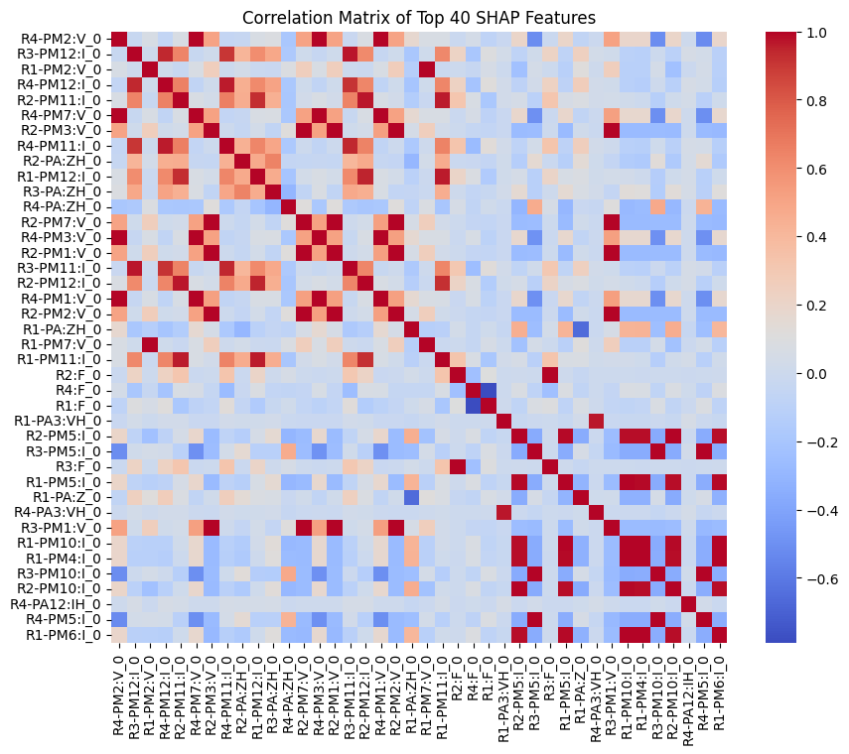
Experiment 7 — Derived Features
Selected Top 40 features using SHAP
Computed correlation between selected features
Identified highly correlated feature pairs
Generated new features using multiplication
New Feature = Feature1 × Feature2
Created multiple derived features from top correlated pairs
2026-03-26
39

Slide 40
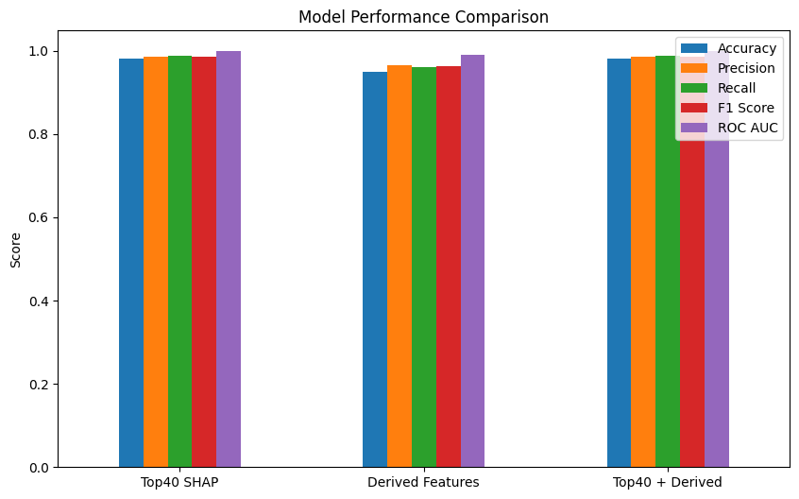
Experiment 7 — Results
Model | Accuracy | F1-Score | ROC-AUC
Top 40 SHAP | 98.21% | 98.65% | 0.9986
Derived Features | 95.01% | 96.24% | 0.9903
Top 40 + Derived | 98.17% | 98.63% | 0.9982
2026-03-26
40

Slide 41
Key Insights from Experiment
Full feature model achieves highest performance but with high complexity
SHAP reduces features significantly with minimal performance loss.
Optimal feature count identified as ~35 features.
Correlation pruning reduces redundancy but slightly impacts performance.
SHAP outperforms WFI in stability and interpretability.
Common features from SHAP and WFI achieve strong performance (98.28% accuracy)
Derived features capture interactions but are most effective when combined with original features
2026-03-26
41

Slide 42
Conclusion & Future Work
42

Slide 43
Conclusion
High detection performance can be achieved without using all available features
Explainable AI (SHAP) enables both accuracy and transparency in decision-making
Feature count was reduced by approximately 65%, significantly improving model efficiency without compromising reliability.
Combining feature selection with feature engineering strengthens model capability
Data-driven approaches provide more robust and generalizable solutions
The proposed framework is effective for securing critical power system infrastructure
43

Slide 44
Future Work
Apply model to real-time streaming data
Test on different power system datasets
Explore deep learning approaches
Improve feature interaction techniques
Deploy system for real-world monitoring
44

Slide 45
Thank You!
45

