Slide 1
+
CLINICAL INTELLIGENCE GATEWAY
A Deterministic, AI-Assisted Triage System for Emergency & Mental Health Care
Multimodal Intake
Deterministic Engine
Role-Based Access
Live Telehealth
Presented by • Project Walkthrough

Slide 2
The Problem
Emergency & psychiatric triage today is slow, fragmented, and inconsistent.
1
Fragmented Intake
2
Inconsistent Decisions
Patient data arrives via chat, voice, phone, and sensors — collected separately, reconciled manually.
Human triage judgment varies by clinician, shift, and fatigue — risking under- or over-triage.
3
No Explainability
4
Disconnected Systems
"Black-box" AI tools give a verdict with no rationale clinicians can trust or audit.
Bed availability, admissions, and staffing live in separate tools, slowing hand-offs.
CLINICAL INTELLIGENCE GATEWAY
2

Slide 3
The Solution
One gateway that ingests every signal, applies deterministic rules, and hands off — with a full audit trail.
1
2
3
4
⌨
⚙
⚠
→
Multimodal Intake
→
Deterministic Engine
→
Decision + Rationale
→
Hand-off & Action
Chat, voice & live sensor telemetry (SpO2, HR)
Rule-based scoring, timestamp reconciliation
LEVEL 1-4 / MH-URGENT with explainable logic
Bed reservation, admission, or AI-assistant chat
Backed by a HIPAA Level 5 architecture with per-decision audit logging.
CLINICAL INTELLIGENCE GATEWAY
3

Slide 4
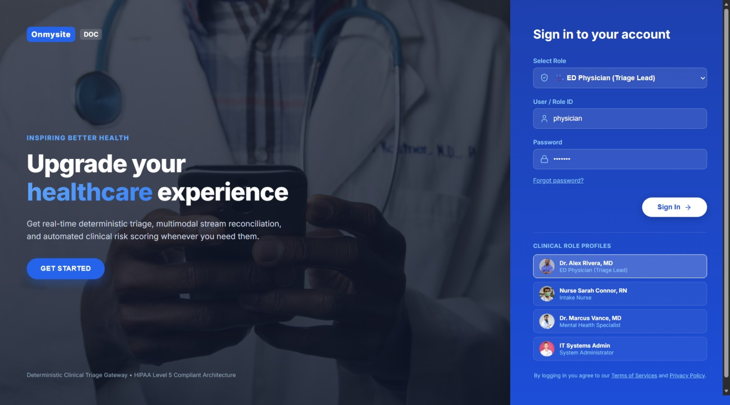
Secure, Role-Based Access
✓
4 Clinical Role Profiles
ED Physician, Intake Nurse, Mental Health Specialist, System Admin.
✓
Tailored Dashboards
Each role sees only the queues and tools relevant to their work.
✓
HIPAA Level 5 Architecture
Security clearance and role privileges shown in every session.
✓
One-Click Role Switching
Clinicians can log out and switch roles without losing context.
CLINICAL INTELLIGENCE GATEWAY
4

Slide 5
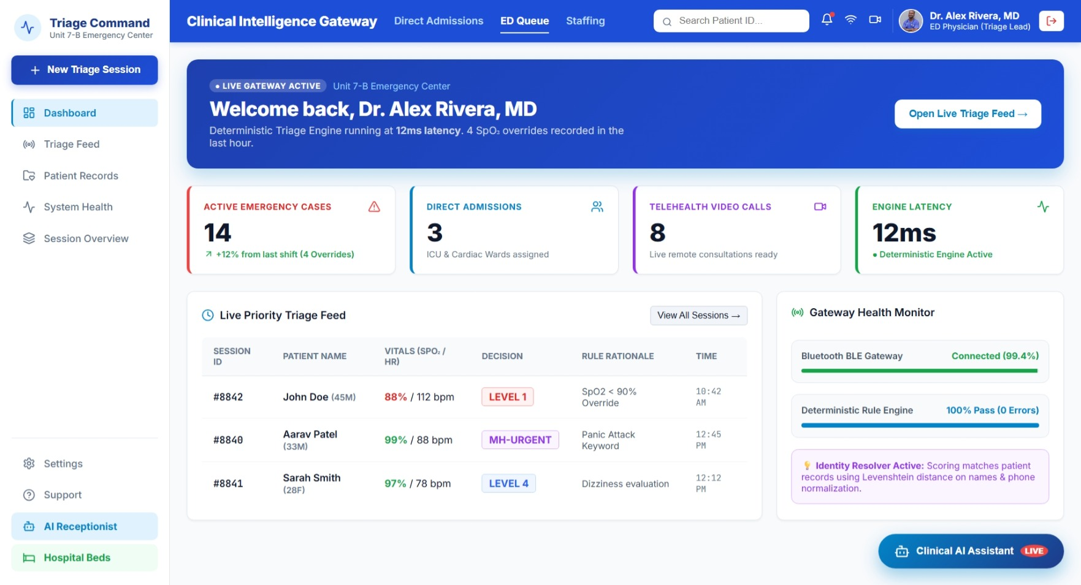
Command Dashboard
A single real-time view of active cases, admissions, telehealth load, and engine health.
14
Active Emergency
Cases
8
Live Telehealth
Calls
12ms
Deterministic Engine
Latency
99.4%
Gateway Connection
Uptime
CLINICAL INTELLIGENCE GATEWAY
5

Slide 6
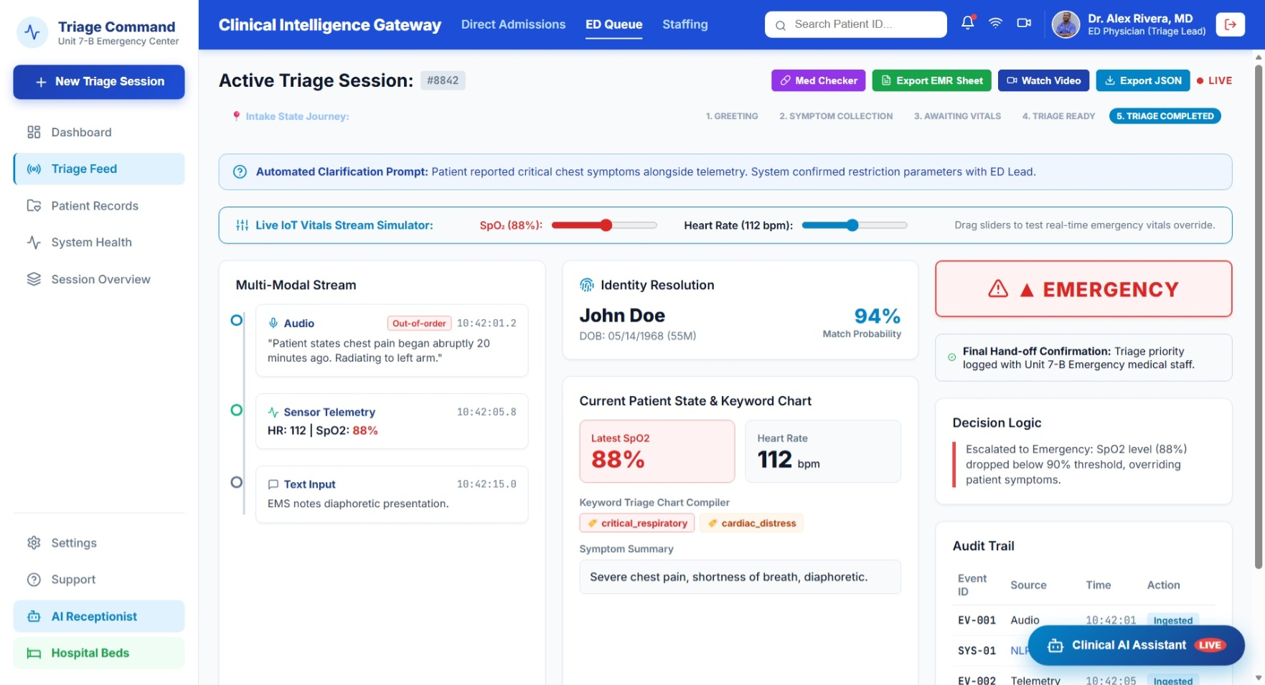
Live Multimodal Triage
✓
3 Input Channels
Text chat, voice audio, and live IoT sensor telemetry (SpO2 / HR).
✓
Out-of-Order Handling
Events are timestamp-reconciled even if audio arrives after telemetry.
✓
Live Vitals Simulator
Drag SpO2 / HR sliders to test real-time emergency override behavior.
✓
Keyword Symptom Tagging
Auto-tags "critical_respiratory", "cardiac_distress", etc. from patient text.
CLINICAL INTELLIGENCE GATEWAY
6

Slide 7
Deterministic Decision Engine
Rules, not guesswork — every escalation traces to a specific, auditable threshold.
Configurable, Not Hardcoded
Example: Live Override in Action
SpO2 Critical Threshold
< 90%
Patient text: “Chest pain 20 mins ago” → suggests Level 3
HR Max Threshold
150 bpm
↓ overridden by ↓
SpO2 = 88% (threshold < 90%) → Escalated to EMERGENCY
Session Timeout
5 min
Every override is written to a timestamped Audit Trail (Event ID, Source, Action) for compliance review.
Engine Determinism
100% (0 errors)
CLINICAL INTELLIGENCE GATEWAY
7

Slide 8
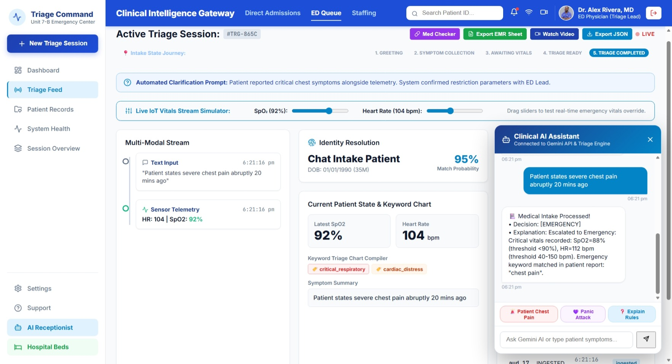
AI Clinical Assistant
The engine explains its own decisions in plain language — keeping clinicians in the loop.
✓
Powered by Gemini API
Connected live to the triage engine's decision output.
✓
Plain-Language Rationale
Explains exactly why a case was escalated, citing vitals & keywords.
✓
Quick-Reply Chips
One-tap prompts: “Patient Chest Pain”, “Panic Attack”, “Explain Rules”.
✓
Human-in-the-Loop
Assistive, not autonomous — clinicians retain final decision authority.
CLINICAL INTELLIGENCE GATEWAY
8

Slide 9
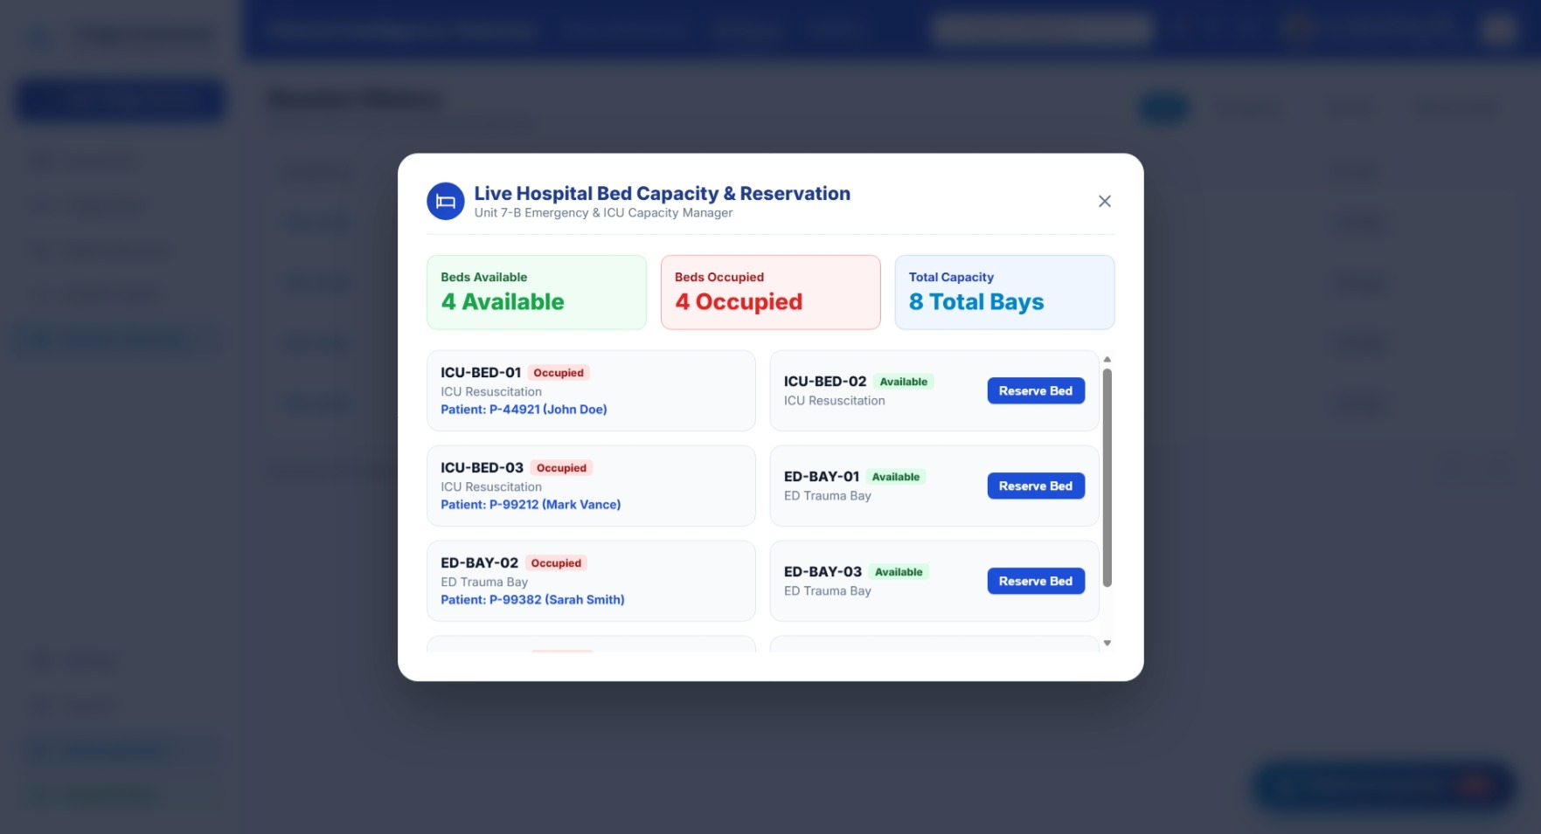
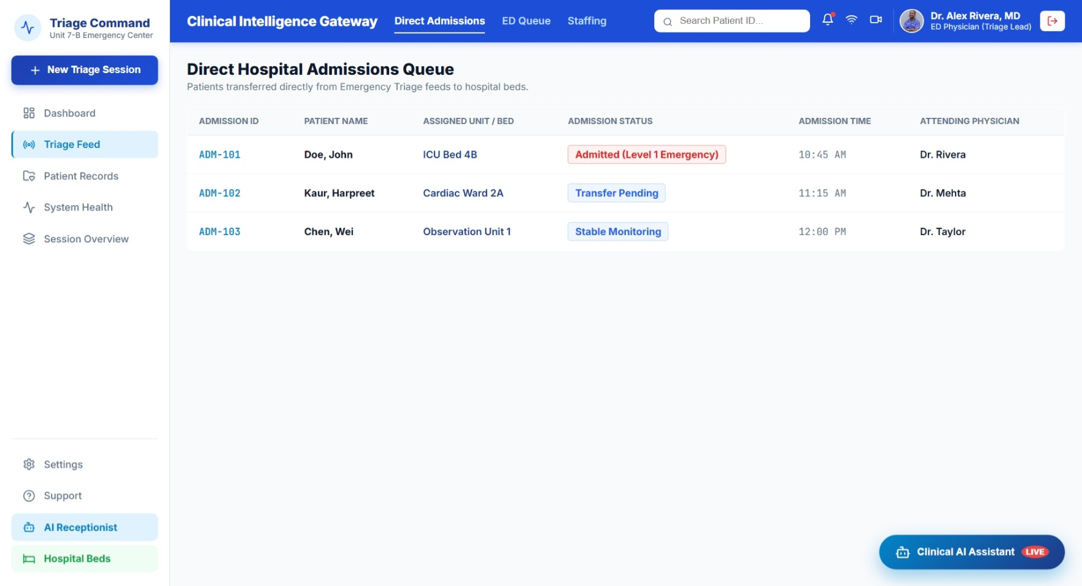
Bed Capacity & Direct Admissions
Triage decisions flow straight into hospital operations — no separate system, no delay.
Live Bed Manager
Direct Admissions Queue
Real-time ICU / ED bay availability with one-click reservation.
Auto-populated from Level-1 triage cases, with attending physician assigned.
CLINICAL INTELLIGENCE GATEWAY
9

Slide 10
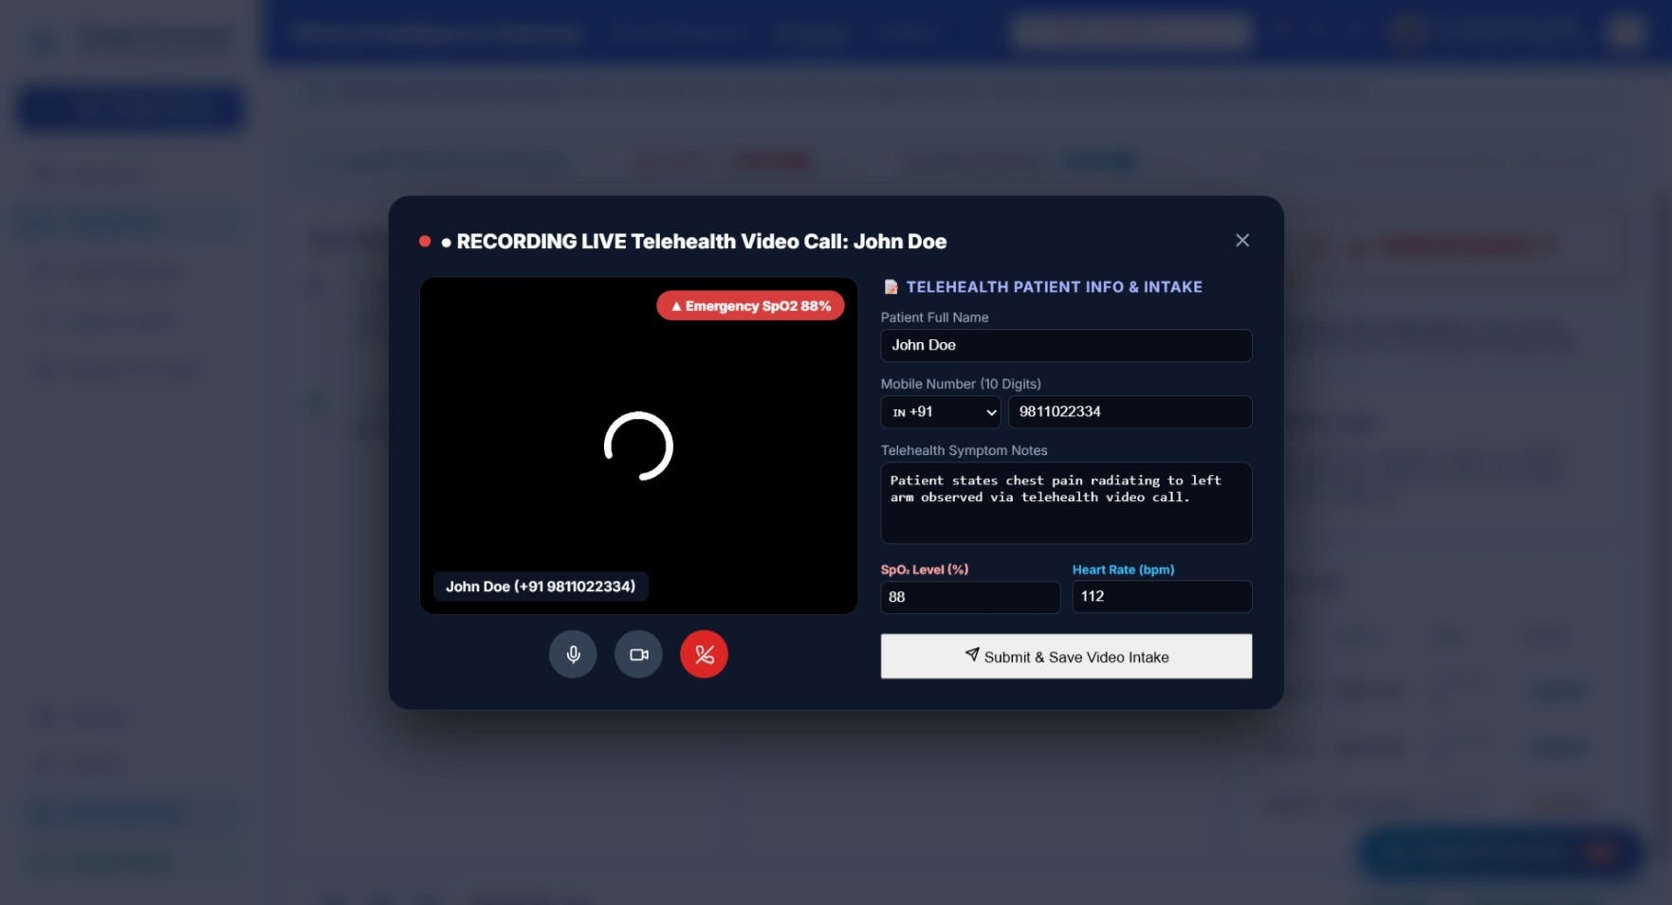
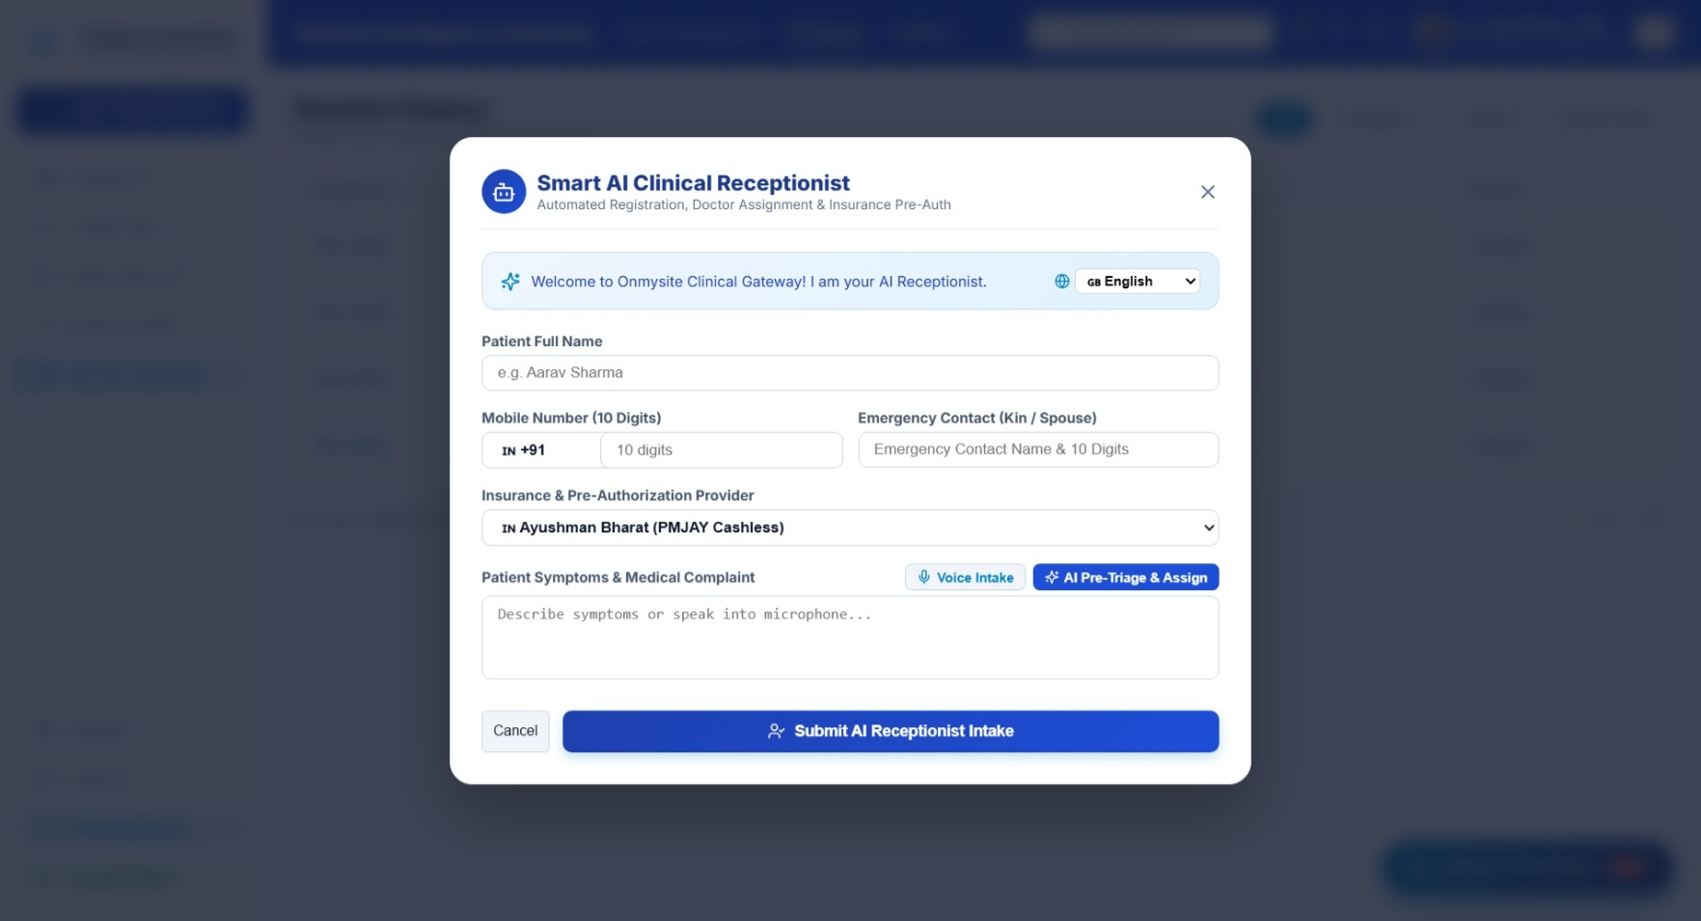
Telehealth & AI Receptionist
Patients can be triaged before they ever reach a human — by video or automated intake.
Live Video Intake
Smart AI Receptionist
Recorded telehealth call with synced vitals & symptom form, feeding the same engine.
Automated registration, insurance pre-auth, voice intake & AI pre-triage assignment.
CLINICAL INTELLIGENCE GATEWAY
10

Slide 11
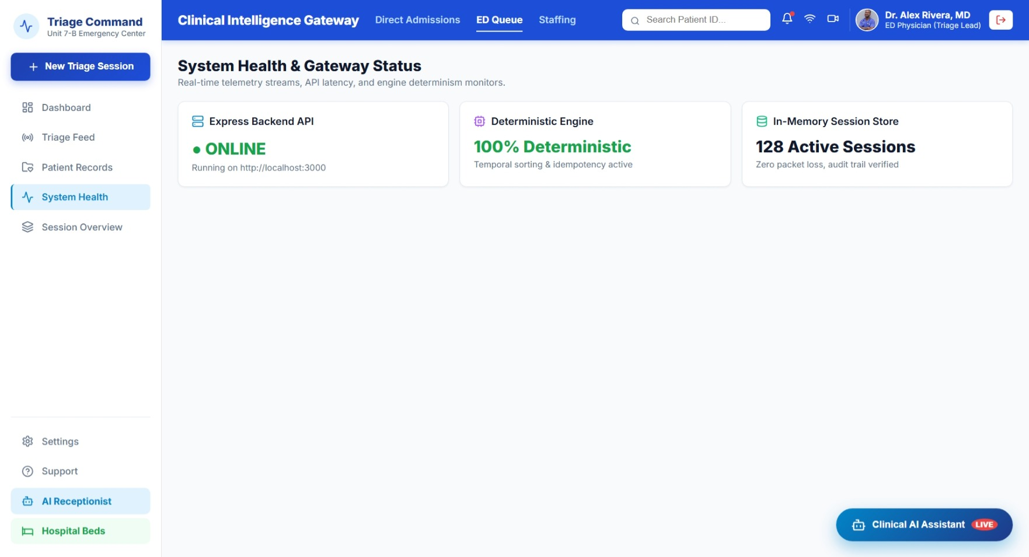
Compliance, Audit & System Health
✓
Express Backend API
Online, real-time WebSocket/HTTP gateway at ~12ms latency.
✓
100% Deterministic Engine
Temporal sorting & idempotency verified — same input, same output.
✓
Zero Packet Loss
In-memory session store with full audit-trail verification.
✓
HIPAA Level 5
Role privileges, security clearance & audit logs on every session.
CLINICAL INTELLIGENCE GATEWAY
11

Slide 12
Built With
React
Node.js / Express
WebSocket Gateway
Gemini API
Deterministic Rule Engine
Google Places / Maps
Thank You
Questions welcome — happy to walk through any workflow live.
+

