Slide 1
DISQUS
UNDER Guidance of :-
Prof. TINAL ma’am
Group No : 30
29 | TIRTH
79 | HENIL
1 | MOHIT

Slide 2
Technology Used :
PHP + MYSQL and PYTHON + MYSQLBENCH (Backend)
HTML5 / CSS3 / JQUERY + AJAX (Frontend)

Slide 3
Abstract
By pronouncing the word “DISQUS“ tell all the thing.
This platform is fully referred from the “Discuss Forum”.
This application is mostly SPA ( Single Page Application ) using AJAX
In this platform you can Disqus or Ask any kind of question which will be shown to the registered users and if other user knows the answer they will reply you back in the comment section you can like the question or bookmark it for your future purpose except this you can even follow the other user in suggested friend list and also see there question and there answers.
As I told you before that this platform is build on two backend technology PHP and Python above description is done with PHP and from Python we have done Web Scrapping from one of the best Python Library called “scrappy.py”. In this platform we have use scrappy in Blog section were we are scrapping the Quotes Website in to the blog page this quotes is specially for the Developer’s.

Slide 4
Description
Starting from the Registration where user will register with [ name , email , phone , password , confirmation password ] and same email or contact are not allowed to register it again
After completing the registration you will able to login and here we provided the 1 year of session expire were user not going to login again after first time
Then after login, page will redirect to the Home page Where there is three columns first one for the “suggestion friends” list view second one “Questioner and answer” app third one is Bookmark List View. In Questioner Section you can like – share – bookmark your question.
Navigation bar include Home – Blog and Profile
In Profile – you will able to see your friends question and there answer able to update your profile and pic and also able to Manage Your Question you can see your question with its answer and also able to delete your question.
Last one is Blog page where you can able to find the best technical quotes fetching from the another website

Slide 5
Advantages
Smooth Performance
SPA (Single Page Application)
Disqus with anyone
Faster Answer

Slide 6
Disadvantage
Currently This platform may not able handle multiple data like if question like 1000 and replies like 500 this occurrence may lead to slower down your physical device or may hang, but this may resolve in future version of this platform

Slide 7
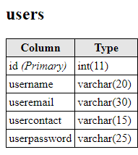
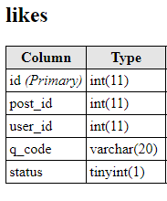
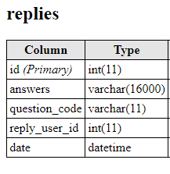
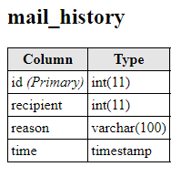
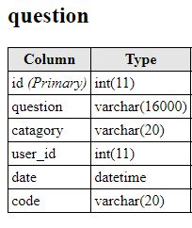
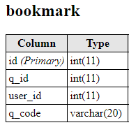
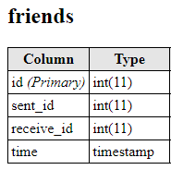
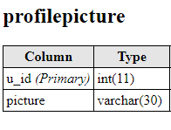
DATA - DICTONARY

Slide 8
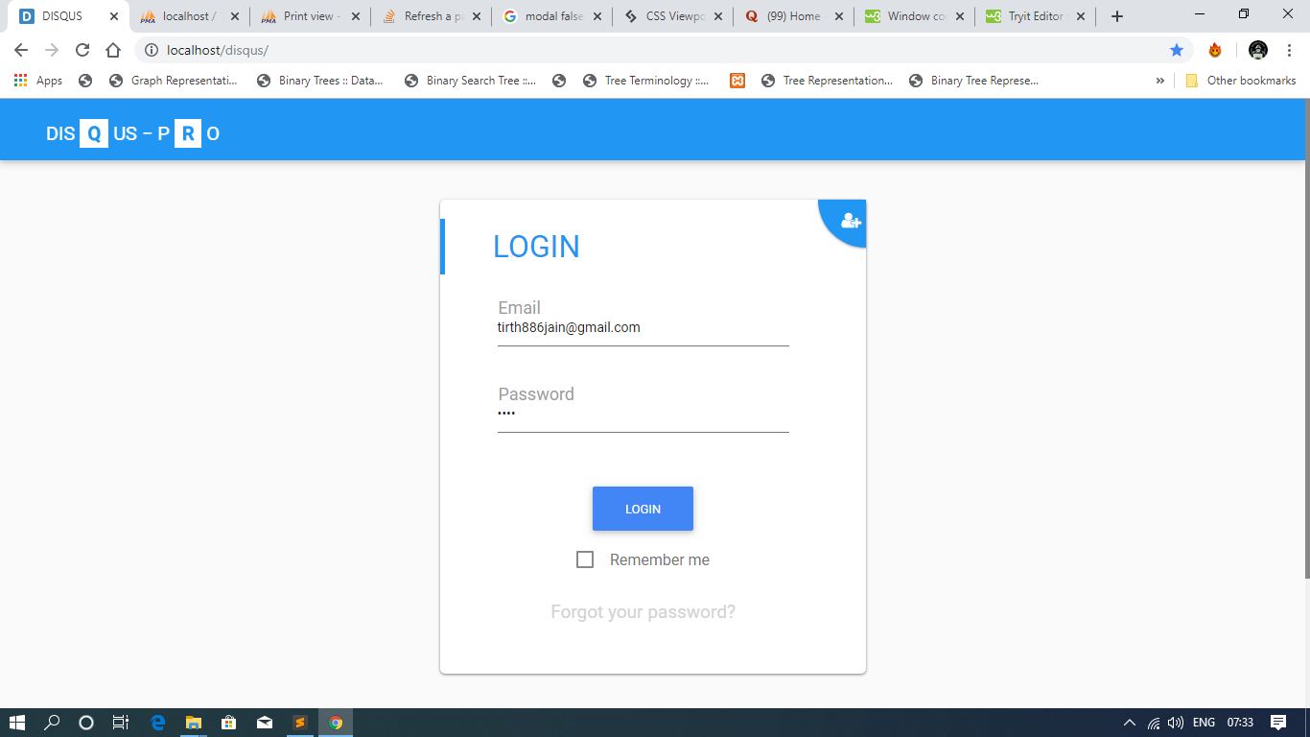
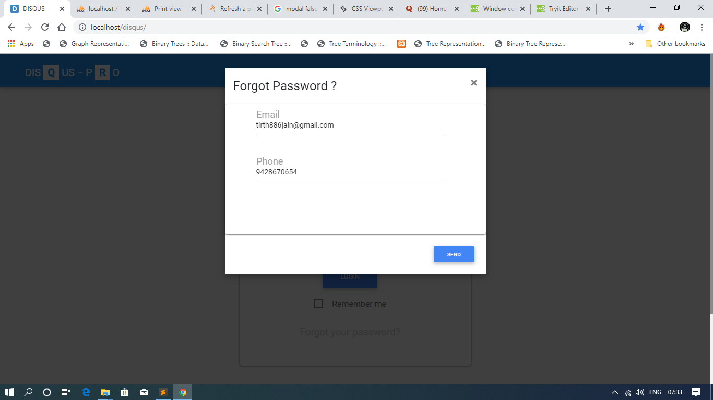
LOGIN PAGE + FORGOT PASSWORD

Slide 9
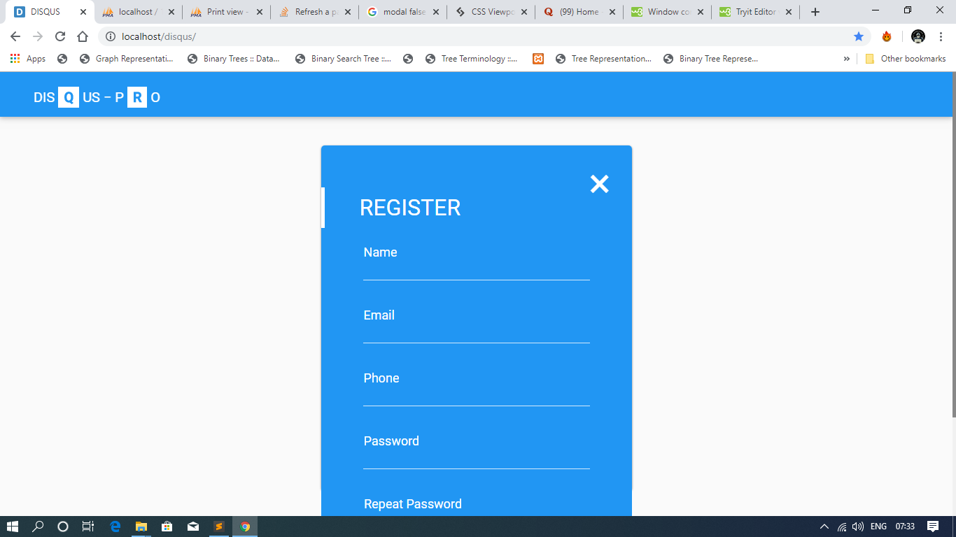
REGISTER PAGE

Slide 10
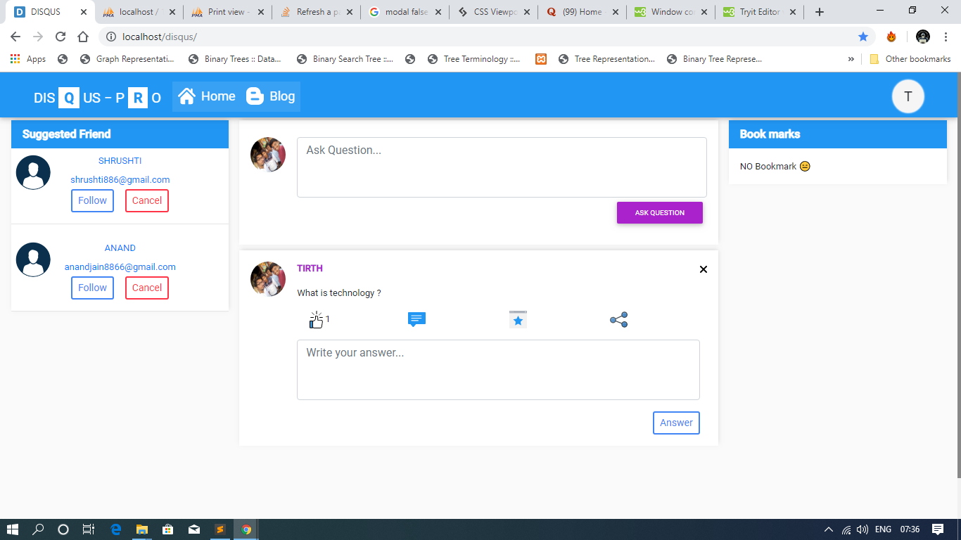
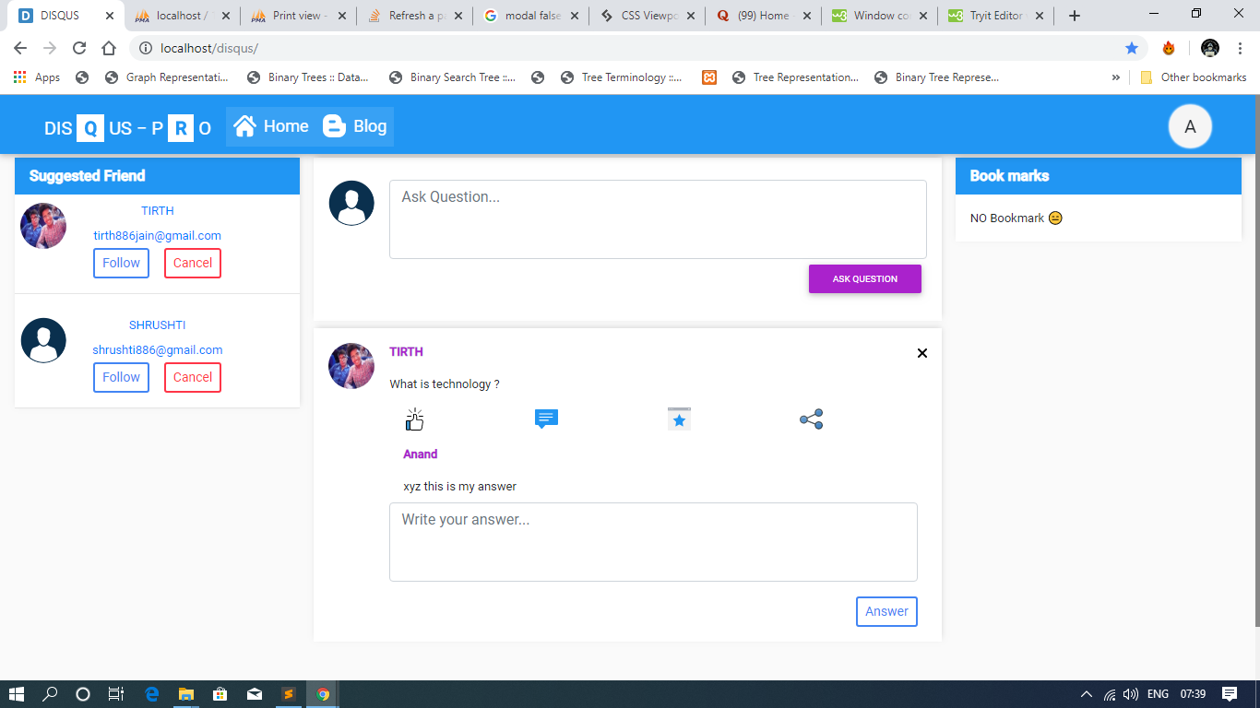
HOME PAGE ( first requesting , second answering his request )

Slide 11
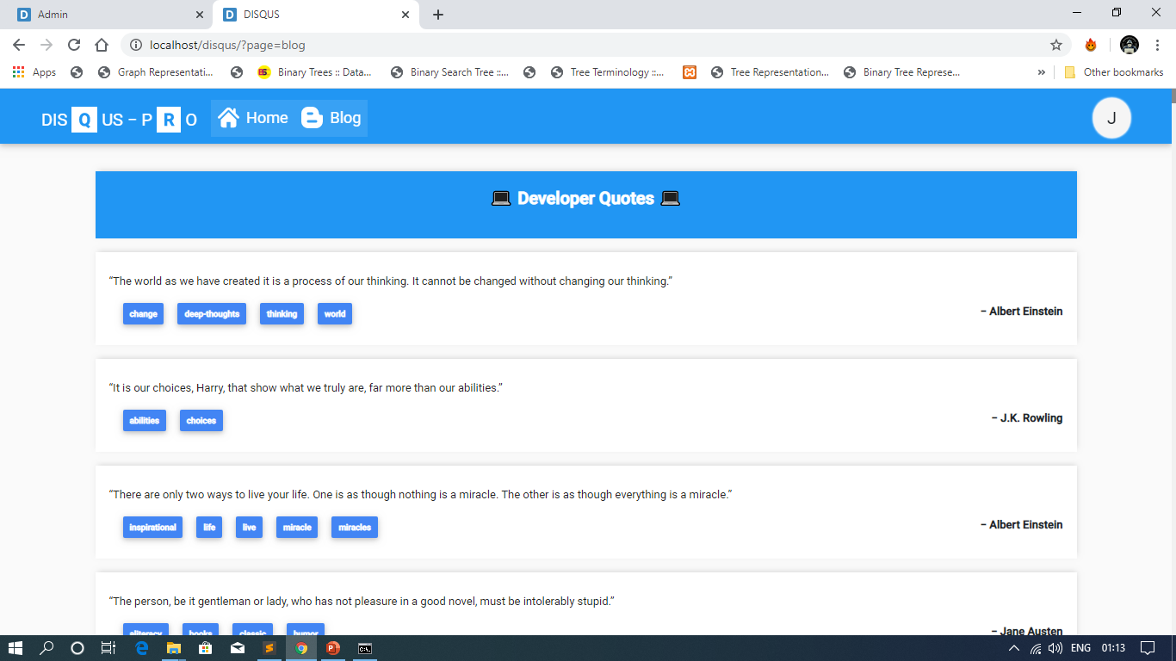
BLOG PAGE

Slide 12
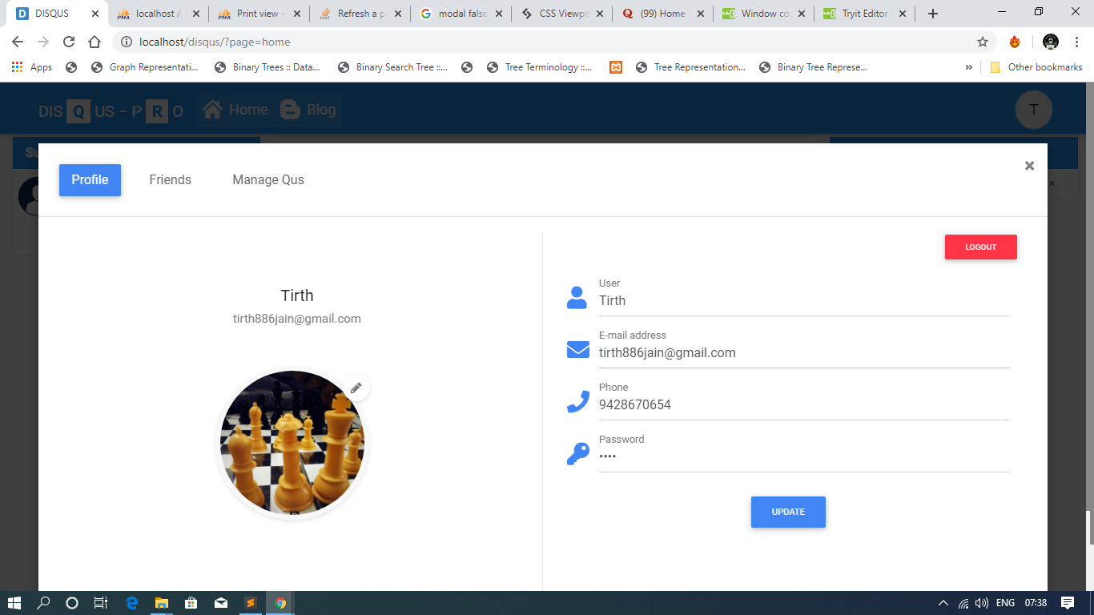
PROFILE VIEW

Slide 13
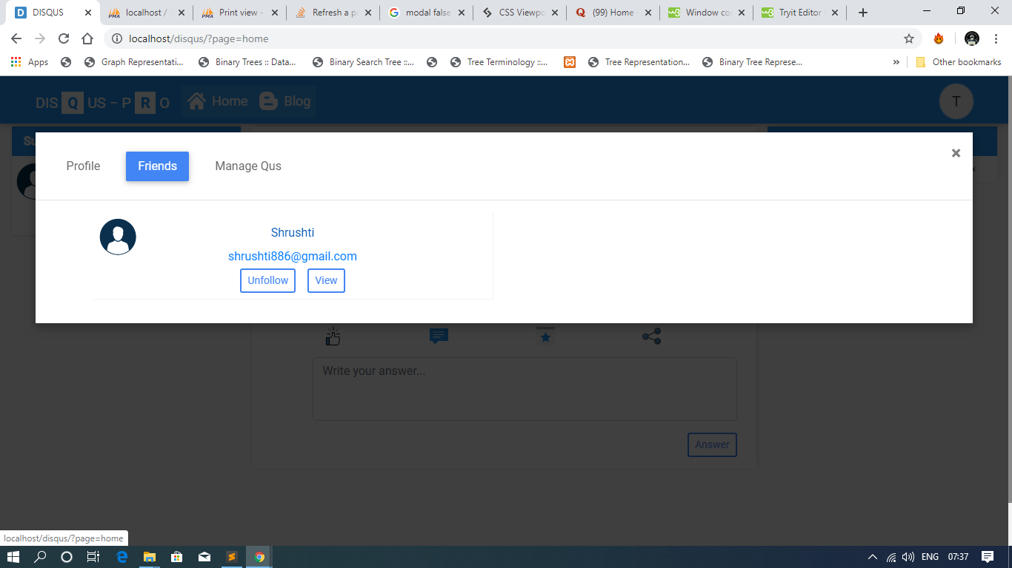
FOLLOWING LIST

Slide 14
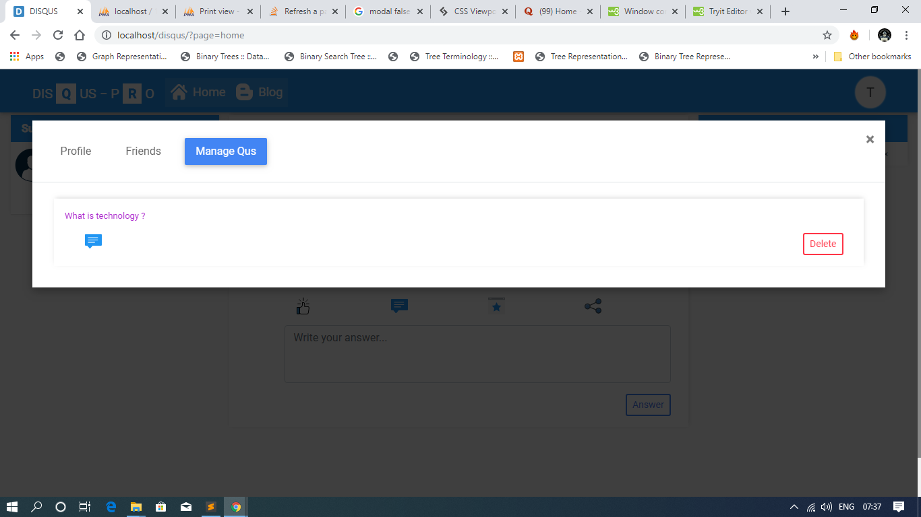
MANAGE QUESTION LIST

Slide 15
Admin Description
I have Create a another view for the admin and there no link of the user server files except user profile image’s.
Admin only delete the user, question, reply and I didn’t provide the update option just because we are using the minimum amount of data or privacy info so user has only rights to update his / her information but system admin has right from the DB.
I have also provide the reusable component of pagination for achieving the dynamic programming pagination only visible when the data or record are greater than 10 then it will automatically create pages.
Admin can view the total number of user and question and bookmark done in by the user in the platform.

Slide 16
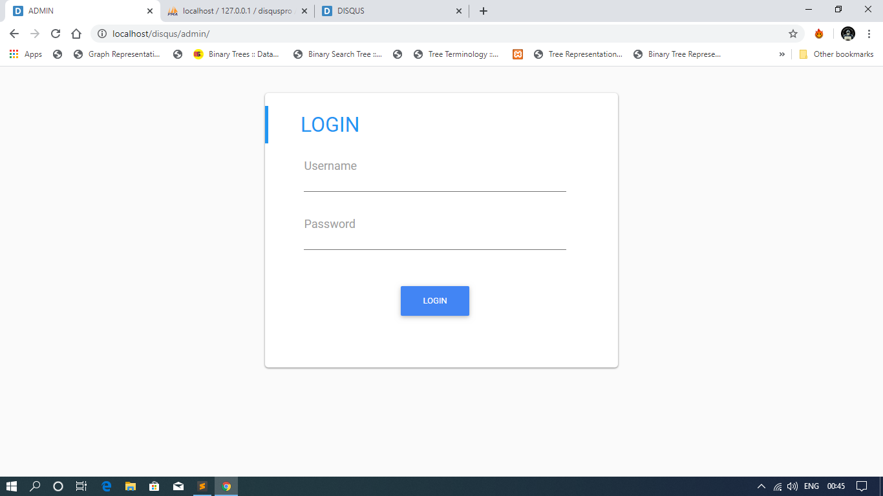
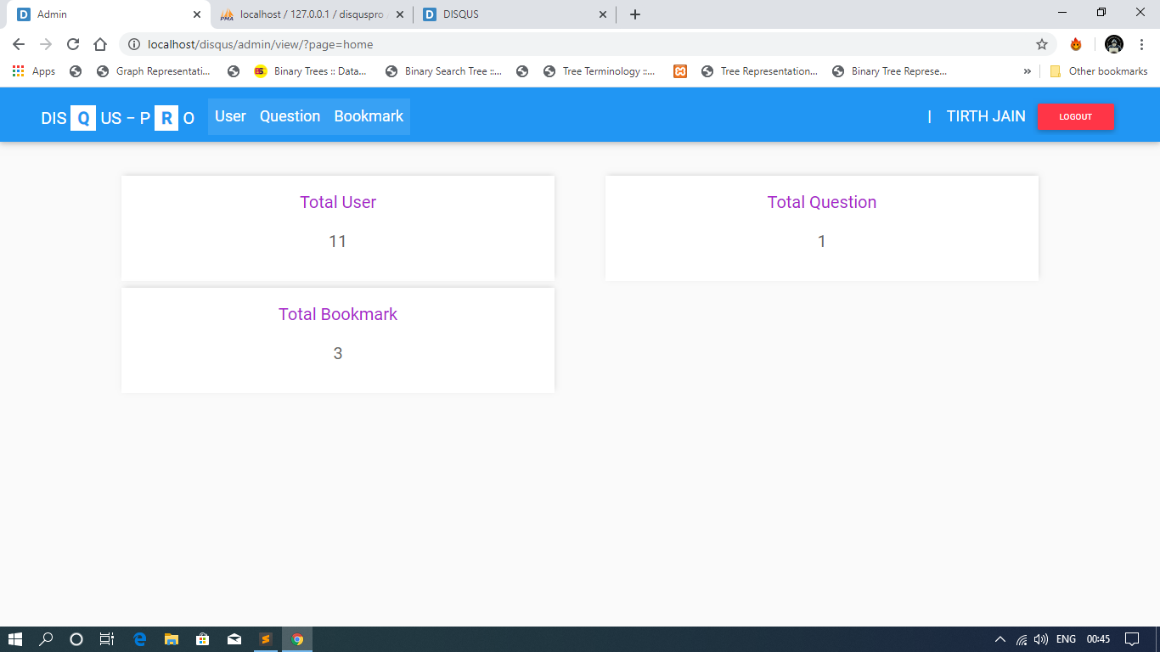
ADMIN LOGIN AND DASHBOARD

Slide 17
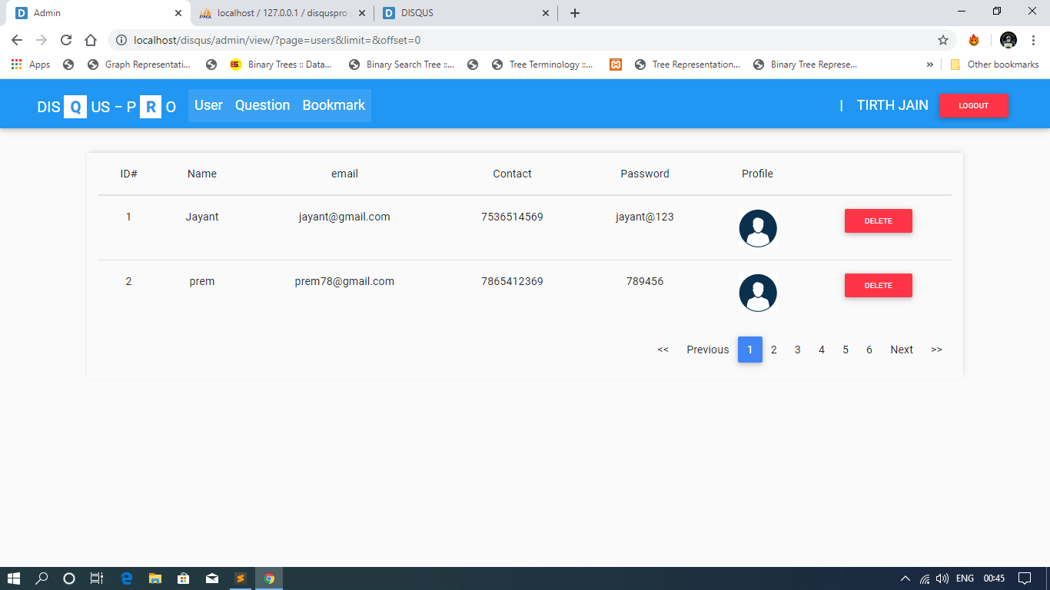
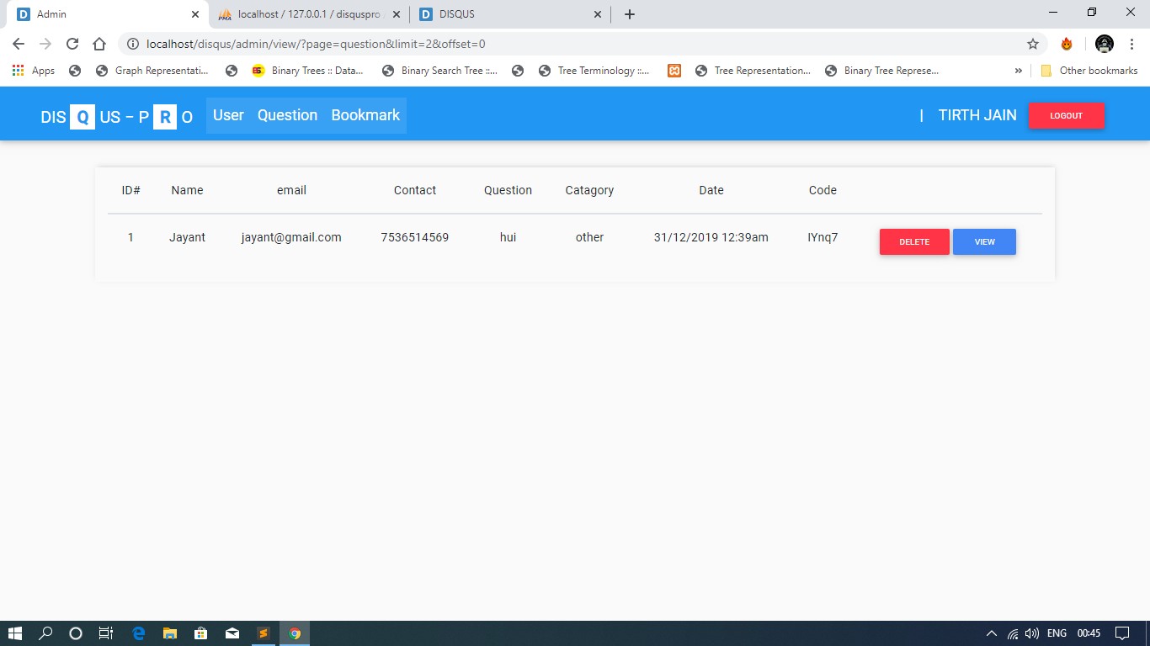
USER LIST AND QUESTION LIST

Slide 18
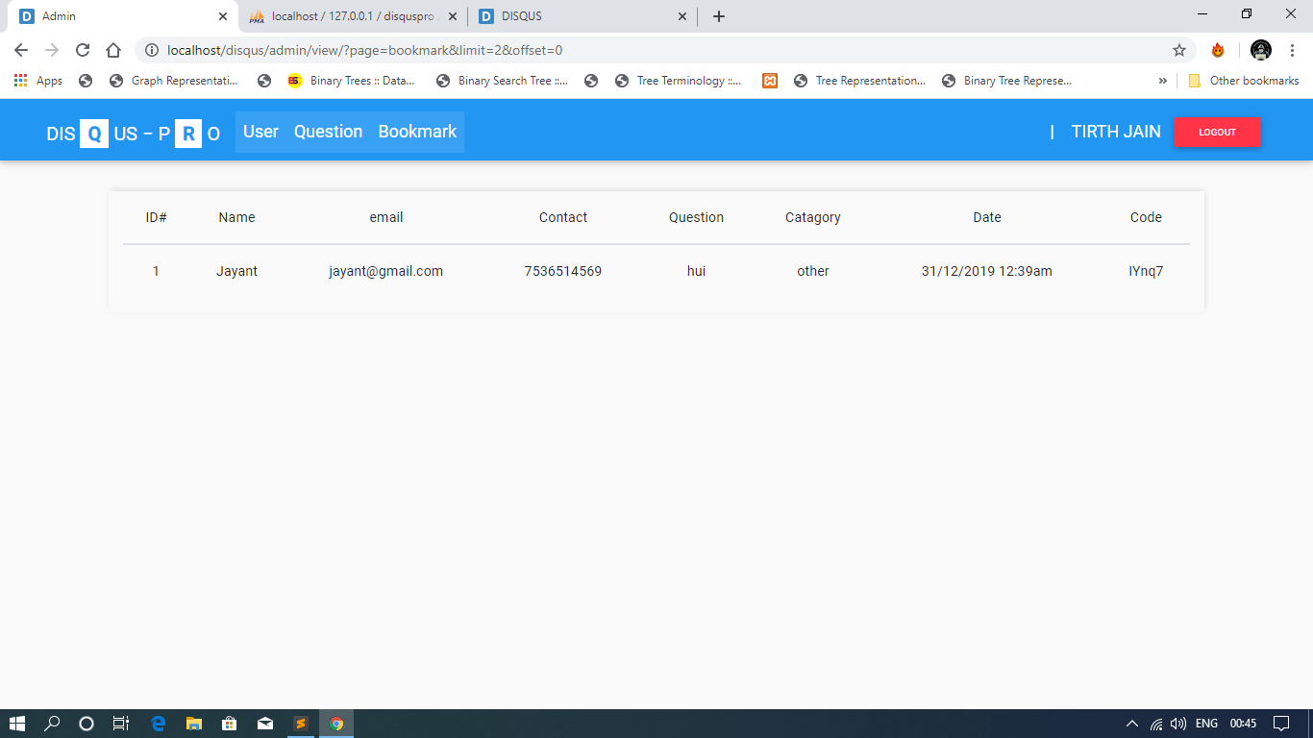
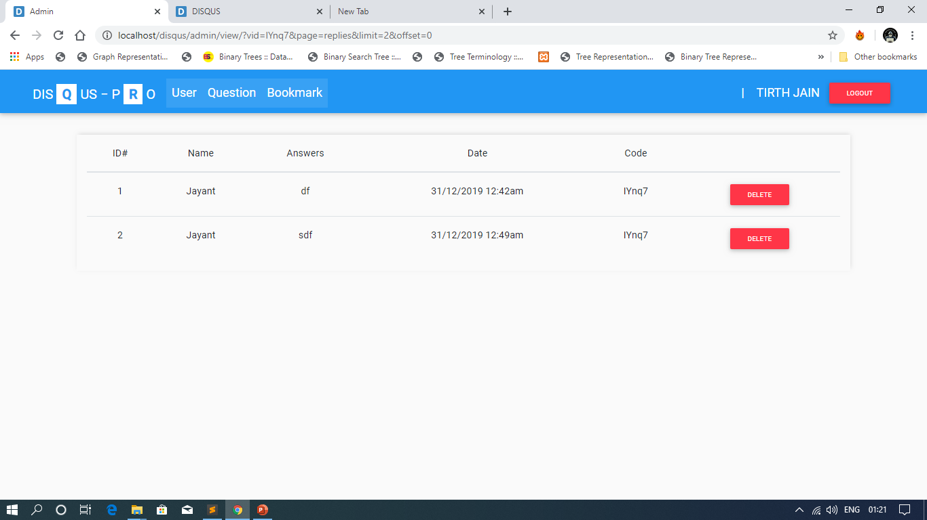
REPLY LIST AND BOOKMARK LIST

Slide 19
THANK YOU

