Slide 1
146
IT462 - EXPLORATORY DATA ANALYSIS - FINAL PROJECT - AUTUMN AY 2026-27
Exploratory Data Analysis of
Gujarat Company Master Data
A 146-year census of 222,915 registered companies - structure, quality, capital, concentration and growth
222,915
1880-2026
16
14
COMPANIES
REGISTRATION SPAN
FIELDS PER RECORD
REPRODUCIBLE FIGURES
Data: MCA company master extract (data.gov.in) - ROC Ahmedabad - Built with Python: pandas, matplotlib, streamlit

Slide 2
Agenda - from raw registry to evidence
01
02
Problem & objectives
Dataset & course mapping
Three questions the EDA answers
What the file contains, which IT462 modules it exercises
Six sections, one storyline: what the file is, what is wrong with it, what the companies look like, and how the registry grows.
03
04
Data quality & cleaning
Univariate profiles
Duplicates, sentinel dates, block missingness (MCAR/MAR/MNAR)
Class, status, sectors, log-scale capitals, outliers
05
06
Relationships & fitting
Time, findings & conclusions
Crosstabs, chi-square, Pearson/Spearman, OLS R2
Trend, seasonality, key insights, limitations
All numbers computed live from the dataset - notebook, dashboard, report and this deck share one pipeline

Slide 3
01 · PROBLEM & OBJECTIVES
The final project brief asks for a public dataset from data.gov.in explored end-to-end. We analyse the MCA company master extract for Gujarat - every company ever registered with ROC Ahmedabad - to profile corporate structure, expose data-quality traps, and quantify capital, concentration and growth. The analysis is deliberately descriptive-exploratory: classical statistical EDA in Python, per the course textbook (Tukey, Exploratory Data Analysis).
Understand the registry before modelling it
Q1
What does the registry actually contain?
Q2
What does corporate Gujarat look like?
Q3
How has registration evolved?
Structure, measurement scales
Duplicates, invalid entries
Missing-data mechanism
Class/status/listing mix
Capital distributions, sectors, concentration
Authorised vs paid-up relationship
146-year trend
Within-year seasonality
MAPPED TO COURSE OUTCOMES
CO1
import-clean-visualise-export (sections 1-4)
CO2
systematic EDA of mixed types (sections 5-10)
CO3
valid conclusions from evidence (sections 11-12)

Slide 4
02 · DATASET OVERVIEW
One file, 222,915 companies, 16 administrative fields
rows 222,915 x cols 16
63.5 MB CSV
identifier 100% populated
Structure & field groups
16 FIELDS · 5 GROUPS
Measurement scales
COURSE MODULE
NOMINAL
CIN, class, status, NIC code
⎙
Identity
CIN, name, ROC code
RATIO
both capitals (true zero)
INTERVAL
registration date
▣
Classification
category, subcategory, class
⚠
First quality signals
🏛
Financial
authorised capital, paid-up capital - INR ratio scales
✕date column arrives as text
✕nic_code as float
✕country mixes names with code '91'
✕51,773 rows missing every detail field
▦
Lifecycle
registration date, listing status, 18-valued company status
◎
Location & activity
address, state code = gujarat 100%, NIC 5-digit code + classification text
Raw file treated as read-only; every cleaning step works on copies.

Slide 5
02 · COURSE-CONCEPT MAPPING
Every IT462 module exercised on real data
7 modules · 1 dataset
→
field-by-scale inventory, nominal NIC recode to 21 letter sections
Measurement scales
histograms, boxplots, bars, crosstabs + chi-square, heatmaps
→
Univariate & bivariate
read-only load, 0 duplicates verified, 16 sentinel dates (1111-*), 74 paid-up>authorised violations, type conversions
→
Data import & cleaning
→
Pearson 0.770, Spearman 0.765, OLS slope 0.874, R2 0.5925
Correlation & fitting
→
block-missing 51,773 rows (23.23%), chi-square mechanism tests, keep-and-flag policy
Missing data analysis
Advanced EDA & dashboards
trend + seasonality detection, Lorenz/Gini, Streamlit+Plotly dashboard, this deck
five-number summary, IQR, MAD, CV 7,433%, skewness 163-202, log10 transforms
→
→
Descriptive summary
✓
Course brief: collect data from data.gov.in, perform EDA, report, present - all four delivered.

Slide 6
03 · EDA WORKFLOW
One reproducible pipeline, four synchronized deliverables
1
▣
2
✓
3
⚙
Load & inventory
Quality register
Clean & engineer
read-only CSV, structure + measurement-scale map data_loader.py
duplicates, sentinel dates, rule violations, block missingness data_cleaning.py
logged pipeline, country normalisation, status groups, NIC sections, capital buckets
4
✦
5
▦
6
▤
Statistical EDA
Visualise
Narrate
descriptive, crosstabs, correlation, OLS fit, outliers, Lorenz, trends statistical_analysis.py
14 consistent matplotlib figures + interactive Plotly visualization.py website/app.py
evidence-attached insights feed notebook, report, deck insights.py
↻
Single source of truth: analysis_results.json - every deliverable cites identical numbers; re-run scripts to reproduce end-to-end.

Slide 7
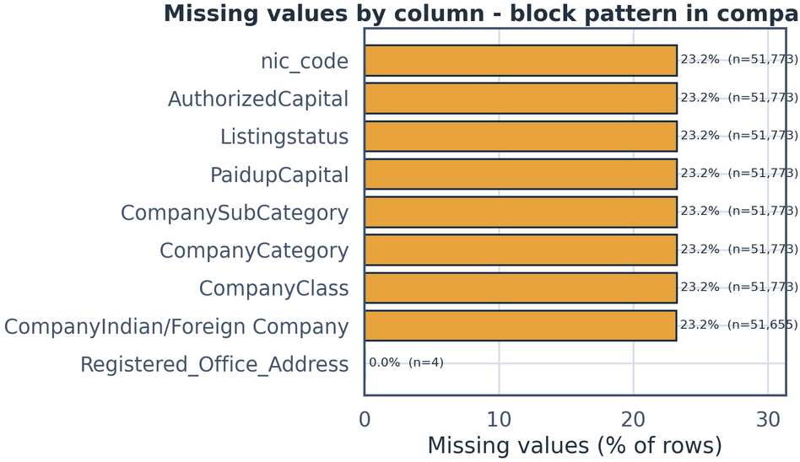
03 · DATA QUALITY & CLEANING
Identity pristine, content needs real work
0
✓
16
▦
FIGURE · MISSING VALUES BY FIELD
n = 222,915 rows
duplicate rows & CINs · good
sentinel dates 1111-01-01
74
▤
39,392
☎
paid-up > authorised violations
country stored as calling code 91
✦
USA vs United States style inconsistencies unified
Missing values concentrate in the 7–8 detail fields with IDENTICAL counts — a block pattern, not random noise; identifier fields are 100% populated.
◎
10,925 zero paid-up, 2,209 zero authorised — kept & flagged
⚑
Policy: flag, never silently drop or invent — corrections belong upstream at the registry.

Slide 8
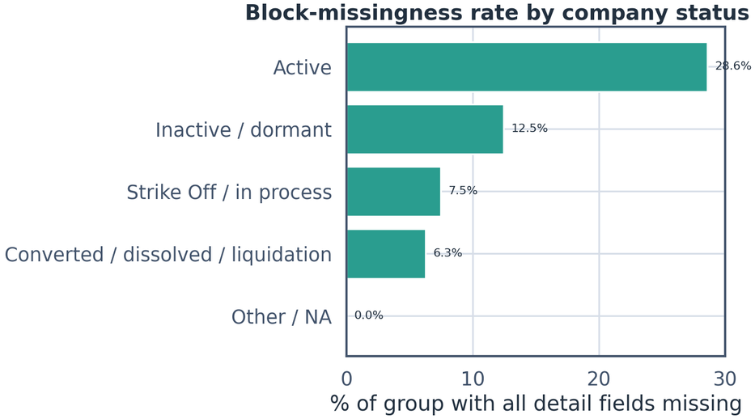
03 · MISSING DATA ANALYSIS
MCAR ruled out — missingness follows era and status
FIGURE · BLOCK-MISSINGNESS BY STATUS GROUP
share of rows missing all details
⌇
ERA ASSOCIATION
chi2 32,871
p<0.001
Cramers V 0.384
Block-missing rate 36.1% for 2016–2026 cohort vs ~0% before 2001.
▣
STATUS ASSOCIATION
chi2 10,667
V 0.219
Active 28.6% vs Strike Off 7.5%.
⚠
IMPLICATION
Newest third of the registry would vanish under naive row deletion.
Block-missingness by current status group — Active companies miss details most: recent registrations lack populated fields in this extract.
⚖
Verdict: MAR/MNAR with an administrative cause → keep + flag (block_missing column); capital statistics restricted to 171,142 detail-known rows, stated everywhere.

Slide 9
03 · DATA QUALITY & CLEANING
A logged, reversible pipeline — nothing silent
✦
Pipeline steps
EVIDENCE LOGGED
⚒
Engineered features
9
01
Deduplicate CIN — 0 removed
▦
RegistrationYear / RegistrationMonth
02
Parse dates — 16 sentinel values set to NaT
CompanyStatusGroup
✦
18 MCA statuses → 4 groups
⌘
IsListed
03
Standardise country — 39,392 × code 91 → India, USA → United States
◯
IsForeign
▤
CapitalRatio
paid-up / authorised, clipped
04
Coerce capitals to numeric
⚑
CapitalViolation flag
▦
NICSection
5-digit NIC 2008 → 21 letter sections
05
Flag 51,773 block-missing rows — kept by default
CapitalBucket
⚙
log-scale INR bins
06
Export cleaned CSV (222,915 rows)
↻
Same functions power notebook, dashboard and this deck (src/ package) — options are user-controllable in the website.

Slide 10
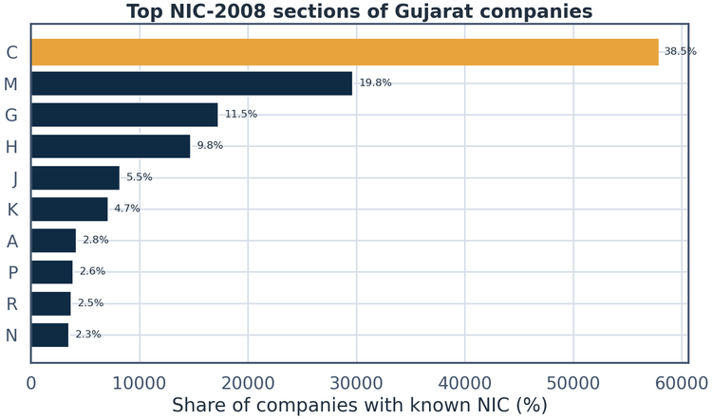
04 · UNIVARIATE PROFILES
A private, active, unlisted, manufacturing-led registry
COMPANY CLASS
STATUS GROUPS
LISTING
ORIGIN
91.8%
Private
74.7%
Active
99.2%
Unlisted
171,141
Indian
Public 6.2% · OPC 1.9%
Strike Off + in process 22.3%
of 171,142 detail-known
converted/dissolved 2.9%
only 1,327 listed
vs foreign 119 (~0.07%)
Top NIC-2008 sections of 165,485 classified companies — a textbook Gujarat signature.
Manufacturing
34.9%
Professional & scientific
17.9%
Trade
10.4%
Transport
8.9%
Figure · top NIC-2008 sections, share of classified companies

Slide 11
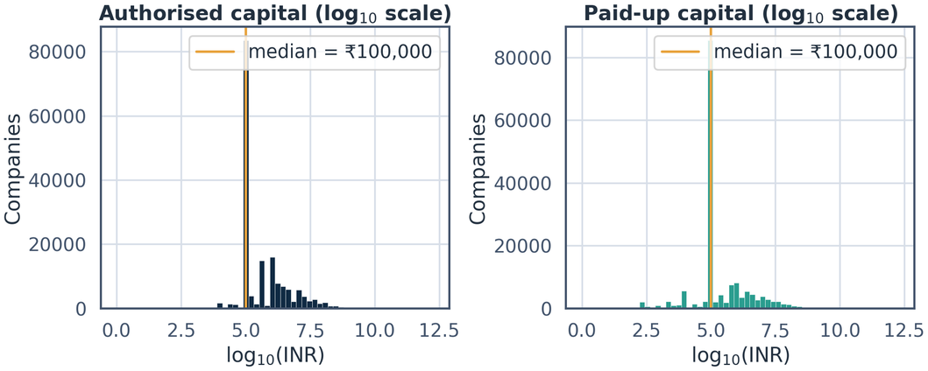
04 · UNIVARIATE PROFILES
Capitals span seven orders of magnitude — go log or go home
FIGURE · LOG10 CAPITAL HISTOGRAMS
authorised vs paid-up
CENTRAL TENDENCY
median authorised Rs 1.00 L
vs mean Rs 11.16 Cr
1,100× gap
SKEWNESS
163.3 authorised
201.5 paid-up
CV
7,433% authorised
9,444% paid-up
ROBUST SPREAD
IQR Rs 1.4 L · MAD Rs 0.8 L
FIVE-NUMBER SUMMARY
log10 histograms: authorised vs paid-up. Spike at 10⁵ = the Rs 1-lakh statutory default; comb spikes at round numbers.
0
1L
1L
15L
1.9 trillion
✦
Means mislead: all downstream analysis uses log10 + robust statistics (median, IQR, MAD) per the descriptive-summary module.

Slide 12
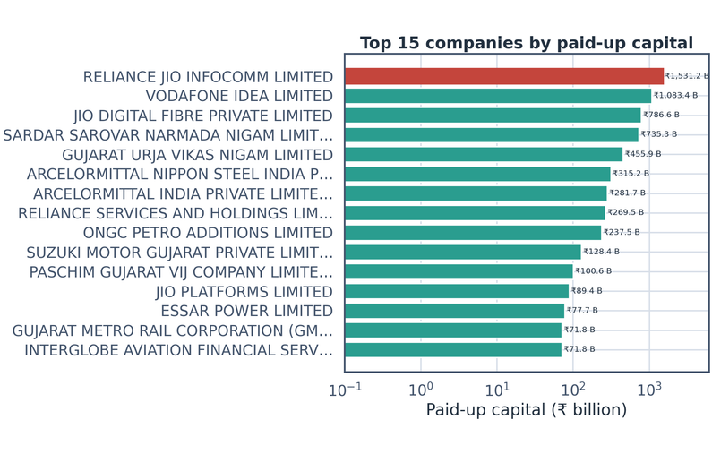
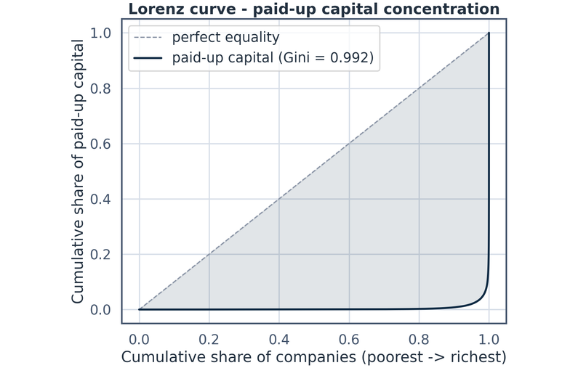
04 · UNIVARIATE PROFILES — OUTLIERS & CONCENTRATION
The outliers are real giants — and capital is a two-tier system
Top 15 by paid-up capital: Reliance Jio Rs 1,531 B, Vodafone Idea Rs 1,083 B, Jio Digital Fibre Rs 787 B, Sardar Sarovar Rs 735 B…
Lorenz curve: top 1% of companies hold 93.26% of paid-up capital (Gini 0.992); top 5% hold 98.0%.
TUKEY IQR OUTLIERS · 11.27%
Z-SCORE |Z| > 3 · 0.92%
ZERO PAID-UP CAPITAL
☰
18,050
✦
1,479
$
10,925
log10 fences Rs 4,419 – Rs 1.81 Cr
beyond 3 standard deviations
Rs 0 paid-up recorded — kept & flagged
✓
Outliers kept — handled with log transforms and robust stats; zeros treated as the structural low side, not errors.

Slide 13
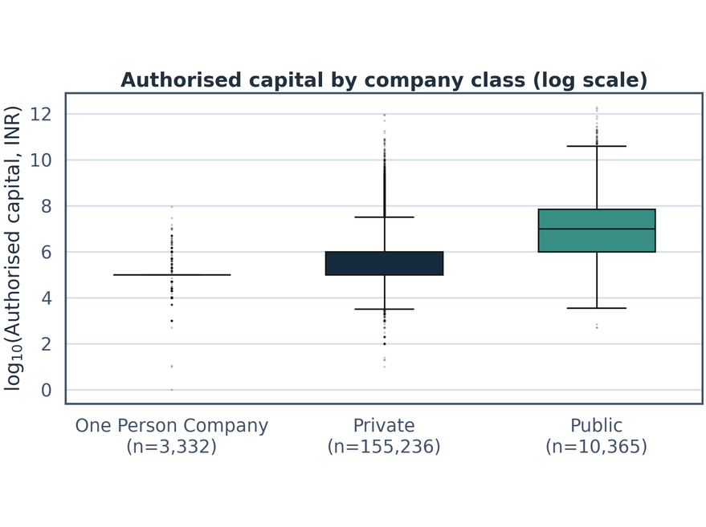
05 · RELATIONSHIPS & FITTING
Class and legal status are significantly dependent
CHI-SQUARE TEST OF INDEPENDENCE
χ² = 2,499.1
p < 0.001
dof 8
✓
Dependence confirmed
V = 0.085
Cramér's V — modest effect size
(honest with n = 171k)
ACTIVE SHARE BY CLASS
One Person Companies
87.5% active
post-2013 vehicles — little time to fail
Private
69.8% active
Public
58.6% active
30.4% struck off / in process — many defunct shells
Authorised capital by class (log10): public companies carry visibly higher medians — infrastructure and state utilities live here.
✦
Status mix depends on cohort age — the era chart in the dashboard warns against naive survival comparisons (survivorship bias).

Slide 14
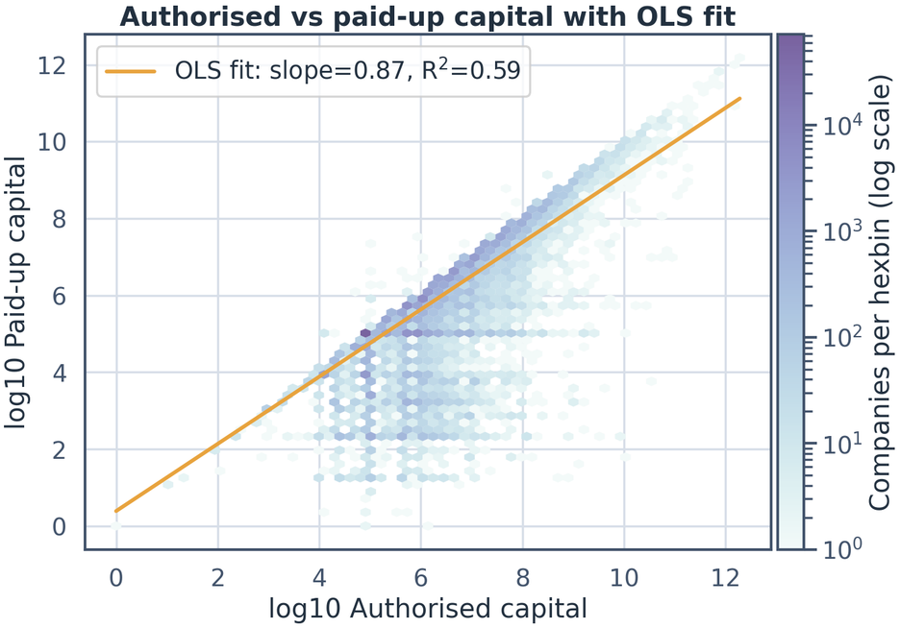
05 · RELATIONSHIPS & FITTING
Authorisation tracks capitalisation — but does not guarantee it
PEARSON R (LOG10)
SPEARMAN Ρ
0.770
0.765
authorised ↔ paid-up
monotone picture agrees — not outlier-driven
OLS SLOPE (SE 0.002)
R² · OLS FIT
0.5925
0.874
RMSE 0.696 log-units · p < 0.001
Hexbin (log-log, n = 160,198 pairs) with OLS line; horizontal stripe = Rs 1-lakh default paid-up.
10× authorised ≈ 7.5× paid-up
◆
Read: authorised capital explains ~59% of log-variation in paid-up capital — a commitment ceiling, not a guarantee; residuals are the interesting companies.

Slide 15
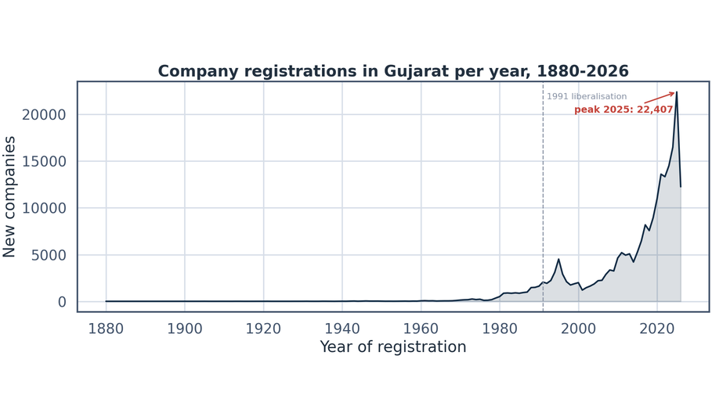
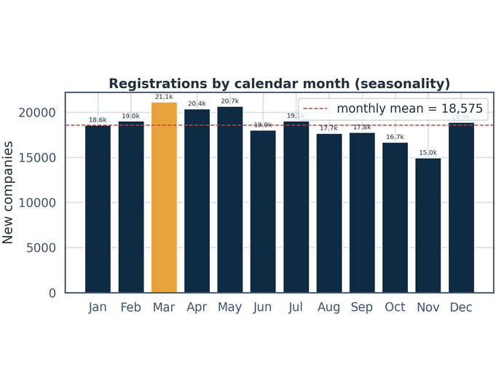
06 · TIME, FINDINGS & CONCLUSIONS
From trickle to torrent — 22,407 registrations at the 2025 peak
♛
PEAK YEAR
↗
CAGR 2015–2025
▦
MARCH VS NOVEMBER REGISTRATIONS
2025
22,407 registrations
15.59%
full years; 2026 partial
21,134
14,972
vs
146-year registration series: pre-1991 trickle, liberalisation lift, explosive post-2020 phase (12,261 more by June 2026).
Calendar-month seasonality: March = financial-year-end rush; November trough — moderate but real cycle.
⚠
Note: era status-mix chart (dashboard) doubles as survivorship warning: older cohorts are majority struck-off.

Slide 16
06 · TIME, FINDINGS & CONCLUSIONS — CLOSING
What 222,915 rows told us
KEY FINDINGS
01
Identity pristine
⊗
Limitations (stated honestly)
0 duplicates
Registry counts, not economic activity
23.2% detail-missing → documented selection
June-2026 snapshot censoring
02
Block missingness is era-driven
Status ≠ survival time
23.23% · V 0.384 → MAR/MNAR
Zero-capital & 74 violations flagged, never fixed
03
Extreme skew
CONCLUSION + NEXT STEPS
median Rs 1 L vs mean Rs 11.2 Cr
“A clean identity spine wrapped in instructive content-quality traps — private-dominated, manufacturing-led, extraordinarily concentrated, and growing at 15.6% a year.”
04
Extraordinary concentration
top 1% hold 93.26% of paid-up capital (Gini 0.992)
05
Authorised vs paid-up
r 0.770 · R² 0.593 · slope 0.874
NEXT →
strike-off risk modelling
XBRL financial join
06
Explosive recent growth
address geocoding
peak 22,407 in 2025 · CAGR 15.6%
▤
Notebook: EDA_Demo.ipynb
▦
Dashboard: streamlit run website/app.py
▤
Report: analysis_report.md

