Slide 1
Tracking and repositioning of Aruco Markers
MAE 575 Project
Tirth Gadhvi Zafar Kamil

Slide 2
Outline
Motivation
Decoding marker data
Marker position calibration
Denso robot programming
Project setup
Video of project
Conclusion

Slide 3
Motivation
Learn about Aruco Markers and their unique properties.
Detect products that are faulty in product lines.
Sorting through different products in a product line
Decrease time for production and supply chain.

Slide 4
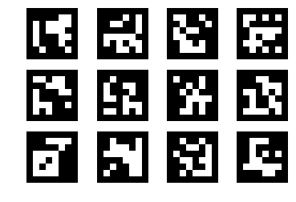
Aruco Basics - 1.0 Marker Creation
aruco_dict = aruco.Dictionary_get(aruco.DICT_6X6_250)
fig = plt.figure()
for i in range(1, nx*ny+1):
ax = fig.add_subplot(ny,nx, i)
img = aruco.drawMarker(aruco_dict,i, 700)
plt.imshow(img, cmap = mpl.cm.gray, interpolation = "nearest")
ax.axis("off")
plt.savefig("_data/markers.jpeg")
plt.show()

Slide 5
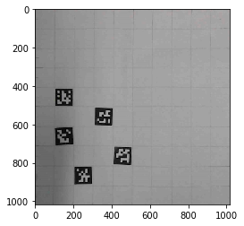
Aruco Basics - 2.0 Marker Detection
gray = cv2.cvtColor(frame, cv2.COLOR_BGR2GRAY)
aruco_dict = aruco.Dictionary_get(aruco.DICT_6X6_250)
parameters = aruco.DetectorParameters_create()
corners, ids, rejectedImgPoints = aruco.detectMarkers(gray, aruco_dict, parameters=parameters)
frame_markers = aruco.drawDetectedMarkers(frame.copy(), corners, ids)

Slide 6
Aruco Basics - 3.0 Marker’s centroid
Picture of grid with markers decoded in Python.
Generates marker positions through marker corner tracking.
Markers decoded in Python to generate marker number.
Notes:
Picture of grid with markers decoded to give marker number and position through Python.
Generating marker positions through marker corner tracking and centroid calculation.

Slide 7
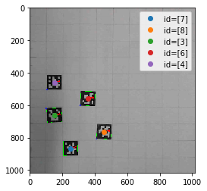
Results
Marker - 7 | Marker - 3
[207. 821.] | [[103. 619.]
[294. 819.] | [195. 615.]
[296. 909.] | [200. 701.]
[207. 911.] | [109. 708.]

Slide 8
Marker position calibration
Square grid : 10* 10 inches
Scale : 100 units = 1 inch
Average Error : 0.04 inches
Calculated marker positions from python with respect to Denso frame by using equations :
x1p = 250; y1p = 850; %python generated marker positions
x1 = 275-(500-y1p)*(25.4/100); %denso robot positions
y1 = 20-(500-x1p)*(25.4/100);

Slide 9
Robot programming
Positions from Python are imported into MATLAB and converted to physical positions for the robot to execute.
Neutral and out-of-grid positions are pre-defined in MATLAB.
Robot was programmed to have the same Rx, Ry & Rz with the positions in 3D changed.
Robot is programmed to move from neutral position to marker, pick up marker, drop it off at out-of-grid position, and then return to neutral position.

Slide 10
Project setup
Gripper was connected to the robot.
Grid was placed on table below robot with markers.
Picture of grid with two markers decoded in Python and converted to robot coordinates in MATLAB.
Matlab code run to perform repositioning of blocks.

Slide 11
Video presentation
https://drive.google.com/file/d/16IhKUNnpfnVSLn6zadkVT6k8BfZBoOFL/view?ts=5cd22d55

Slide 12
Conclusion/Recommendations
Errors in translating block positions from grid to denso robot were minimal due large size of blocks.
Better image quality will result in improved tracking of Aruco markers.
Latency of data transfer can be reduced if denso can be directly controlled from python
Notes:
Decoding marker data real time with video feed and robot will sort through products

Slide 13
Improvements
Decoding aruco marker data and position data could be done real time using video feed.
Detecting faulty/misplaced products on a product line.
Sorting through different products in a product line and moving them to their appropriate location.

