Slide 1

Nostalgic Terminal Games

Slide 2
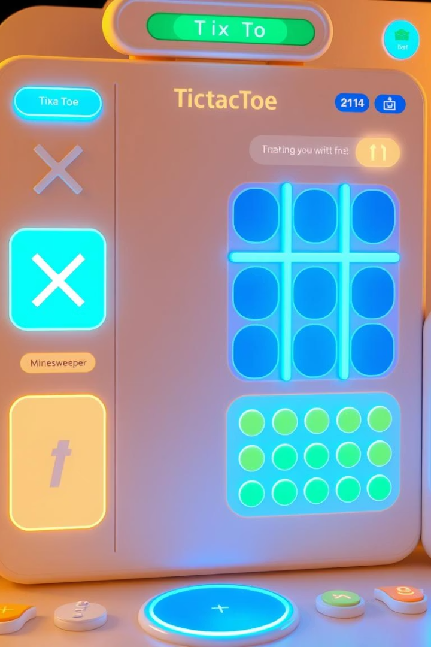
Multi-GameApplication with Design Patterns
This project is a modular multi-game application featuring 3 classics. TicTacToe, Hangman, and Minesweeper. It showcases strong object-oriented principles and the use of design patterns to create maintainable, extensible software. The platform provides a unified game interface, an intelligent hint system, state saving and restoring, and difficulty-level customization.

Slide 3
Singleton & Observer Patterns
Singleton Pattern
Observer Pattern
Used in: GameEngine, CustomLogger
Purpose: Ensure one instance only
Advantages:
Central control of game logic
Global access to game state
Saves memory
Used in: GameEventPublisher, GameObserver, ConsoleUI, ScoreBoard
Purpose: Notify UI on game state changes
Advantages:
Decouples game logic and UI
Multiple views observe state
Easy to add new observer

Slide 4
State & Command Patterns
State Pattern
Command Pattern
Used in: InitialState, PlayingState, PausedState, EndedState
Purpose: Represent different game states
Advantages:
Avoids conditionals
Clear transitions
Easy to add states
Used in: CommandProcessor, StartGameCommand, MakeMoveCommand, etc.
Purpose: Encapsulate user actions
Advantages:
Separates execution from invocation
Easy to add commands
Enables undo/redo support

Slide 5
Strategy & Factory Patterns
Strategy Pattern
Factory Pattern
Used in: TicTacToeStrategy, HangmanStrategy, MinesweeperStrategy
Purpose: Vary game logic
Advantages:
Algorithm selection at runtime
Reusable logic
Add new games easily
Used in: GameFactory, CellFlyweightFactory
Purpose: Centralized object creation
Advantages:
Decouples instantiation
Easier to extend games
Clean object creation

Slide 6
Builder & Decorator Patterns
Builder Pattern
Decorator Pattern
Used in: GameBuilder
Purpose: Construct complex games step-by-step
Advantages:
Clear construction process
Separate config from logic
Cleaner code
Used in: HintDecorator
Purpose: Centralized object creation
Advantages:
No subclassing needed
Flexible feature composition
Follows single responsibility

Slide 7
Memento & Flyweight Patterns
Memento Pattern
Flyweight Pattern
Used in: TicTacToeMemento, HangmanMemento,
Purpose: Save/restore game state
Advantages:
Maintains encapsulation
Supports pause/resume
Undo capability
Used in: HintDecorator
Purpose: Reuse cell objects
Advantages:
Saves memory
Speeds up object creation
Separates state logic

Slide 8
Facade & Composite Patterns
Façade Pattern
Composite Pattern
Used in: GameFacade
Purpose: Simplify access to game system
Advantages:
Easy-to-use interface
Hides complexity
Loose coupling
Used in: Menu, MenuItem, MenuComponent
Purpose: Uniform treatment of menus and items
Advantages:
Supports hierarchy
Simplifies navigation
Easy component addition

Slide 9




Impact of Design Patterns on the Project
Maintainability
Extensibility
Each pattern enforces a single responsibility, making code easier to understand, update, and debug.
The modular design allows adding new games and features with minimal disruption to existing code.
1
2
Reusability
Robustness
4
3
Shared components like common UI updates and factories promote code reuse across different games.
Patterns enable cleaner, modular, and testable codebase, reducing bugs and improving reliability.

Slide 10
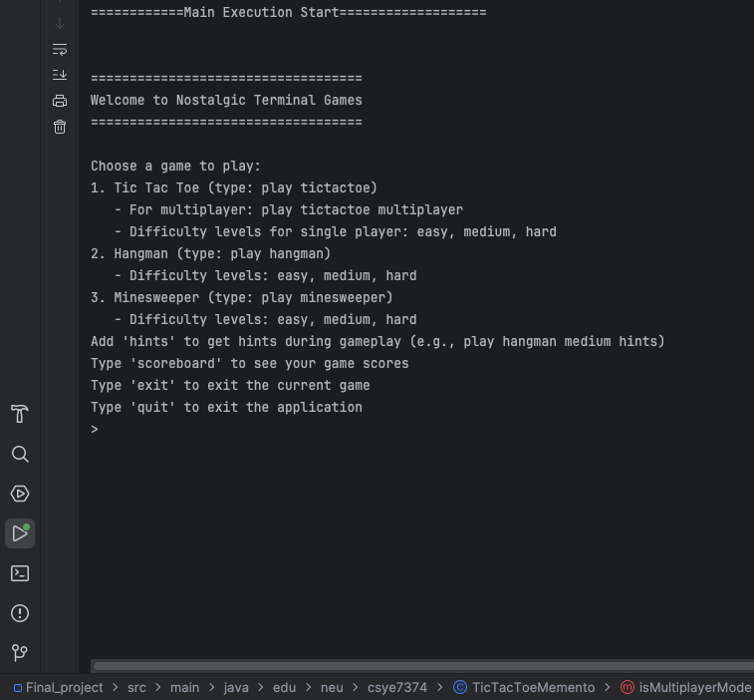

Slide 11
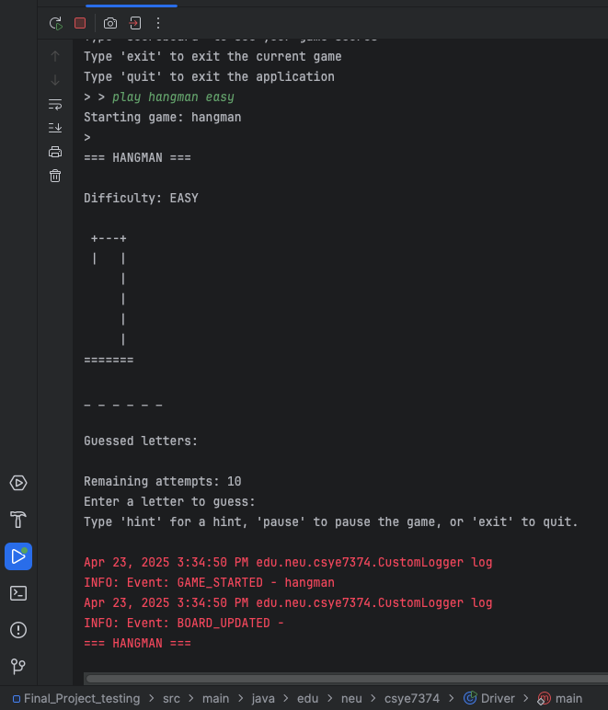
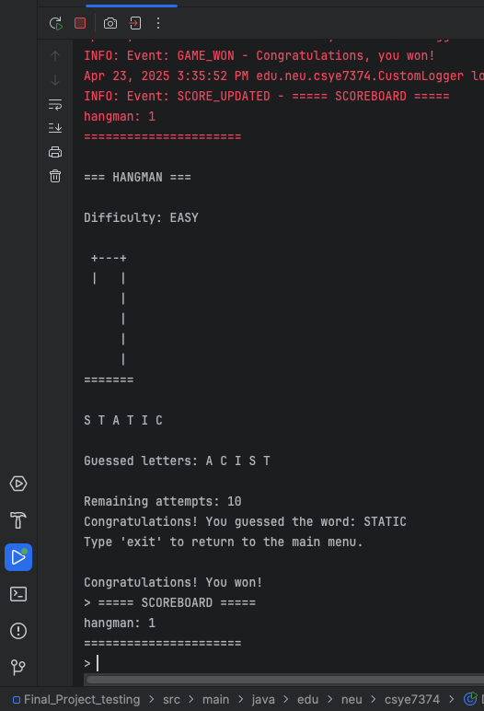

Slide 12
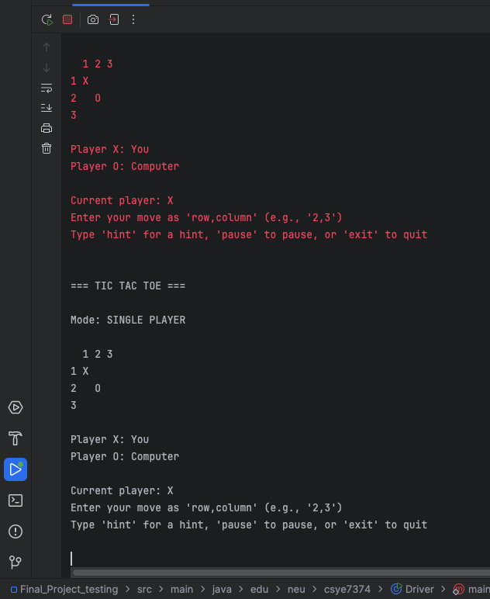
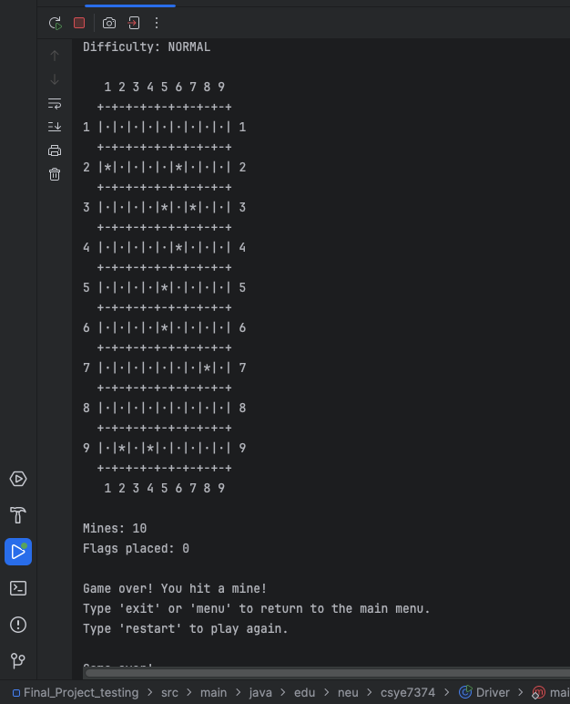

Slide 13
Contributions
Team Member | Key Contributions
Bhargav | Game, GameFacade, Event system
Sai Chebrolu | Minesweeper logic, Hint system
Mukul | Hangman logic, Console UI
Tirth | TicTacToe logic, Command implementations
Ethan | Resume/Pause feature, ScoreBoard integration

