Slide 1

Content-Based Recommender for E-Commerce Webstore
Data Science Bootcamp

Slide 2
Introduction
Recommender System for E-commerce (Content-Based Filtering).
Engineered an algorithm from scratch.
Tools Applied: Cosine Similarity, Matrix Product, Tfidf Vectorizer, MinMaxScaler.
Obtained about 110million user interactions from Kaggle.

Slide 3





Python Tools

Slide 4
Exploratory Data Analysis
 | event_time | event_type | product_id | category_code | brand | price | user_id | category
0 | 2019-10-01 00:00:01 UTC | view | 1307067 | computers.notebook | lenovo | 251.74 | 550050854 | computers
1 | 2019-10-01 00:00:05 UTC | view | 1480613 | computers.desktop | pulser | 908.62 | 512742880 | computers
2 | 2019-10-01 00:00:19 UTC | view | 1306631 | computers.notebook | hp | 580.89 | 550050854 | computers
3 | 2019-10-01 00:00:22 UTC | view | 1480714 | computers.desktop | pulser | 921.49 | 512742880 | computers
4 | 2019-10-01 00:00:37 UTC | view | 1701111 | computers.peripherals.monitor | acer | 514.79 | 547028884 | computers
... | ... | ... | ... | ... | ... | ... | ... | ...
356720 | 2019-10-05 23:59:20 UTC | view | 1480584 | computers.desktop | hp | 984.20 | 514752680 | computers
356721 | 2019-10-05 23:59:40 UTC | view | 1480584 | computers.desktop | hp | 984.20 | 514752680 | computers
356722 | 2019-10-05 23:59:50 UTC | view | 1480171 | computers.desktop | acer | 823.67 | 514752680 | computers
356723 | 2019-10-05 23:59:55 UTC | view | 1306556 | computers.notebook | lenovo | 926.64 | 513465266 | computers
356724 | 2019-10-05 23:59:57 UTC | view | 6400313 | computers.components.cpu | intel | 177.48 | 546038044 | computers

Slide 5
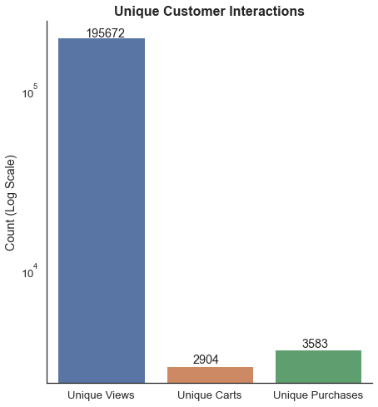
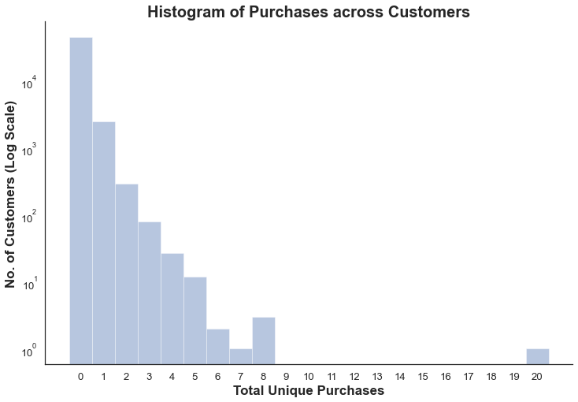
Exploratory Data Analysis
About 1.8% View-to-Purchase Conversion!

Slide 6
Target Processing
Create user score for each user-product interaction.
No interaction: 0, View: 1, Cart: 10, Purchase: 50 => Sum
Apply MinMaxScaler to obtain interaction score between 0 and 1.
Interaction score of 0.5 would potentially indicate purchase.

Slide 7

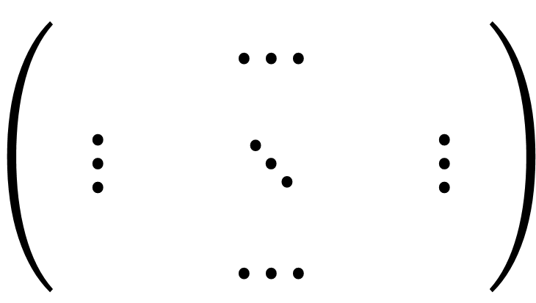

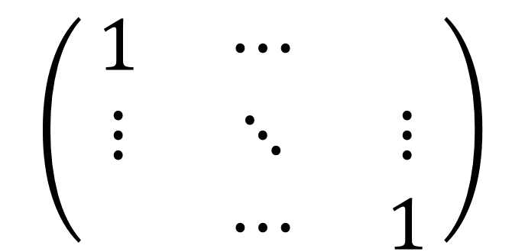
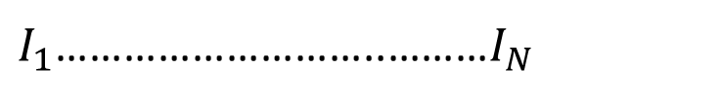
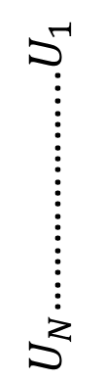
Model One: Item Category
User-Item Matrix
Item Category Similarity
$I_{1}$………………………..………$I_{N}$
$I_{1}$………………………..………$I_{N}$
$U_{N}$………………...$U_{1}$
$$\left(\begin{matrix} & ⋯ & \\ ⋮ & ⋱ & ⋮ \\ & ⋯ & \end{matrix}\right)$$
$$\left(\begin{matrix}1 & ⋯ & \\ ⋮ & ⋱ & ⋮ \\ & ⋯ & 1\end{matrix}\right)$$
Matrix Product
$$⋅$$

Slide 8

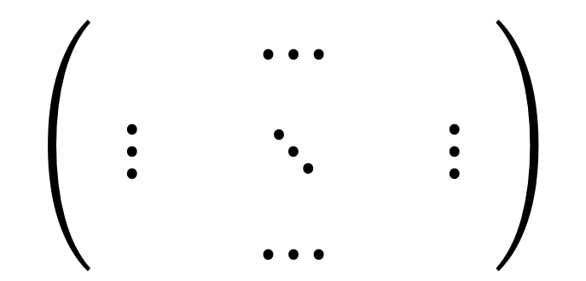

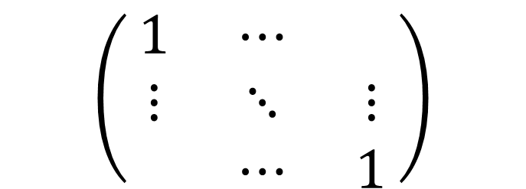




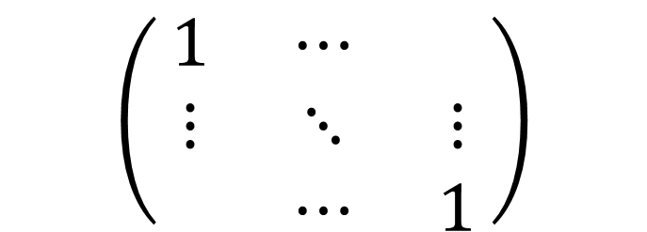
Model Two: Item/Price Category
User-Item Matrix
$I_{1}$………………………..………$I_{N}$
Item Category Similarity
Price Category Similarity
$U_{N}$………………...$U_{1}$
$$\left(\begin{matrix} & ⋯ & \\ ⋮ & ⋱ & ⋮ \\ & ⋯ & \end{matrix}\right)$$
$I_{1}$………………………..………$I_{N}$
$I_{1}$………………………..………$I_{N}$
Element-wise Product
Matrix Product
$$\left(\begin{matrix}1 & ⋯ & \\ ⋮ & ⋱ & ⋮ \\ & ⋯ & 1\end{matrix}\right)$$
$$\left(\begin{matrix}1 & ⋯ & \\ ⋮ & ⋱ & ⋮ \\ & ⋯ & 1\end{matrix}\right)$$
$$⋅$$
$$×$$

Slide 9




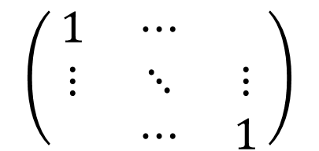





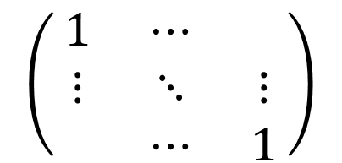
Model Three: Item/Price/Brand Category
$U_{N}$………………...$U_{1}$
User-Item Matrix
Item Category Similarity
Price Category Similarity
Brand Similarity
$I_{1}$………………………..………$I_{N}$
$$\left(\begin{matrix} & ⋯ & \\ ⋮ & ⋱ & ⋮ \\ & ⋯ & \end{matrix}\right)$$
$I_{1}$………………………..………$I_{N}$
$I_{1}$………………………..………$I_{N}$
$I_{1}$………………………..………$I_{N}$
Element-wise Product
Element-wise Product
Matrix Product
$$\left(\begin{matrix}1 & ⋯ & \\ ⋮ & ⋱ & ⋮ \\ & ⋯ & 1\end{matrix}\right)$$
$$\left(\begin{matrix}1 & ⋯ & \\ ⋮ & ⋱ & ⋮ \\ & ⋯ & 1\end{matrix}\right)$$
$$\left(\begin{matrix}1 & ⋯ & \\ ⋮ & ⋱ & ⋮ \\ & ⋯ & 1\end{matrix}\right)$$
$$⋅$$
$$×$$
$$×$$

Slide 10
Model Selection – Simple CV
Training Set
Validation Set
Test Set
60% | 20% | 20%
Matrix operation is executed on the training set
MinMaxScaler is applied on matrix to predict interaction score.
Predicted Interaction above 0.5 is labelled as predicted purchase.

Slide 11
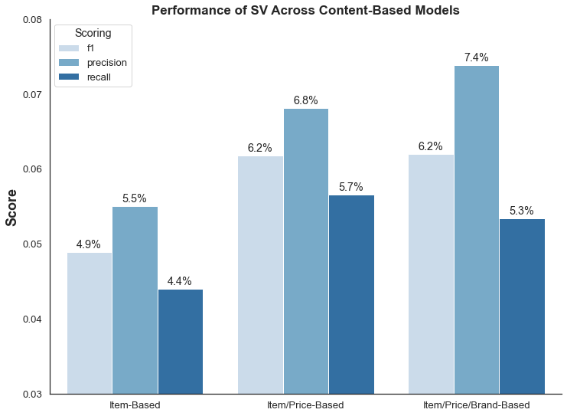
Model Selection – Simple CV

Slide 12
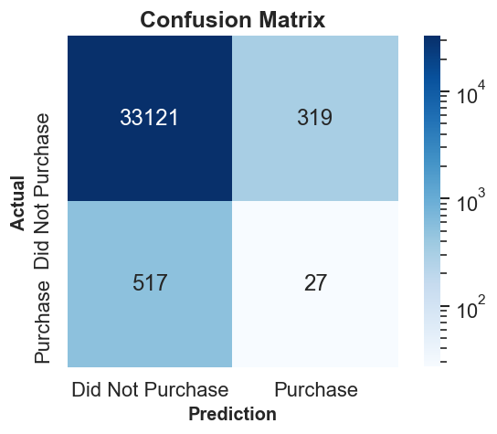
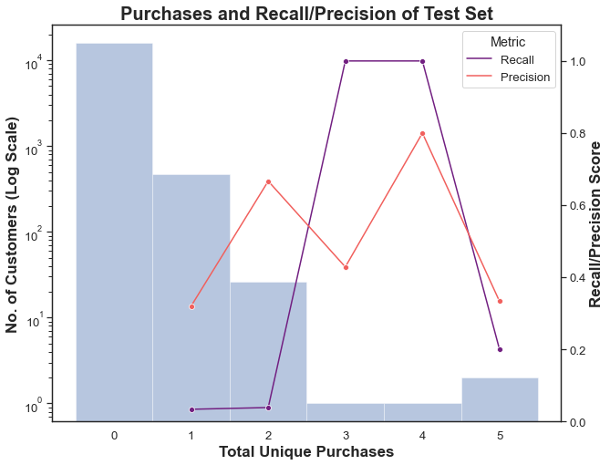
Model Evaluation – Test Set
Recall: 4.96%
Precision: 7.80%

Slide 13
Model Evaluation – Demonstration
Train-Validation Set for User_Id: 518044530
 | user_id | product_id | user_score | user_purchase | interaction_score | category_code | brand | price | price_category
543 | 518044530 | 1307237 | 6 | 0 | 0.074242 | computers.notebook | lenovo | 257.38 | 1
2063 | 518044530 | 1307366 | 54 | 1 | 0.546970 | computers.notebook | lenovo | 248.62 | 1
9017 | 518044530 | 1307067 | 100 | 1 | 1.000000 | computers.notebook | lenovo | 251.74 | 1
113488 | 518044530 | 1307316 | 1 | 0 | 0.025000 | computers.notebook | lenovo | 248.89 | 1
49036 | 518044530 | 1307188 | 100 | 1 | 1.000000 | computers.notebook | hp | 285.51 | 1
20103 | 518044530 | 1307370 | 52 | 1 | 0.527273 | computers.notebook | acer | 257.15 | 1
Test Set for User_Id: 518044530
 | user_id | product_id | user_score | user_purchase | interaction_score | category_code | brand | price | price_category | predicted_interaction | predicted_purchase
7739 | 518044530 | 1307135 | 100 | 1 | 1.000000 | computers.notebook | hp | 320.35 | 1 | 0.595432 | 1
13096 | 518044530 | 1307356 | 1 | 0 | 0.025000 | computers.notebook | asus | 373.21 | 2 | 0.035718 | 0
16729 | 518044530 | 1306686 | 1 | 0 | 0.025000 | computers.notebook | prestigio | 257.15 | 1 | 0.104291 | 0
20097 | 518044530 | 1306185 | 2 | 0 | 0.034848 | computers.notebook | acer | 386.08 | 2 | 0.148099 | 0

Slide 14
Model Evaluation – Demonstration
Top Recommendations for User_Id: 518044530
 | user_id | product_id | predicted_interaction | category_code | brand | price | price_category
22 | 518044530 | 1304392 | 0.623003 | computers.notebook | lenovo | 180.11 | 1
29 | 518044530 | 1307188 | 0.595432 | computers.notebook | hp | 285.51 | 1
16 | 518044530 | 1306818 | 0.623003 | computers.notebook | lenovo | 218.77 | 1
15 | 518044530 | 1307004 | 0.623003 | computers.notebook | lenovo | 290.61 | 1
11 | 518044530 | 1307068 | 0.623003 | computers.notebook | lenovo | 303.48 | 1
20 | 518044530 | 1307366 | 0.623003 | computers.notebook | lenovo | 248.62 | 1
26 | 518044530 | 1305998 | 0.595432 | computers.notebook | hp | 270.02 | 1
10 | 518044530 | 1307151 | 0.623003 | computers.notebook | lenovo | 329.46 | 1
25 | 518044530 | 1305583 | 0.595432 | computers.notebook | hp | 295.99 | 1
2 | 518044530 | 1304995 | 0.623003 | computers.notebook | lenovo | 180.11 | 1

Slide 15
Conclusion & Future Work
Created Content-Based Recommender based on multiple categories.
Precision of model is generally higher for eventual buyers.
Recall of model is becomes higher when a customer purchase more.
Future Work may consider using a data of longer period.
Neural networks can be applied to create a hybrid recommender.

Slide 16

Thank You!

