Slide 1
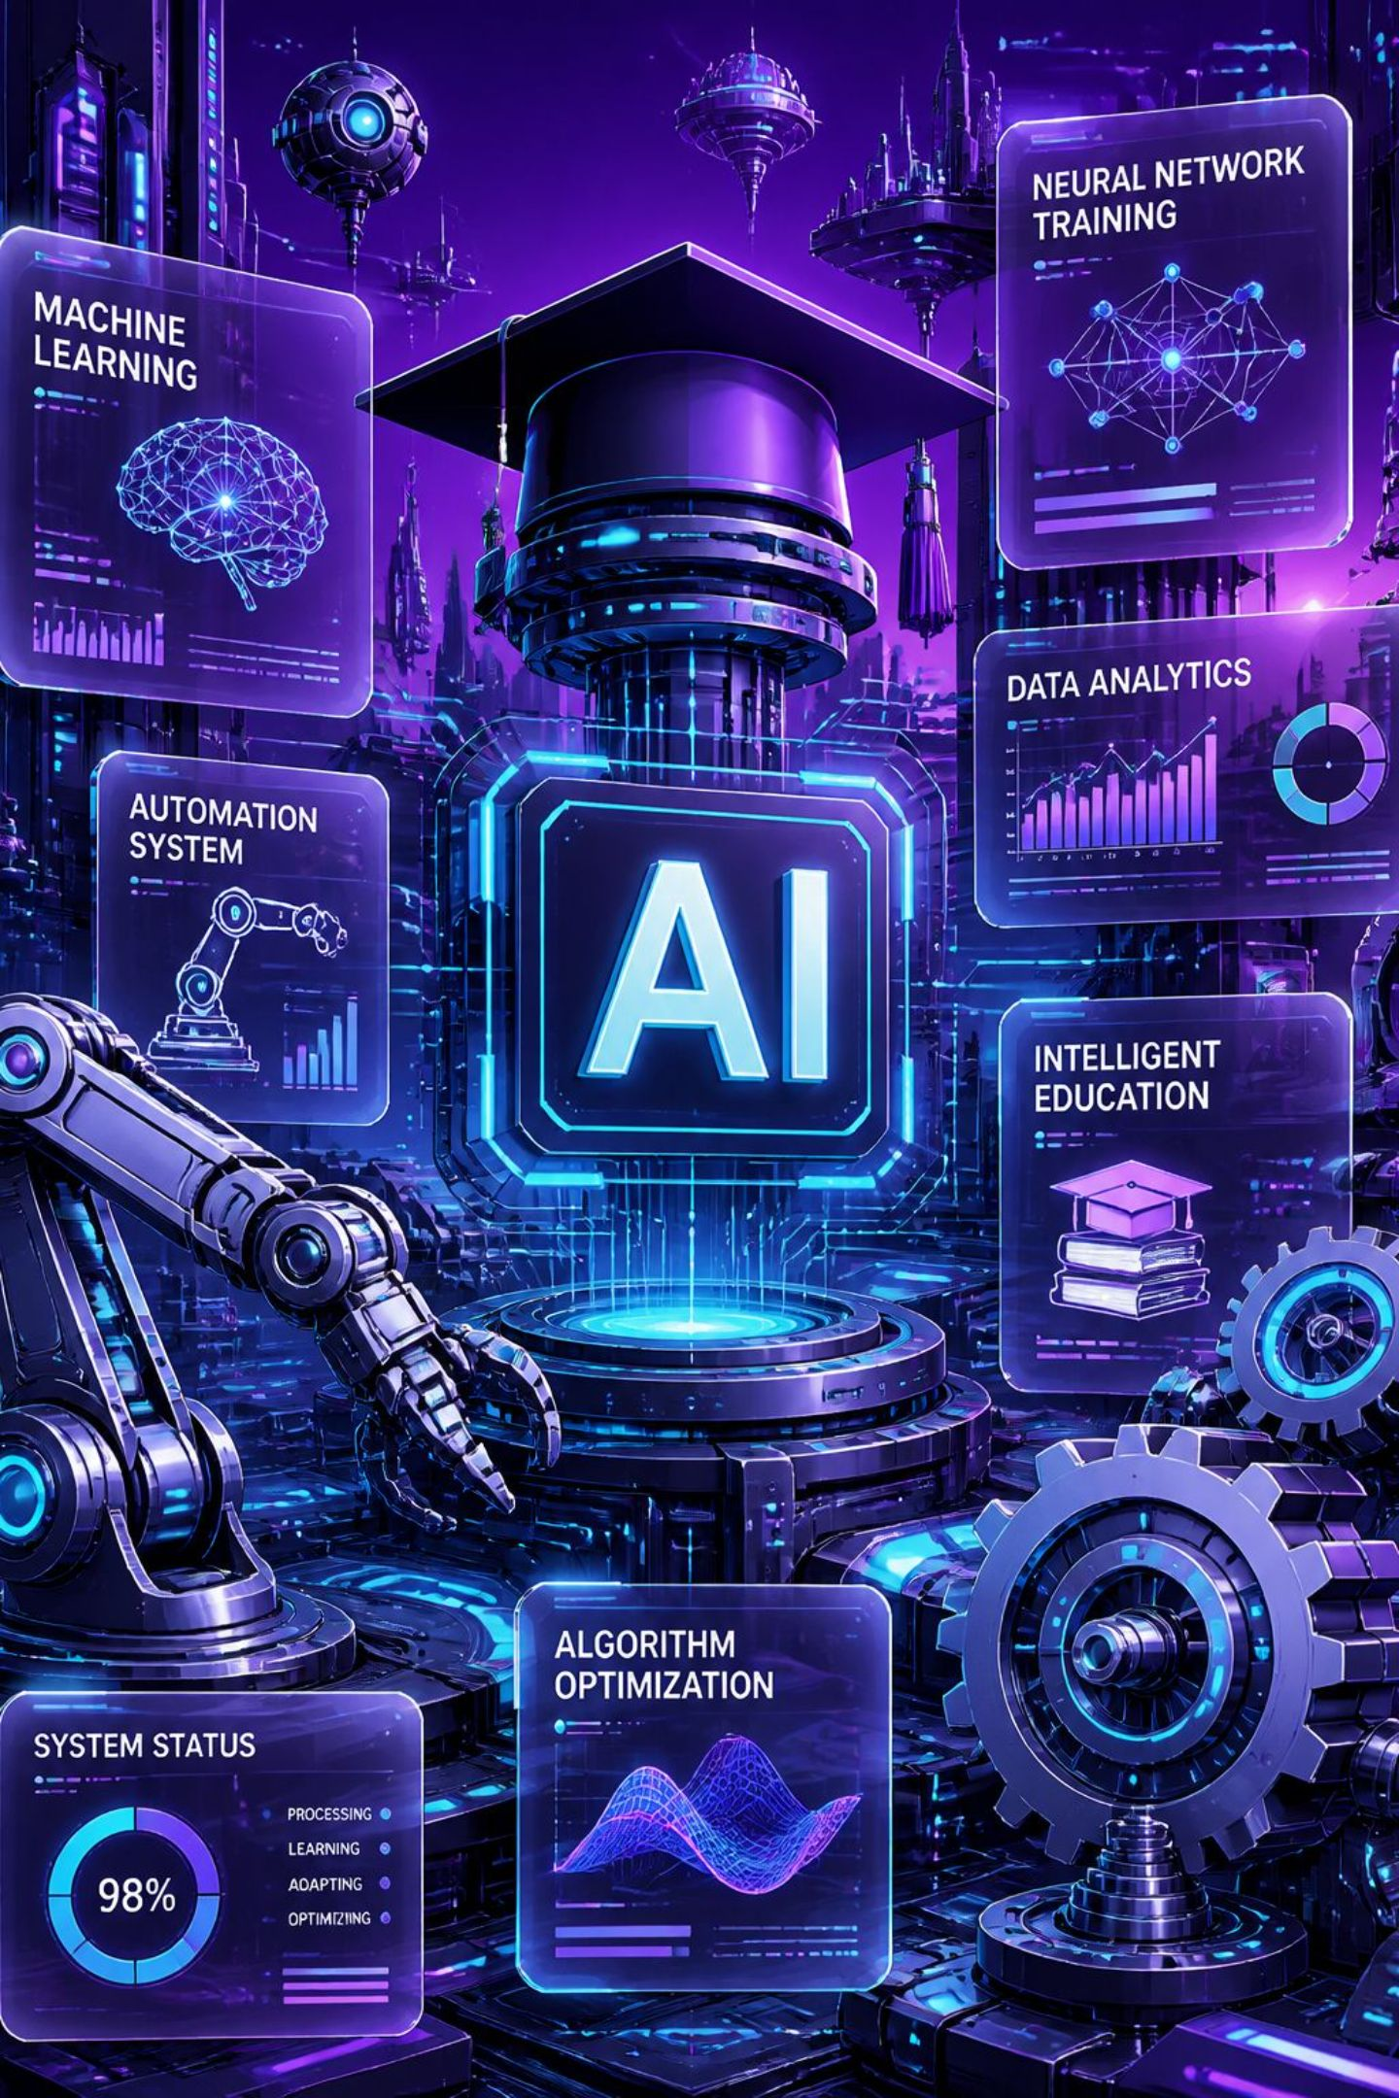
AI-Powered Career Guidance Platform
Smart Education & Career Automation using n8n, OpenAI GPT-4o-mini & Google Sheets
Author: Tirth Panchal
Tag: N8N Summer School '26 | Capstone Project | Assignment 14

Slide 2



The Problem
Limited personalised guidance
Manual counseling bottleneck
No automated skill-gap analysis
Students lack scalable, individualized career advice tailored to their skills and goals.
One-on-one counseling is time-consuming and doesn't scale across large cohorts.
Universities lack tools to automatically detect and recommend upskilling paths for each student.
Internship matching is manual
Follow-ups consume staff time
Recommendations and placements require significant human effort and coordination.
Weekly progress tracking and reminders take sustained human resources.
Many students graduate without a clear career roadmap.

Slide 3

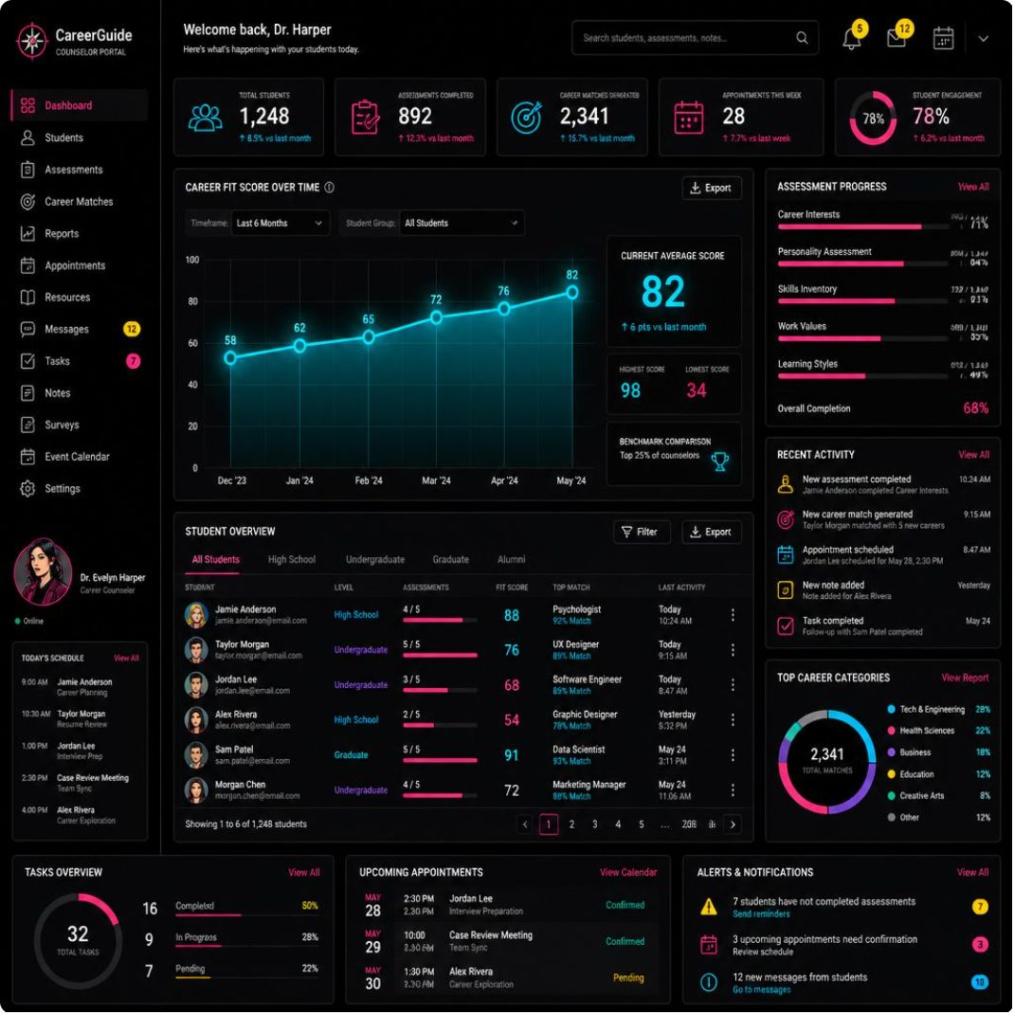
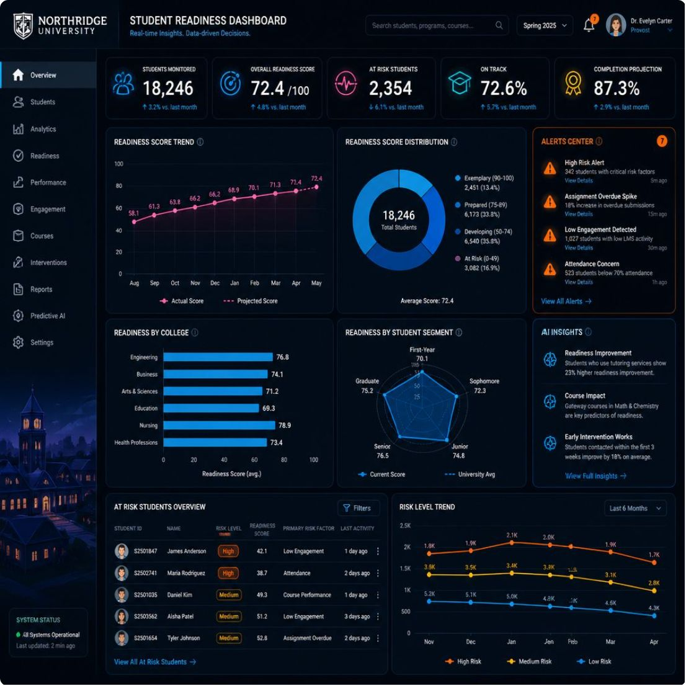
Who Is This Platform For?
Students
Career Counselors
University Management
Personalized AI career guidance
Automated skill-gap analysis
Actionable learning roadmap
Reduced manual effort
Automated reporting & alerts
Better tracking of student outcomes
Institution-wide readiness insights
Centralized student data
Performance monitoring & KPIs
Business Goal
Build a fully automated AI-powered career guidance platform with zero manual intervention.

Slide 4
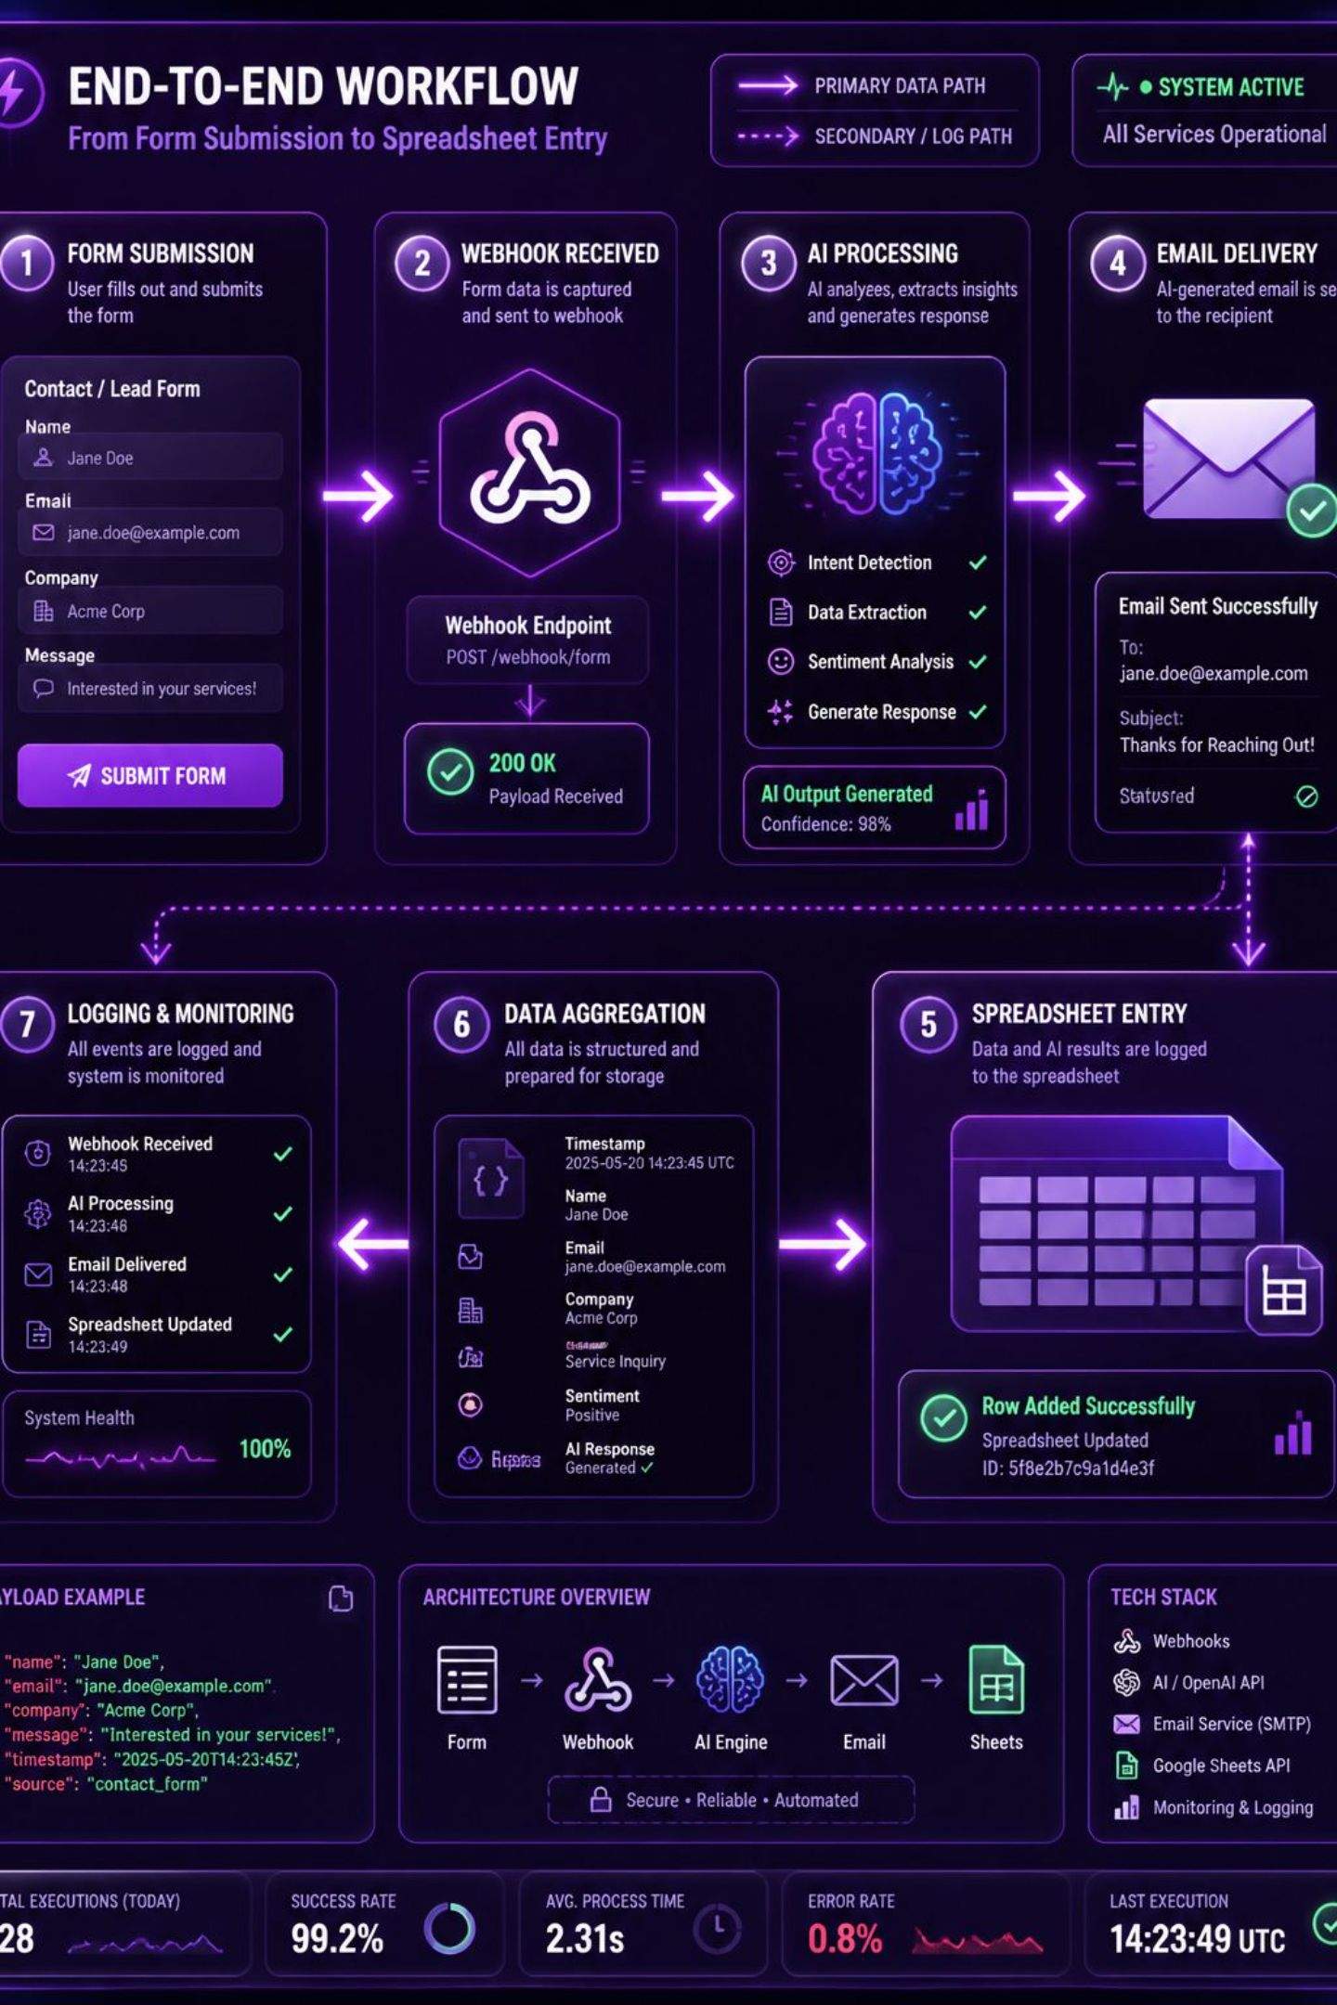
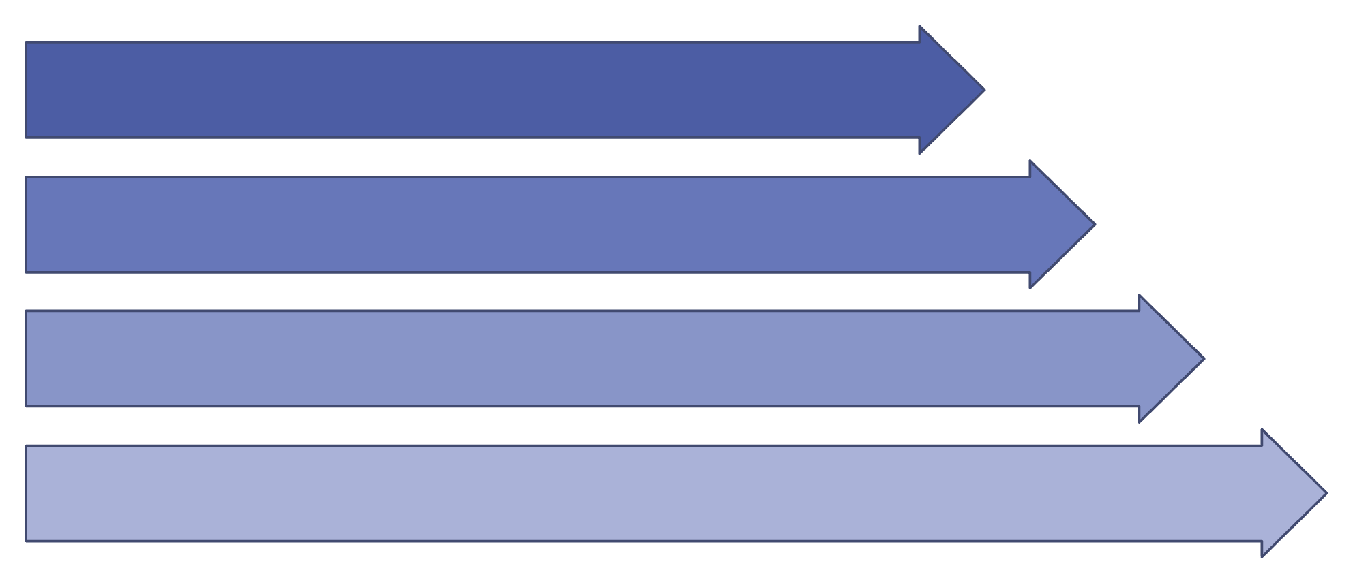
Complete Automation using n8n
Form Submission
Webhook Trigger
n8n Processing
OpenAI Analysis
From form submission to personalized career report in under 60 seconds. Real-time decisioning, conditional logic, and audit logging built into automated pipelines.

Slide 5
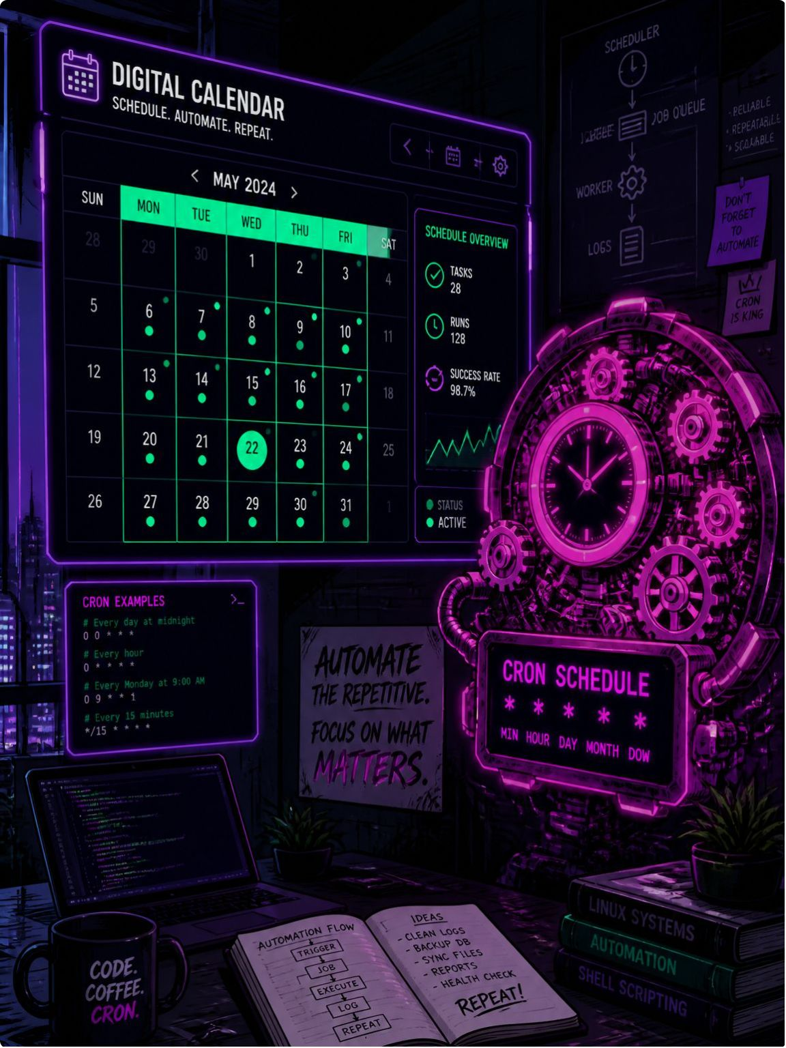

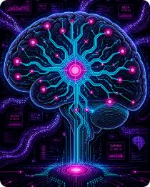


5-Workflow Architecture
WF-01
WF-02
WF-03
Student Registration & Data Processor
AI Career Recommendation Engine
Course & Internship Matcher
WF-04
HTML Report Dispatcher
WF-05
Weekly Progress Tracker (Cron-based automation, reminders, engagement logging)

Slide 6

Automation Workflow — Deep Dive
01
WF-01
Receive student form via webhook → Validate → Append to Google Sheets → Audit log entry
WF-01 Receive
02
WF-02
WF-02 Analyze
Generate AI prompt → OpenAI GPT-4o-mini → Skill-gap analysis → 4-week learning roadmap → Career & project recommendations
WF-03 Match
03
WF-04 Notify
WF-03
Course & internship matching using conditional rules and confidence thresholds
Each workflow is modular, testable, and independently deployable—allowing rapid iteration and fault isolation.
04
WF-04
Render HTML report → Send via Gmail API → Update report status in Sheets

Slide 7



Automation Features
Weekly Progress Tracker
Implemented
Cron scheduling, automated reminders, and engagement analytics to sustain student momentum.
Key features deployed and tested:
✅ OpenAI GPT Integration
✅ Google Sheets Database
✅ Gmail Automation
✅ HTML Email Reports
✅ Conditional Logic & Error Handling
✅ Audit Logging & Scheduling
Error Handling
Retry logic, alerting, and audit logs ensure reliable end-to-end automation.
Cloud-based Workflows
Hosted n8n backend with modular workflow orchestration and scalable infrastructure.

Slide 8
Technical Overview — At a Glance
5
25+
Independent Workflows
Workflow Nodes
3
1
External Integrations
Responsive Frontend
OpenAI · Google Sheets · Gmail
100%
<60s
Automated
Execution Time
End-to-end personalization delivered under 60 seconds

Slide 9
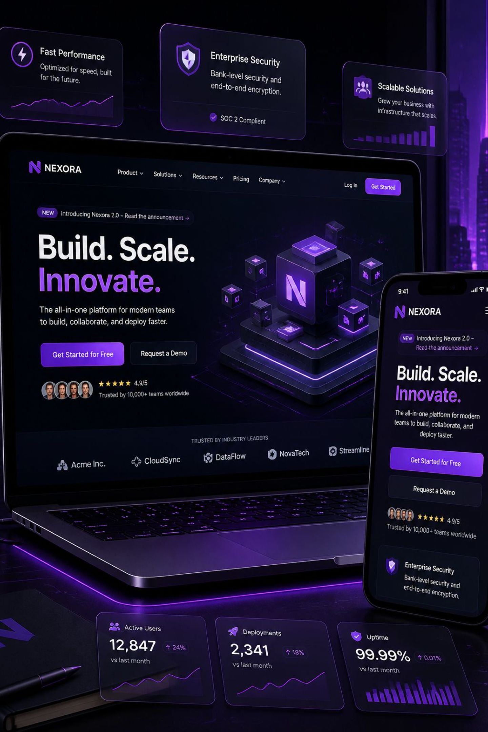
Live Project Demonstration 🚀
End-to-end flow — student fills form, n8n triggers pipelines, GPT-4o-mini generates recommendations, Google Sheets stores data, and HTML email reports are sent automatically.
Student visits the live site: https://tangerine-lolly-278d55.netlify.app/
Completes AI Career Assessment Form
Data lands in Google Sheets
OpenAI generates personalised recommendations
Student receives HTML email report
Weekly follow-ups continue automatically via WF-05
Repository: https://github.com/TirthPanchal123/n8n-career-guidance-platform

Slide 10
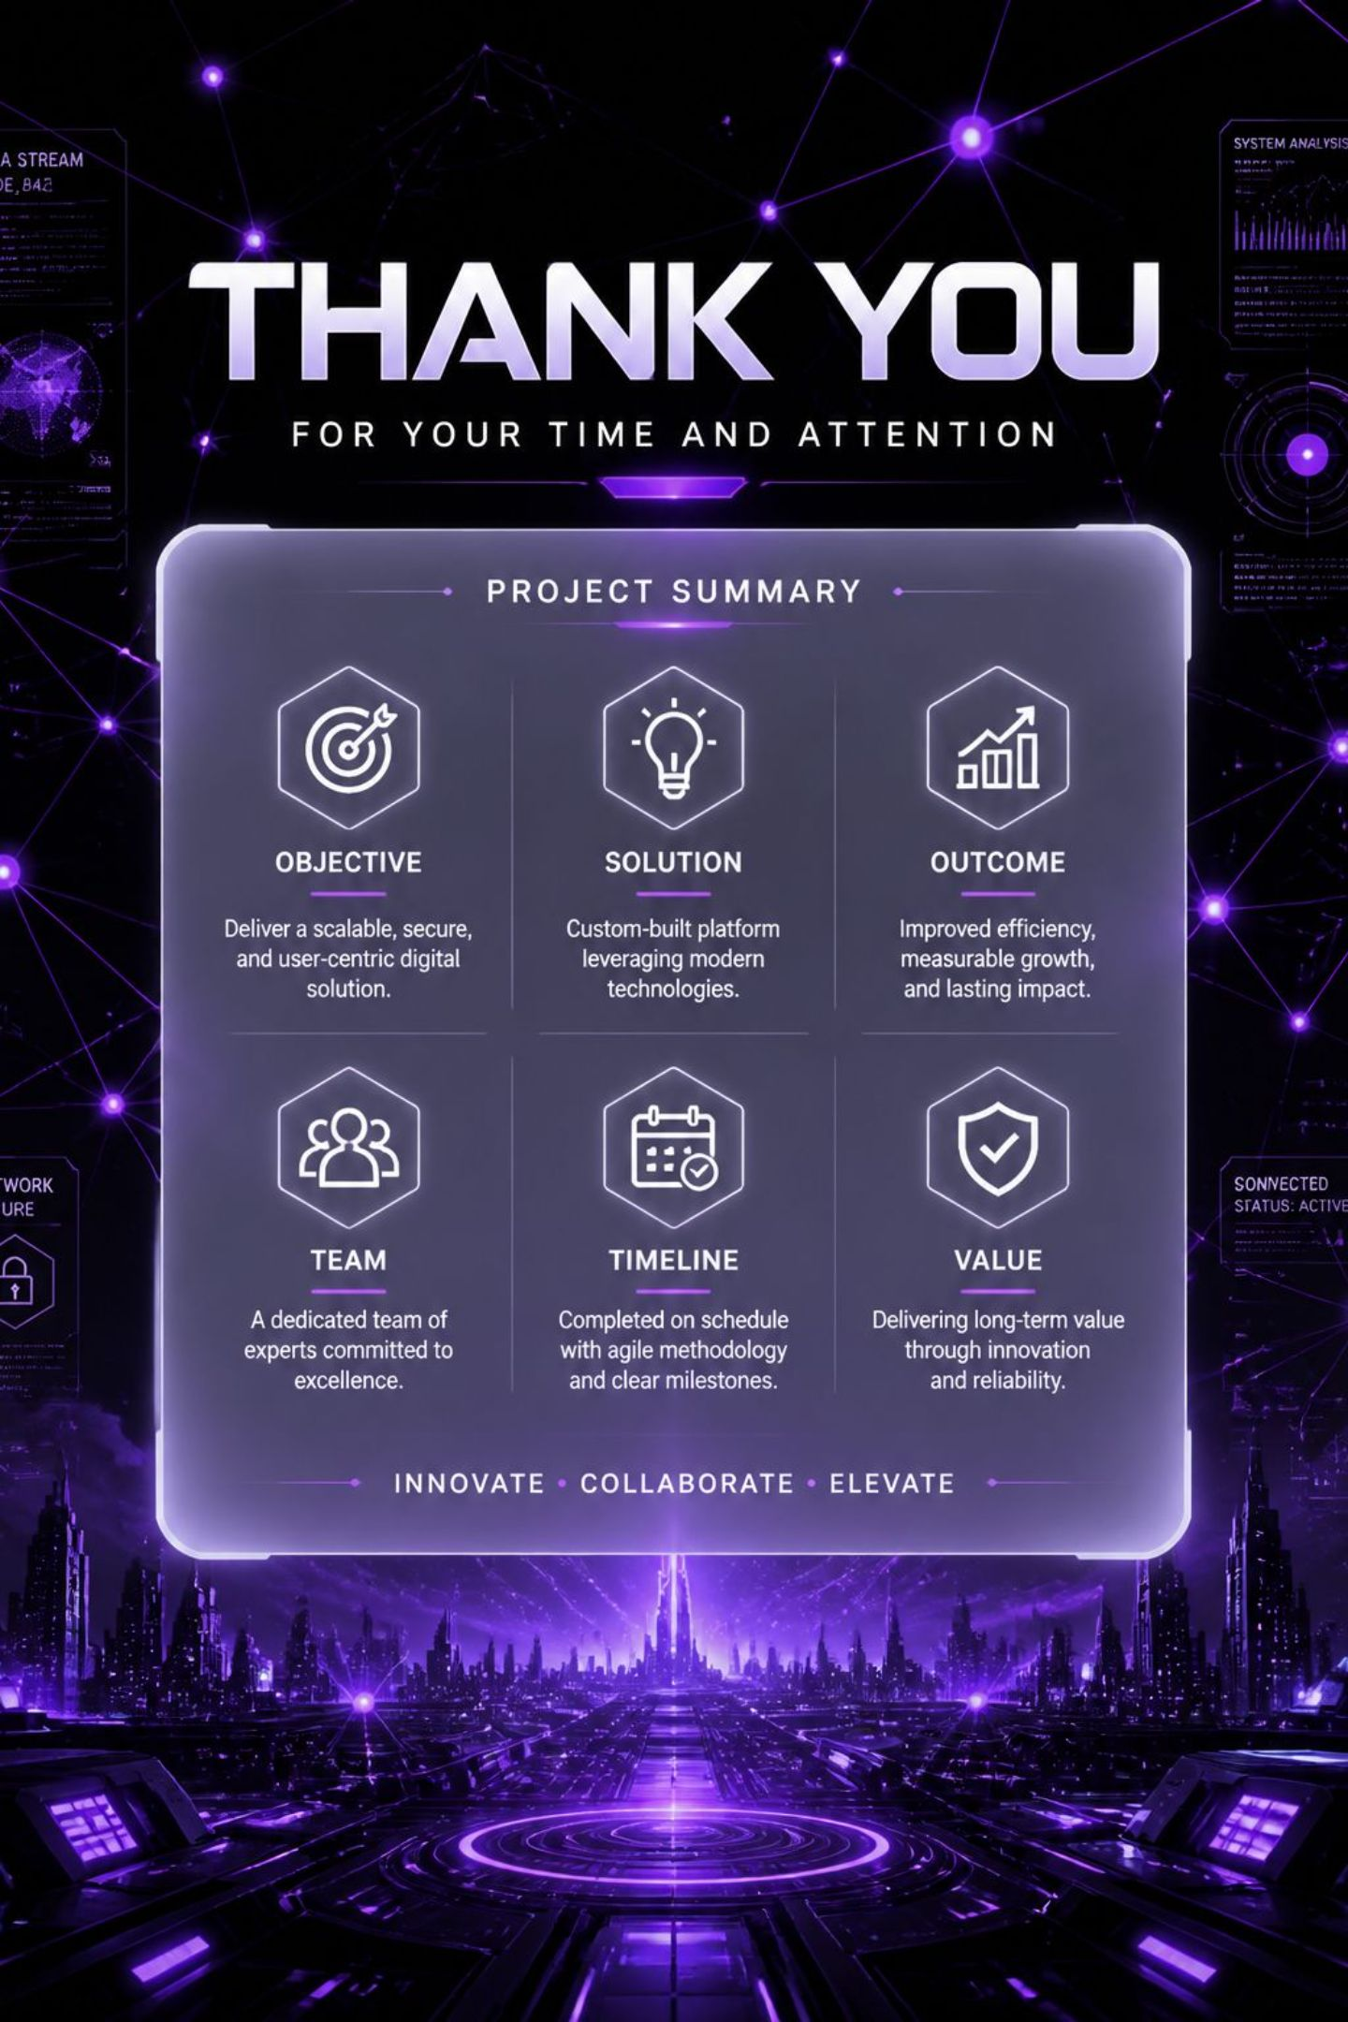

Thank You!
Project: AI-Powered Career Guidance Platform
Developed by: Tirth Panchal
Technology Stack
Links
n8n Cloud
OpenAI GPT-4o-mini
Google Sheets
Gmail API
HTML · CSS · JavaScript
Live Demo: https://tangerine-lolly-278d55.netlify.app/
GitHub: https://github.com/TirthPanchal123/n8n-career-guidance-platform
"Empowering every student with personalized AI-driven career guidance through intelligent workflow automation."

