Slide 1

Proposal
April 2026
DeepXube RAG Chatbot
Making the DeepXube codebase and research accessible via a retrieval-augmented generation assistant
PRESENTED BY
PROFESSOR
Tirth Patel
Prof. Forest Agostinelli

Slide 2
02 — PROBLEM STATEMENT
02 / 16
The access gap
DeepXube is a capable system. Navigating it shouldn't require a research internship.
WHAT EXISTS TODAY
WHAT A NEW USER FACES
PROF.'S STATED GOAL
Full Python library: deepxube-main/ — several thousand LOC across many modules
Q: "How do I define a custom environment?" → grep the source, read 6 files
"Make DeepXube easily accessible to outside users via the lab website."
~15 research papers (DeepCubeA, DeepXube, etc.) — dense, not cross-linked
Q: "What heuristic function does DeepXube train?" → find the right paper section
Target audience: researchers, students, and practitioners who understand the problem domain but not the codebase.
Auto-generated .md function docs with YAML frontmatter — rich but unsurfaced
Q: "What calls solve()?" → manual call-graph traversal
Result: high onboarding friction, underuse of the system
No guided entry point for outside researchers or practitioners

Slide 3
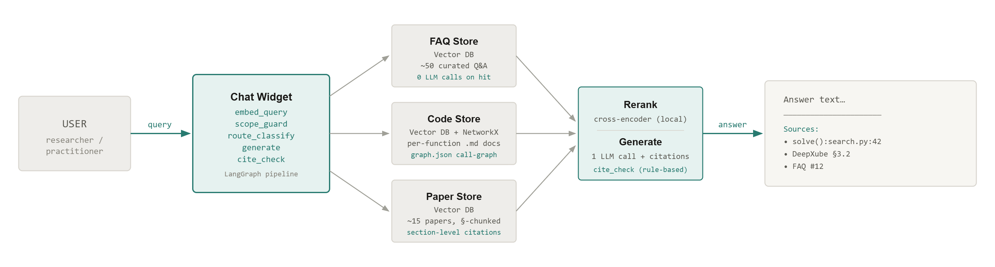
03 — PROPOSED SOLUTION
03 / 16
A RAG chatbot, embeddable on the lab website
One embedding call routes each query to a pre-built knowledge store — FAQ, code, or papers — and returns a grounded, cited answer with minimal LLM cost.

Slide 4
04 — DATA SOURCES
04 / 16
Most of the retrieval corpus already exists
SOURCE
LOCATION / FORMAT
KEY PROPERTIES
STATUS
Function docs
docs/functions/<mod>/<Class>/<fn>.md
YAML frontmatter: qualified_name, file:line, callees, reads_attrs — one doc per function. Already perfect retrieval units.
✓ Ready
Call graph
docs/graph.json
Nodes = functions/classes. Edges = caller→callee. Enables structural "what calls X?" traversal without any LLM call. Load once into NetworkX.
✓ Ready
Class + module docs
docs/classes/, docs/modules/
Higher-level summaries for broad "what does module X do?" queries. Supplement function-level retrieval.
✓ Ready
Research papers
~15 PDFs (DeepCubeA, DeepXube, related)
Need section-level chunking with metadata: paper_id, §section , page range. Standard PDF → text pipeline.
⟳ Ingest
FAQ store
To be hand-curated: {question, answer, sources}
Seed with ~30–50 entries. Later auto-promoted from approved misses. The single biggest cost-reduction lever.
⟳ Curate
The .md function docs have structured frontmatter for filtering and prose for semantic matching and source snippets for grounded answers. They were designed exactly for this use case.
Key insight —

Slide 5
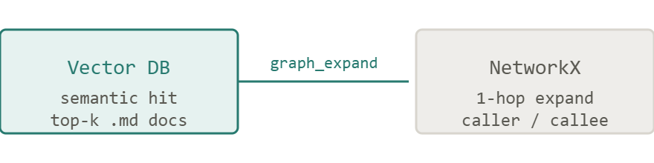
05 — ARCHITECTURE · STORES
05 / 16
Three purpose-built knowledge stores
FAQ Store
Vector DB
Code Store
Vector DB
NetworkX
Paper Store
Vector DB
Maps question embeddings → {canonical_answer, sources} . Returns answers with zero LLM calls on cache hit.
One vector per function/class .md doc. Semantic retrieval answers "what does X do?". Graph traversal answers "what calls X?" — no extra LLM call.
~15 papers chunked at section granularity . Each chunk carries paper_id + §section metadata. Enables citations users can actually verify.
THRESHOLD
CITATION FORMAT
cosine sim ≥ τ_{high} → cached
DeepXube §3.2 · p.5
Neo4j is overkill for ~hundreds of nodes. graph.json loaded in-memory is free infrastructure.
Section-level chunking balances context size vs. citation precision.
Grows over time: approved misses promoted automatically.

Slide 6
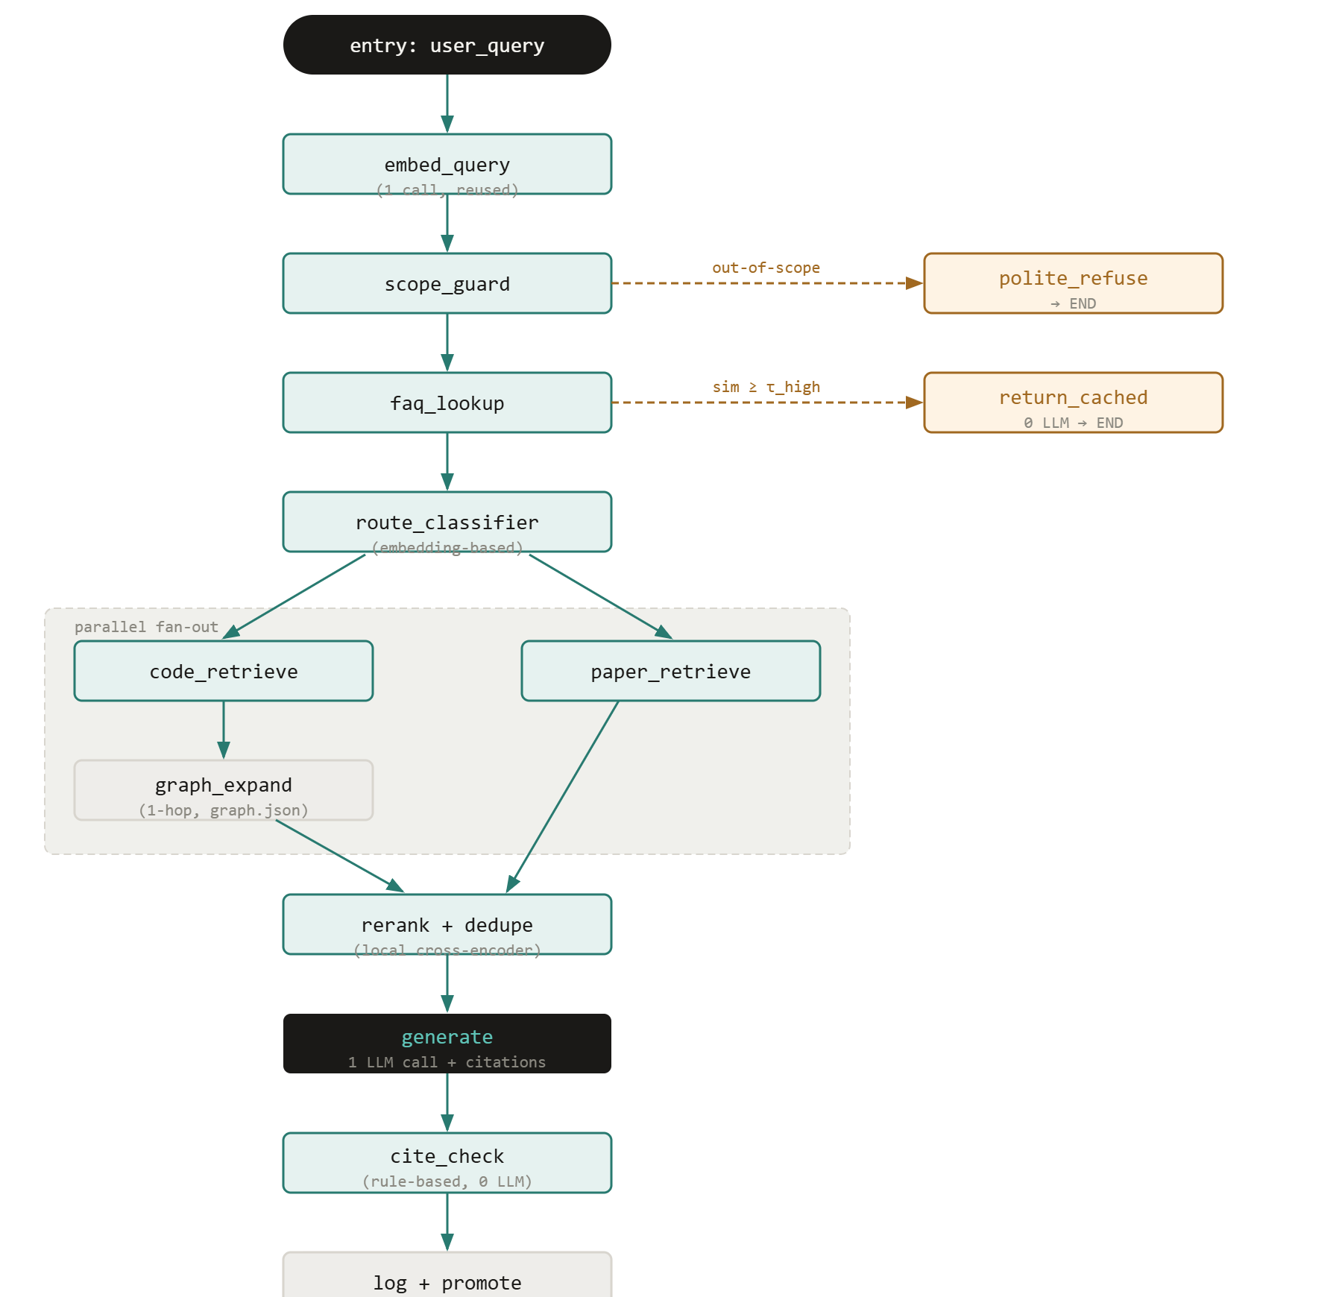
06 — ARCHITECTURE · LANGGRAPH PIPELINE
06 / 16
Pipeline walkthrough
A single embedding call is shared across all nodes. The graph has two early exits — out-of-scope and FAQ cache hit — that short-circuit before any LLM call.
Main flow (sequential / parallel)
Early-exit / terminal paths
LangGraph edge
Conditional branch
PARALLEL FAN-OUT
LangGraph's native fan-out runs code_retrieve and paper_retrieve concurrently; results join at rerank.

Slide 7
07 — ROUTING & COST STRATEGY
07 / 16
FAQ-first, embedding-based routing
One embedding call per query. No LLM used for routing decisions.
DECISION LOGIC
LLM CALLS PER PATH
q_emb = embed(query) # 1 call, reused sim = cosine(q_emb, faq_store) if sim ≥ τ_high: # e.g. 0.92 return cached_answer # 0 LLM calls route = classifier(q_emb) # linear probe # → {code, papers, both} if route == "code": retrieve(code_store, q_emb) elif route == "papers": retrieve(paper_store, q_emb) else: retrieve(both) # parallel fan-out
PATH
LLM CALLS
Out-of-scope
0
template response
FAQ cache hit
0
free
Code-only query
1
+ 1 retry max
Paper-only query
1
+ 1 retry max
Code + papers
1
merged context
RERANKER
Cross-encoder (e.g. ms-marco-MiniLM ) runs locally — no API cost, no latency dependency. Deduplicates overlapping code + paper hits before the generate step.

Slide 8
08 — MEMORY & CITATIONS
08 / 16
Bounded memory. Verifiable citations.
CONVERSATION MEMORY
CITATION STRATEGY
Rolling summary (≤ 200 tokens) + last 2 turns verbatim. No growing transcript — history is compressed, not appended.
SOURCE TYPE
CITATION FORMAT
Code function
qualified_name · file:line_start
FOLLOW-UP RESOLUTION
From YAML frontmatter — no LLM inference needed
User: "where is that called from?" → prepend rolling summary to new query → re-run retrieval → no need to re-send full prior context to LLM
Keeps context token cost flat regardless of conversation length.
Research paper
paper_id §section · p.N
Section-chunked at ingest time
FAQ entry
FAQ #{id}
Includes original sources from curation
CITE_CHECK NODE
Structural / regex check — every claim in the generated answer must match a retrieved source identifier. If not, triggers one retry. Zero LLM calls.

Slide 9
09 — TECH STACK
09 / 16
Stack — fixed decisions and open choices
COMPONENT
CANDIDATE(S)
RATIONALE
STATUS
Orchestration
LangGraph
Native fan-out, conditional edges, streaming — matches our pipeline exactly.
Fixed
Graph traversal
NetworkX (in-memory)
graph.json is small (~hundreds of nodes). No separate DB process needed.
Fixed
Reranker
ms-marco-MiniLM-L-6-v2
Runs locally, no API cost. Standard cross-encoder for passage reranking.
Fixed
Vector DB
Chroma · LanceDB · Pinecone
Chroma / LanceDB for local prototype (free, zero infra). Pinecone / Weaviate if hosted scale is needed.
Open
Embedding model
text-embedding-3-small · open alternatives
OpenAI is cheap + strong baseline. Could swap to local model to eliminate API dependency.
Open
LLM (generate)
claude-haiku-4-5 · gpt-4o-mini
Small, fast, cheap. One call per novel query. Haiku preferred for latency.
Open
Backend / API
FastAPI
Thin wrapper around LangGraph. Exposes /chat endpoint for the widget.
Fixed
Frontend widget
Embeddable JS chat widget
Drops into existing website with a single <script> tag.
Fixed
Open
= decision where your input is wanted — see slide 11

Slide 10
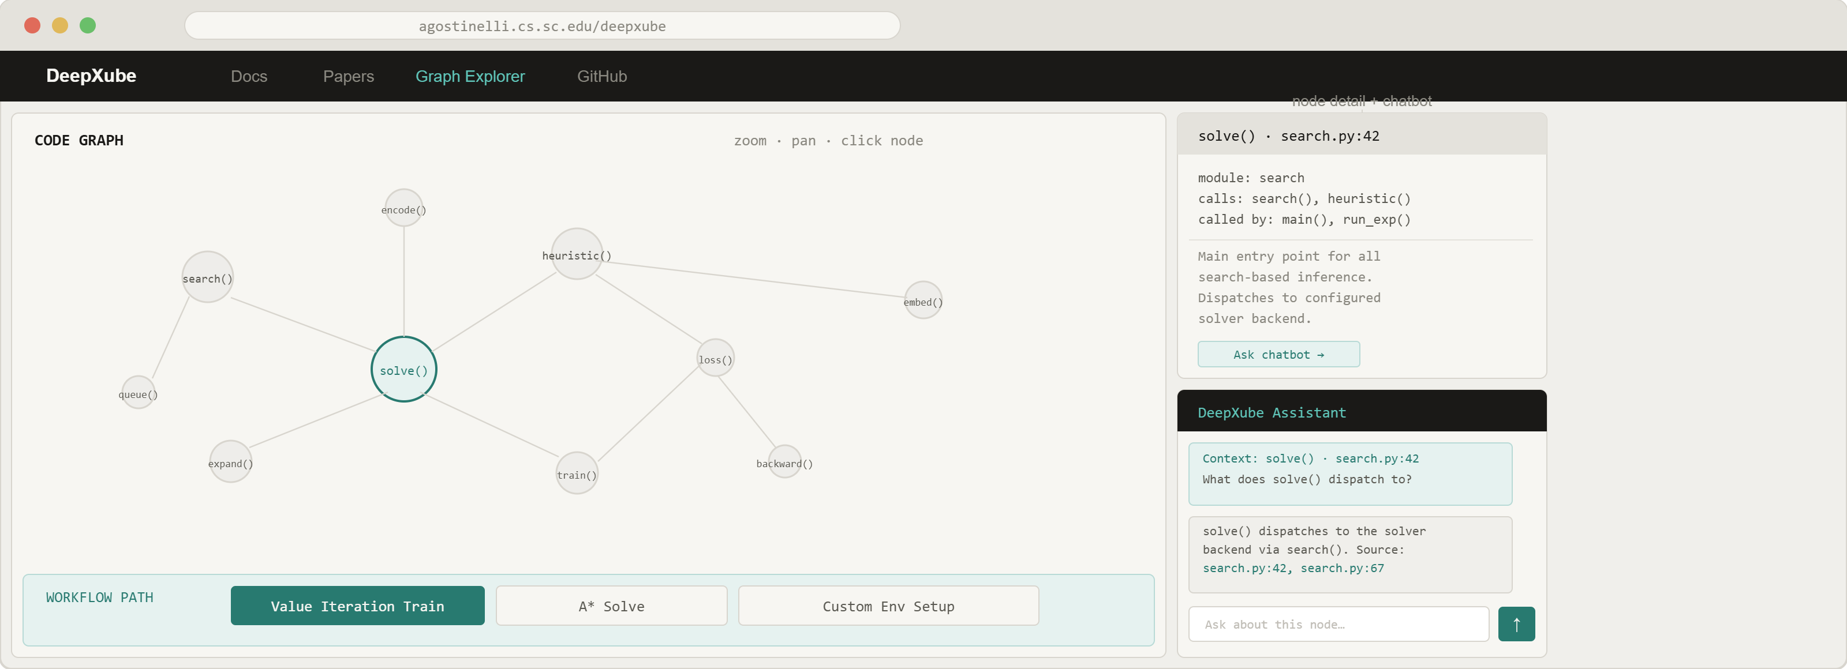
13 — WEBSITE REDESIGN
13 / 16
The website becomes a knowledge environment
Three components, one surface — graph explorer, workflow tracer, and chatbot working together.

Slide 11
14 — INTERACTIVE CODE GRAPH
14 / 16
graph.json → live, navigable visualization
The call graph we already use for retrieval becomes the primary navigation surface of the website.
WHAT GETS RENDERED
INTERACTION MODEL
Nodes — every function and class in the codebase. Sized by call-degree.
USER ACTION
RESPONSE
Edges — caller → callee directed edges from graph.json . Already computed, zero extra work.
Click node
Load .md doc panel + pre-fill chatbot context
Modules — color-coded by module; visible as soft clusters.
Hover node
Show tooltip: qualified name, module, call count
Zoom / pan — standard graph navigation. Force-directed layout with module gravity.
Search bar
Filter + zoom to matching nodes
Module filter
Isolate subgraph by module
CLICK A NODE
Select workflow
Trace path → highlight / fade (see slide 15)
Side panel loads the .md doc: signature, parameters, docstring, source snippet
Immediate chatbot context injection: "Ask about solve()"
CANDIDATE LIBRARIES
1-hop neighbors highlighted; rest dimmed
Cytoscape.js
Preferred
Purpose-built for biological/code graphs. Rich layout algorithms, styling API.
D3.js force layout
Open
DATA SOURCE
More customizable, more implementation work. Better if bespoke visual design is a priority.
graph.json is already the retrieval backbone. The visualization is a zero-cost frontend layer on top of it — no new graph computation needed.

Slide 12
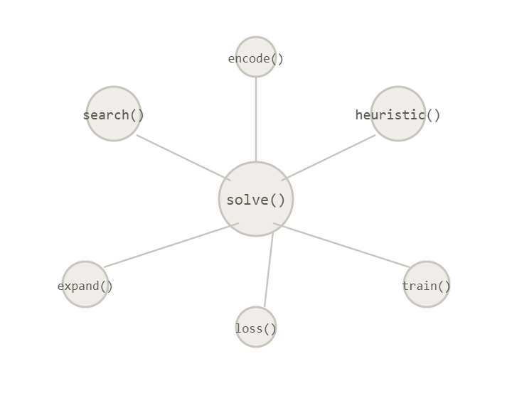
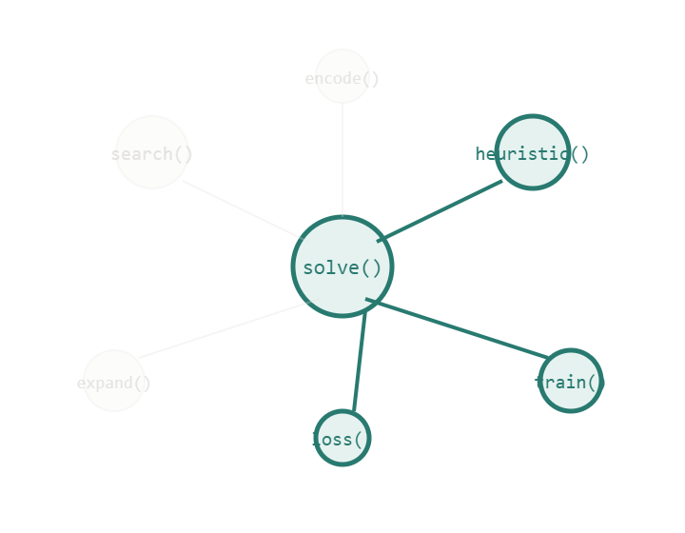
15 — WORKFLOW PATH HIGHLIGHTING
15 / 16
"Show me value iteration training" → graph traces the path
Preset workflows trigger a subgraph traversal. Relevant nodes stay vivid; everything else fades.
DEFAULT — ALL NODES EQUAL
PATH HIGHLIGHTED
HOW IT WORKS
Preset workflows — curated entry-point function lists (e.g. value iteration starts at train())
select "Value Iteration Train"
→
BFS/DFS traversal — walks graph.json from the entry point, collecting all reachable nodes within a depth limit
Visual diff — in-path nodes rendered at full opacity + accent stroke; out-of-path nodes at ~10% opacity
Ordered step view — optionally animate the traversal order to show the execution sequence
CHATBOT SYNC
When a workflow is selected, the chatbot is pre-prompted with the path context — "You are viewing the value iteration training path: train() → heuristic() → loss() ". Follow-up questions resolve against this subgraph automatically.
OPEN QUESTION
How many preset workflows should ship at launch? Suggest: 3–5 canonical paths. Should users be able to define custom entry points?

Slide 13
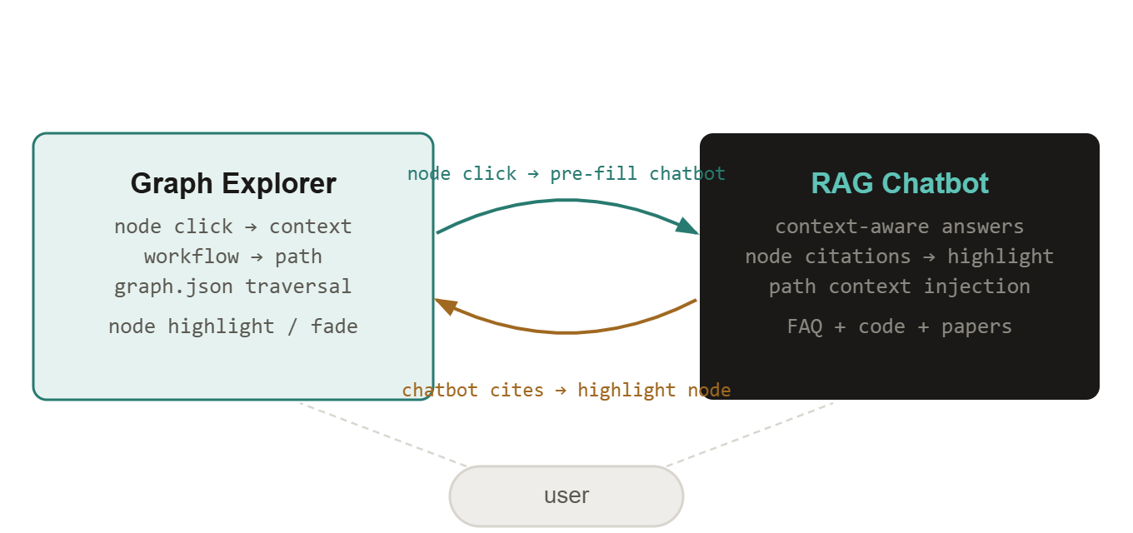
16 — INTEGRATED EXPERIENCE
16 / 16
Graph and chatbot as one system
The two components are not independent — they share context and reinforce each other.
BIDIRECTIONAL CONTEXT FLOW
REVISED SCOPE SUMMARY
COMPONENT
COMPLEXITY
RAG chatbot
As proposed — Stages 1–6
Graph visualization
Medium — Cytoscape.js + graph.json
Path highlighting
Low — BFS over existing graph data
Graph ↔ chatbot sync
Low — shared context object in frontend
The chatbot already cites qualified_name · file:line — those references can directly trigger node highlights in the graph. No new data pipeline needed.
Website redesign
Open — scope TBD with you
Q5 — WEBSITE REDESIGN SCOPE
Build the graph explorer as a standalone page first, then integrate into the existing site? Or redesign the full site from scratch with the graph as the centerpiece? The chatbot + graph can ship independently of a full redesign.
Suggested sequence: (1) ship chatbot, (2) add graph explorer page, (3) wire bidirectional context, (4) revisit site-wide redesign.

Slide 14
11 — OPEN QUESTIONS
11 / 16
Four decisions where your input shapes the design
Q1 — PROVIDER LOCK-IN
Q3 — FAQ CURATION WORKFLOW
Should we commit to OpenAI for embeddings + LLM from the start, or prototype with a local embedding model to avoid vendor dependency? Both are viable at prototype scale.
Manual weekly review of logged misses, or auto-promotion with approval threshold? Auto-promotion scales better but requires a review interface. How much curation bandwidth is realistic?
Q2 — HOSTED VS. SELF-HOSTED VECTOR DB
Q4 — SCOPE: EXPLANATION ONLY VS. RUNNABLE CODE GENERATION
Local Chroma / LanceDB is free and sufficient for the corpus size. Hosted Pinecone simplifies deployment but adds cost + a service dependency. Preference?
The current proposal is explanation + citation — grounded answers with source references. Should the bot also generate runnable code examples? This widens scope significantly and raises citation complexity.

Slide 15
10 — ROADMAP
10 / 16
Six stages, two already underway
01
Finalize codebase documentation
Complete
Auto-generated .md function docs in deepxube-main/docs/. YAML frontmatter, call-graph, module summaries — complete.
02
Ingest pipeline — code store
In progress
Vectorize .md function docs → Vector DB. Load graph.json → NetworkX in-memory graph.
03
Ingest research papers
Up next
PDF → section-chunked text → Vector DB. Tag each chunk with paper_id + §section + page range.
04
Seed FAQ store
Planned
Hand-curate ~30–50 Q&A entries covering the highest-frequency expected questions. Establish promotion workflow for approved misses.
05
Build and deploy LangGraph pipeline
Planned
All nodes end-to-end. FastAPI endpoint. Internal evaluation on held-out query set.
06
Embed widget on website · close the feedback loop
Planned
Deploy chat widget. Log queries. Grow FAQ from approved misses. Monitor citation quality.

Slide 16
12 — NEXT STEPS
12 / 16
WHY THIS APPROACH IS THE RIGHT FIT
What happens after this meeting
The .md docs are already perfect retrieval units — structured, grounded, citable
Pending your feedback on the four open questions, the path forward is clear.
graph.json gives structural knowledge for free
Resolve the four open decisions (provider, DB, FAQ workflow, scope)
Complete Stage 2: code store ingest + NetworkX load
Begin paper ingest pipeline (Stage 3)
Align on evaluation criteria: what does "good enough to ship" look like?
Schedule a demo review after Stage 5 (LangGraph end-to-end)
FAQ-first routing directly targets the cost constraint
No new infrastructure: runs on existing hosting
PROPOSAL BY
Tirth Patel
University of South Carolina · April 2026

