Slide 1
PyPower Projects
Geo-Coding
(Extracting Co-Ordinates )
In Python

Slide 2
Concept Of Geo-Coding
What Is Geocoding??
Geocoding is the process of transforming a given Address into a pair of coordinates that points to a location on the Earth's surface.
We can quickly find various kinds of locations through geocoding.
It can come in a variety of styles and formats, including street intersections, house numbers with street names, and postal codes.
PyPower Projects
Geo-Coding (Extracting Co-Ordinates)

Slide 3
Why Geo-Coding??
2 Points For Adapting Geo-Coding
Making Virtual Points on Earth
This Makes any Laymen to Understand the Locations their Variants and Consequences On a Global Scale.
Visualization Becomes Simpler
Visualization
Virtualization
In-Order to make Proper Points to Visualize the Idea of Pros-Cons Over an Area.
PyPower Projects
Geo-Coding (Extracting Co-Ordinates)

Slide 4
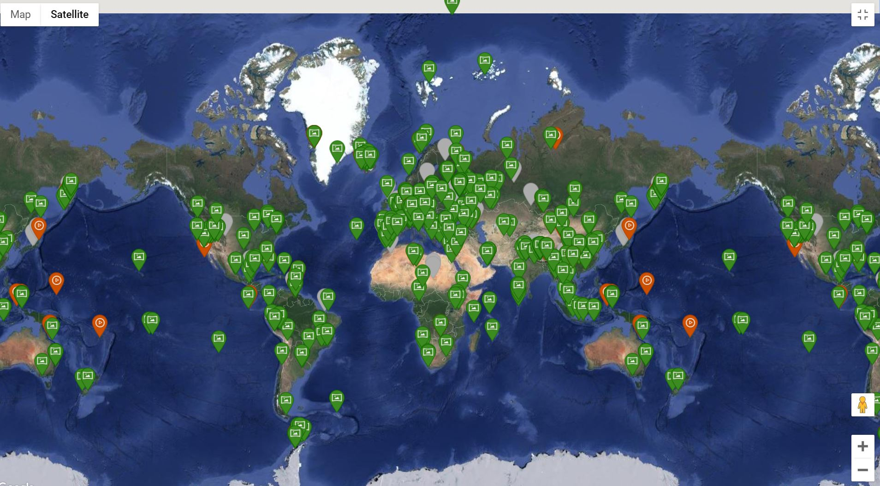
View Of Geo-Coding
PyPower Projects
Geo-Coding (Extracting Co-Ordinates)

Slide 5
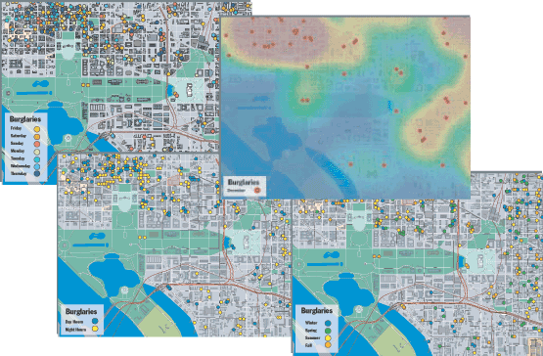
1. Address data analysis
Applications Of Geo-Coding
With geocoded addresses, you can spatially display the address locations and begin to recognize patterns within the information. This can be done by simply looking at the information or by using some of the analysis tools available with ArcGIS. You can also display your address information based on certain parameters, allowing you to further analyze the information.
PyPower Projects
Geo-Coding (Extracting Co-Ordinates)

Slide 6
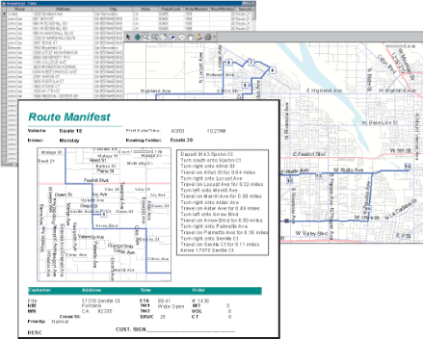
2. Customer data management
Applications Of Geo-Coding
Geocoding acts as a crucial part of customer data management. Nearly every organization maintains address information for each customer or client. This is usually in tabular format, containing the customer name, address, buying habits, and any other information you have collected. Geocoding allows you to take your customers' information and create a map of their locations. Using a variety of related applications, you can use this information in many ways, from establishing marketing strategies to targeting specific clusters of customers to producing route maps and directions. The geocoded locations of your customers can be invaluable data.
PyPower Projects
Geo-Coding (Extracting Co-Ordinates)

Slide 7
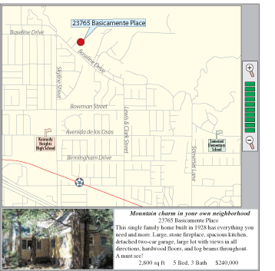
3. Distributed Geo-Coding Applications
Applications Of Geo-Coding
You can use various methods to share your geocoding functionality. These include everything from collecting the address locators and sharing via a compressed file or compact disc to developing an online application, allowing users to do geocoding over the Internet.
PyPower Projects
Geo-Coding (Extracting Co-Ordinates)

