Slide 1
MS COMPUTER SCIENCE — CAPSTONE
Motivational Interviewing Chatbot.
Fine-tuned Gemma 2 + retrieval + safety layer + a clean end-user web app, all on top of one Python pipeline.
Tirth Shah · 2026

Slide 2
01 — THE PROBLEM
Empathy doesn't scale. Confrontation backfires.
High-risk alcohol use is one of the largest preventable health burdens, but Motivational Interviewing (the evidence-based approach) requires a trained counselor.
General-purpose LLMs default to advice-giving and confrontation, which is exactly what drives ambivalent or defensive users away.
What's missing a small, local, fine-tuned model that knows MI, recognizes user state, retrieves the right counseling guidance, and stays within explicit safety boundaries.
THE PROBLEM
02 / 13

Slide 3
02 — THE APPROACH
Motivational Interviewing.
Four principles. Reflective by design — not directive.
Express empathy — meet the user where they actually are.
Roll with resistance — do not push back; reflect.
Support autonomy — the choice is theirs, always.
Develop discrepancy — let them notice the gap themselves.
Why MI fits an LLM: models are bad at confrontation but reasonable at reflective listening — the technique plays to a strength.
MOTIVATIONAL INTERVIEWING
03 / 13

Slide 4
03 — WHAT I BUILT
One pipeline. Two interfaces.
Fine-tuned core google/gemma-2-2b-it tuned with LoRA on the AnnoMI dataset plus ~1,000 synthetic MI conversations I generated with Claude.
Retrieval-augmented FAISS over a curated MI knowledge base (OARS, anti-patterns, stage-of-change, real AnnoMI excerpts), top-3 per turn, biased by user state.
Safety layer regex-based crisis and medical-boundary detection before AND after the LLM call. Per-turn JSONL audit log for every conversation.
Two faces a Streamlit dev/eval app that exposes internal state, and a clean React + FastAPI end-user web app — same backend, different audience.
WHAT I BUILT
04 / 13

Slide 5
04 — ARCHITECTURE
Six stages, every turn.
User message in, audited response out. No black box.
1. Input safety regex match for crisis ideation or restricted topics; if triggered, short-circuit with the resource response.
2. State inference score emotion (7-way) and defensiveness (4-way) — used silently to steer style, never surfaced to the user.
3. RAG retrieval top-3 MI knowledge chunks via FAISS, weighted by inferred state.
4. Response generation fine-tuned mi-therapist on Ollama (Claude Haiku is a transparent fallback).
5. Output safety screen for medical-advice patterns; replace if matched.
6. Audit log one JSONL entry per turn — state, safety, retrieved chunks, full text.
ARCHITECTURE
05 / 13

Slide 6
05 — FINE-TUNING
LoRA on Gemma 2, deployed via Ollama.
Base model google/gemma-2-2b-it — small enough to run locally on CPU, instruction-tuned out of the box.
Method Parameter-Efficient Fine-Tuning (LoRA via PEFT). Trained on a Colab T4.
Training data AnnoMI alcohol-only subset (~676 KB, 363 dialogue examples) + ~1,000 synthetic MI conversations covering short / medium / long / mixed-defensiveness scenarios.
Deployment merged + quantized to 4-bit GGUF (Q4_K_M, 1.6 GB). Registered with Ollama as `mi-therapist`. Total turn latency on CPU: ~2–4 seconds.
FINE-TUNING
06 / 13

Slide 7
06 — SYNTHETIC DATA
Real MI transcripts are rare. So I generated more.
Claude simulates both sides of a session, parameterized by scenario type.
Scenario types short (single-turn), medium (3–5 turns), long (8–12 turns), mixed-defensiveness (user shifts between open and resistant).
Generator scripts/generate_synthetic_data.py prompts Claude with explicit MI guardrails: no advice-giving, no closed questions, simple-then-complex reflections, vary openers.
Output 1,000+ conversations as JSONL batches under data/synthetic/, deduplicated and merged into the fine-tuning split.
Why this works real AnnoMI is too small to train on alone; synthetic data widens coverage of scenario shapes a 363-example set can't hit.
SYNTHETIC DATA
07 / 13

Slide 8
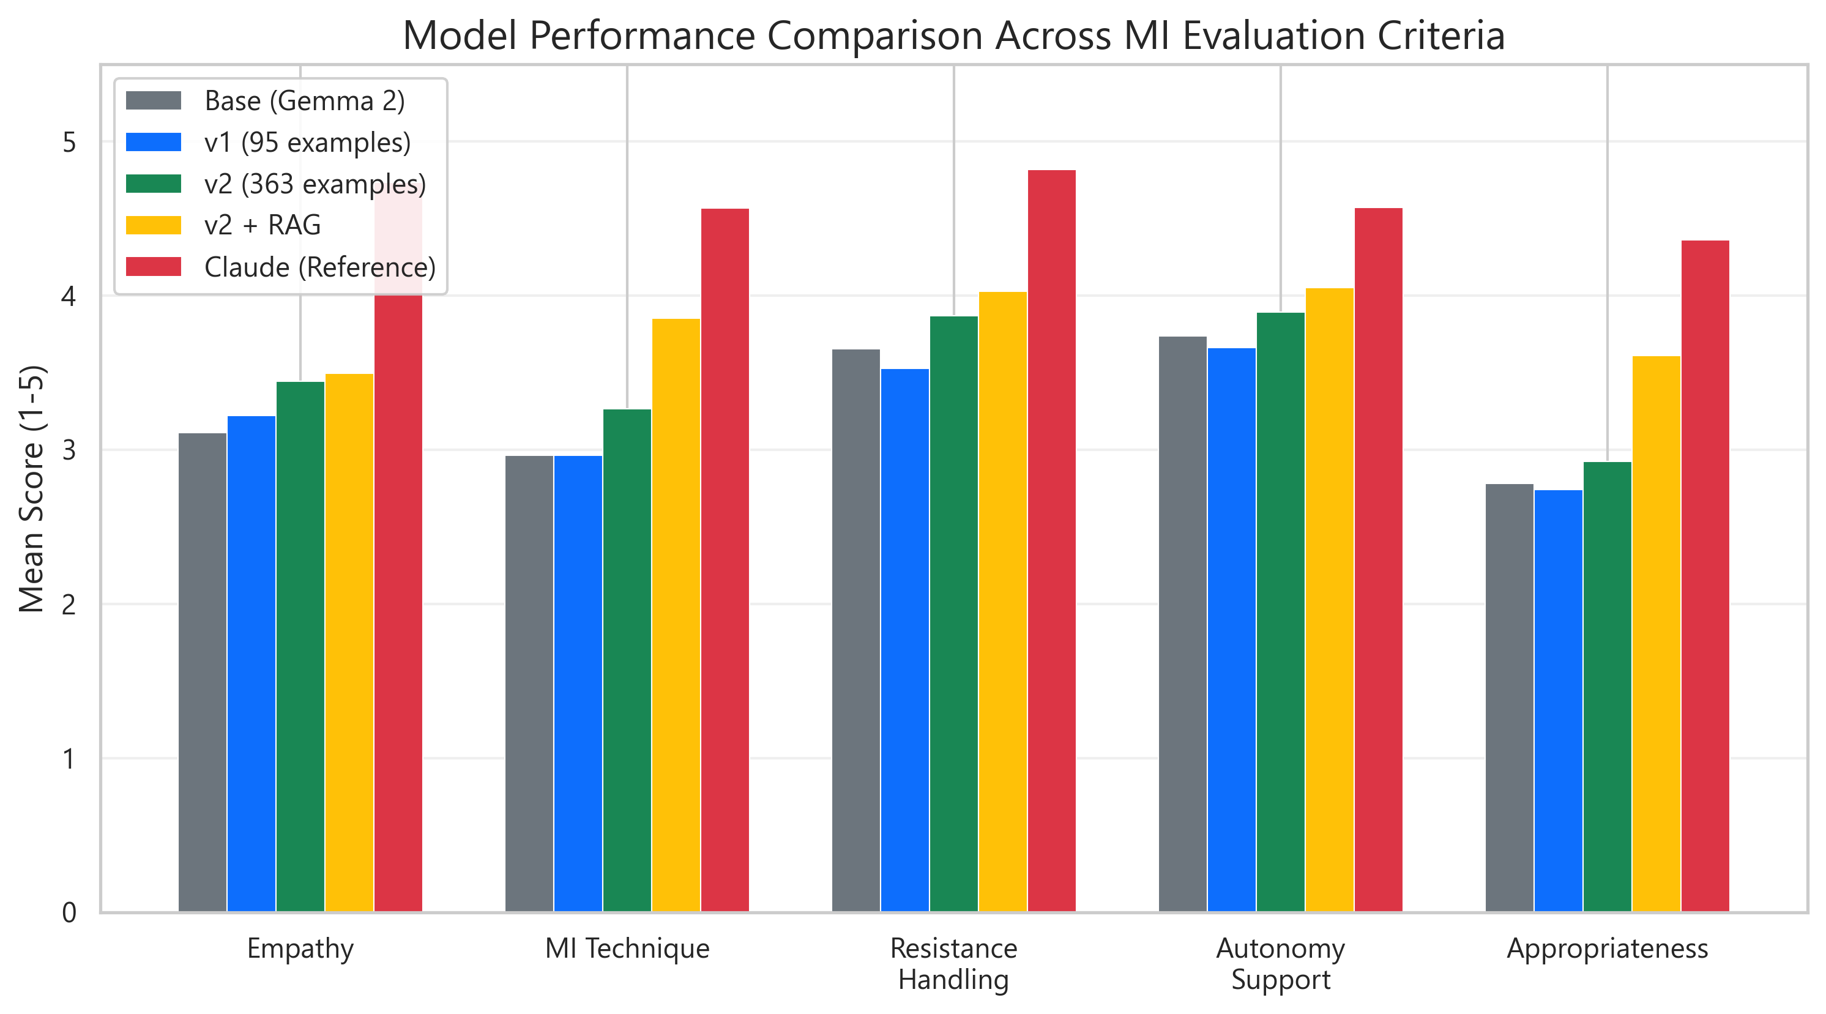
07 — EVALUATION
LLM-as-judge across MI dimensions.
Test set 20 handcrafted user turns spanning emotion × defensiveness.
Judge Claude Sonnet, scored on a 1–5 scale across five MI dimensions.
Configs Base Gemma 2 → v1 → v2 → v2 + RAG → Claude as reference.
Why human MI scoring is too slow for iteration; LLM-as-judge correlates well enough to be a coarse signal.
v2 + RAG closes most of the gap to Claude on technique and resistance handling.
EVALUATION
08 / 13

Slide 9
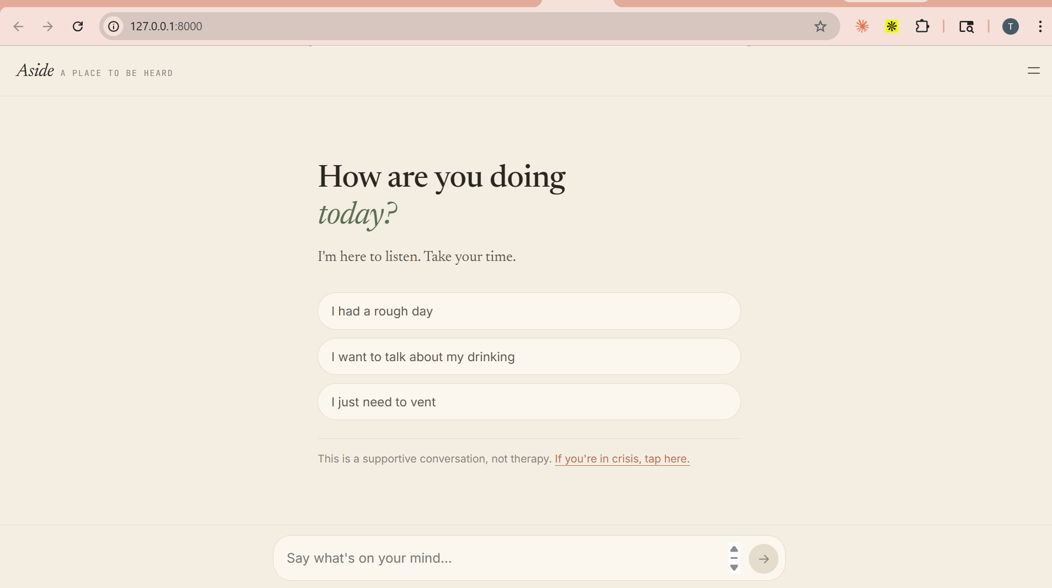
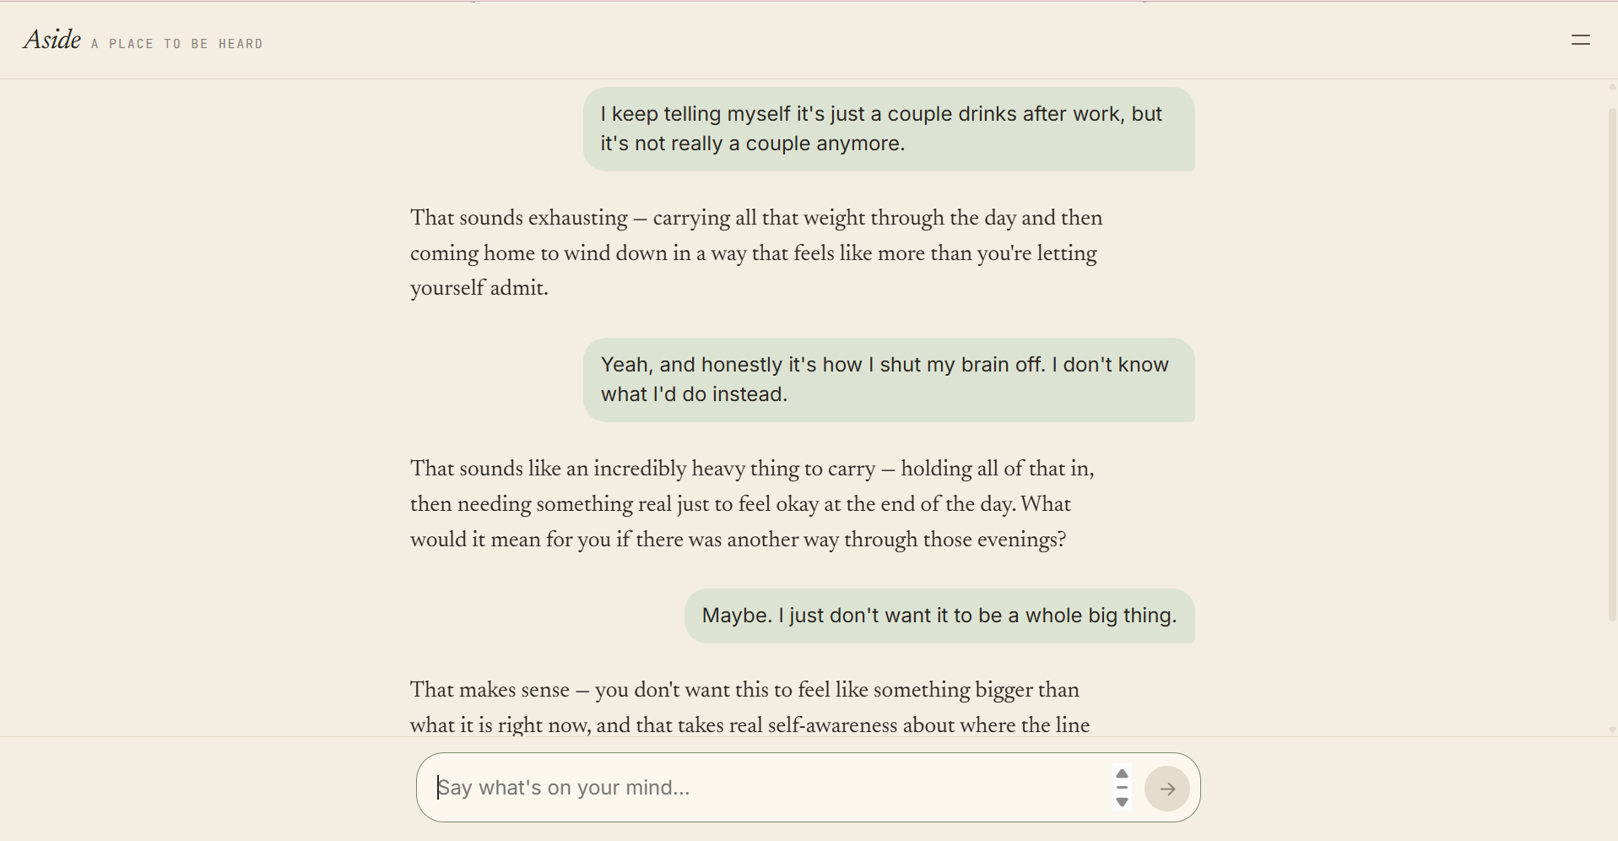
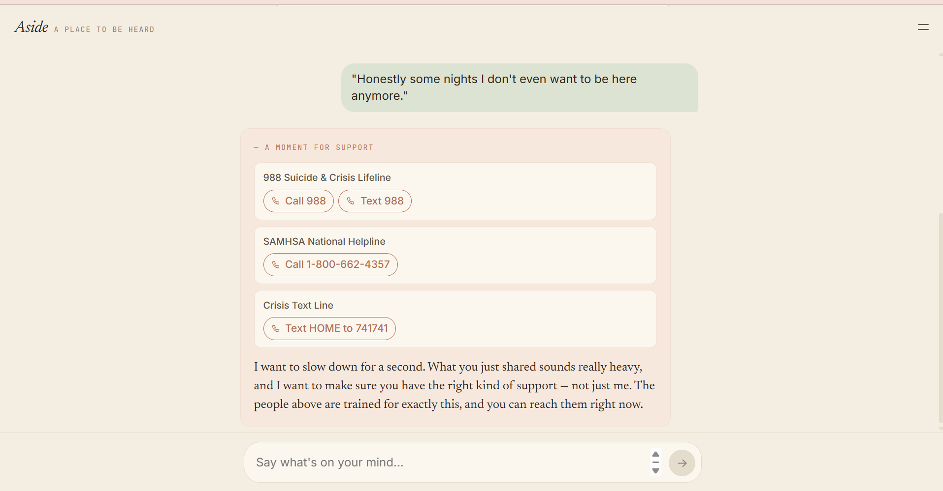
08 — TWO INTERFACES
Same pipeline. Different audiences.
WELCOME — open invitation, three starter prompts, soft crisis link.
CHAT — assistant text reads as a thoughtful reply, not a chat bubble.
CRISIS — soft card with 988, SAMHSA, Crisis Text Line surfaced inline.
End-user web app: React + FastAPI on a single port. Streamlit dev app remains for evaluation and debug.
TWO INTERFACES
09 / 13

Slide 10
09 — SAFETY
Two-stage guardrails. Auditable by design.
Input screen regex patterns for active and passive ideation (suicidal language, self-harm, overdose) and restricted topics (medication dosing, prescriptions). Match → short-circuit, no LLM call.
Output screen scan generated response for medical-advice patterns; replace with a safe reflective fallback if matched.
Recently broadened added optional-intensifier groups so 'don't even want to be here' and 'no reason to keep going' now trigger correctly — the original strict-adjacency regex was missing them.
Auditability every turn writes one JSONL record under logs/<session_id>.jsonl with the inferred state, safety level, and retrieved chunks. Crisis turns are also appended to logs/flagged_for_review.jsonl.
SAFETY LAYER
10 / 13

Slide 11
10 — TECH STACK
What it's built on.
ML & DATA
Python · PyTorch · Hugging Face Transformers (LoRA via PEFT) · sentence-transformers · FAISS · LangChain · pandas
INFERENCE & DEPLOYMENT
Ollama (Gemma 2 fine-tune, Q4_K_M GGUF) · Anthropic API (Claude Haiku fallback) · OpenAI API (optional)
WEB
FastAPI · uvicorn · Pydantic · React 18 (UMD) · Babel Standalone (in-browser JSX) · Streamlit
OBSERVABILITY
loguru · per-turn JSONL audit logs · Claude-as-judge eval framework
TECH STACK
11 / 13

Slide 12
11 — WHAT I'D WANT TO FIX
Honest limits.
What this is, and what it isn't, stated plainly.
Not clinically validated. This is a capstone, not a product. No IRB, no clinician review at scale.
Emotion classifier gets subtle affects wrong — resignation often reads as 'sad'.
LLM-as-judge correlates with human MI ratings, but isn't ground truth. I treat the scores as a coarse iteration signal.
Latency ~2–4 seconds per turn on CPU Ollama. Fine for demos; too slow for real-time conversation.
No memory across sessions — each conversation starts fresh.
Crisis regex is enumerative. Semantically equivalent phrasings still slip through if not pre-listed. Recently broadened, but not exhaustive.
HONEST LIMITS
12 / 13

Slide 13
Thank you.
github.com/TirthShahh28/motivational-interviewing-chatbot
tirthshah2812@gmail.com
Happy to walk through the live web app or any layer of the pipeline.

