Slide 1

OJT Part 2 Internship – Data Analysis Projects
Presented by Tirthanand Singh
Roll No: FO1123
Academic Year: 2025–2026
MIT ACSC, Alandi (D), Pune
Conducted at SyntaxHub — A structured internship focused on applied data
analysis using Python and real-world datasets.

Slide 2
OVERVIEW
What Is This Internship About?
The Objective
Why Data Analysis Matters
Gain hands-on experience with real-world datasets
Apply Python-based data analysis techniques end-to-end
Build a strong foundation in Exploratory Data Analysis (EDA)
Data drives decisions across industries — from business strategy to healthcare. Learning to clean, explore, and visualize data is a core skill for any analyst or data professional.

Slide 3
TECH STACK
Tools & Libraries Used
Python
Pandas
NumPy
Core programming language for all data processing, analysis, and scripting tasks.
Data manipulation and DataFrame operations — loading, filtering, and transforming datasets.
Numerical computing library for mathematical operations and array handling.
Matplotlib
Seaborn
Foundational plotting library for creating charts, histograms, and visual summaries.
Statistical visualization library built on Matplotlib — cleaner, publication-ready plots.

Slide 4


PROJECT 1
Titanic Dataset — Exploratory Data Analysis
Project Goal
Analyze the famous Titanic passenger dataset to uncover patterns in survival rates based on demographics, class, and other passenger attributes.
Dataset Overview
~891 passenger records
Features: Age, Gender, Class (Pclass), Fare, Embarked, and more
Target variable: Survived (0 or 1)

Slide 5
PROJECT 1 · DATA PREPARATION
Data Cleaning Steps
1
2
Missing Values — Age
Missing Values — Embarked
Imputed missing Age values using the median to preserve distribution without introducing bias.
Two missing Embarked entries were filled using the most frequent port value.
3
4
Dropped Cabin Column
Standardized Column Names
Removed the Cabin column due to excessive missing data (~77% nulls).
Renamed and cleaned column headers for consistency and easier referencing in code.

Slide 6
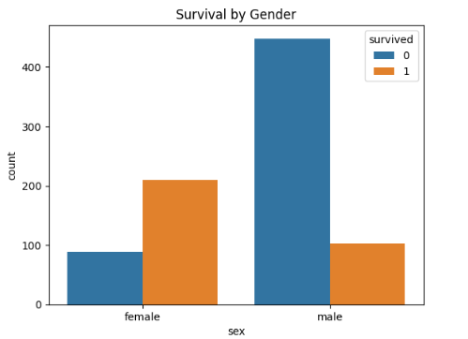

PROJECT 1 · INSIGHTS
Key Findings — Titanic Survival Analysis
What the Data Reveals
Gender was the strongest predictor — females had a 74% survival rate vs. 19% for males
Class mattered significantly — 1st class passengers survived at nearly 3× the rate of 3rd class
Age analysis showed children had a notably higher survival probability
Key Insight: Social hierarchy and gender-based evacuation protocols are clearly reflected in the survival data.

Slide 7
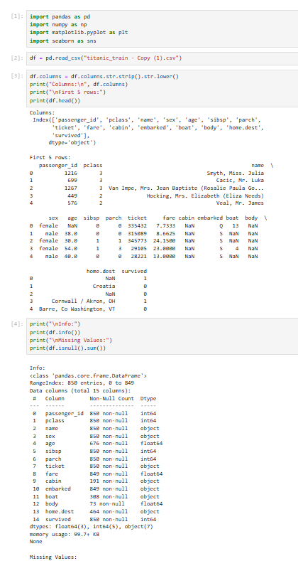
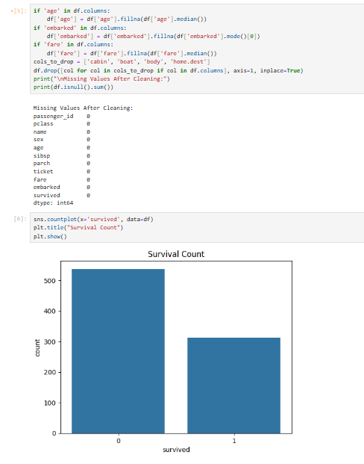
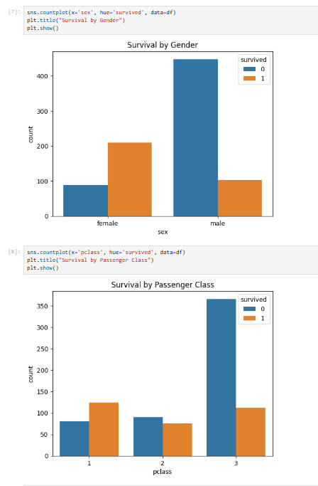
Code Implementation and Output

Slide 8
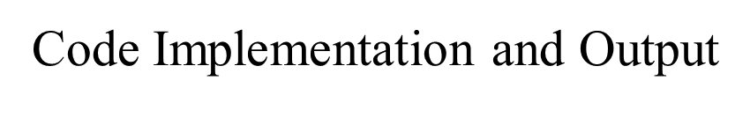
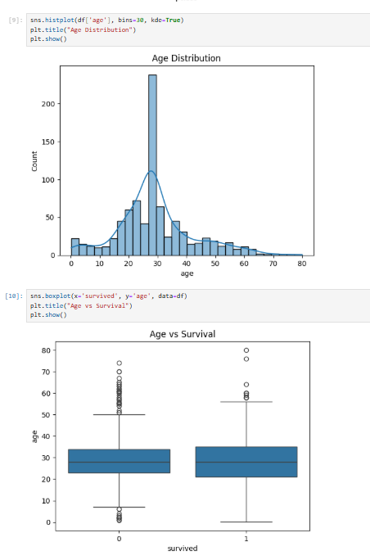
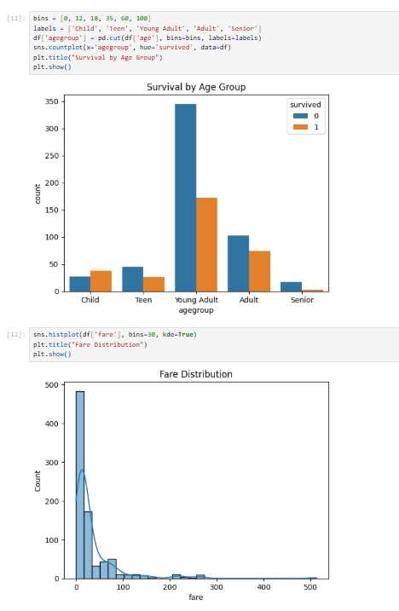

Slide 9
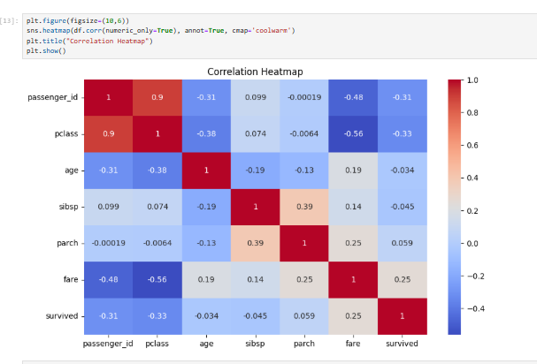

Slide 10
PROJECT 2
IPL Sports Data Analysis
Project Goal
🏏 Batsmen
🎯 Bowlers
Analyze IPL match-level ball-by-ball data to evaluate player performance, team statistics, and match outcomes across seasons.
Total runs, strike rate, boundaries
Wickets, economy rate, dot balls
Dataset
🏆 Teams
deliveries.csv — ball-by-ball match records
Thousands of rows covering multiple IPL seasons
Fields: batsman, bowler, runs, wickets, team, match ID
Win rates, total scores, consistency

Slide 11
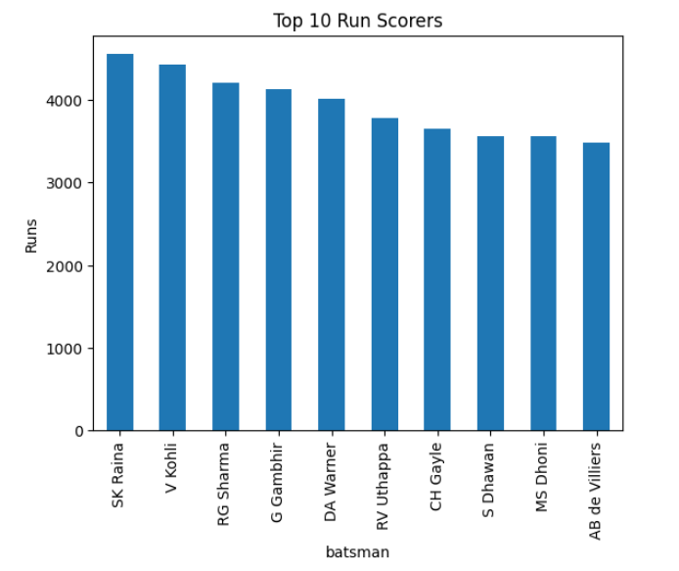
PROJECT 2 · INSIGHTS
IPL Analysis — Performance Highlights
Top Performer
League Average
What the Data Reveals
Top batsmen significantly outpace the league average in both total runs and strike rate
Elite bowlers claim more than double the average wickets with a tighter economy rate
A small set of teams consistently dominate total run aggregates across seasons
Key Insight: Performance in the IPL is heavily concentrated — a handful of elite players drive the majority of impactful outcomes.

Slide 12
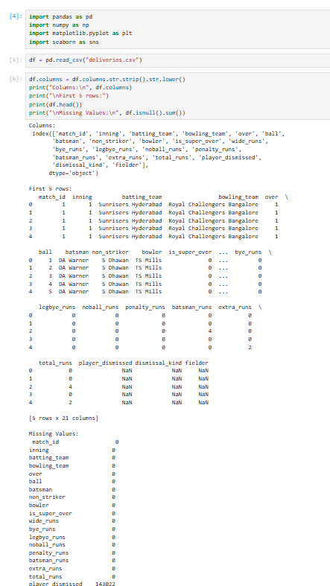
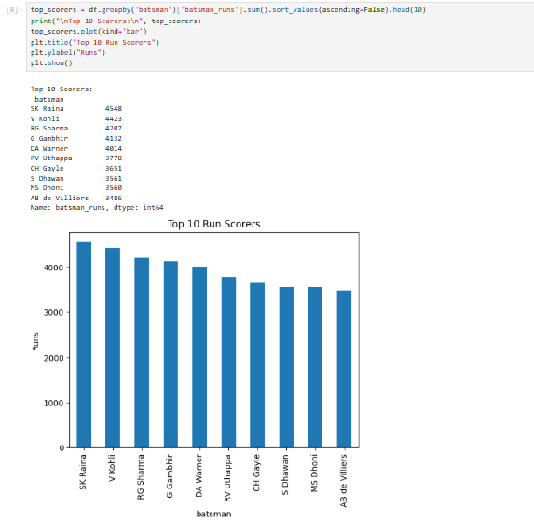
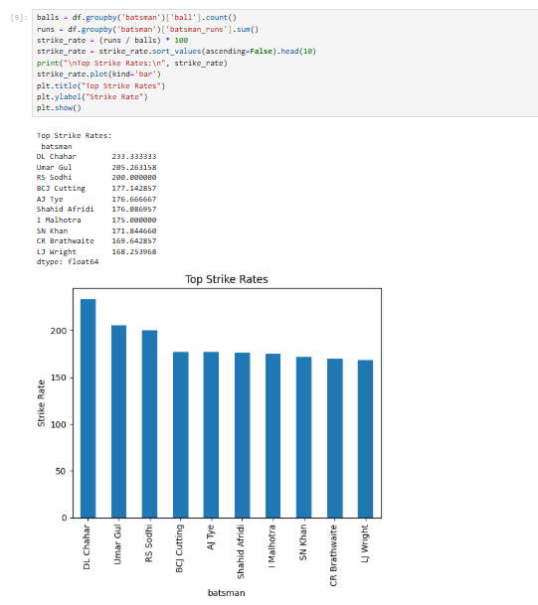

Slide 13
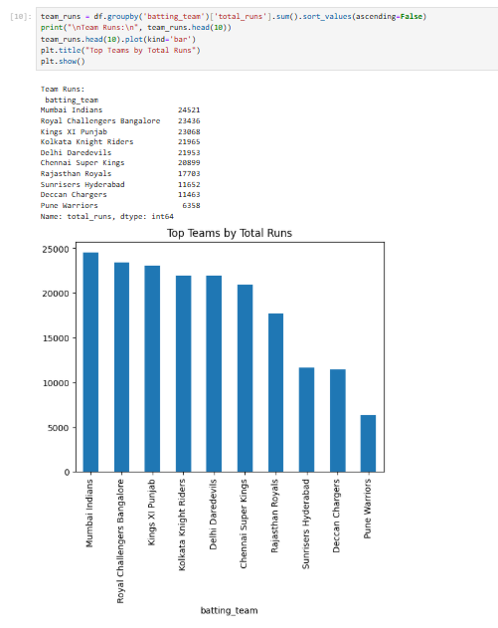
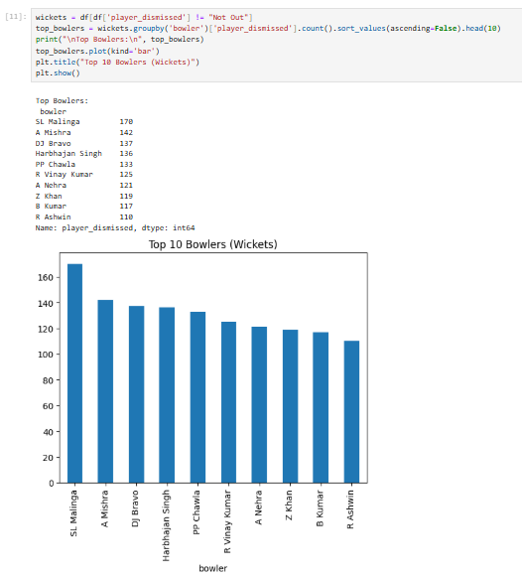
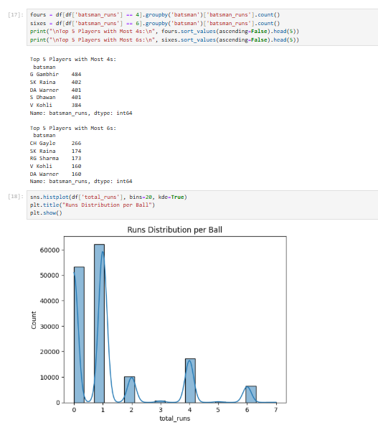

Slide 14
SUMMARY
What I Learned
Exploratory Data Analysis
Data Cleaning & Preprocessing
Used Pandas, NumPy, Matplotlib, and Seaborn to explore, summarize, and visualize real-world datasets.
Handling missing values, dropping irrelevant columns, and standardizing datasets for analysis-ready quality.
Improved Analytical Skills
Deriving Actionable Insights
Developed a structured approach to problem-solving with data — a foundation for advanced analytics work.
Translated raw data into meaningful conclusions — from Titanic survival patterns to IPL player dominance.

Slide 15
Thank You
Thank you for your time and attention. I welcome any questions or feedback on my OJT Part 2 projects.
Presented By
Organization
Ready for Questions
Tirthanand SinghRoll No: FO1123
SyntaxHubOJT Internship · Part 2
Open to discussion on methodology, tools, and insights from both projects.

Slide 16
