Slide 1
From 31.5 billion readings to one decision
SMART-FACTORY DATA PLATFORM
How factory data should flow, what we built and measured on real Bosch data, and the live system
100
3
876,100
Live
CNC machines
plants: Chakan · Oragadam · Manesar
machine-hours in SQL
on Google BigQuery
Tirthanker Singh · github.com/TirthankerSingh/industrial-data-platform · industrial-data-platform.streamlit.app
Notes:
We didn't just compare clouds on paper. We built the pipeline, measured it on real factory data, and the last slide is the live system.

Slide 2
Nine stages, one command to rebuild, one source of truth
WHAT WE BUILT
01
02
03
04
05
Collect 4 datasets
Edge features
Calibrate
Fleet table
PostgreSQL / BigQuery
06
07
08
09
ML models
MQTT gateway
Dashboard
Decision
1
0
4
command rebuilds everything
numbers typed by hand
public datasets, each labelled
Notes:
Raw datasets go in on the left, a manufacturing decision comes out on the right. Every number in the report, slides and dashboard comes from these same scripts, so nothing is typed in by hand.

Slide 3
Pipeline design moves the bill more than the cloud does
PIPELINE COMPARISON 1
18–70×
lower monthly bill when the edge batches messages instead of sending one per reading
₹14–30 lakh → ₹43–80k a month
Batching at the edge is the single biggest cost lever, bigger than which cloud you pick.
Notes:
Same factory, same data: 14 to 30 lakh rupees a month if every reading is its own message, 43 to 80 thousand if the edge batches. Batching at the edge is the single biggest lever, bigger than which cloud you pick. Prices from official calculators, FX 94.71 per USD, 21 Oct 2026.

Slide 4
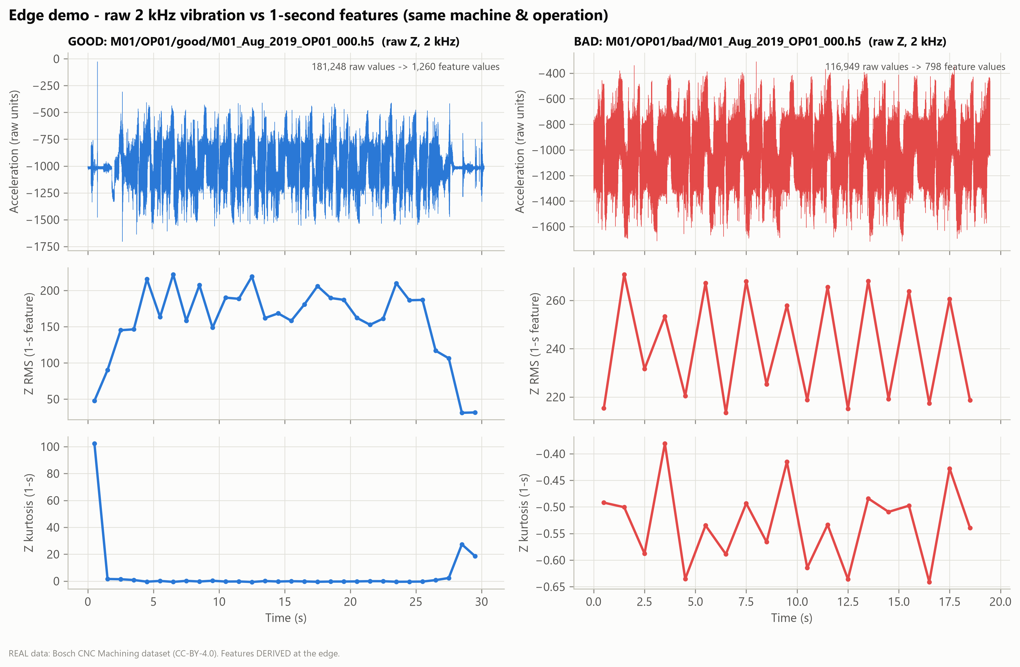
Compression gives 5×. Feature extraction gives 143×
PIPELINE COMPARISON 2
5×
lossless compression of raw Bosch vibration (Parquet + Zstd): noise doesn't compress
143×
smaller with 42 edge features a second instead of 6,000 raw samples
0.98
ROC-AUC: the fault signal survives, good vs bad operations
Measured on real Bosch production data: 1,702 operations, 2 kHz × 3 axes
Notes:
This is measured on real Bosch production data, not assumed. You can't compress noise, but you can summarise it: RMS, kurtosis, crest factor, band energies. 143 times smaller and the anomaly model still separates good from bad at 0.98.

Slide 5
Three shapes of data need three kinds of home
STORAGE COMPARISON
 | Data lake | Data warehouse | Lakehouse
Holds | Everything, raw | Clean tables | Everything + clean tables
Structure | Decided when reading | Fixed before loading | Both
Cost | Lowest | Highest | Low
Updates, de-dup, history | No | Yes | Yes
Examples | S3, ADLS, GCS | Snowflake, BigQuery, Redshift | Databricks, Fabric
Our data | Raw vibration | Fleet table, KPIs | All of it, one copy
99%+
of the bytes are raw vibration, the data that needs the least SQL
→ that one fact picks a lakehouse
Notes:
A lake is cheap but messy, a warehouse is tidy but costly for raw signals. A lakehouse is the storeroom with a librarian: cheap open files plus a transaction log for de-duplication, updates and history. Over 99% of our bytes are raw vibration, the data that needs the least SQL. That one fact chooses the storage design.

Slide 6
Everyone is converging on the lakehouse
PLATFORM COMPARISON
Lakes
Warehouses
65%
Amazon S3 · Azure ADLS · Google Cloud Storage
Snowflake · Google BigQuery · Amazon Redshift
Cheap, durable home for raw signals and files
Best SQL and reporting; awkward for raw signals and heavy ML
of enterprises already run most of their analytics on a lakehouse
WE USED: BigQuery
Lakehouses
Operational DB
42% of them moved from a cloud warehouse
Databricks (Delta Lake) · Microsoft Fabric
PostgreSQL
Open formats, ACID, one copy for BI and ML
Strict rules, fast lookups for the app and KPIs
Dremio, State of the Data Lakehouse 2024 (vendor-sponsored survey, n = 500)
OUR RECOMMENDATION
WE USED: PostgreSQL 16
Notes:
Lakes store, warehouses query, lakehouses do both. Warehouses are adding lake features and lakehouses are adding warehouse features: they meet in the middle. We used two of these for real: PostgreSQL locally and Google BigQuery in the cloud. You'll see BigQuery live in the demo.

Slide 7
Four public datasets, each with a job
OUR DATA
REAL
REAL
BENCHMARK
BENCHMARK
Bosch CNC
UMich CNC mill
Microsoft Azure PdM
AI4I 2020
1,702 operations · 2 kHz × 3 axes · 2019–2021
18 experiments · spindle current · inspection
100 machines × 1 year · 876,100 hours
10,000 records · 5 failure types
JOB
JOB
JOB
JOB
Edge proof and anomaly detection
Spindle load, tool wear, quality
Fleet backbone, failure warning
Machine physics, failure modes
Honesty rule: every calculated column is tagged DERIVED and traced back to its source in a provenance file.
Notes:
Two real industrial datasets and two benchmarks. Bosch is the heart: real production vibration. Our rule was that no number appears without a source you can trace.

Slide 8
31.5 billion readings a year, before vibration
PART A · DATA VOLUME
100 machines × 10 sensors × 1 Hz
31.5 B
2.59 B
per year
86.4 M
per month
3.6 M
per day
1,000
per hour
per second
3.15 B
10×
378 TB
a year from ONE 100 Hz vibration sensor on one machine
the whole 1 Hz fleet, if every machine gets one (315 B a year)
a year of raw vibration at the real Bosch rate (96 Mbps)
Notes:
1 Hz fleet: 1,000 a second, 3.6 million an hour, 86.4 million a day, 2.59 billion a month, 31.5 billion a year. One 100 Hz sensor is 3.15 billion a year per machine; on every machine it is ten times the whole fleet. One vibration sensor outweighs everything else combined. That's why the edge exists.

Slide 9
Many IIoT services in older comparisons are now retired
PART B · CLOUD COMPARISON
GCP IoT Core
Azure Time Series Insights
AWS IoT Analytics
AWS IoT Events
retired 2023
retired 2024
end of support 2025
retired 2026
AWS
Microsoft Azure
Google Cloud
STRENGTH
STRENGTH
STRENGTH
Best-documented edge buffering (Greengrass, SiteWise Edge) and SageMaker
Most complete OPC UA → dashboard chain: IoT Operations, Fabric, Power BI
Strongest, cheapest analytics: BigQuery, Vertex AI
GAP
GAP
GAP
IIoT stack is now separate parts after retirements
Highest cost, Kubernetes at the edge
No first-party factory-floor layer; partner edge needed
Notes:
We checked every service against official vendor pages on 21 October 2026. A comparison built from old blog posts would recommend products that no longer exist. Full 13-criterion table is in the backup slides and the report.

Slide 10
Azure 4.22 · AWS 3.92 · GCP 3.57
PART C · WEIGHTED DECISION MATRIX
100%
WHY AZURE, FOR THIS FACTORY
of ±5-point weight shifts won by Azure
Old Fanuc / Siemens controllers speak OPC UA
Microsoft tools already in the plants
Pune region next to Chakan
Edge design removes its cost and offline weaknesses
88.7%
of 10,000 random re-weightings won by Azure
≥ 35%
cost weight needed before AWS wins
Heaviest weights: Industrial IoT 15% · Cost 13% · Edge 12% · Security 12%
Notes:
The score isn't the argument; the scenario is. Old OPC UA controllers, Microsoft tools already in the plants, and a Pune region next to Chakan. Azure wins every 5-point weight shift and 88.7% of 10,000 random re-weightings. AWS only wins if cost carries at least 35% of the weight.

Slide 11
Every Azure block has a working stand-in in our prototype
PART F · ARCHITECTURE
Block | Azure (recommended) | Our prototype
CNC / sensors → protocol | OPC UA + MQTT | MQTT, ISA-95 topic tree
Edge gateway | IoT Operations, 7-day buffer | Python gateway, store-and-forward
Ingestion | IoT Hub / Event Hubs | MQTT broker → loader
Lake / time-series | ADLS lakehouse + Eventhouse | Parquet, bronze / silver / gold
SQL database | Azure Database for PostgreSQL | PostgreSQL 16 + Google BigQuery
Analytics / AI | Azure ML / Fabric | scikit-learn models
Dashboard → decision | Power BI | Streamlit, live
Open formats everywhere: the same data moved to BigQuery with identical query results.
Notes:
Map of the professor's flow onto Azure services, and next to it what actually runs in our prototype. Open formats everywhere: that's why we could move the same data to BigQuery in under an hour without changing a single query result.

Slide 12
We cut the internet. 0 of 482 messages lost
PART G · EDGE VS CLOUD
AT THE EDGE
IN THE CLOUD
0 / 482
2 kHz vibration → features
Immediate alarms, machine protection
Noise filtering, aggregation
Store-and-forward buffering
Fleet-level and historical analysis
Long-term lakehouse storage
ML training and management
Dashboards, remote access
messages lost when we stopped the receiver, then cut the link. 0 duplicates.
Latency
Reliability
Bandwidth
Cost
Security
Scale
ms protection
survives outages
143× less
lakhs → thousands
outbound only, IEC 62443
one node per plant
Notes:
Protection needs milliseconds, plants lose internet, raw signals cost lakhs. So high-frequency work stays at the edge, and fleet-scale work goes to the cloud. We stopped the receiver, then cut the link, and all 482 messages arrived exactly once.

Slide 13
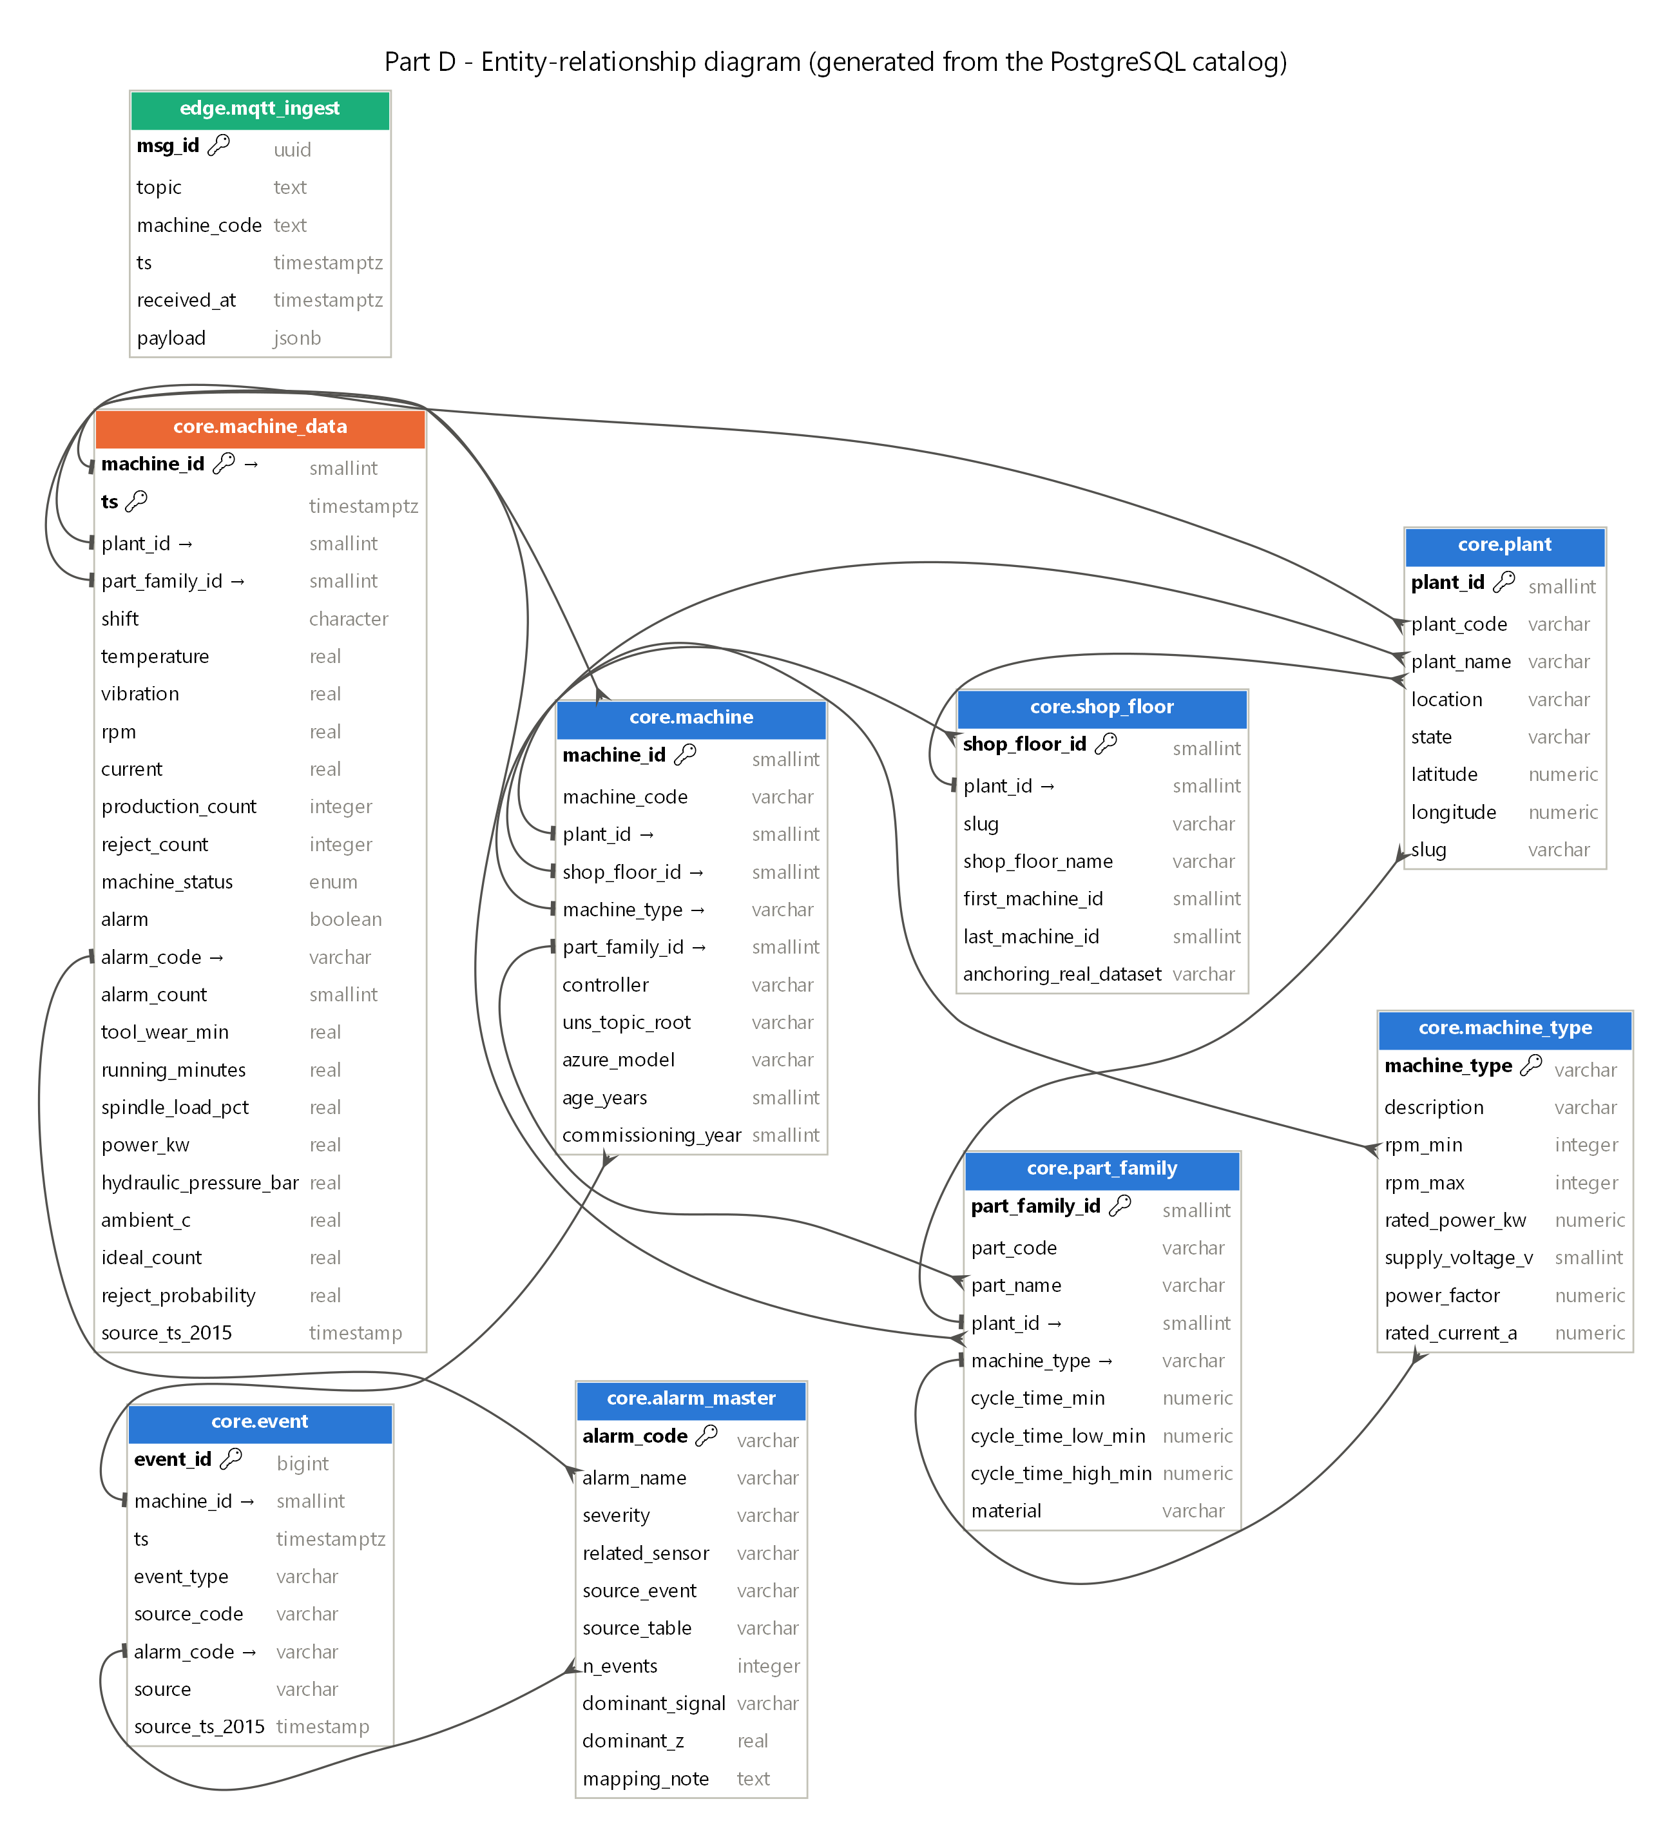
876,100 machine-hours, same answers on two engines
PART D · SQL
Question | Answer
Most parts produced | P3-TURN-05 · 199,677
Highest rejection rate | P2-GRIND-06 · 1.97%
Longest continuous run | P1-HMC-18 · 209 h
Highest average vibration | P1-VMC-13 · 1.86 mm/s (ISO zone B)
Parts on 16 Jun 2025 | 23,974 (381 rejected)
Fleet OEE | 75.3% (world-class 85%)
PostgreSQL 16 (local)
=
BigQuery (Mumbai)
Notes:
One star schema: the machine_data fact table with machine, plant, part and alarm masters, and check constraints that reject impossible values. All 8 required questions answered. We ran the same SQL on BigQuery and got the same answers: that's our proof of no lock-in.

Slide 14
Descriptive → diagnostic → predictive → prescriptive
ANALYTICS AND ML
₹5.8 cr
Prescriptive
What to do?
estimated value a year (indicative)
Predictive
Tool change on condition: rejects 1.50% → 0.92%
What next?
We report precision too: one industry study found a 10% false-alarm rate wiped out the savings.
Diagnostic
Bosch anomaly ROC-AUC 0.98 (2019 → 2021), 24 h failure warning
Why?
Descriptive
Alarm Pareto, ISO 10816 vibration zones
What happened?
KPIs, OEE 75.3%, reject rates
Notes:
We climb all four rungs. The Bosch anomaly model holds when trained on 2019 and tested on 2021. We report precision as well as recall, because one industry study found a 10% false-alarm rate wiped out the savings of predictive maintenance.

Slide 15
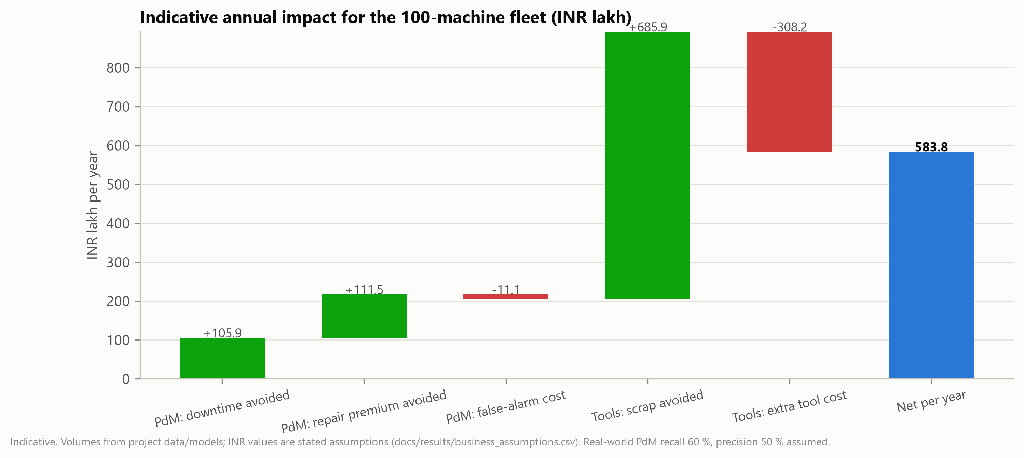
Downtime is expensive, and most factory data goes unused
WHY IT MATTERS
$2.3 M
11%
80%
WHAT WE'RE HONEST ABOUT
Fleet backbone is simulated, and labelled as such
Worn-tool model doesn't generalise across only 18 experiments
Cloud runs on a BigQuery sandbox, not production Azure
per hour of downtime on an automotive line (Siemens, 2024)
of revenue lost to unplanned downtime by the 500 largest industrial firms
of industrial data is never used (ABB; WEF 2026)
Predictive maintenance typically cuts downtime 30–50% in mature programmes.
Notes:
Downtime costs the biggest industrial companies 11% of revenue, up to 2.3 million dollars an hour in automotive, yet most factory data is never used. We'd rather show you where our work breaks than hide it.

Slide 16
From BigQuery to the live dashboard
LIVE DEMO
Google BigQuery
asia-south1
→
Service account
read-only
→
Streamlit dashboard
8 pages
1
Fleet overview: sidebar says “Google BigQuery”
5
Edge demo: real Bosch waveform → 42 features
2
Plant drill-down: one plant's heat map
6
Data volume & cost: switch off batching, watch ₹ jump
3
Machine health: ISO 10816 zones
7
Predictive maintenance: which machine first
4
Alarms: top 4 types ≈ 80%
industrial-data-platform.streamlit.app
Notes:
Open the app 10 minutes early: the first load after sleep takes about 20 seconds. Path: 1 Fleet overview, point at the sidebar 'Data source: Google BigQuery', 83 of 100 running, OEE 75.5%. 2 Plant drill-down. 3 Machine health with ISO zones. 4 Alarms Pareto. 5 Edge demo: 'this is the 143x'. 6 Data volume and cost: turn off batching and watch the rupees jump. 7 Predictive maintenance ranking. Optional 30 s: BigQuery console query returns P3-TURN-05 = 199,677, same as PostgreSQL. Backup: screenshots in the hidden slides if Wi-Fi fails.

Slide 17
Pipeline compared. Platforms compared. Decision made. Running live.
THANK YOU
Questions?
github.com/TirthankerSingh/industrial-data-platform · industrial-data-platform.streamlit.app
Notes:
Pipeline compared, platforms compared, decision made, and it's running. Thank you.

Slide 18
Cloud comparison across all 13 criteria
BACKUP B1 · PART B
Criterion | AWS | Microsoft Azure | Google Cloud
Industrial IoT | SiteWise Edge (OPC UA); several retired | IoT Operations: OPC UA, asset discovery | No first-party; partner (Litmus)
Ingestion | IoT Core, Kinesis | IoT Hub, Event Hubs, Eventstreams | Pub/Sub
Storage | S3, Timestream | ADLS Gen2, Eventhouse | Cloud Storage, BigQuery, Bigtable
Stream processing | Kinesis, Flink | Eventstreams (no-code) | Dataflow (code-first)
SQL | RDS / Aurora PostgreSQL | Azure DB for PostgreSQL | Cloud SQL, BigQuery
Analytics | Athena, QuickSight | KQL, Fabric, Power BI | BigQuery
AI/ML | SageMaker | Azure ML, Fabric | Vertex AI, BigQuery ML
Edge | Greengrass (best buffering docs) | IoT Operations on Arc | Partner edge only
Security | X.509, Mumbai region | OT PKI, Defender for IoT | India-pinned storage
Scalability | Very high | Very high | Very high
Integration | SAP via AppFlow | M365, Entra, Power BI, SAP | Best SAP connector
Ease of use | Separate parts | Fabric SaaS, common skills | BigQuery simple; edge DIY
Cost (edge design) | ₹43k / month | ₹80k / month | ₹33k / month
Notes:
Full Part B table, checked against official sources on 21 October 2026.

Slide 19
Monthly cloud cost in INR by pipeline design
BACKUP B2 · COST MODEL
Pipeline design | AWS | Azure | GCP
S0 one message per reading | ₹29,91,825 | ₹14,25,721 | ₹55,447
S1 batched raw 1 Hz + 100 Hz | ₹43,297 | ₹80,226 | ₹33,216
S2 batched + edge features | ₹43,121 | ₹80,085 | ₹32,928
S3 raw 2 kHz tri-axial | ₹2,84,788 | ₹3,94,487 | ₹1,19,208
FX ₹94.7145 per USD (RBI, 21 Oct 2026)
List prices from official pricing pages; India regions
Excludes edge hardware and people
Notes:
Indicative list-price model; see docs/results/part_c_cost_model.csv.

Slide 20
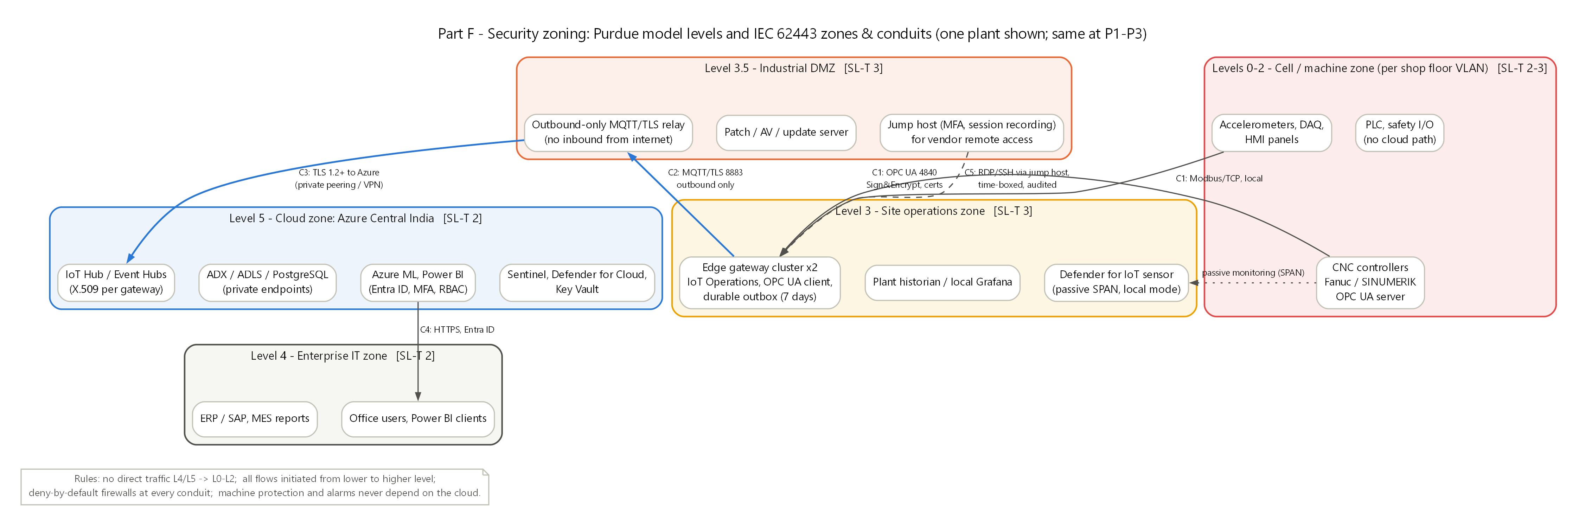
OT network zones and conduits (IEC 62443)
BACKUP B3 · SECURITY
Notes:
Machines never accept inbound connections; the edge gateway makes outbound, encrypted connections only.

