Slide 1


Campus Placement Recruitment System

Slide 2
Acknowledgement
Knowledge in itself is a continuous process. At this moment of our substantial enhancement, We rarely find words to express our gratitude towards those who were constantly involved with us.
The completion of any inter disciplinary project depends upon coordination, cooperation and combined efforts of several resources of knowledge, creativity, skill, energy and time. The work being accomplished now, we feel our sincerest urge to recall and knowledge through these lines, trying our best to give full credit wherever it deserves.
We would like to thank our project guide Ms Kritika Pandey , I/C Principal Dr. Dharmendra Patel and I/C Dean Dr. Sanskruti Patel who advised and gave us moral support through the duration of our project. Without their constant encouragement we could not have been able to achieve what we have.
It’s our good fortune that we had support and well wishes of many. We are thankful to all and those names which have been forgotten to acknowledge here but contributions have not gone unnoticed.

Slide 3
Existing System
Proposed System
Use Case Diagram
Activity Diagram
Class Diagram
Data dictionaries
Screen Layout
Future Enhancement
Bibliography/References

Slide 4
Project Profile
Project Name: Campus Placement Recruitment System
Type of Application: Web Application
Project Description: This Project is aimed at developing an web application for the training and Placement Department of the College. The system is a web application that can be accessed throughout the organization with proper login provide.
Team Size:3 PEOPLE
Front End: HTML,CSS,JAVASCRIPT
Back End: DJANGO
Database: SQLITE 3
Tools used: VISUAL STUDIO CODE

Slide 5
Existing System
The existing manual placement management system is inefficient and error-prone, requiring significant time and effort to collect and maintain student data, which leads to inaccuracies, confidentiality risks, and difficulties in tracking progress, ultimately hindering effective placements for students and employers.

Slide 6
Proposed System
Web-Based Management System: The proposed system is an online placement management application designed to streamline the collection and organization of student data, reducing the time and manpower required for manual processes.
User-Friendly Access: The application supports multiple user roles—such as principals, HODs, placement officers, and students—allowing each user to manage and upload information securely through personalized accounts.
Predictive Analytics: A key feature includes a machine learning component that predicts students' placement probabilities based on their skills, academic performance, and historical placement data from their department, enhancing the placement process for both students and colleges.

Slide 7
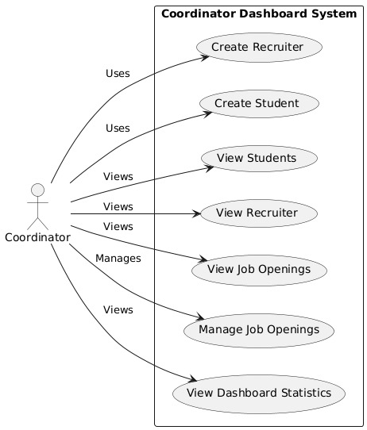
Use Case Coordinator

Slide 8
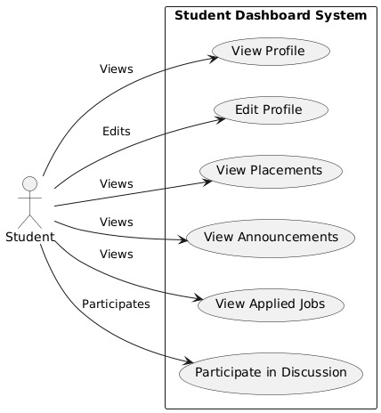
Use Case Student

Slide 9
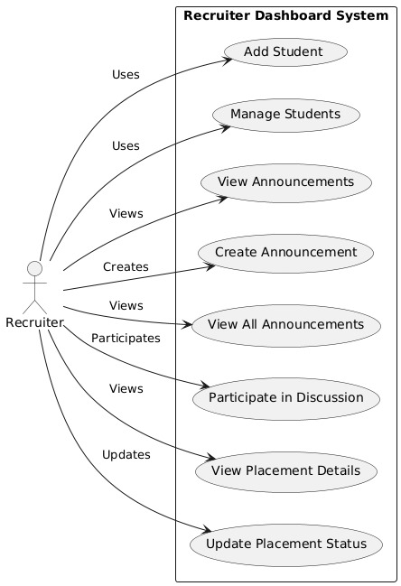
Use Case Recruiter

Slide 10
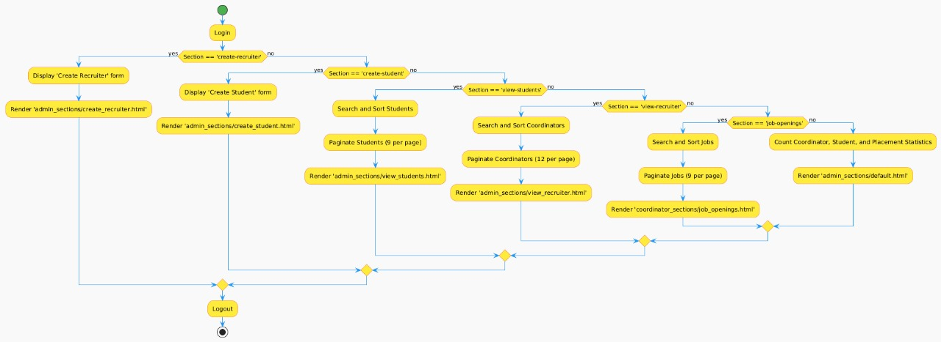
Activity Diagram

Slide 11
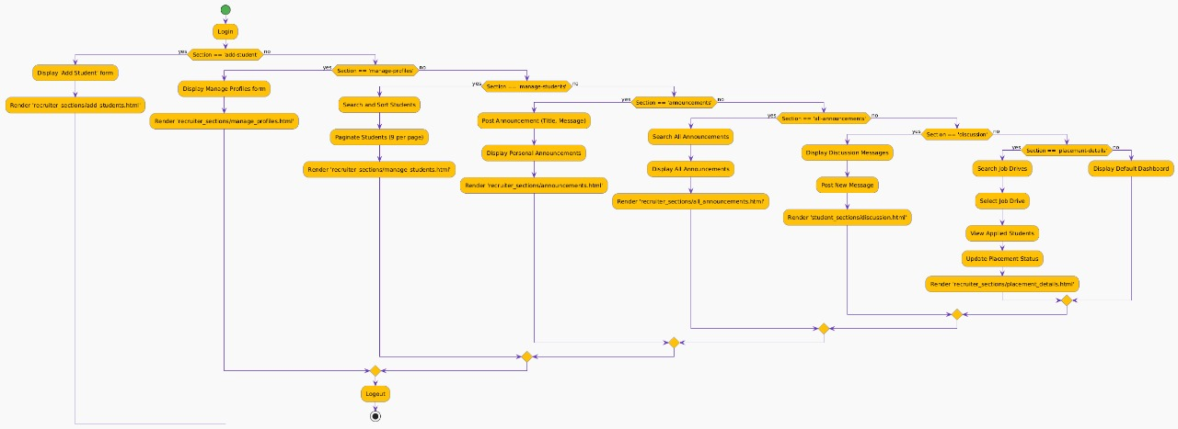

Slide 12
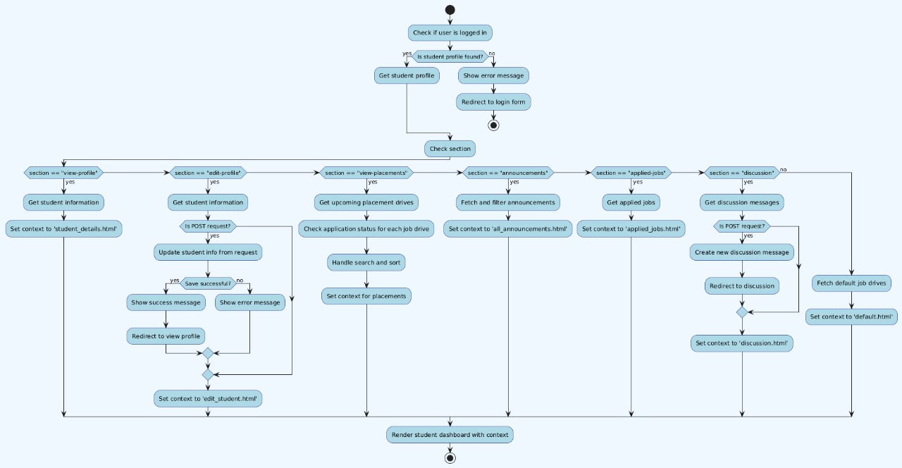

Slide 13
SCREEN LAYOUT

Slide 14
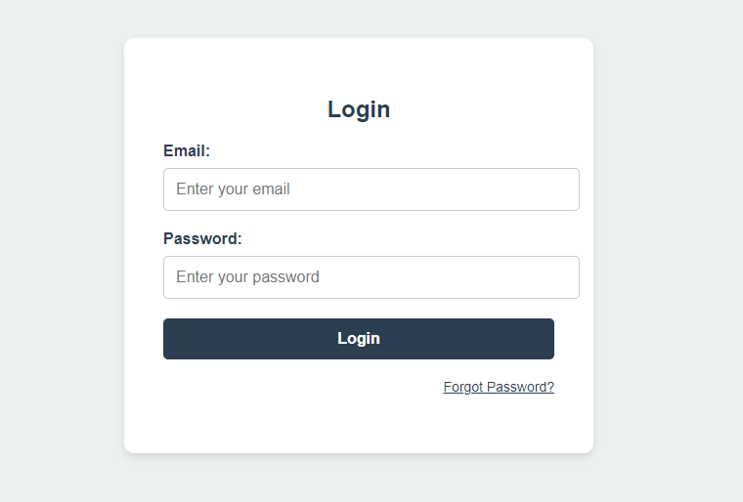
Login Form

Slide 15
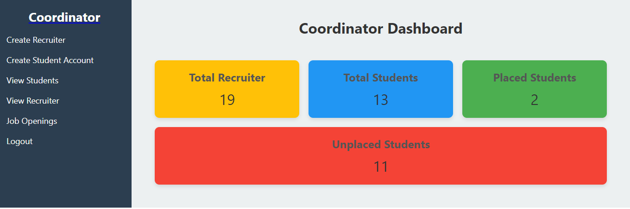
Coordinator Dashboard

Slide 16
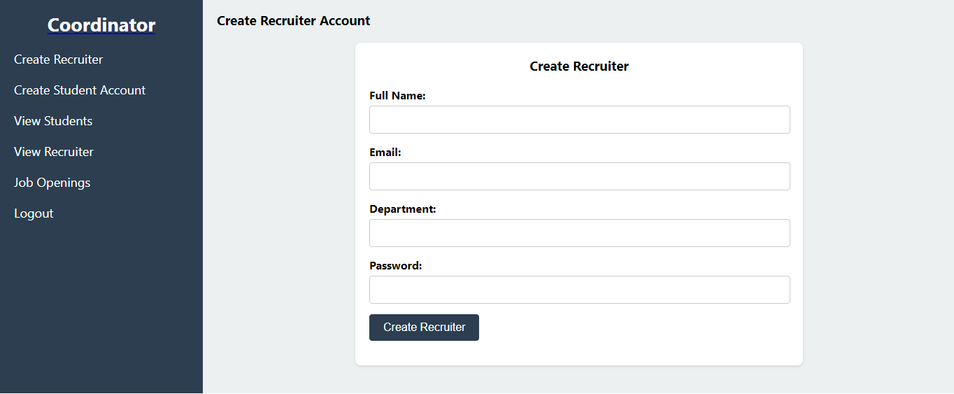
Recruiter Creation

Slide 17
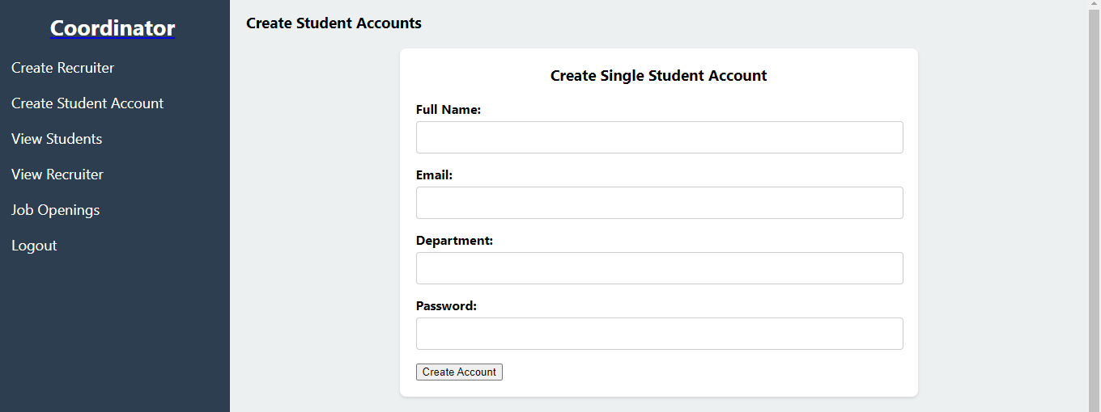
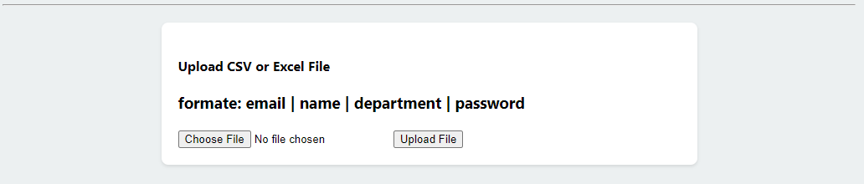
Create Student Account

Slide 18
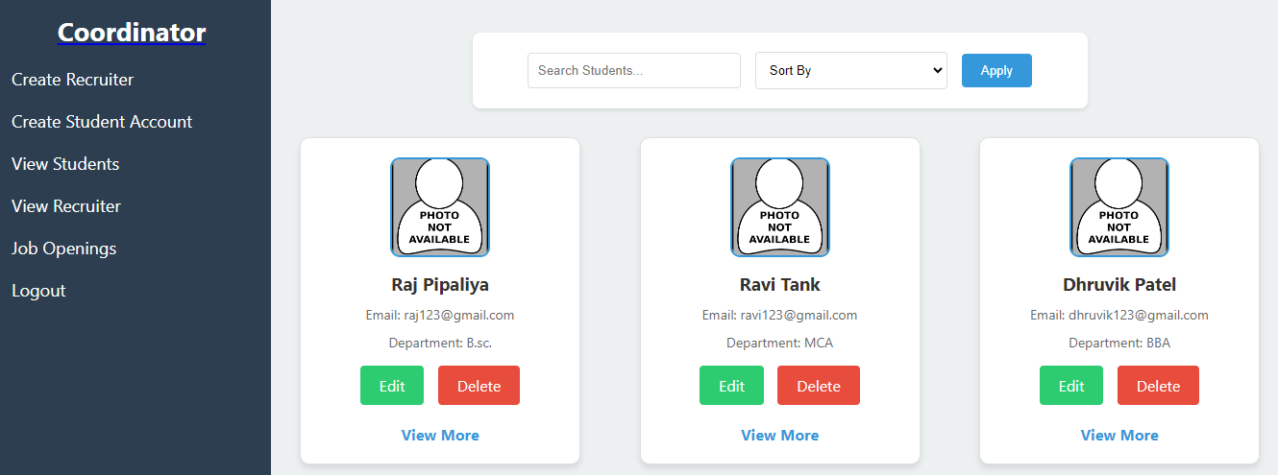
View Student

Slide 19
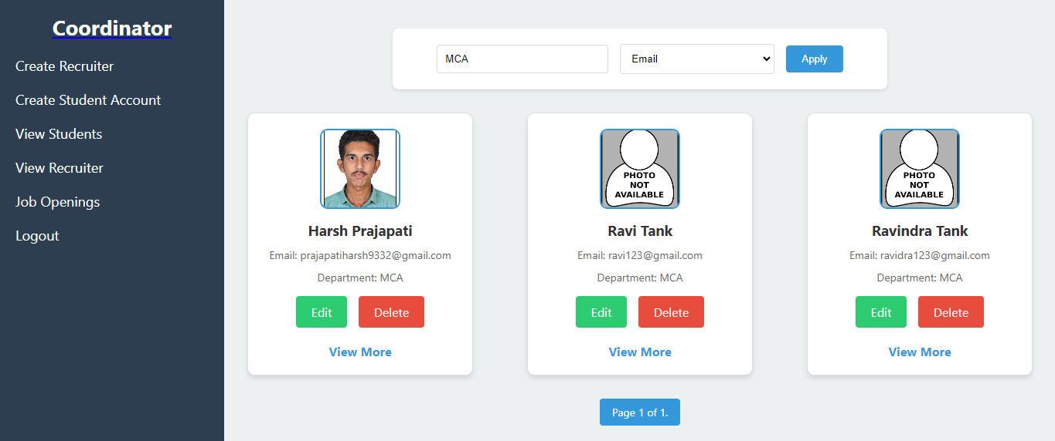
Search By Course

Slide 20
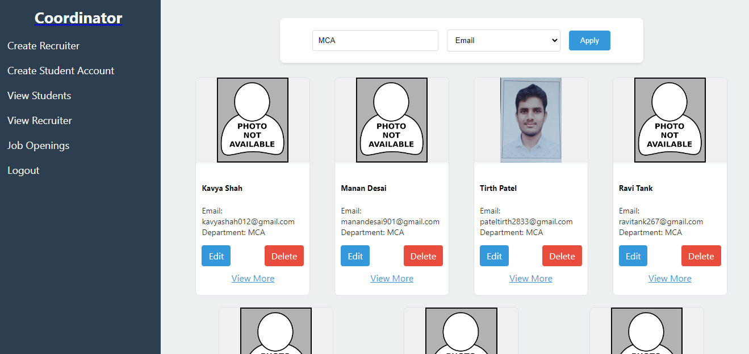
Recruiter View

Slide 21
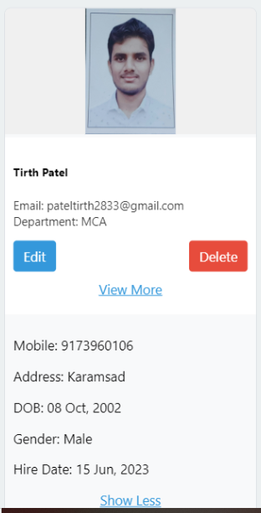
More View Recruiter

Slide 22
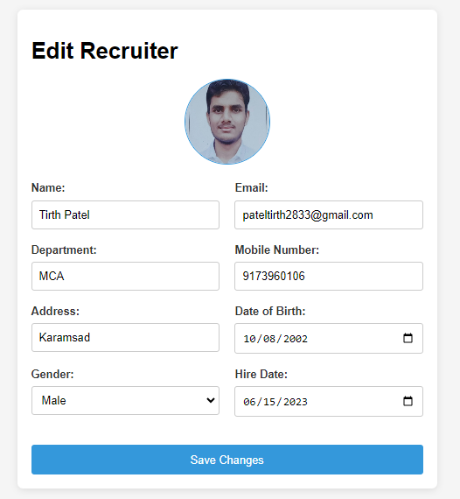
Edit Recruiter

Slide 23
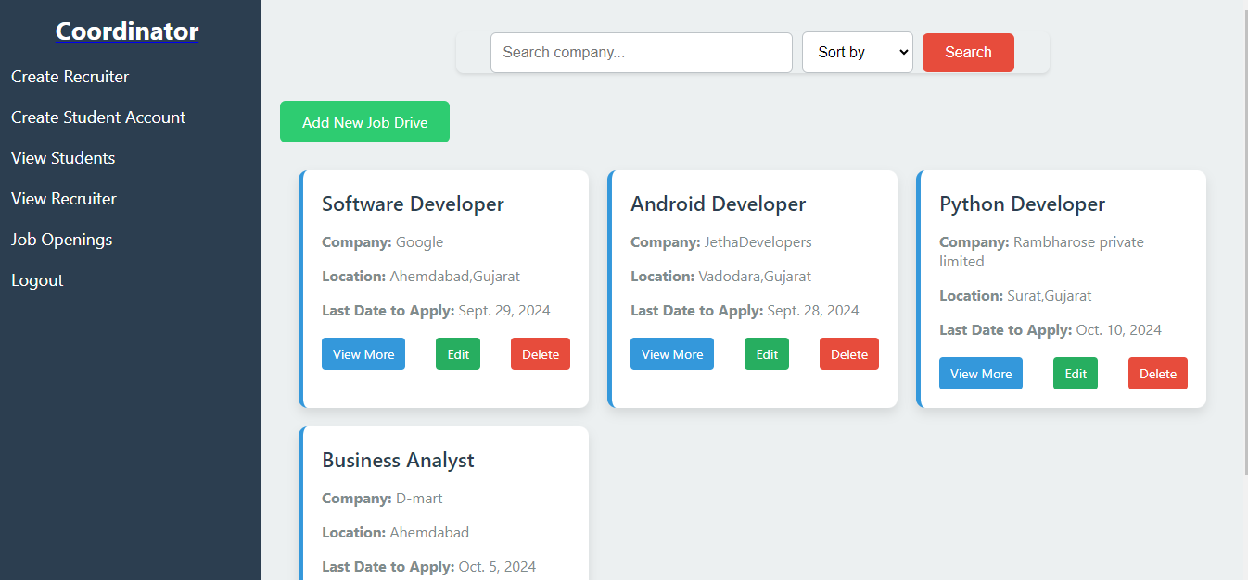
Job Openings

Slide 24
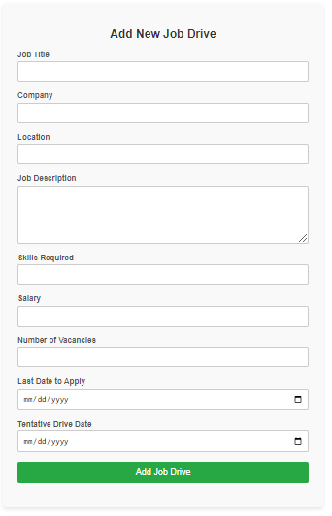
Add New Job

Slide 25
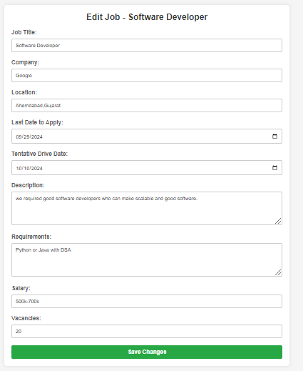
Edit Job

Slide 26
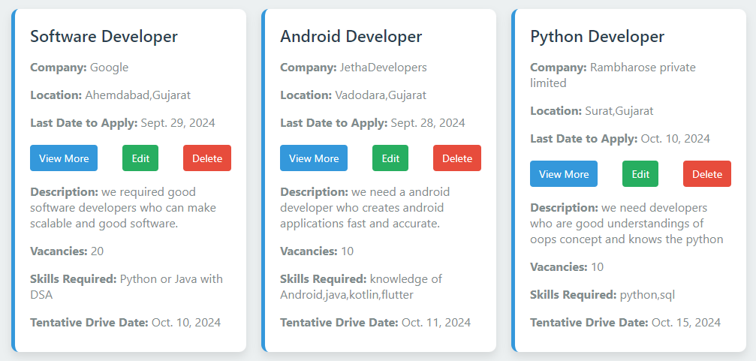
More View

Slide 27
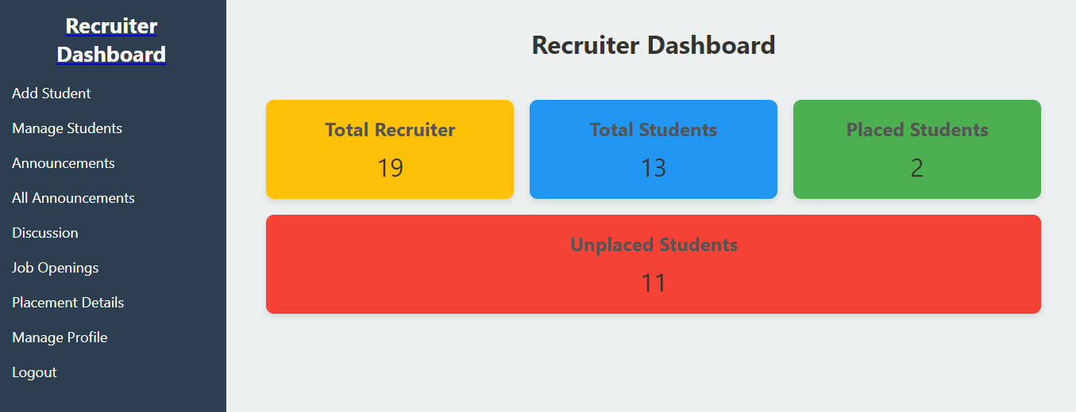
Recruiter Dashboard

Slide 28
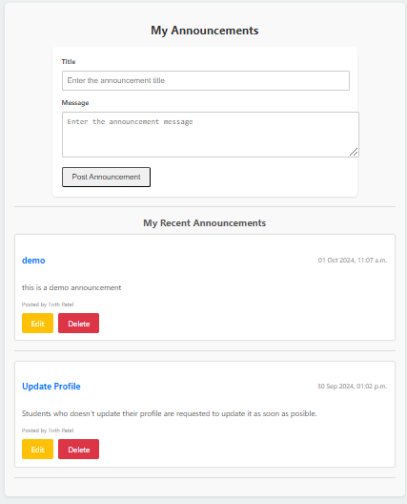
Announcements

Slide 29
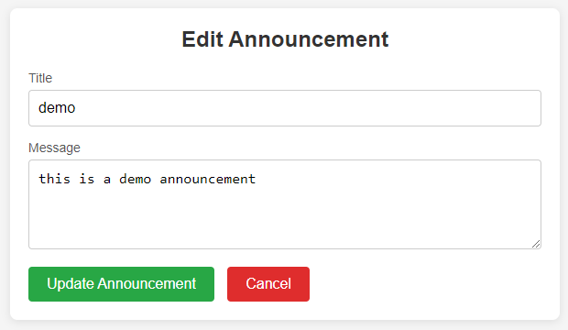
Edit Announcements

Slide 30
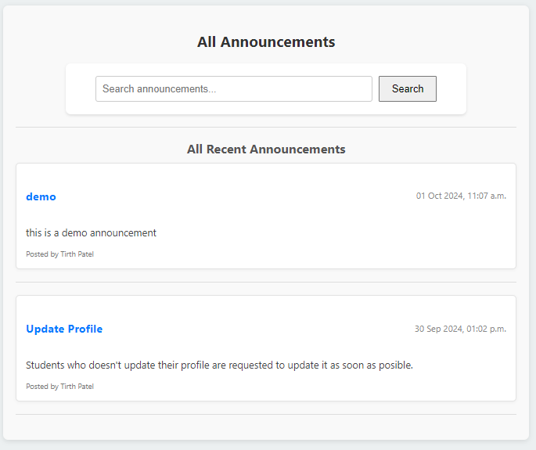
All Announcements

Slide 31
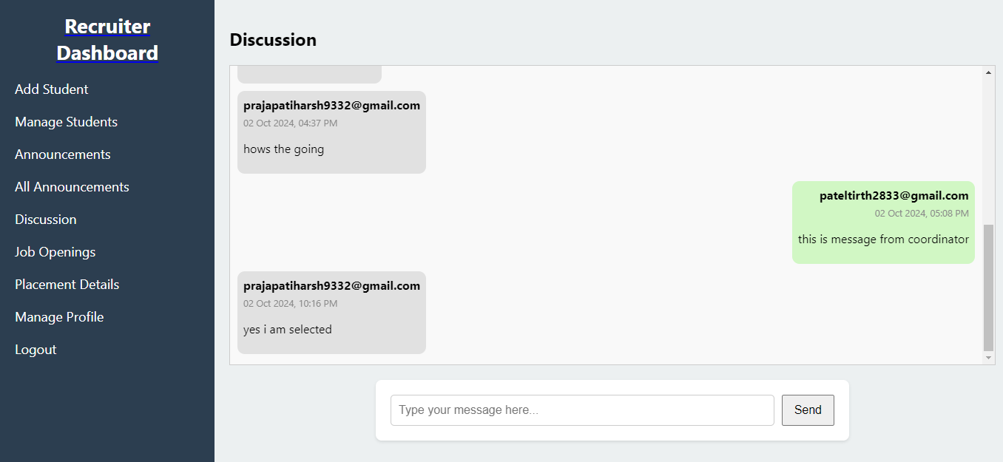
Discussion

Slide 32
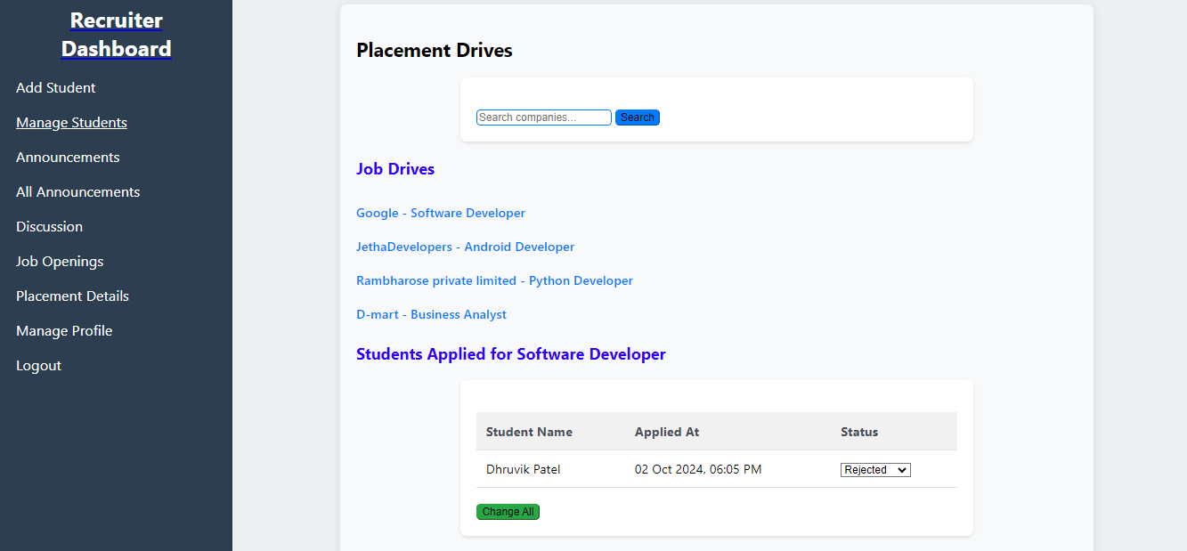
Placement Drive

Slide 33
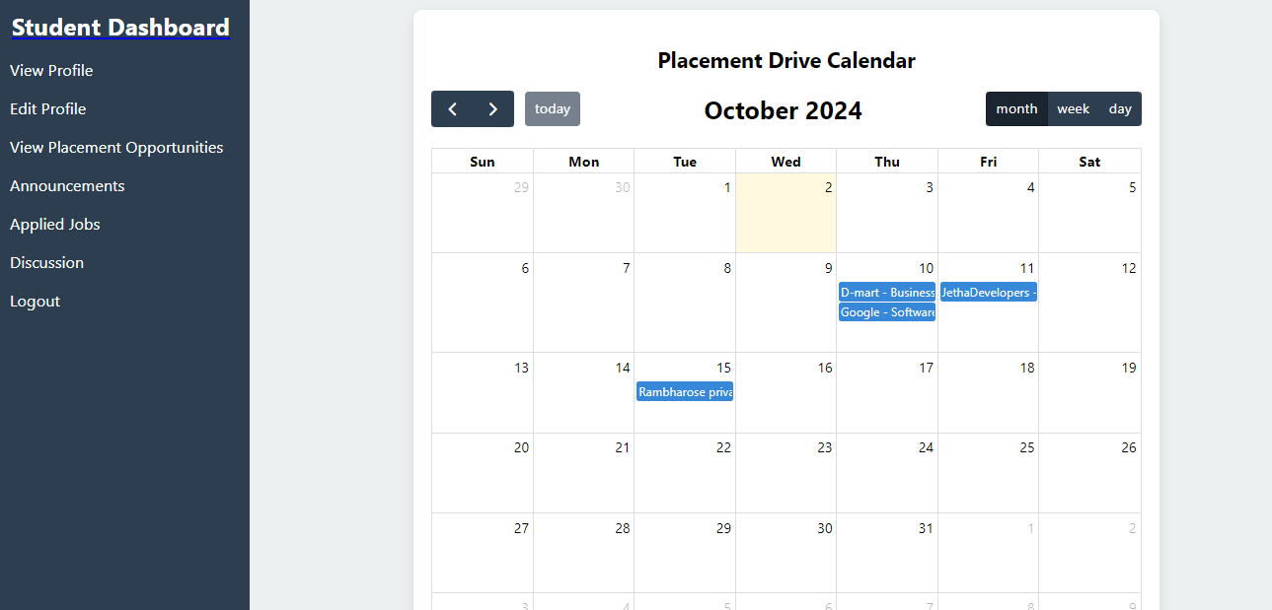
Student Dashboard

Slide 34
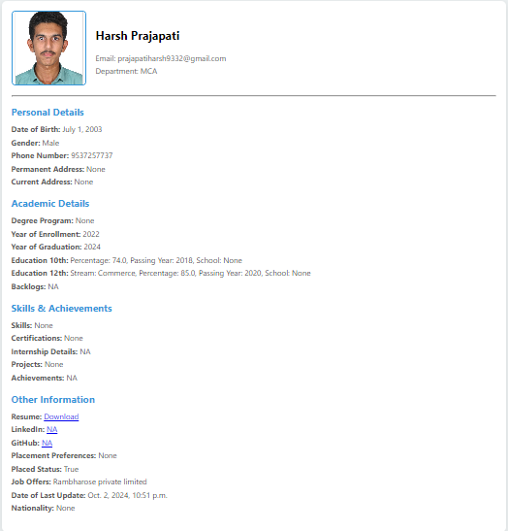
View Profile

Slide 35
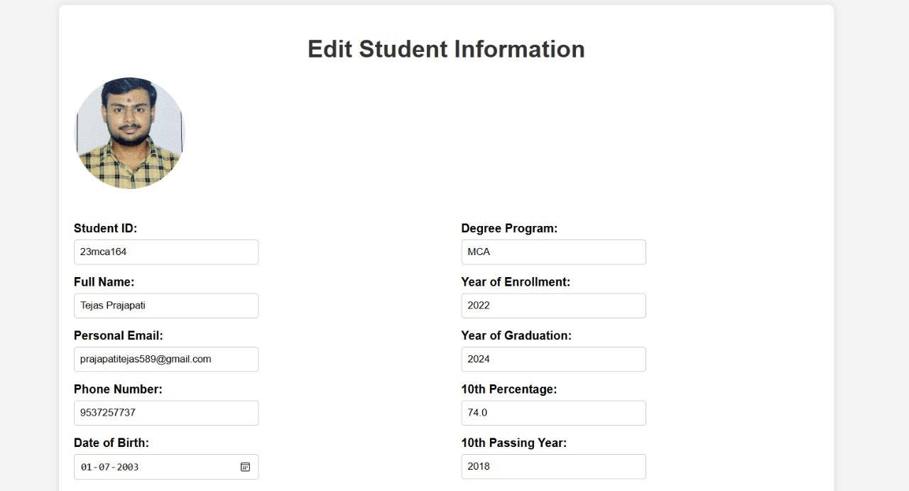
Edit Profile

Slide 36
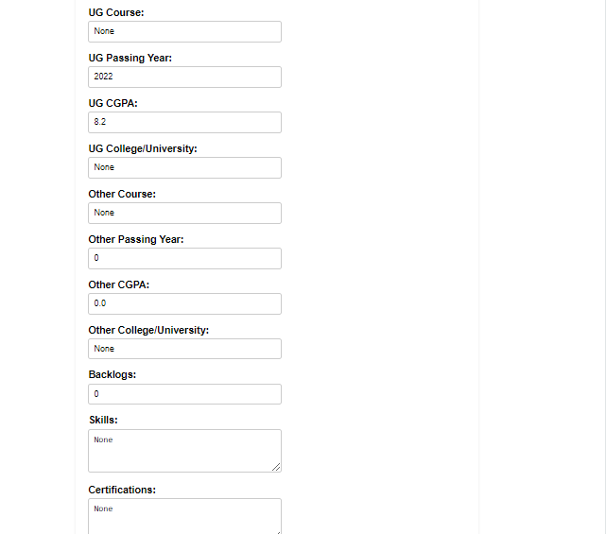

Slide 38
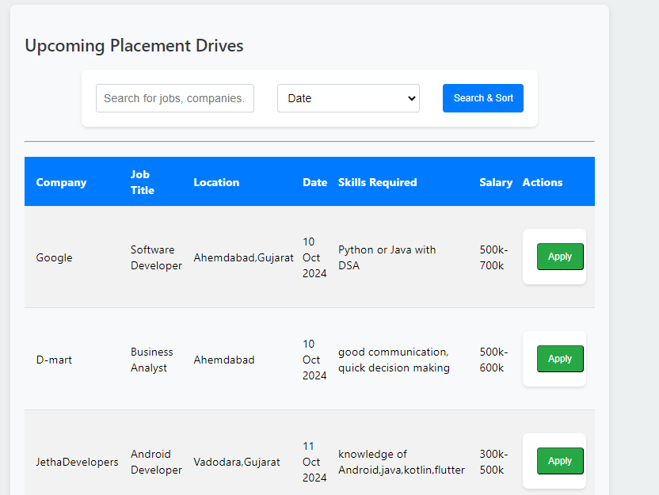
View Opportunities

Slide 39
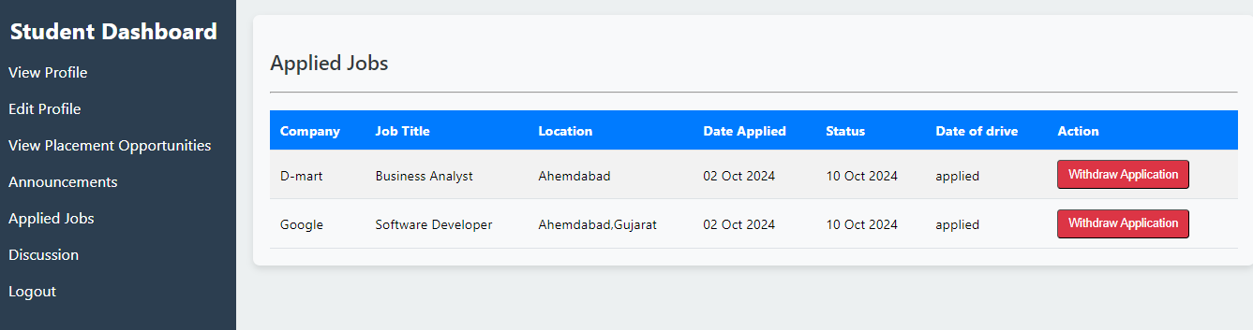
Applied Jobs

Slide 40
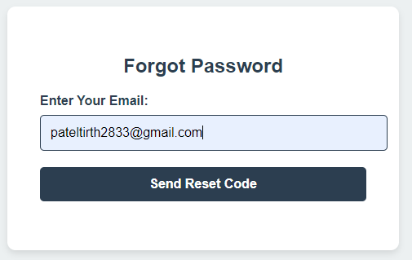
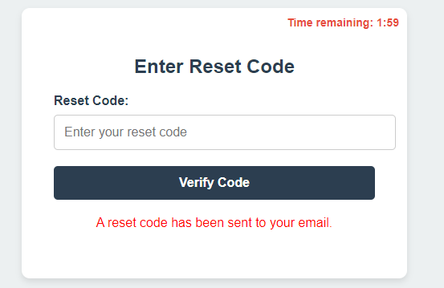
Forgot Password

Slide 41
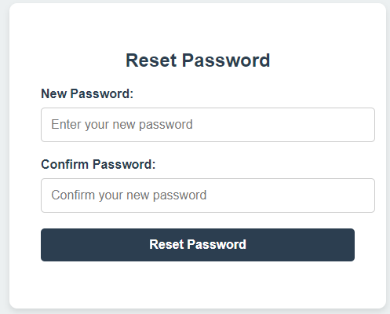

Slide 42
Future Enhancements
AI-Powered Candidate Matching: Leverages AI algorithms to connect students with job opportunities based on their skills and interests, providing tailored recommendations for both students and recruiters.
Automated Interview Scheduling: Streamlines the interview process by automating scheduling based on availability, reducing conflicts, and sending timely notifications and reminders.
Mobile Application: Offers a mobile-friendly interface for students and recruiters to access the system anytime, receive real-time updates on job postings, and track recruitment activities.
Social Media Integration: Integrates with LinkedIn for students to showcase their profiles and enables companies to share content, enhancing employer branding and helping students understand company culture.

Slide 43
Bibliography
The Campus Placement Recruitment System project references The Definitive Guide to Django by Pollock & Holovaty (2009) and academic articles like Reddy’s "A Comparative Study on Campus Placement Systems" (2019). Key resources include Django Documentation (2023), MDN Web Docs (2023), and tutorials like Traversy Media’s Django Crash Course (2022).

Slide 44
Thank You

