Slide 1
Lending Club Case Study
Tirumalesh

Slide 2
Abstract
Lending club is the largest online loan marketplace, facilitating personal loans,
business loans, and financing of medical procedures.
Borrowers can easily access lower interest rate loans through a fast online interface.
The objective of analysis is to use the information about past loan applicants and find whether they ‘defaulted’ or not.

Slide 3
Problem solving methodology
Data Analysis
Data Analysis
Data Analysis
Data Cleaning
Data Understanding
Univariate Analysis
Segmented Univariate Analysis
Analysing the continuous data columns with respect to the categorical column
Bivariate Analysis
Recommendations
Removing the null valued columns, unnecessary variables and checking the null value percentage and removing the respective rows.
Working with the Data Dictionary and getting knowledge of all the columns and their domain speciﬁc uses
Analysing each column, plotting the distributions of each column.
Analysing the two variable behaviour like term and loan status with respect to loan amount.
Analysing all plots and recommendations for reducing the loss of business by detecting columns best which contribute to loan defaulters.

Slide 4
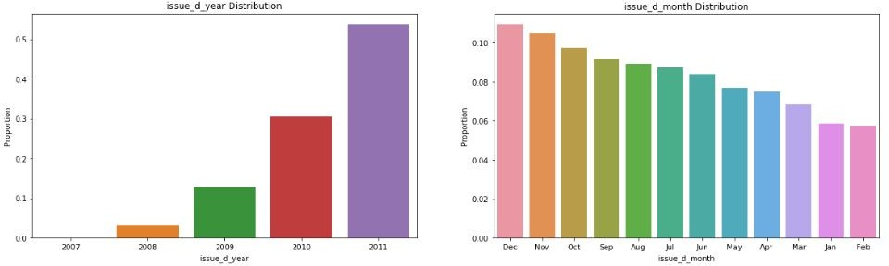
Analysis
Lending club has really expanded year by year, the number of loan issued are doubled every year.
Also the issued month of loans is also increasing from January to December. In the final quarter of year there are more loans issued this could be because of vacation and christmas.

Slide 5
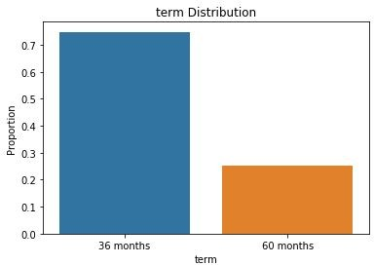
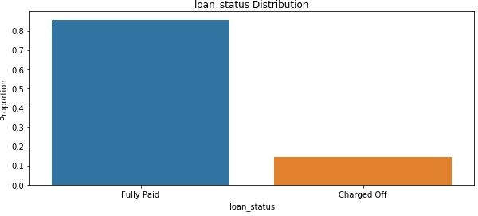
Analysis
There are only two loan terms 36 and 60 months. Around 75% borrowers took loans with 36 months term.
The charged off borrowers are around 15% and fully paid is around 85% in the given data set.

Slide 6
When the loan interest rate is high there is high chance of loan getting defaulted.

Slide 7
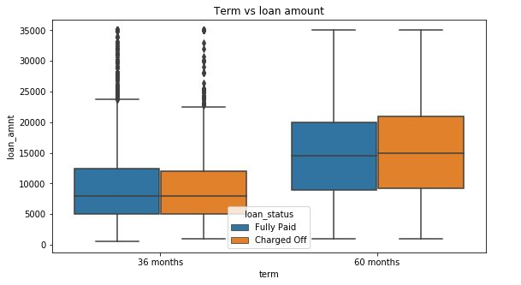
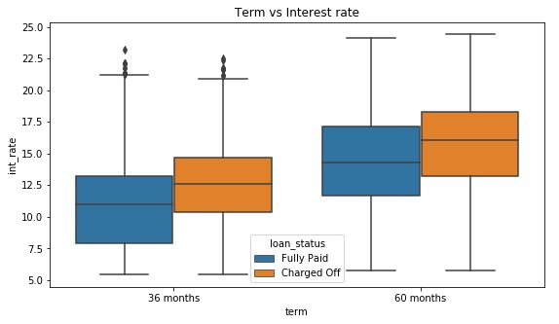
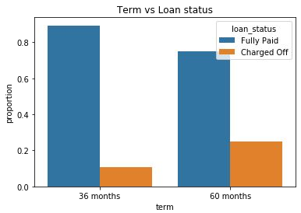
Analysis
The default rate is high in 60 months tenure because most people took high loan amount with high interest rate in it and they faced difficulties in returning the sum to bank.

Slide 8
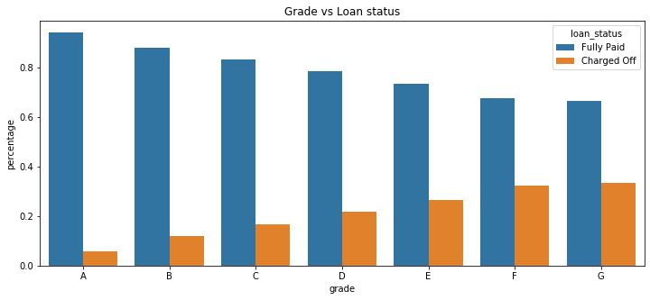
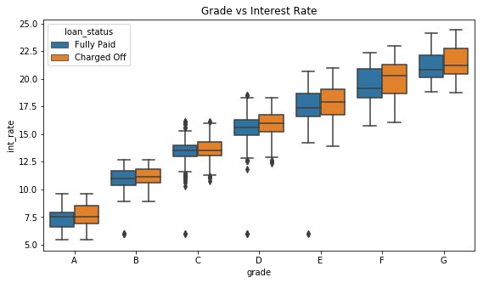
Analysis
Grades are very good category to tell the borrower probability of defaulting the loan.
The Lower grades(E,F,G) have higher chances of defaulting the loan than Higher ones(A,B)
Also the Lower grades are getting loans for higher interest rates which might be the cause for loan default.

Slide 9
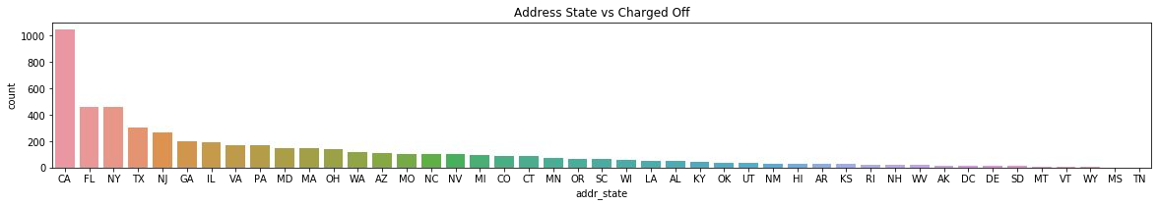
Analysis
The loans which are given for CA, FL and TX state borrower’s are defaulted more than other states.

Slide 10
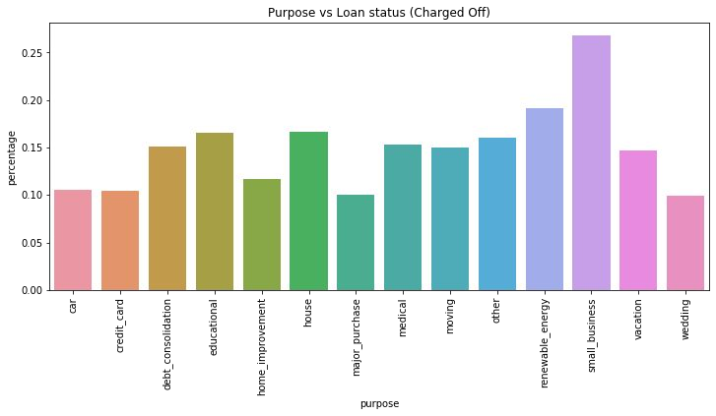
Analysis
Borrower’s who took loans for small business purpose have defaulted more.

Slide 11
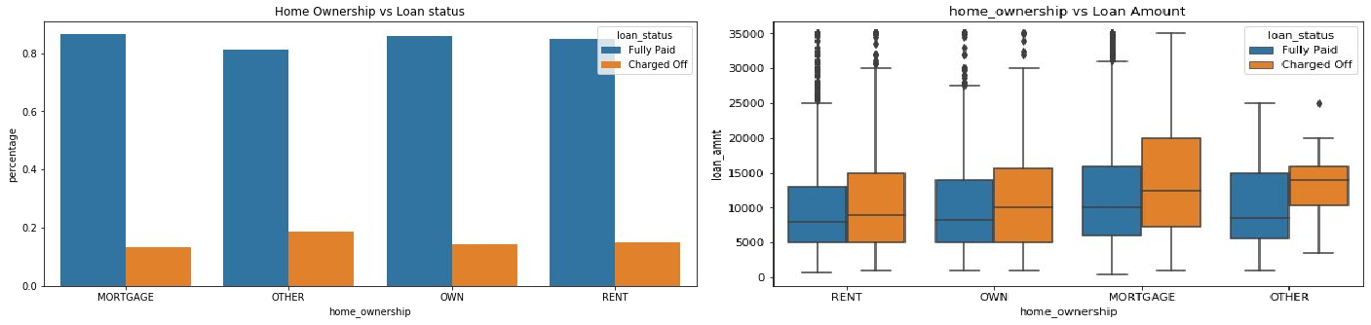
Analysis
There is around 20% chance of loan default in each home ownership category.
From the 2nd plot we can see the people with higher loan amounts in mortgage home ownership has high default rate than others.

Slide 12
Approved loan (Funded Amount by investor) is less than than the requested loan amount by borrowers for Other Home ownership category.

Slide 13
Conclusions
Lending club should reduce the high interest loans for 60 months tenure, they are prone to loan default.
Grades are good metric for detecting defaulters. Lending club should examine more information from borrowers before issuing loans to Low grade (G to A).
Lending Club should control their number of loan issues to borrowers who are from CA, FL and NY to make profits.
Small business loans are defaulted more. Lending club should stop/reduce issuing the loans to them.
Borrowers with mortgage home ownership are taking higher loans and defaulting the approved loans. Lending club should stop giving loans to this category when loan amount requested is more than 12000.
People with more number of public derogatory records are having more chance of filing a bankruptcy. Lending club should make sure there are no public derogatory records for borrower.

