Slide 1
Lending Club Case Study
Exploratory Data Analysis
Tirumalesh

Slide 2
Problem Statement Data Summary Data Cleaning Data conversions VS Derived Columns Dropping/Imputing the Rows Univariate Analysis Bivariate Analysis Segmented Univariate Analysis Correlations Conclusions

Slide 3
Problem Statement
Problem:
You work for a consumer finance company which specialises in lending various types of loans to urban customers. When the company receives a loan application, the company has to make a decision for loan approval based on the applicant’s profile. Two types of risks are associated with the bank’s decision:
If the applicant is likely to repay the loan, then not approving the loan results in a loss of business to the company
If the applicant is not likely to repay the loan, i.e. he/she is likely to default, then approving the loan may lead to a financial loss for the company.
•
Objective:
Use EDA to understand how consumer attributes and loan attributes influence the tendency of default
Constraints:
When a person applies for a loan, there are two types of decisions that could be taken by the company:
•
Loan accepted: If the company approves the loan, there are 3 possible scenarios described below:
Fully paid: Applicant has fully paid the loan (the principal and the interest rate)
Current: Applicant is in the process of paying the instalments, i.e. the tenure of the loan is not yet completed. These candidates are not labelled as ‘defaulted’.
Charged-off: Applicant has not paid the instalments in due time for a long period of time, i.e. he/she has defaulted on the loan
Loan rejected: The company had rejected the loan (because the candidate does not meet their requirements etc.). Since the
loan was rejected, there is no transactional history of those applicants with the company and so this data is notavailable with the company (and thus in this dataset)

Slide 4
Data Summary
•
•
Loan.csv file contains 39717 rows and 111 columns.
There are two types of attributes Loan Attribute and Customer attributes.

Slide 5
Data Cleaning
•
•
•
•
•
•
•
•
There were no header, footers, summary or Total rows found. There were no duplicates rows found.
There were 1140 rows present of loan_status=‘current’ which has been deleted as loan_status =‘current’ does n’t participate in analysis. There were 55 columns which is having all the rows values as null/blank and doesn’t participate in analyse has been removed.
‘url’ and ‘member_id’ is unique in nature and has been deleted.Have kept ‘id’ for future purpose analyse. ‘desc’ and ‘title’ text/description values and doesn’t participate has been dropped from analysis.
Limiting our analysis till ‘Group’ level only hence sub group has been dropped.
Using domain knowledge, behavioural data is captured and hence will not available during the loan approval and doesn’t participate in analysis. 21 behavioural data columns has deleted.
8 columns whose values were 1, and is uniqueness in nature has been dropped from analysis. There were two columns which is having more that 50% of data as na has been removed.
After all the Data cleaning process we are left with 38577 rows and 20 columns.
•
•
•

Slide 6
Data Conversions vs Derived Columns
•
Additional string value has been trimmed from ‘term’ column and has been converted to int data types.
•
‘int_rate’ has been converted from string to int. Additional ‘%’ has been trimmed.
•
Column ‘loan_funded_amnt’ and ‘funded_amnt’ converted to float.
•
loan_amnt', 'funded_amnt', 'funded_amnt_inv', 'int_rate', ‘dti' columns valued rounded off to two decimal points.
•
issue_d has been converted to datatype.
•
Creating a derived columns for ‘issue_year’ and ‘issue_month ’ from ‘issue_d’ which will be using for further analysis.
•
‘loan_amnt_b’, ‘annual_inc_b’, ‘int_rate_b, and ‘dti_b’ derived columns(multiple bucket kind of data from continuous data ) has been created for better analysis.

Slide 7
Dropping/Inputing the rows
‘emp_lenght’ and pub_rec_bankruptcies contains 2.67% and 1.80% of rows as null, which is very small percetnage of data which we can drop it.
Total % of rows deleted: 4.48%,
Outliers exits for numeric data 'loan_amnt', 'funded_amnt', ‘funded_amnt_inv','int_rate', 'installment', ‘annual_inc'.
Outliers treatment has been done for above fields using quantile mechanism.

Slide 8
Univariate Analysis

Slide 9
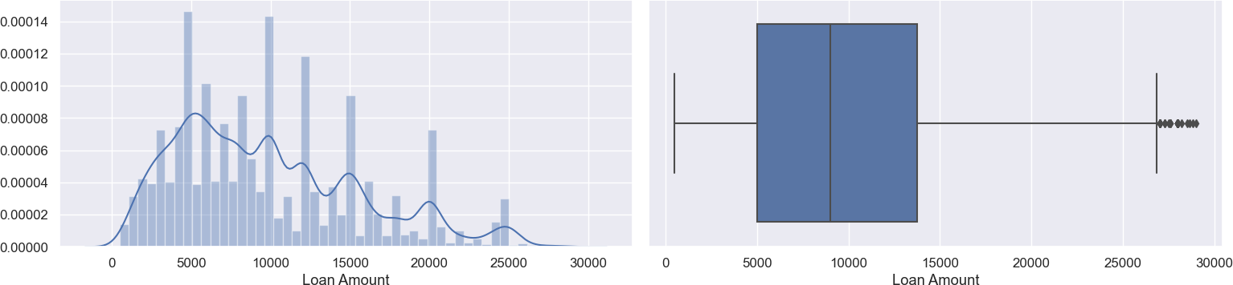
Loan Amount
•
Observations:
Most of the loan amount applied was in the range of 5k-14k.
Max Loan amount applied was
~27k.

Slide 10
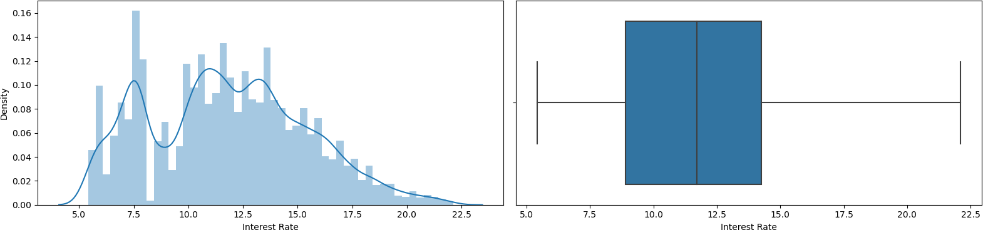
Interest Rate
•
Observations:
Most of the applicant's rate of interest is between in the range of 8%-14%.
Average Rate of interest of rate is
11.7 %

Slide 11
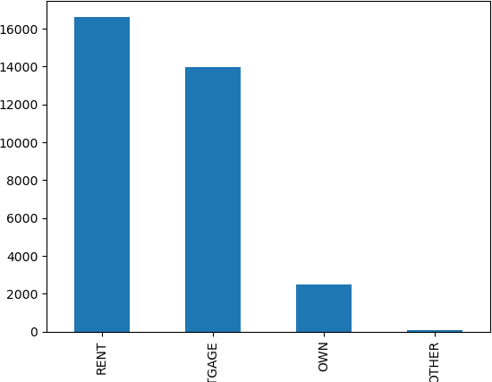
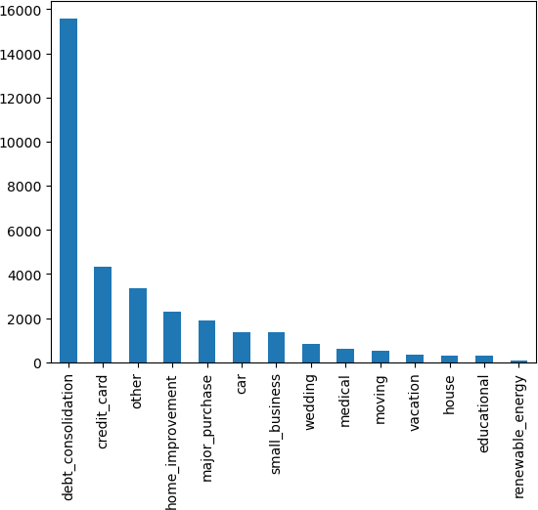
Univarients Analysis
Unordered & Ordered Categorical Variable Analysis
•
Observations:
Majority of loan applicants are either living on Rent or on Mortgage
Most of the loan applicants are for debt_consolidations
Most of the Loan applicants are from CA(State).
Most of the applications are having 10+ yrs of Exp.

Slide 12
Bivariate Analysis

Slide 13
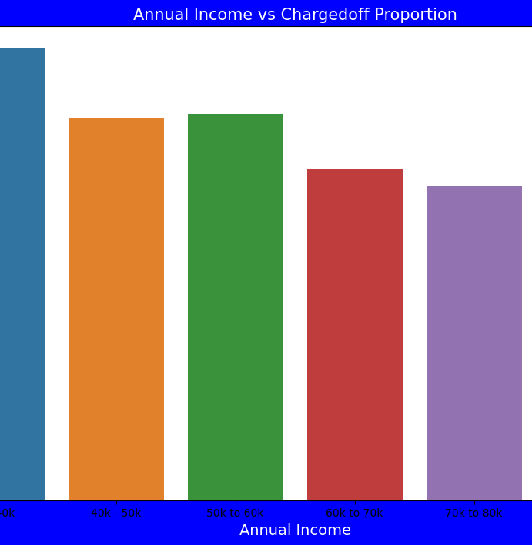
Annual income vs Charged Off
•
Observations:
Income range 80000+ has less chances of charged off.
Income range 0-20000 has high chances of charged off.
Notice that with increase in annual income charged off proportion got decreased.
loan_status | int_rate_b | Charged Off | Fully Paid | Total | Chargedoff_Proportion
3 | Very High | 1670 | 4751 | 6421 | 0.260084
0 | High | 985 | 4851 | 5836 | 0.168780
2 | Moderate | 961 | 5638 | 6599 | 0.145628
1 | Low | 579 | 4983 | 5562 | 0.104099
4 | Very Low | 519 | 8254 | 8773 | 0.059159

Slide 14
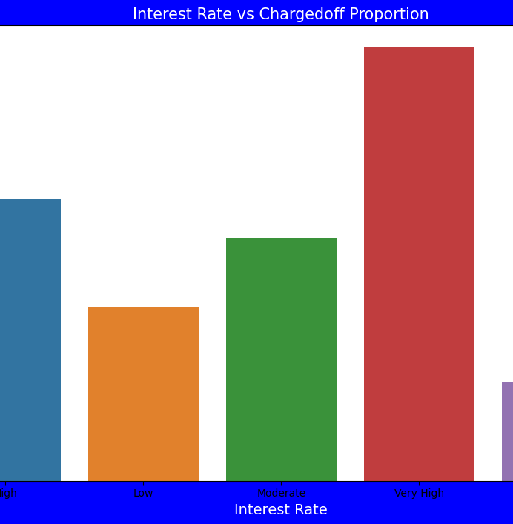
Interest Rate vs Charged off
Observations:
Interest rate less than 10% or very low has very less chances of charged off. Interest rates are starting from minimum 5 %.
Interest rate more than 16% or very high has good chances of charged off as compared to other category interest rates.
Charged off proportion is increasing with higher interest rates.
loan_status | home_ownership | Charged Off | Fully Paid | Total | Chargedoff_Proportion
1 | OTHER | 16 | 73 | 89 | 0.179775
3 | RENT | 2488 | 14156 | 16644 | 0.149483
2 | OWN | 355 | 2121 | 2476 | 0.143376
0 | MORTGAGE | 1855 | 12127 | 13982 | 0.132671

Slide 15
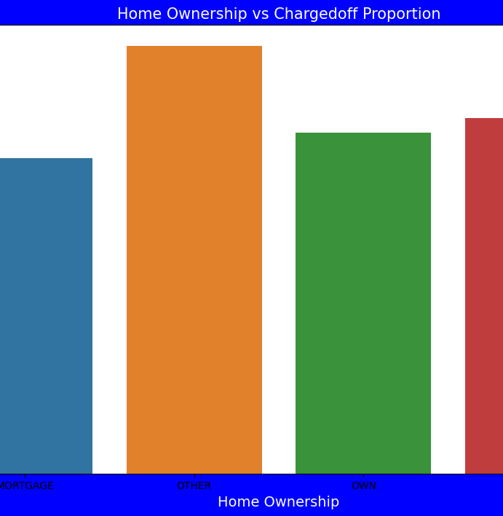
Home Ownership vs Charged off
•
Observations:
Those who are not owning the home is having high chances of loan defaulter.
From the graph even shows high chances of charged off. Proportions, but data available is very limited compared to other points
loan_status | home_ownership | Charged Off | Fully Paid | Total | Chargedoff_Proportion
1 | OTHER | 16 | 73 | 89 | 0.179775
3 | RENT | 2488 | 14156 | 16644 | 0.149483
2 | OWN | 355 | 2121 | 2476 | 0.143376
0 | MORTGAGE | 1855 | 12127 | 13982 | 0.132671

Slide 16
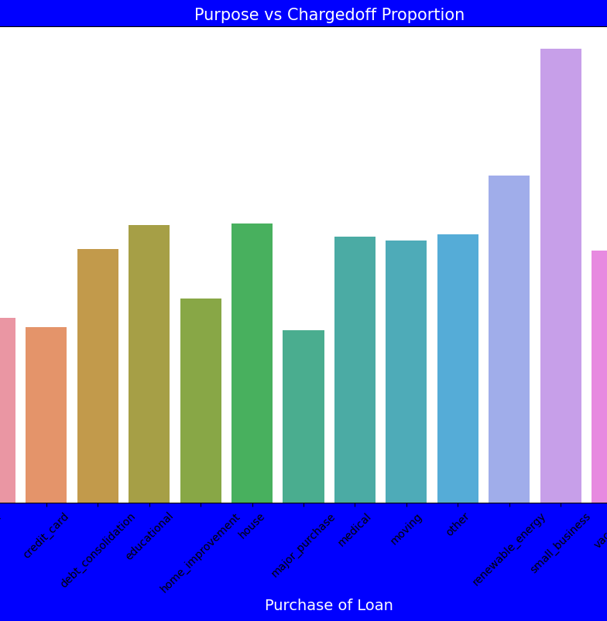
Purpose vs Charged Off
•
Observations:
Those applicants who is having home loan is having low chances of loan defaults.
Those applicants having loan for small business is having high chances for loan defaults.
loan_statu s | purpose | Charged Off | Fully Paid | Total | Chargedoff_Proporti on
11 | small_business | 366 | 1003 | 1369 | 0.267348
10 | renewable_energy | 16 | 67 | 83 | 0.192771
5 | house | 49 | 249 | 298 | 0.164430
3 | educational | 46 | 235 | 281 | 0.163701
9 | other | 531 | 2823 | 3354 | 0.158318
7 | medical | 95 | 510 | 605 | 0.157025
8 | moving | 79 | 433 | 512 | 0.154297
2 | debt_consolidatio n | 2329 | 13253 | 15582 | 0.149467
12 | vacation | 49 | 281 | 330 | 0.148485
4 | home_improveme nt | 277 | 2026 | 2303 | 0.120278
0 | car | 150 | 1224 | 1374 | 0.109170
1 | credit_card | 450 | 3894 | 4344 | 0.103591
6 | major_purchase | 195 | 1719 | 1914 | 0.101881
13 | wedding | 82 | 760 | 842 | 0.097387

Slide 17
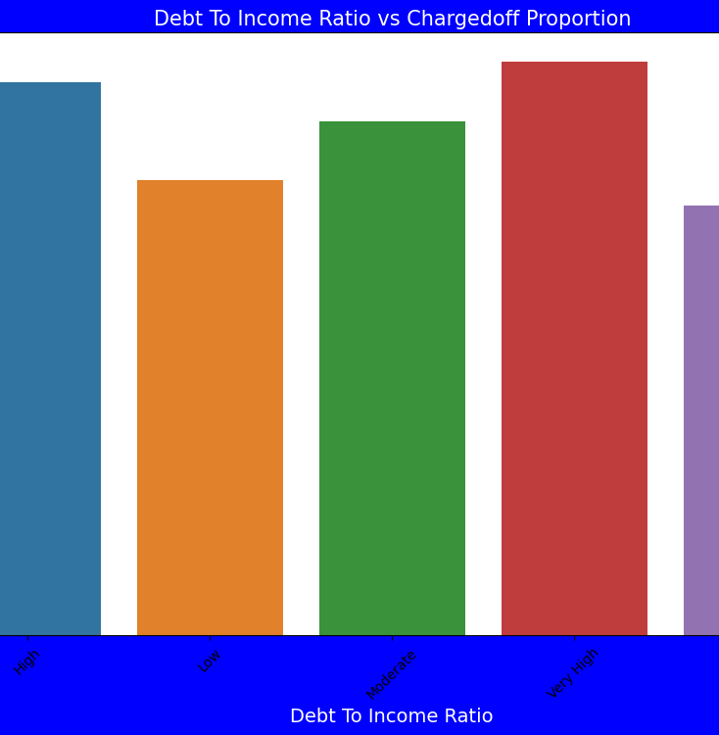
DTI Vs Charged off
•
Observation:
•
•
High DTI value having high risk of defaults
Lower the DTO having low chances loan defaults.
loan_status | dti_b Ch | arged Off | Fully Paid | TotalCh | argedoff_Proportion
3 | Very High | 1044 | 5387 | 6431 | 0.162339
0 | High | 948 | 5111 | 6059 | 0.156461
2 | Moderate | 985 | 5785 | 6770 | 0.145495
1 | Low | 789 | 5339 | 6128 | 0.128753
4 | Very Low | 948 | 6855 | 7803 | 0.121492

Slide 18
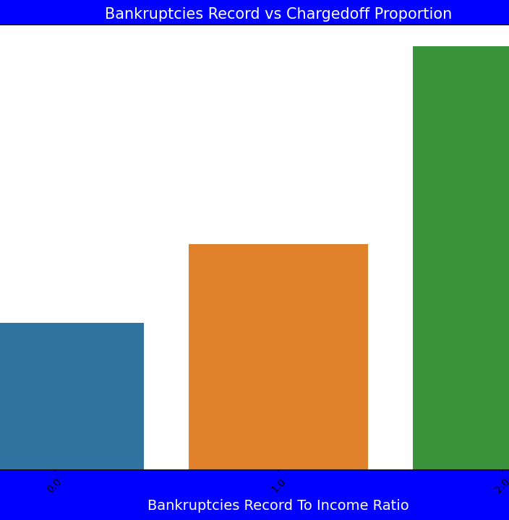
Bankruptcies Record vs Charged off
•
Observations:
Bankruptcies Record with 2 is having high impact on loan defaults
Bankruptcies Record with 0 is low impact on loan defaults
•
Lower the Bankruptcies lower the risk.

Slide 19
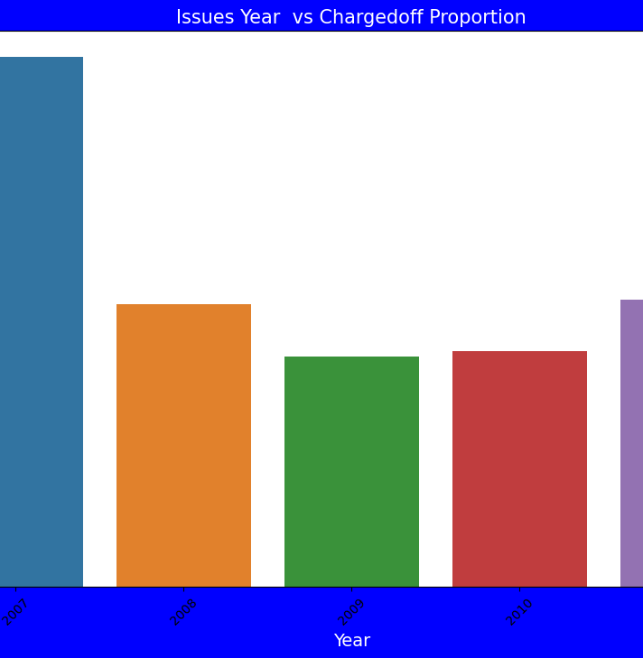
Issue Year vs Charged off
•
Observations:
Year 2007 is highest loan defaults.
2009 is having lowest loan defaults.

Slide 20
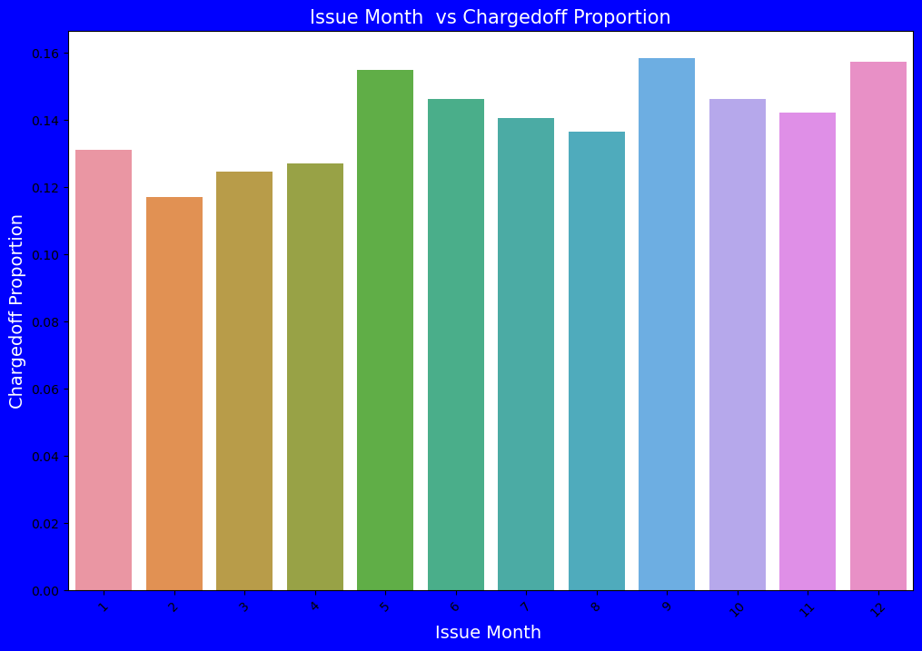
Issue Month Vs Charged off
•
Observations:
Those loan has been issued in May, September and December is having high number of loan defaults
Those loan has been issued in month of February is having high number of loan defaults
Majority of loan defaults coming from applicants whose loan has been approved from September-to December

Slide 21
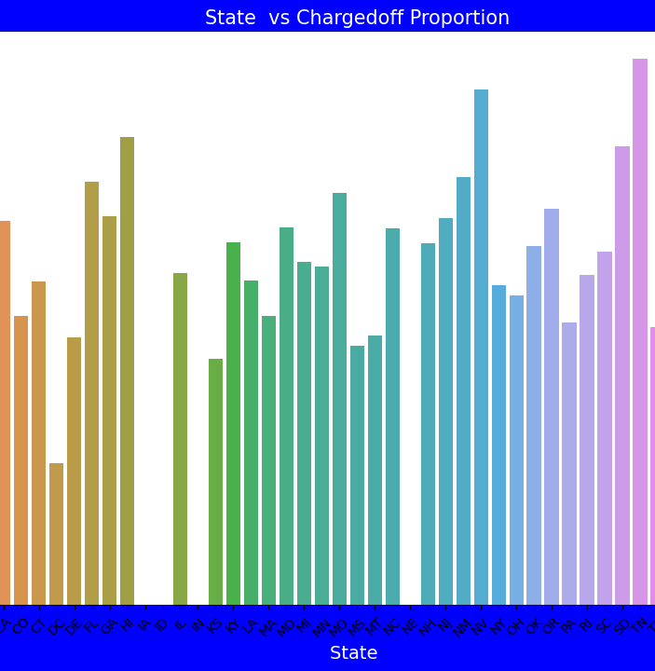
State vs Charged off
•
Observations:
•
DE States is holding highest number of loan defaults.
•
CA is having low number of loan defaults

Slide 22
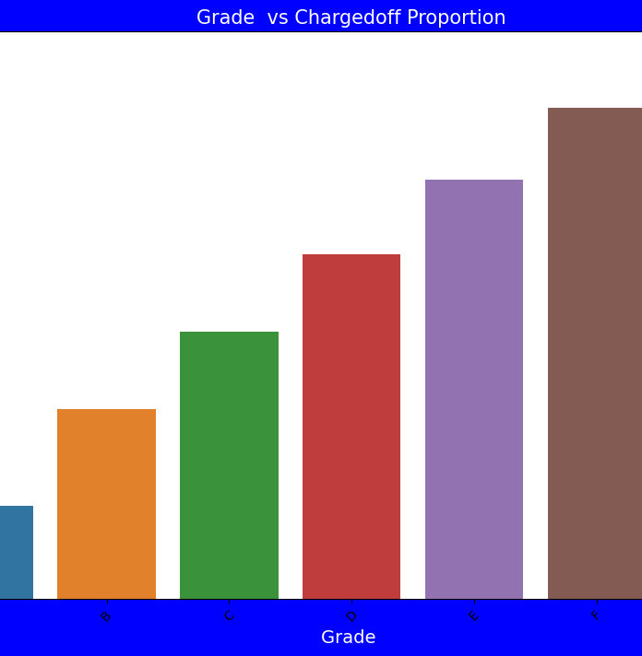
Grade vs ChargedOff
•
Observations:
•
•
The Loan applicants with loan Grade G is having highest Loan Defaults.
The Loan applicants with loan A is having lowest Loan Defaults.

Slide 23
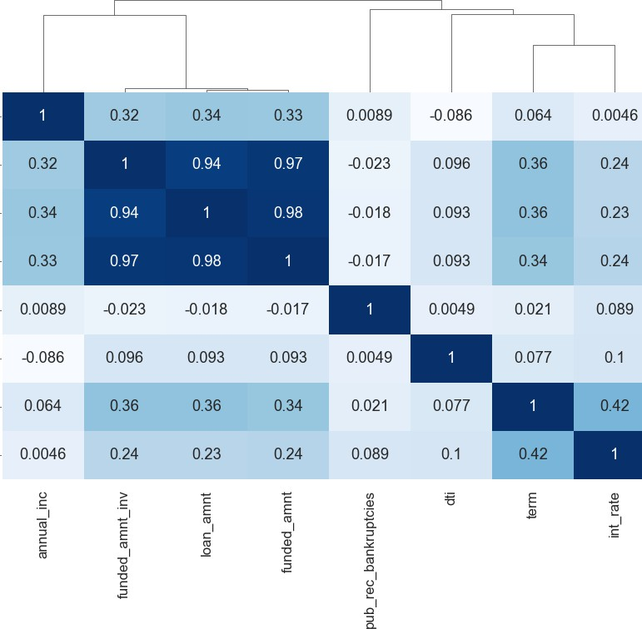
Correlations
Negative Correlation:
loan_amnt has negative correlation with pub_rec_bankrupticies
annual income has a negative correlation with dti
Strong Correlation:
term has a strong correlation with loan amount
term has a strong correlation with interest rate
annual income has a strong correlation with loan_amount

Slide 24
Conclusions
•
•
•
Income range between 0-20000 has high chances of charged off.
Interest rate more than 16% has good chances of charged off as compared to other category interest rates.
Those who are not owning the home is having high chances of loan defaulter.
•
Those applicants having loan for small business is having high chances for loan defaults.
•
•
High DTI value having high risk of defaults.
Higher the Bankruptcies record higher the chance of loan defaults.
•
•
DE States is holding highest number of loan defaults.
The Loan applicants with loan Grade G is having highest Loan Defaults.

