Slide 1
HYPERSPECTRAL IMAGE CLASSIFICATION INTEGRATED WITH MLOPS
PROJECT STAGE - 2
TEAM MEMBERS
LALAN KUMAR (21E51A6932)
T MANAV GOUD (21E51A6955)
K CHAITANYA VENKAT (20E51A6915)
GUIDE: Mr. BHASKAR DAS
Gowdavalli Village, Medchal Mandal & District, Telangana | www.hitam.org

Slide 2
INTRODUCTION
A Hyperspectral image is a type of image that captures information across hundreds of narrow and contiguous spectral bands, ranging from visible to infrared and beyond regions of electromagnetic spectrum.
Unlike normal RGB images, which only record light in three broad bands Red, Green and Blue, hyperspectral images record detailed spectral information at each pixel making it possible to analyze material composition and surface properties.
Each material has a unique spectral signature i.e., Each Material reflects uniquely at different wavelengths. This makes HSI extremely powerful for fine-grained classification, such as detecting plant disease, identifying minerals or analyzing land use from satellite images.

Slide 3
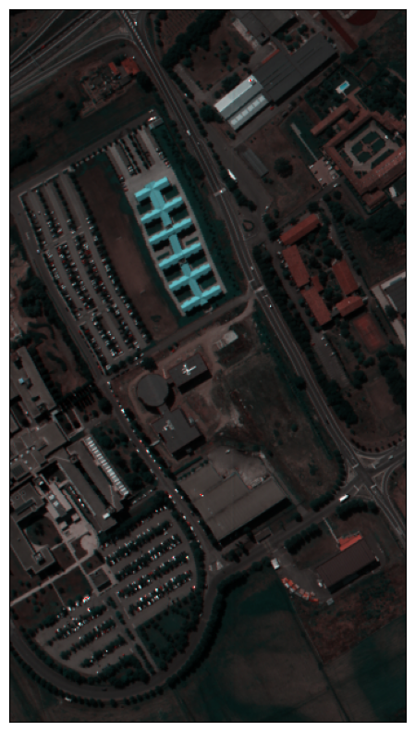
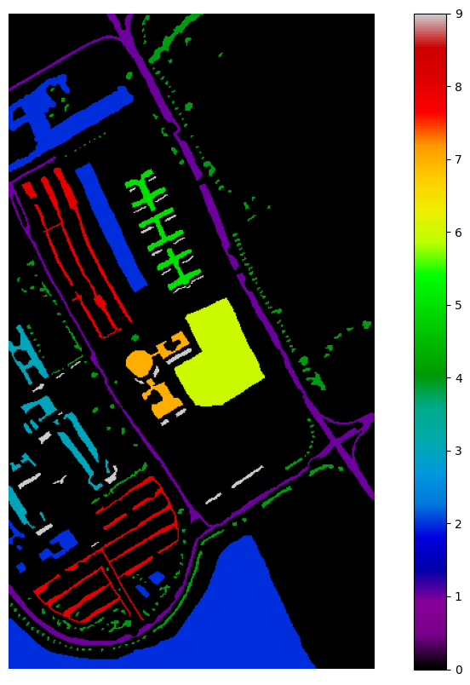
HYPERSPECTRAL DATA EXAMPLE

Slide 4
INTRODUCTION
Another key aspect is the spectral-spatial connection. HSI captures not only spectral data but also the spatial(i.e., physical) arrangement of features in a scene. The data is naturally structured as a 3D cube making it both rich in information and high in dimensionality.
While this offers a lot of potential, it also introduces challenges such as large data size, computational complexity, and the need for dimensionality reduction.
Due to the high dimensionality of hyperspectral data, traditional machine learning algorithms often struggle to interpret it effectively. This results in poor performance on classification tasks a well-known issue referred to as Curse of Dimensionality.

Slide 5
LITERATURE SURVEY
To overcome this challenge, we propose using deep learning-based approaches, which are better suited to handle large, complex datasets.
Now, it’s important to note that deep learning for hyperspectral image classification is not new. There are numerous research papers out there proposing various architectures. Techniques such as CNNs and RNNs have shown promising results, but often require extensive labeled data and computational resources. The literature reveals that:
CNN-based methods are proficient at capturing spatial features but may fall short in encoding high-dimensional spectral data.
RNN-based approaches offer sequential modeling capabilities but can be computationally expensive for high-dimensional inputs.

Slide 6
EXISTING METHODOLOGY
Existing methods for hyperspectral image classification typically involve:
Preprocessing steps such as noise reduction and dimensionality reduction using techniques like Principal Component Analysis(PCA).
Feature extraction using CNNs or hybrid models that combine CNNs and RNNs to capture both spatial and spectral information.
Traditional classifiers such as support vector machines (SVM) or Random Forests used in conjunction with handcrafted features.
These methods often require significant manual intervention and computational power, especially when handling high-dimensional hyperspectral data. Limitations include risk of overfitting with smaller datasets, high training times, and the inability to generalize across different datasets.

Slide 7
PROPOSED METHODOLOGY
Autoencoder Architecture: Utilizes encoder-decoder network to compress high-dimensional data and reconstructs the image with compressed representations.
GAN Architecture: Uses Generator and discriminator to generate images with less dimensions, conserving memory utilization.
CNN: we will improve the existing CNNs to accurately classify the images.
Along with all these we will integrate MLOps tools to log the experiment results and artifacts to make it publicly available and containerize it so that anyone can access and utilize it efficiently.

Slide 8
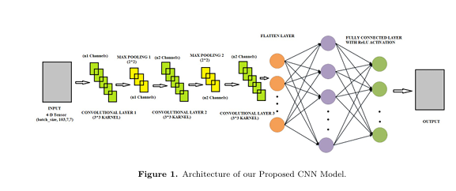
PROPOSED CNN ARCHITECTURE

Slide 9
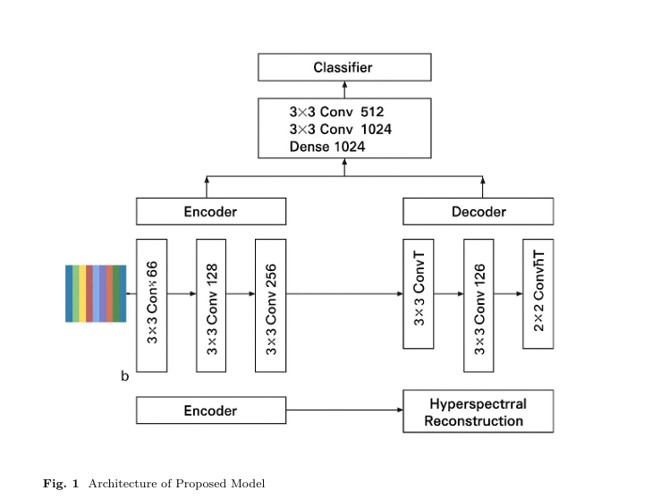
PROPOSED AE ARCHITECTURE

Slide 10
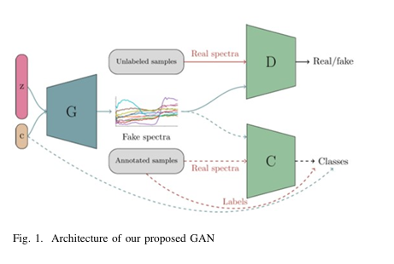
PROPOSED GAN ARCHITECTURE

Slide 11
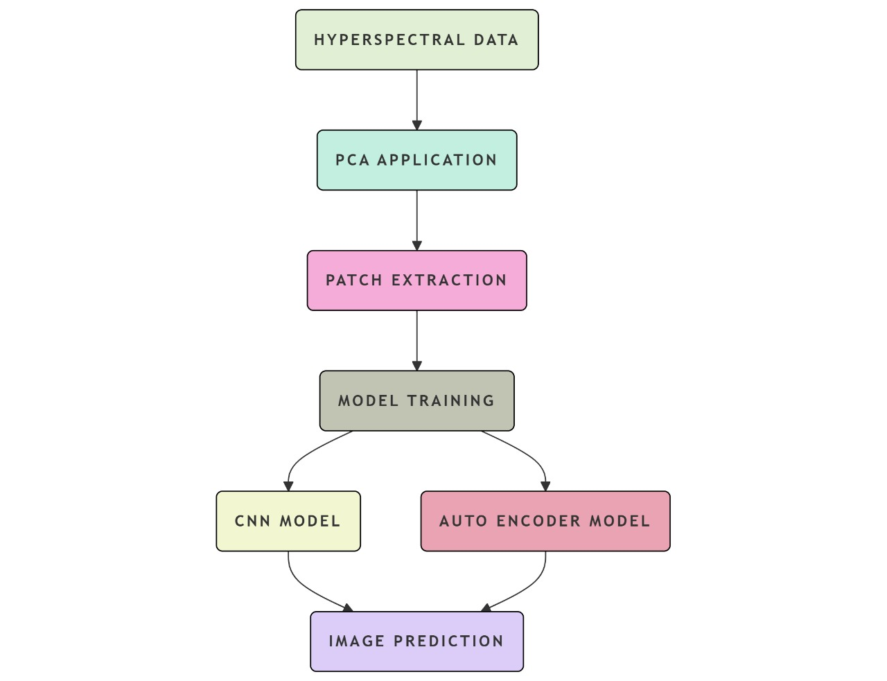
WORKFLOW ARCHITECTURE

Slide 12
THANK YOU

