Slide 1

ANSWER EVALUATION USING MACHINE LEARNING
Presented by
T.Sai Hareesha
Under the esteemed guidance of
Mrs.S.Nahida
Associate Professor, CSE Department
DEPARTMENT OF COMPUTER SCIENCE AND ENGINEERING
NRI INSTITUTE OF TECHNOLOGY
(Accredited by NBA:CSE,ECE &EEE)
An Autonomous Institution, Permanently Affiliated to JNTUK, Kakinada
(Accredited by NAAC with ”A” Grade and ISO 9001:2015 Certified Institution)

Slide 2
List of the Contents
Abstract
Existing Model and Disadvantages of the model
Proposed Model and Advantages of the model
Modules
Flow Diagrams
Methodology
System Requirements
System Design
Screenshots
Conclusion
Publication

Slide 3
ABSTRACT
The main idea is to make it real and easy for the evaluators and the system will evaluate the answer based upon the matched keywords and the minimum length of the answer provided by the student. This is going to be designed with the machine learning process by the use of back propagation algorithm and natural language processor to understand the language of the provided input answer sheet.

Slide 4
EXISTING SYSTEM
Manual evaluation is a time and energy-consuming task. Presently, we have automated systems for objective type, single sentence answers and descriptive answers with less accuracy level.
In this paper, our goal is to develop an automated answer evaluation system using machine learning. The system will evaluate the answer based upon the matched keywords and the minimum length of the answer provided by the moderator.
The scanned handwritten answer sheet will be given as input to the proposed system. The system will use an artificial neural network with back-propagation algorithm.

Slide 5
DISADVANTAGES
The results is low when compared with proposed.
The prediction of text is poor
It doesn’t implement the pytesseract.

Slide 6
PROPOSED SYSTEM
In proposed system, the image dataset was taken as input. Then, we have to implement the pre-processing step.
After that, we have to extract the text from input image by using the pytesseract and the extracted text will be stored in text format.
Then, we have to implement the Natural Language Processing for cleaning the extracted text.
After that, we have to implement the deep learning algorithm such as Artificial Neural Network (ANN).

Slide 7
ADVANTAGES
It displays the text format
It will recognize easy
The accuracy is high.
To evaluate the answers.

Slide 8
MODULES
Input
Preprocessing
Feature extraction
Text recognition
NLP techniques
Data splitting
Classification
Evaluate answer
Performance metrics

Slide 9
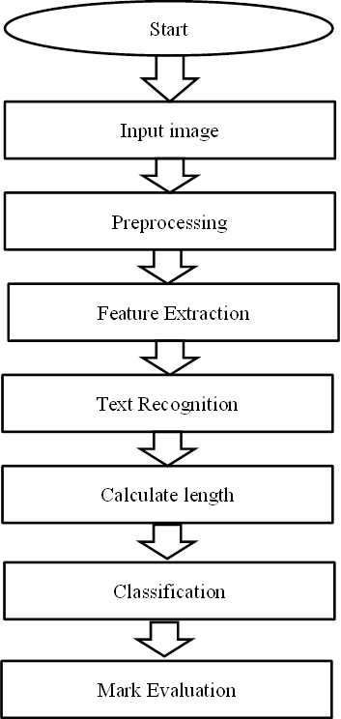
FLOW DIAGRAM

Slide 10
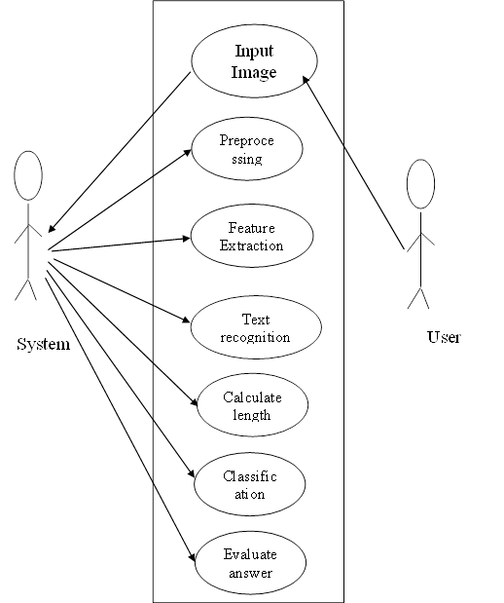
USE CASE DIAGRAM

Slide 11
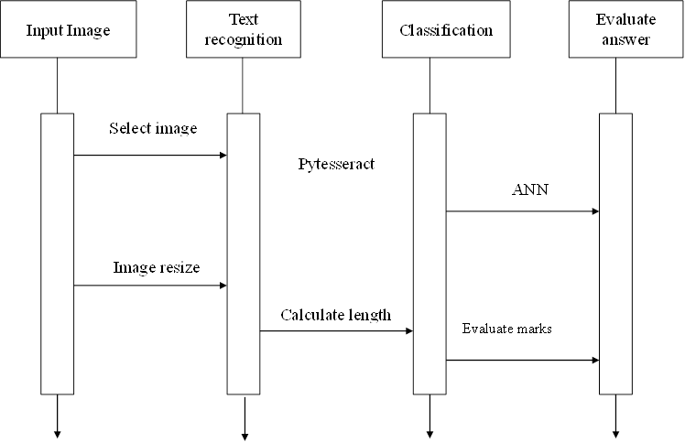
SEQUENCE DIAGRAM

Slide 12
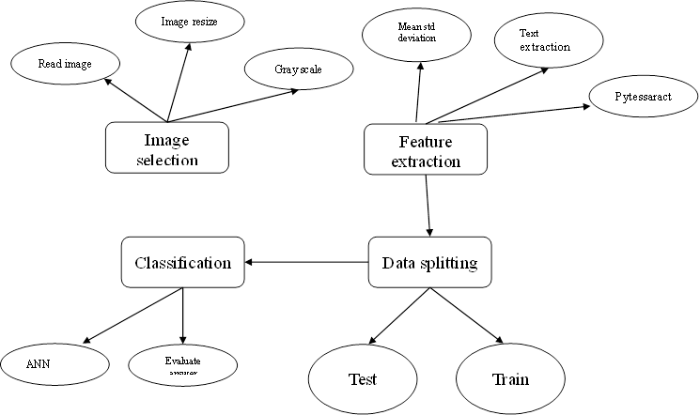
ER DIAGRAM

Slide 13
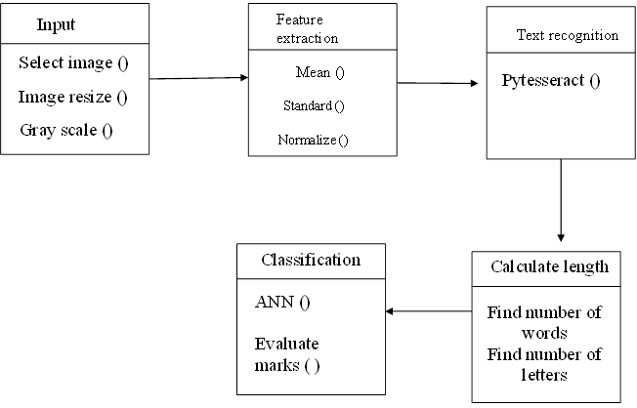
CLASS DIAGRAM

Slide 14
METHODOLOGY
Automatic answer evaluation is implemented by using supervised machine learning algorithms.
The classification techniques like NLP is a field in machine learning with the ability of a computer to understand human language
Artificial Neural Network(ANN) is implemented so that the accuracy is calculated.
To implement the methods used to evaluate the answer from the extracted text based on length of answers and length of words.

Slide 15
SYSTEM REQUIREMENTS
SOFTWARE REQUIREMENTS:
Operating System : Windows
Language : Python
Front End : Anaconda Navigator – Spyder
HARDWARE REQUIREMENTS:
System : Pentium IV 2.4 GHz
Hard Disk : 200 GB
Mouse : Logitech.
Keyboard : 110 keys enhanced
Ram : 4GB

Slide 16
SYSTEM DESIGN

Slide 17


Input image
Preprocessing
Image Resize
Gray scale conversion
Dataset
Mean Standard Deviation
Feature Extraction
Text Recognition
Pytesseract
Length of words
Calculate length
Length of letters
ANN
Classification
Accuracy
Answer Evaluation

Slide 18
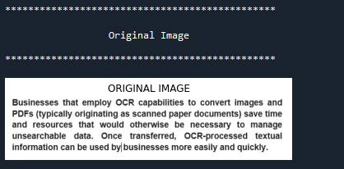
INPUT

Slide 19
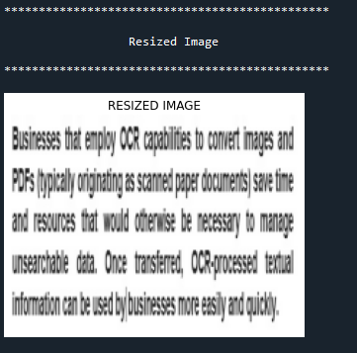
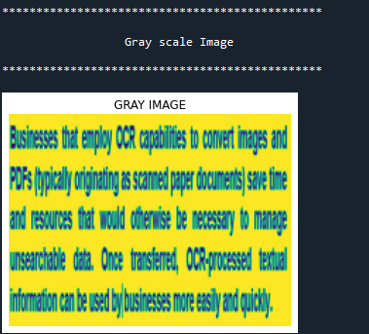
PREPROCESSING

Slide 20
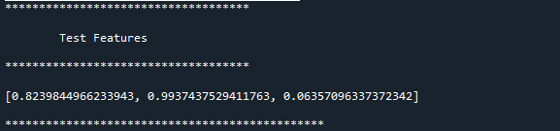
FEATURE EXTRACTION

Slide 21
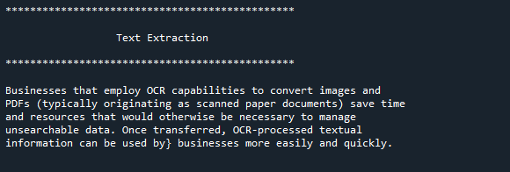
TEXT RECOGNITION

Slide 22
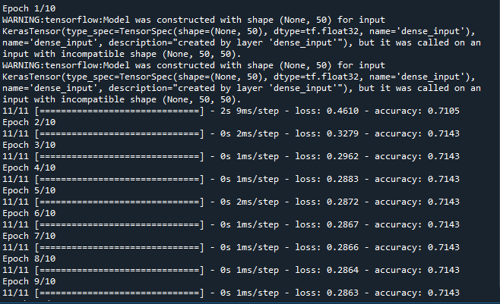
CLASSIFICATION

Slide 23
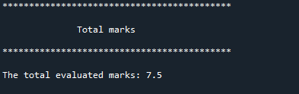
EVALUATE ANSWER

Slide 24
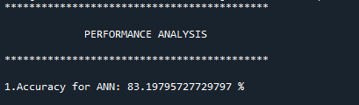
RESULT

Slide 25
CONCLUSION
We conclude that, the image dataset was taken from dataset repository. We are implemented the NLP techniques and classification algorithms (i.e.) deep learning algorithm.
Then, deep learning algorithms such as artificial neural network (ANN). Finally, the result shows that the accuracy for above mentioned algorithm and evaluate the answer and put marks from 0 to 10 based on length of letters and length of words.

Slide 26
PUBLICATION
Journal Name : DOGO RANGSANG RESEARCH
JOURNAL
Type : UGC GROUP—1
ISSN NO : 2347-7180
Impact Factor : 7.12

Slide 27
Thank You…

