Slide 1

Mahatma Gandhi Institute of Technology Department of Computer Science Prediction of Diabetes Using Different Machine Learning Classifiers
T. Vysali
17261A0556
Guide: P.Poornima,
Assistant Proffessor, Dept of CSE

Slide 2
Problem Definition
The lack of insulin hormone due to malfunctioning of the pancreas forms diabetes.
Performance and accuracies of the applied algorithms DT,NB,LR,SVM,ANN,RF is discussed and compared.
Comparison of the accuracies of different classification algorithms reveals which algorithm is best suited for prediction of diabetes.

Slide 3
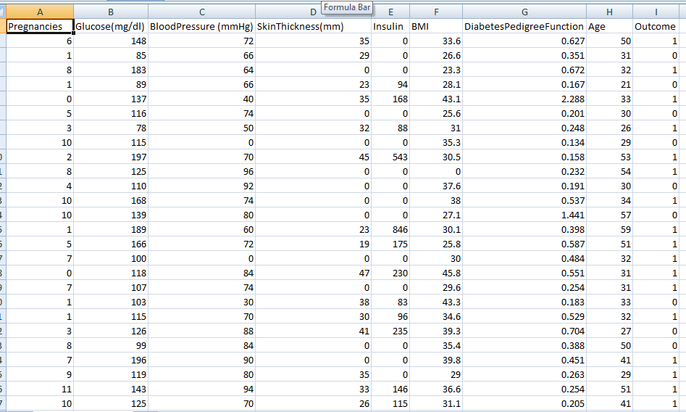
Dataset-PIMA Indian Diabetes

Slide 4
Design Methodology
Data preprocessing on PIMA Indian Diabetes dataset
Splitting into Training and Testing data
Applying Each Algorithm
Training and Testing
Finding accuracy of each algorithm
Comparing Performance

Slide 5
Results
Accuracies:
Logistic Regression:71%
Naive bayes : 74%
Random Forest:81%
Decision Tree:71%
Artificial Neural Network:70%
Support Vector Machine:74%
Random Forest Classifier is the best suited algorithm for prediction of diabetes.

Slide 6
References
Muhammad Azeem Sarwar , Nasir Kamal , Wjeeha Hamid , Munam Ali Shah, "Prediction of Diabetes Using Machine Learning Algorithms in Healthcare”, 24 th International Conference on Automation and Computing (ICAC), 2018
Roxana Mirshahvalad, Nastaran Asadi Zanjani , “Diabetes prediction using ensemble perceptron algorithm” , 9th International Conference on Computational Intelligence and Communication Networks (CICN) ,2017.
K Sowjanya, Ayush Singhal , Chaitali Choudary, “A machine learning based system for predicting diabetes risk using mobile devices”, IEEE International Advance Computing Conference (IACC) ,2015.
Krati Saxena , Dr. Zubair Khan , Shefali Singh, “ Diagnosis of Diabetes Mellitus using K Nearest Neighbor Algorithm” , International Journal of Computer Science Trends and Technology (IJCST) – Volume 2 Issue 4, July-Aug 2014

Slide 7
Thank You

