Slide 1
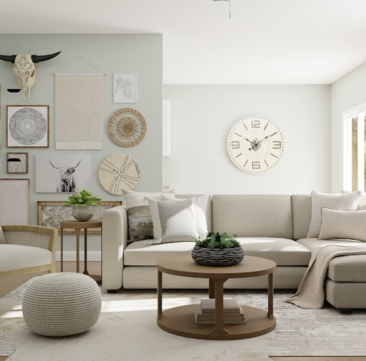
WEB DEVELOPMENT PROJECT
Angkor Maison gives Cambodian craft a modern online storefront.
A responsive e-commerce website for furniture, lighting, plants, wall decoration, and home accessories made by Khmer artisans.
30
6
2
Product items
Website pages
Payment options
HTML · CSS · Bootstrap · JavaScript
Source: local Angkor Maison website project files
01

Slide 2
PROBLEMS
Local handmade products need clearer online discovery and trust.
01
Hard to discover
Customers may not know where to find authentic Cambodian furniture and decor online.
The project focuses on common shopping problems for Cambodian-made home decor: visibility, trust, product detail, and checkout clarity.
02
Low product trust
Handmade products need clear images, prices, details, and origin information.
Project response
Build a website that feels local, clear, and complete enough for real customer use.
03
Weak shopping flow
Without cart, checkout, payment, and receipts, the website feels incomplete.
04
Limited artisan reach
Small workshops need a digital place to show their work beyond one physical location.
Angkor Maison project presentation
02

Slide 3
SOLUTION
The website connects every shopping step in one flow.
Angkor Maison is designed as a complete e-commerce experience, not only a static product gallery.
01
02
03
04
Discover
Browse
Decide
Checkout
Home hero, featured products, discounts, and categories
Products page with category filters and search
Product detail modal with price, material, origin, size, and care
Cart, province delivery, QR/Cash payment, and receipt history
Customer outcome: a clearer way to buy Cambodian-made products from a Phnom Penh-based brand.
Angkor Maison project presentation
03

Slide 4

WHY WE CREATED IT
The project supports Khmer artisans and gives Cambodian homes a local design identity.
The website is built around Cambodian craft, local materials, fair product storytelling, and practical nationwide shopping.
LOCAL VALUE
Khmer artisans first
The About page highlights 40+ partner workshops and fair pricing.
Materials from Cambodia
Rattan, teak, silk, water hyacinth, ceramic, and Kampot pepper appear throughout the products.
Design direction: sandstone, laterite red, saffron, lotus red, and antique Khmer gold.
Angkor Maison project presentation
04

Slide 5
WEBSITE PAGES
Six pages cover the full customer journey.
The navigation is consistent across pages, with clear access to Products, About, Contact, Cart, and Receipt History.
Home
Products
About
Brand introduction, hero message, categories, featured deals, testimonials.
All products, category filters, search, USD and riel pricing.
Story, artisan values, local materials, delivery promise.
Contact
Cart
Receipts
Showroom details, Telegram, email, payment info, contact form.
Selected items, quantity controls, province delivery, payment choice.
Completed order history saved in browser local storage.
Angkor Maison project presentation
05

Slide 6
LANGUAGES & TOOLS
The stack separates content, design, interaction, and storage.
The implementation uses simple web technologies, but the features act like a small e-commerce system.
HTML
CSS
Bootstrap
JavaScript
Storage
Builds the page structure and product content.
Controls layout, responsive rules, and Cambodia-inspired theme.
Supports responsive navbar and UI consistency.
Runs cart, filters, product modals, checkout, and receipts.
localStorage saves cart and receipt history in the browser.
Result: one static front-end project with real shopping interactions and persistent order history.
Angkor Maison project presentation
06

Slide 7
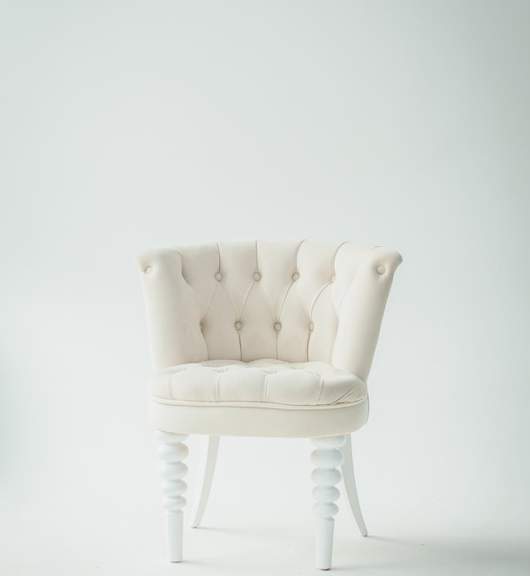


MAIN FEATURES
Product features make browsing fast and shopping practical.
The products page is interactive: it filters, searches, opens detail modals, and connects directly to the cart.
Category filters
Search
All, Furniture, Wall Decoration, Lighting, Plants, and Home Accessories.
Customers can quickly find products by name.
Product detail modal
Cart badge
Shows price, riel conversion, material, origin, size, care, and delivery note.
The navbar updates item count and gives feedback after adding products.
Responsive layout
Cambodia identity
Product grid adapts for desktop and mobile screens.
Copy, colors, products, and materials all connect to the local concept.
Angkor Maison project presentation
07

Slide 8
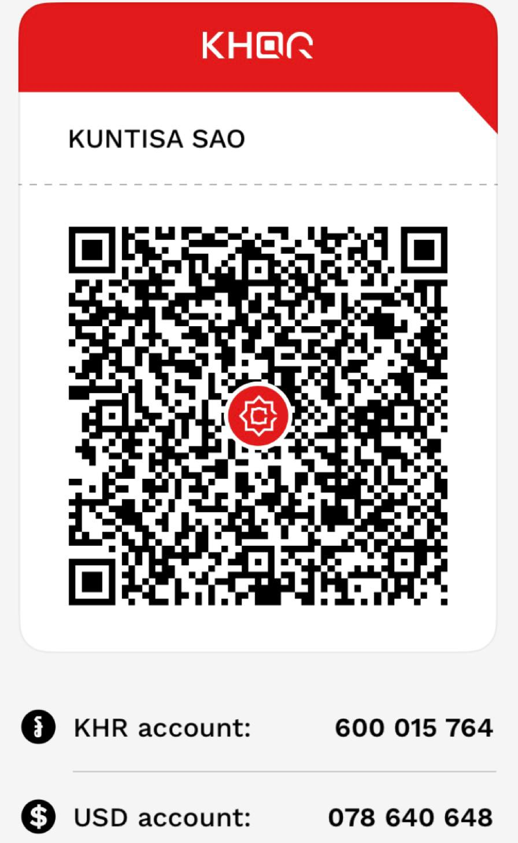
CHECKOUT FLOW
Checkout fits Cambodian delivery and payment needs.
The cart page supports item review, province selection, delivery date, address, payment choice, and receipt saving.
1
Review cart
3
Choose payment
Quantity controls, remove buttons, subtotal, delivery fee, and riel conversion.
Cash by Delivery or QR Code payment before placing the order.
2
Enter delivery
4
Save receipt
Customer name, phone, Cambodia country field, province selector, date, and address.
Completed order is saved to receipt history using localStorage.
Payment options
Cash by Delivery
QR Code
Angkor Maison project presentation
08

Slide 9
CONCLUSION
Angkor Maison is a usable shop with a clear Cambodian visual identity.
The final project combines cultural concept, responsive design, product browsing, cart logic, checkout, payment choices, and receipt history.
Easy to use
Cultural fit
Simple navigation and clear customer flow.
Cambodia-inspired palette, copy, materials, and products.
Final takeaway
Promotes Khmer craft through practical shopping.
Real shopping features
Responsive
Cart, filters, checkout, QR payment, and receipts.
Layout adjusts for desktop and mobile screens.
Angkor Maison project presentation · end
09

