Slide 1
Angkor
Maison
Angkor
Maison
Web Store
Project

Slide 2

Project Overview
Angkor Maison is a responsive online storefront for Cambodian home decor. Visitors can browse artisan-made furniture, lighting, plants, wall decor, and accessories, then complete checkout and view receipts.

Slide 3
Objectives
Build a polished shopping experience that feels local to Cambodia, with bilingual brand cues, USD and riel pricing, and strong product photography.
Implement the customer flow: product filters, item details, cart quantity controls, delivery form, QR/COD payment, confirmation, and receipt history.

Slide 4

Brand
Background
The concept is a Phnom Penh studio working with Cambodian artisans. The design uses warm paper tones, serif display type, product storytelling, and local materials such as rattan, teak, krama cotton, silk, and ceramics.

Slide 5
Development Method
Structure: separate HTML pages for Home, Products, About, Contact, Cart, and Receipts, tied together with shared CSS and navigation.
Behavior: vanilla JavaScript manages cart state in localStorage, product search/filtering, checkout validation, receipt storage, modal details, toast messages, and slideshow timing.

Slide 6
Key Features
Catalog
30 product cards with categories, USD/KHR prices, search, filters, badges, and item detail modal.
Checkout
Cart quantity controls, free shipping threshold, province selector, QR/COD payment, and order confirmation.
Receipts
Completed orders save to receipt history with totals, payment, delivery city, and item summaries.

Slide 7
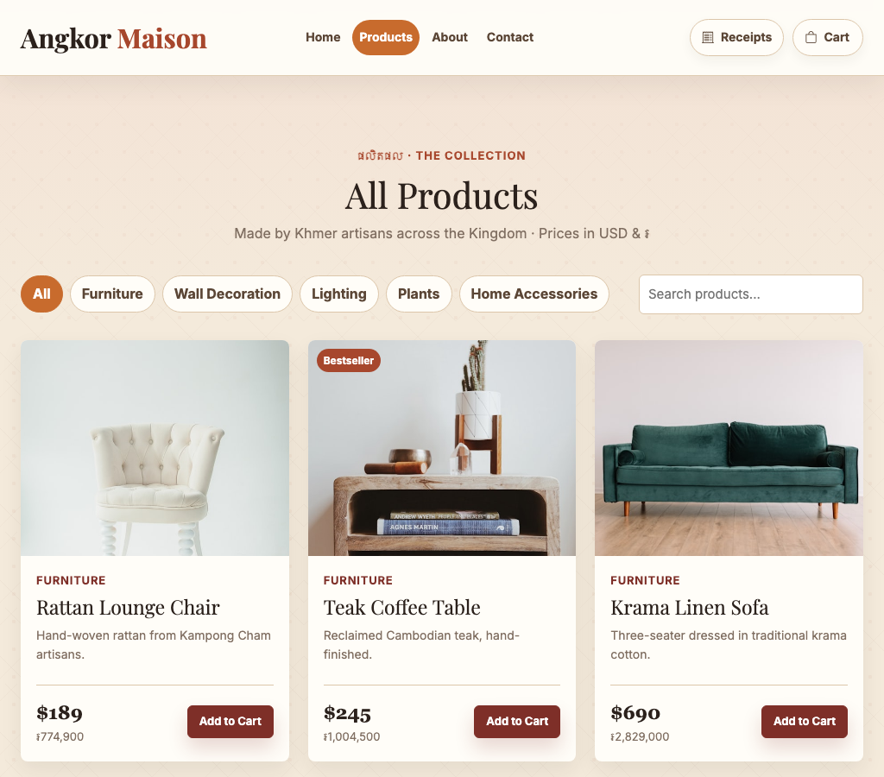
Interface Analysis
The catalog page is the main proof of the project: products are easy to scan, filters reduce choice overload, and the visual system matches the Cambodian home decor theme.

Slide 8
Conclusion
The project delivers a complete front-end e-commerce experience, not just a static product gallery.
Its strongest parts are the branded visual design, product browsing tools, cart/checkout logic, and receipt history.
The site can be extended with a backend, user accounts, inventory data, and online payment integration.

Slide 9
Recommendations
Add account login and real order tracking, so customers can return to receipts across devices.
Connect the catalog to a database or CMS so products, stock, discounts, and photos can be managed without editing HTML.
Integrate a payment gateway and admin dashboard for order status, inventory, and sales reports.

Slide 10
Thank You
Angkor Maison

