Slide 1
Carpooling
Pluridisciplinar project
By Bol Axel and Zaretti Quentin

Slide 2

What about our project ?
Web application
Carpooling website
Online booking platform

Slide 3
How we built the project ?
Analysis
UML diagram design
Class structure and association
Labour division
Meeting scheduling
Idea development
Programming
GitHub creation
Class implementation
Asp.Net use
Entity Framework

Slide 4
Static context diagram

Slide 5
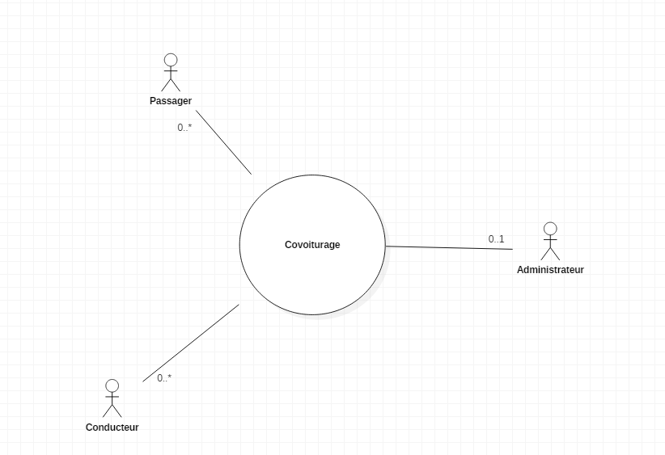

Slide 6
Use Case Diagram

Slide 7
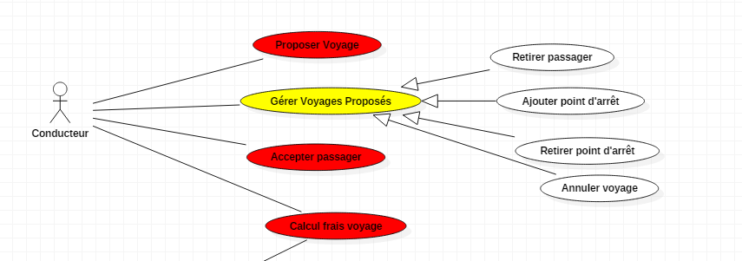
Driver use case diagram

Slide 8
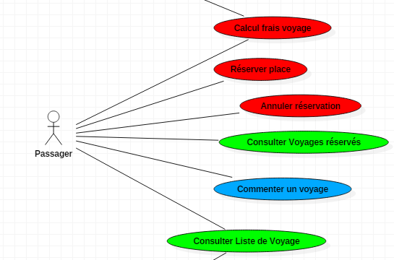
User use case diagram

Slide 9
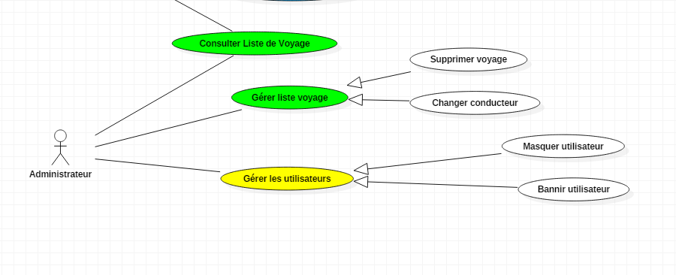
Admin use case diagram

Slide 10
Class diagram

Slide 11
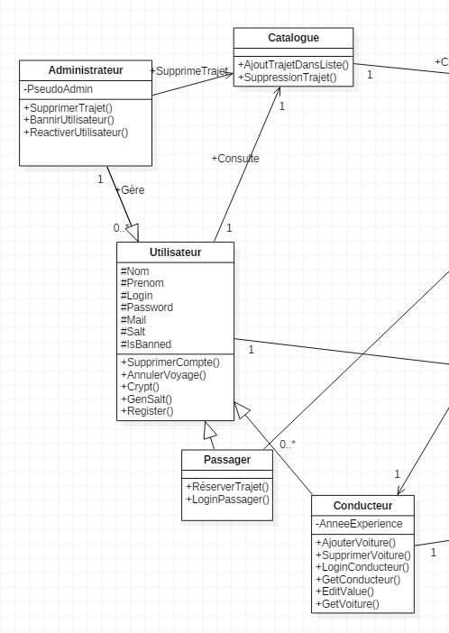
User side class diagram

Slide 12
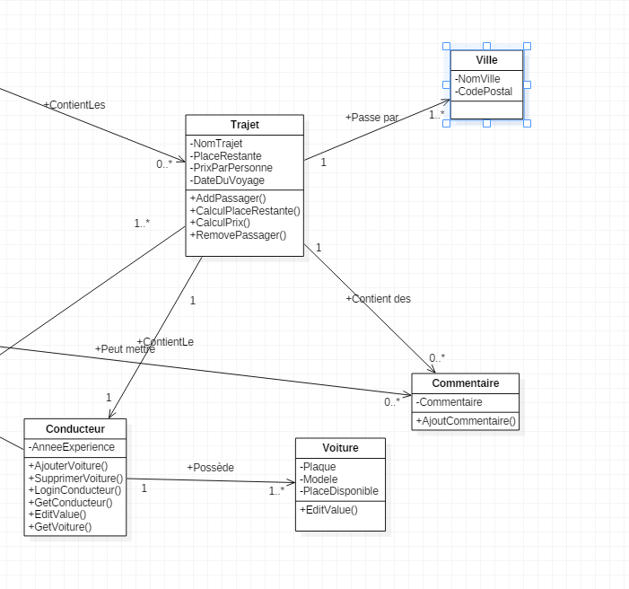
Journey side diagram

Slide 13
LifeLine Diagram

Slide 14
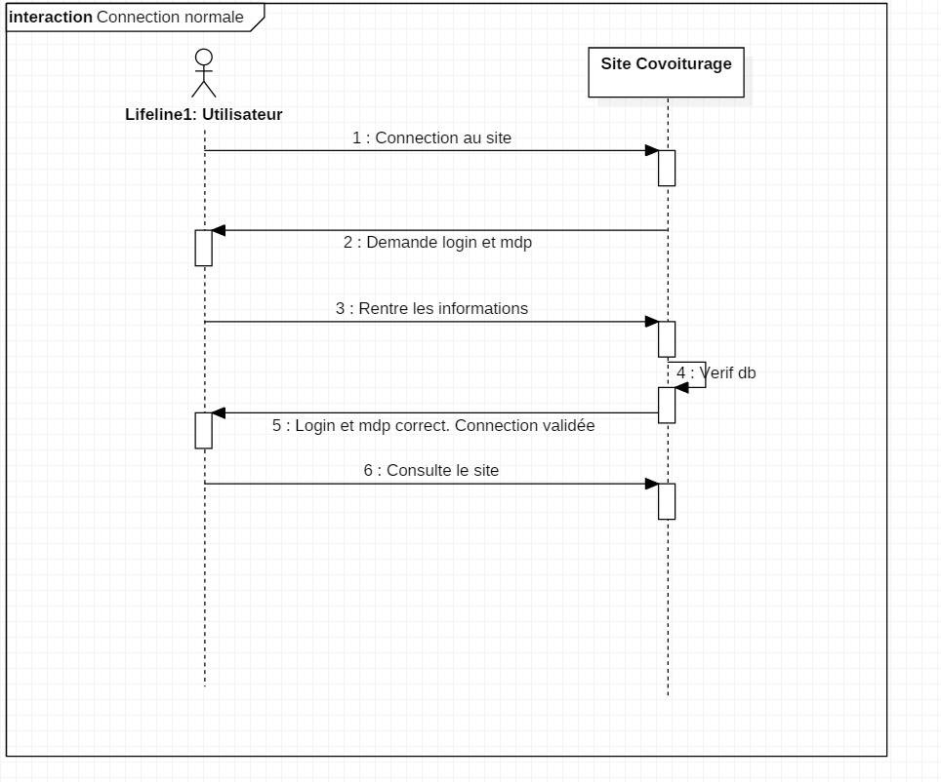
Nominal diagram

Slide 15
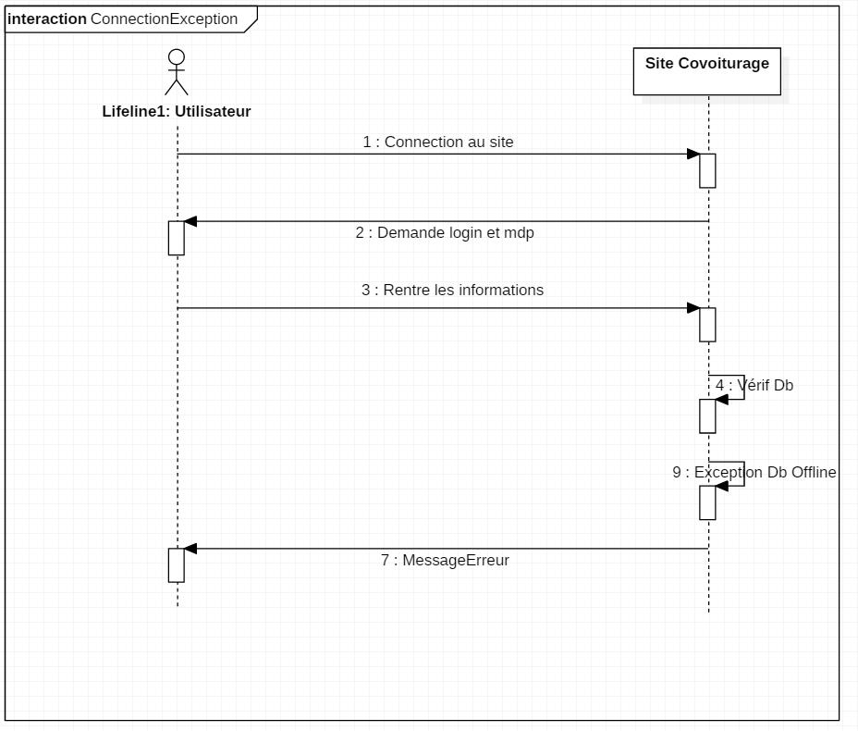
Exception diagram

Slide 16
Demonstration of the program

Slide 17
Conclusion
Zaretti Quentin
Github
Learned how to use foreign code
Bol Axel
Github
Got a preview of the informatician job

