Slide 1

Zhang et al(2017). "RNA-seq and Tn-seq reveal fitness determinants of vancomycin-resistant Enterococcus faecium during growth in human serum"
MSc Bioinformatics - Genome Analysis: Paper I
24th May 2022
Tiscar Graells

Slide 2
Overview
Enterococcus faecium
Aim
Material provided
Analysis Process
Results
Conclusions
References
Supporting slides

Slide 3
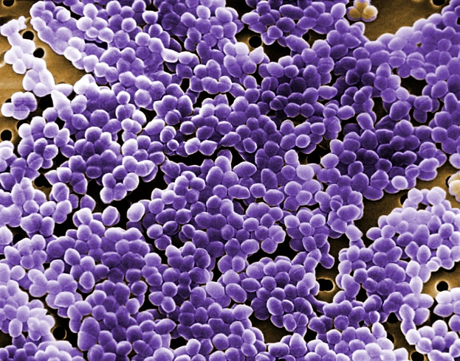
Enterococcus faecium
Gram-Positive cocci
Commensal of the gastrointestinal tract
Opportunistic pathogen: immunocompromised patients and HAI
Have acquired antibiotic resistance (vancomycin resistance)
Strain E745 not found in healthy individuals (A1 clade)
Ability to grow in human blood

Slide 4
Aim
Which genes are involved in E.faecium E745 growth in human serum?
How we can do this?
Design the experiment
Growth in BHI media vs growth in human serum
Compare which genes change their expression levels : differential expression analysis
Bioinformatics
Analysis followed a similar process that the one described in the scientific article by Zhang et al (2017)

Slide 5
Material provided
DNA sequencing
What is the genome and which genes has our strain?
Illumina HiSeq
Nanopore
PacBio SMRTII
RNA sequencing
What genes are differently transcribed when growing in BHI vs serum?
Illumina HiSeq sequencing
Tn sequencing
Note: Transposons are mobile genetic elements that can be inserted in the genome. The incorporation of a transposon in a gene truncates the coding sequence in the gene and these genes are not functional (function off).

Slide 6
Analysis Process
Step | Software
DNA reads preprocessing (QC and trimming) | Illumina: FastQC-Trimmomatic-FastQC PacBio: Canu
DNA Assembly | Canu
DNA evaluation | Quast
Genome annotation | Prokka
Synteny | Blastn
Genome visualization | Artemis comparison tool
RNA reads alignment | BWA (SAMtools)
RNA reads count | Htseq
Differential expression | DESqe2 (R-library)
Pacbio DNA reads
Pacbio DNA reads and RNA reads

Slide 7
RESULTS

Slide 8
Preprocessing DNA Illumina reads:
-FastQC Raw reads
-Trimming: Trimmomatic
-FastQC Trimmed reads

Slide 9
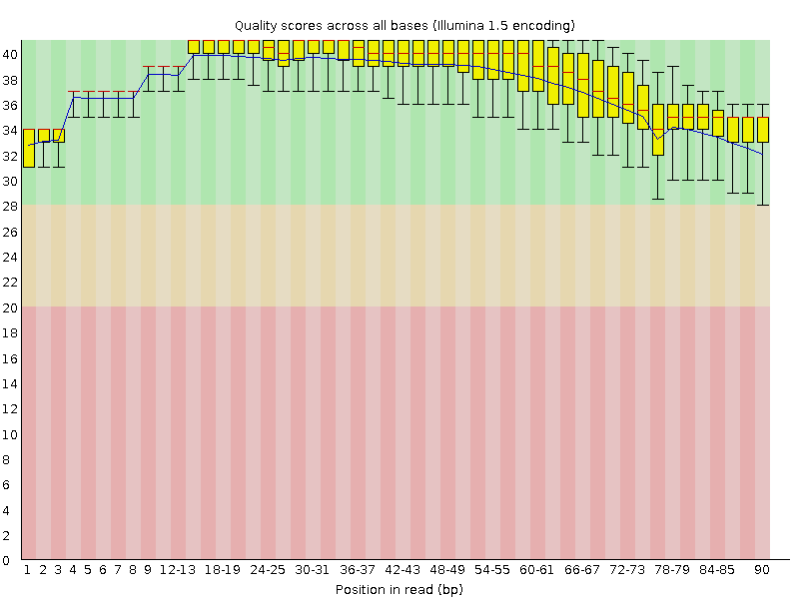

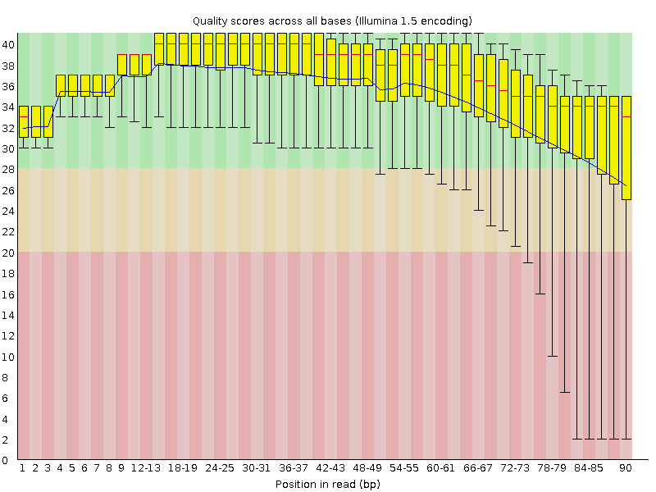
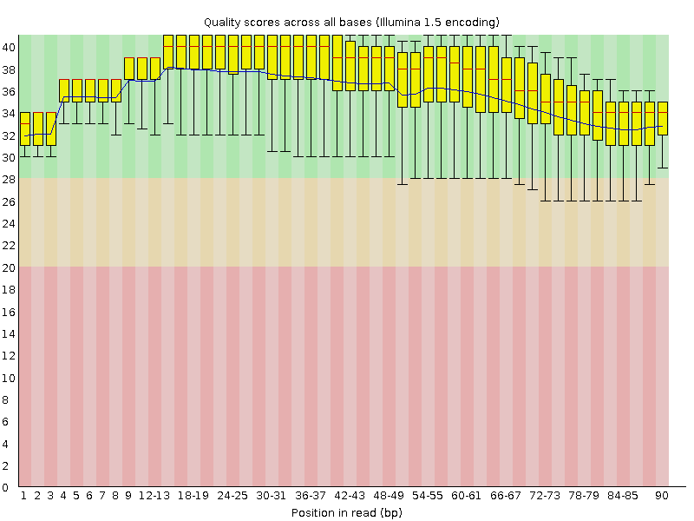
FastQC
Raw_read1
Trim_read1
Trimming
Total Sequences: 1666667
Flagged as poor quality: 0
Sequence length: 90
%GC: 37
Total Sequences: 1666280
Flagged as poor quality: 0
Sequence length: 54-90
%GC: 37
Input Read Pairs: 1666667
Both Surviving: 1666280 (99.98%)
Forward Only Surviving: 387 (0.02%)
Reverse Only Surviving: 0 (0.00%)
Dropped: 0 (0.00%)
Trim_read2
Raw_read2

Slide 10
DNA sequencing with PacBio:
-Preprocesing (QC + trimming): Canu
-Assembly: Canu
-Assembly evaluation: Quast
-Genome annotation: Prokka
-Homology search: Blastn (synteny)
-Visualization: Artemis

Slide 11
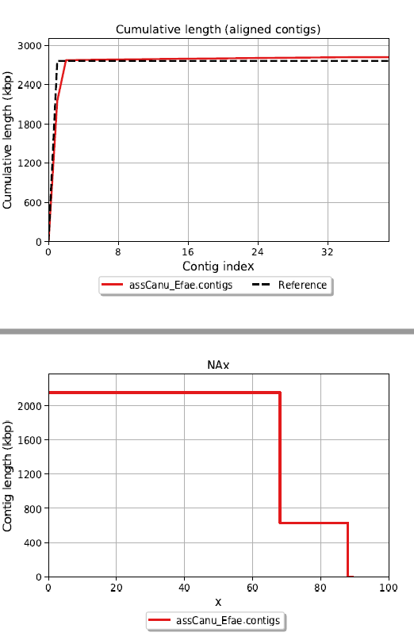
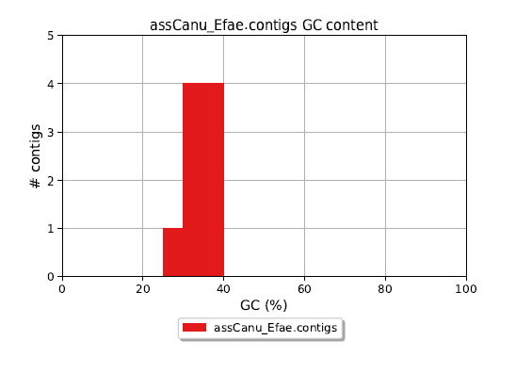
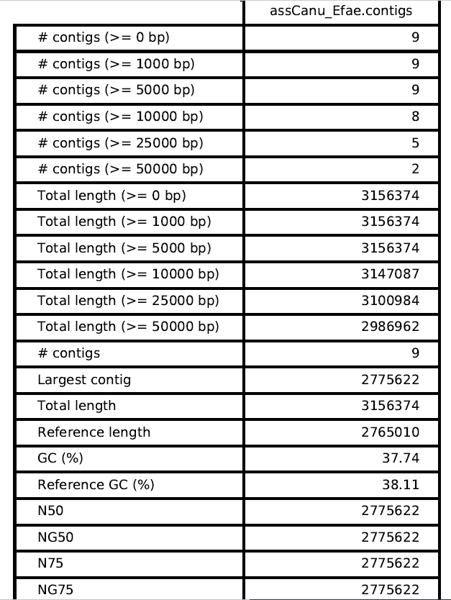
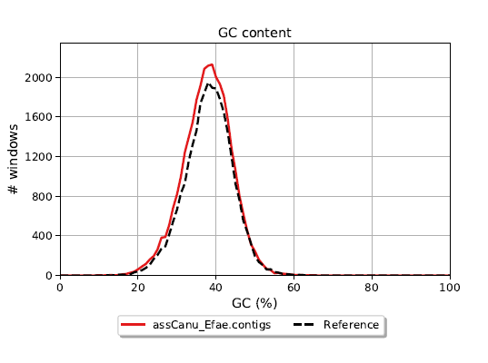
Quast

Slide 12
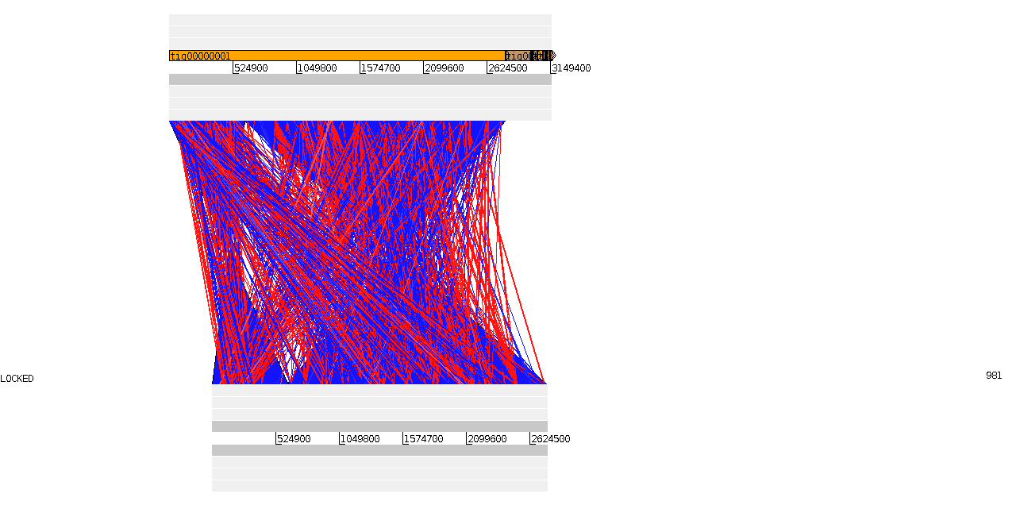
Act Visualization: Annotated genome, Blast and Reference genome

Slide 13
RNA-seq data vs assembled genome:
-Mapping and post-mapping jointly with RNA reads: BWA and SAMtools
-Read count: Htseq
-Expression analyses: DESeq2

Slide 14
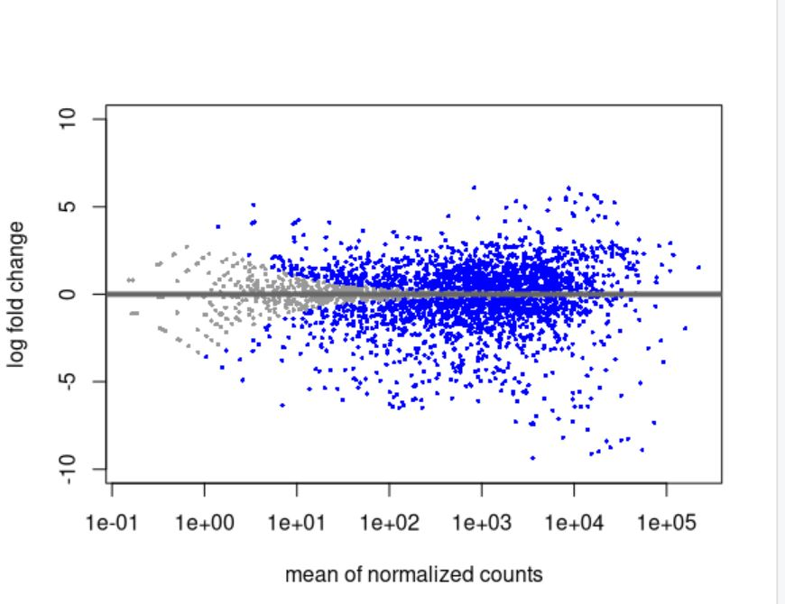
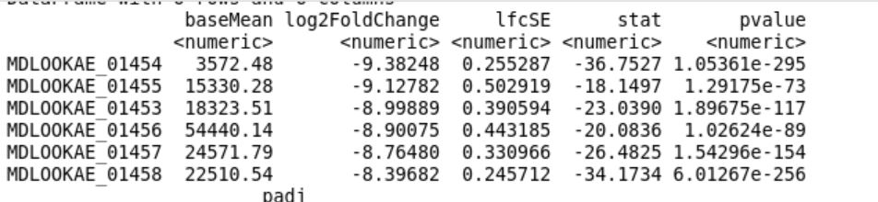
DESeq2
The 6 genes that have the most difference log2FildChange between growing in BHI and Serum. The results show that the expression of these genes is much lower in BHI (which means up-regulation in serum)

Slide 15
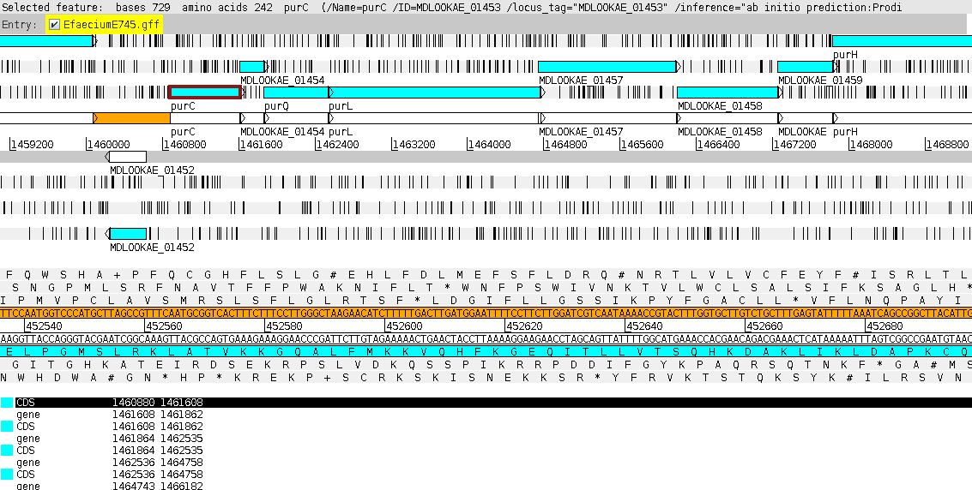
Artemis visualization of the annotated genome (Prokka)
purC
purQ
purL

Slide 16
Cluster of genes: purC, purQ and purL
Genes playing a role in growth in serum are:
purC
purQ
purL
These genes are involved in the biosynthesis of purine and pyrimidine nucleotides
From article these genes (especially purL among these 3) were found to exhibit higher expression upon growth in human serum in the RNA-seq analysis.

Slide 17
Conclusions
purC, purQ and purL genes which are involved in nucleotide biosynthesis are critical genes allowing for growth and survival in blood.
Similar results obtained in the article by Zhang et al (2017).
The genes identified can be used as target for novel antibiotics or therapeutic targets to treat multi-drug resistant infections of E.faecium E745.

Slide 18
Thank you!
Reference:
Zhang, X., de Maat, V., Prieto, A. M. G., Prajsnar, T. K., Bayjanov, J. R., de Been, M., ... & van Schaik, W. (2017). RNA-seq and Tn-seq reveal fitness determinants of vancomycin-resistant Enterococcus faecium during growth in human serum. BMC genomics, 18(1), 1-12.

Slide 19
Supporting slides

Slide 20
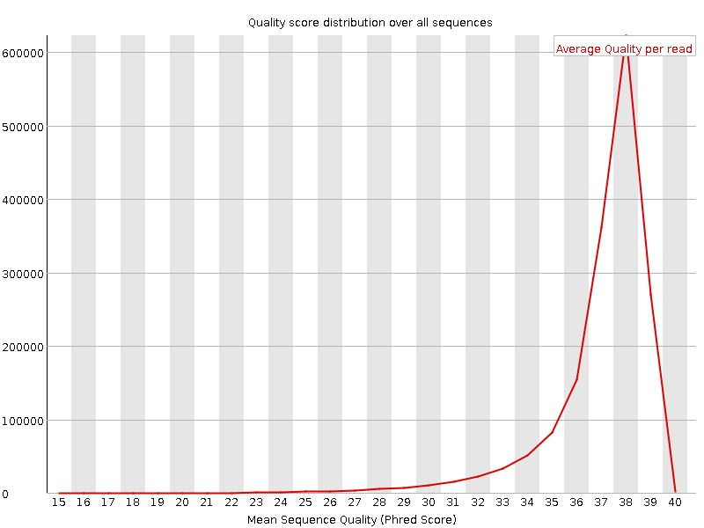
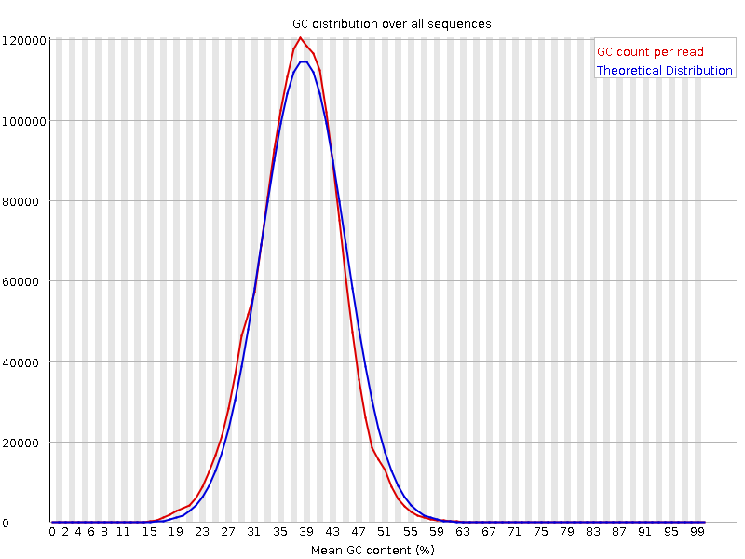
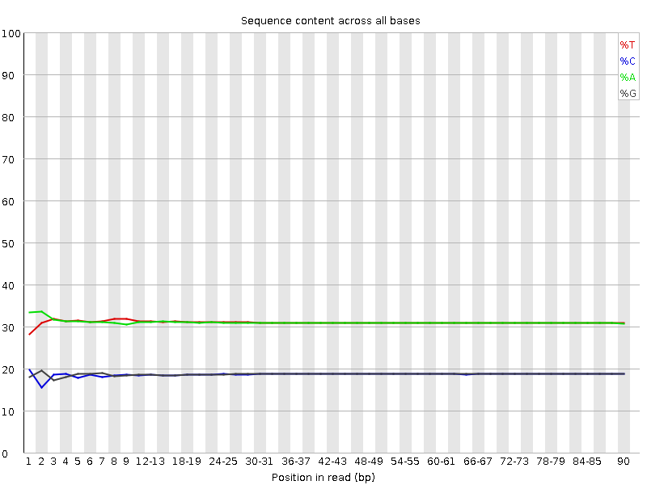
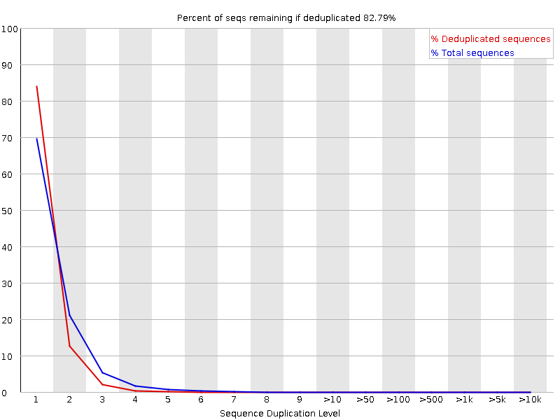
FastQC
Raw_read1
Encoding Illumina 1.5
Total Sequences: 1666667
Sequences flagged as poor quality: 0
Sequence length: 90
%GC: 37

Slide 21
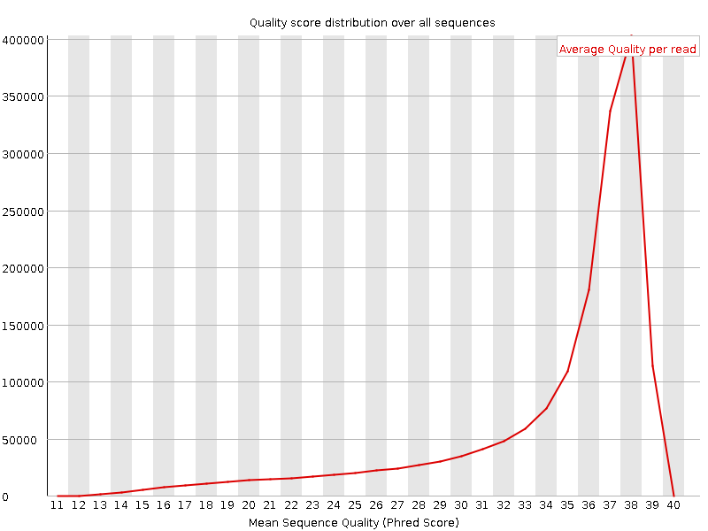
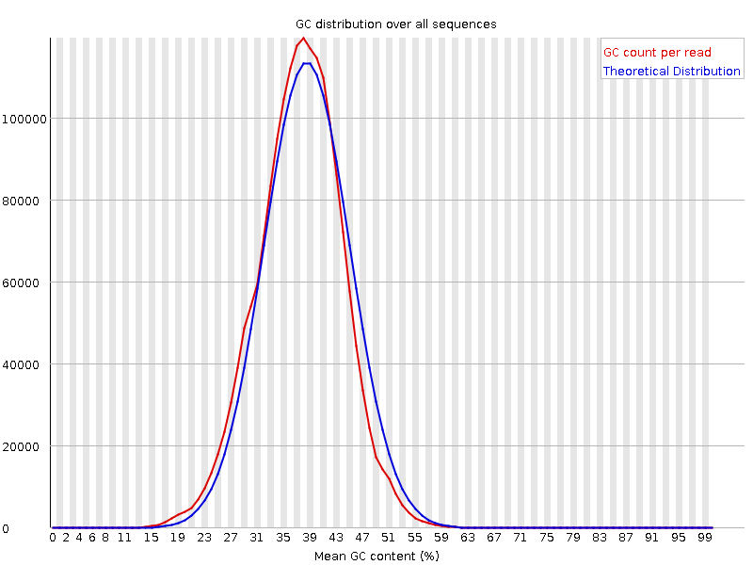
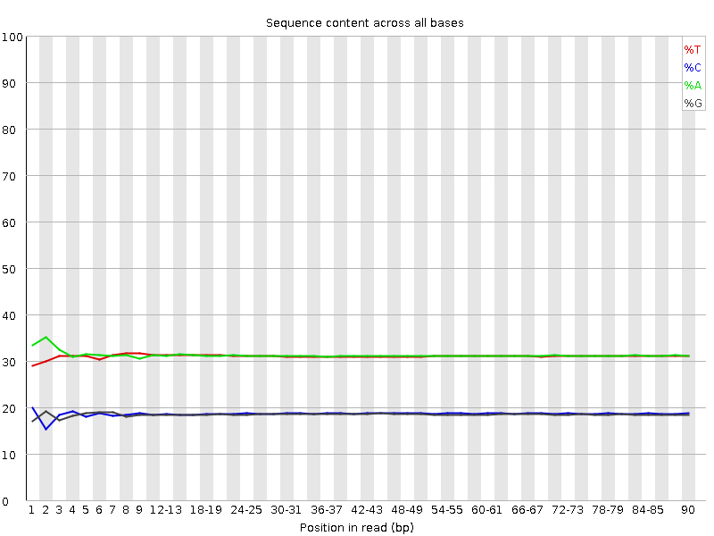
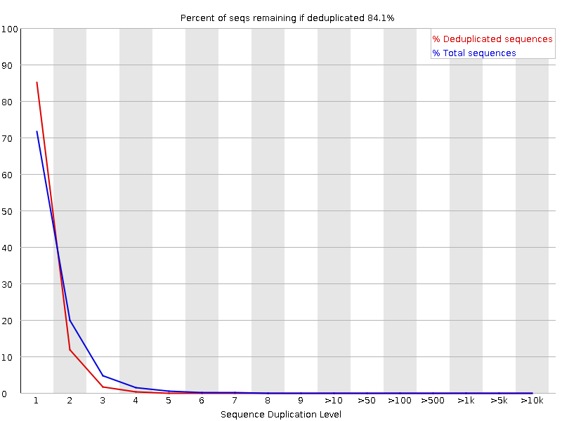
FastQC
Raw_read2
Encoding Illumina 1.5
Total Sequences: 1666667
Sequences flagged as poor quality: 0
Sequence length: 90
%GC: 37

Slide 22
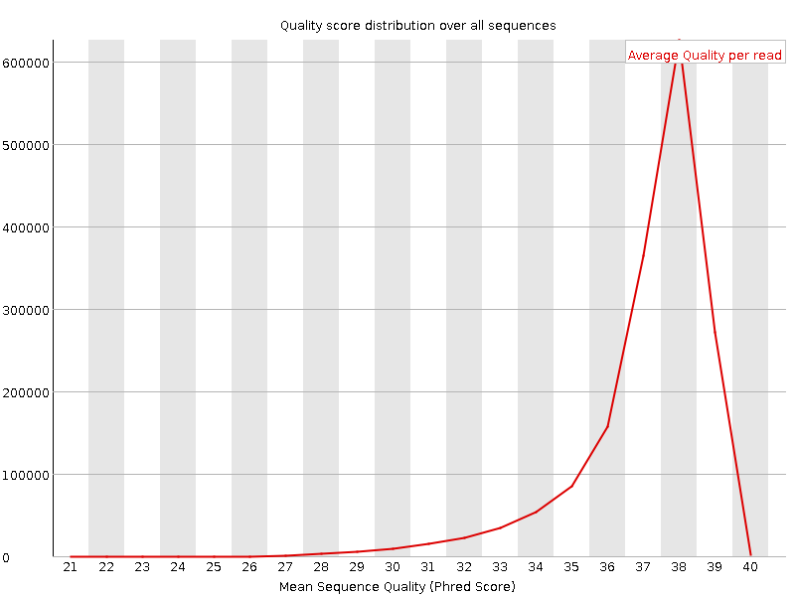

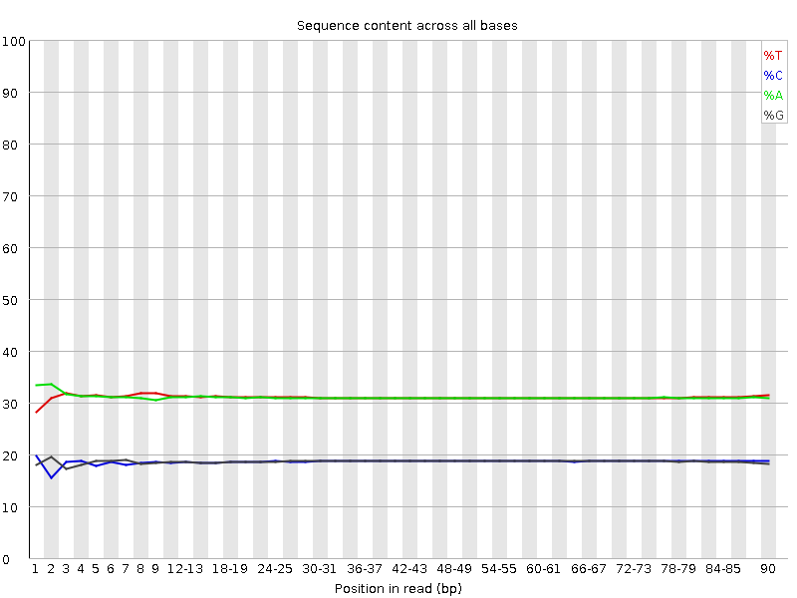

FastQC
Trim_read1
Encoding Illumina 1.5
Total Sequences: 1666280
Sequences flagged as poor quality: 0
Sequence length: 54-90
%GC: 37

Slide 23
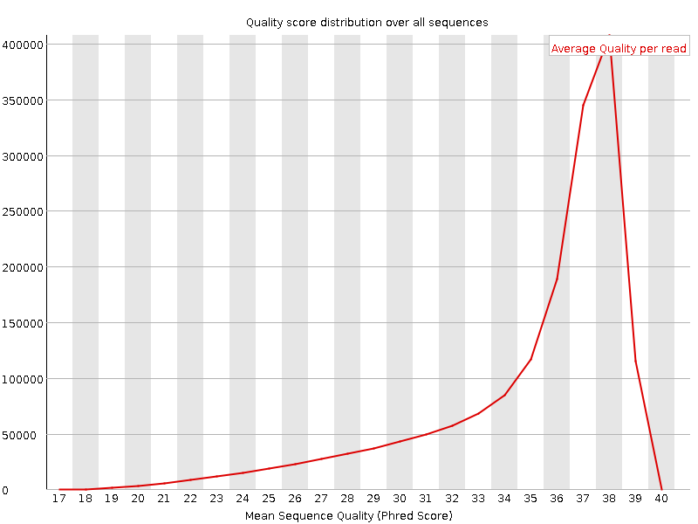
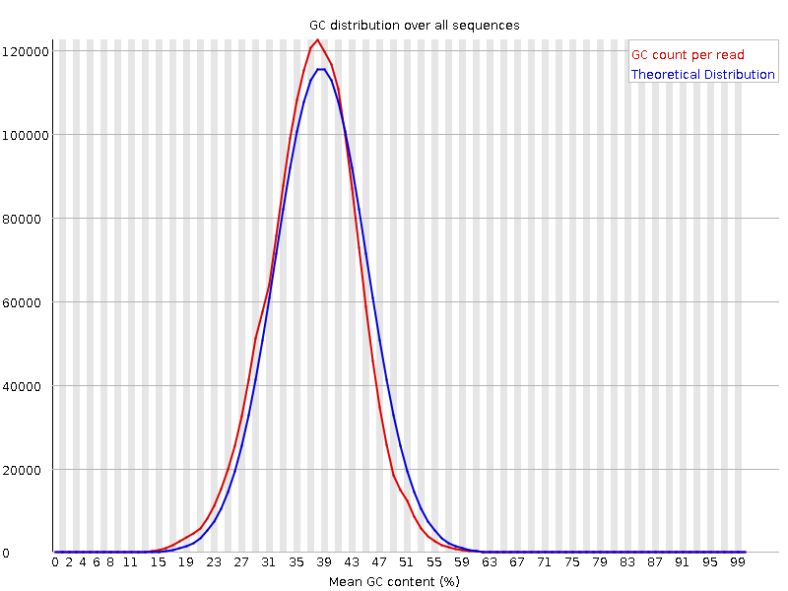
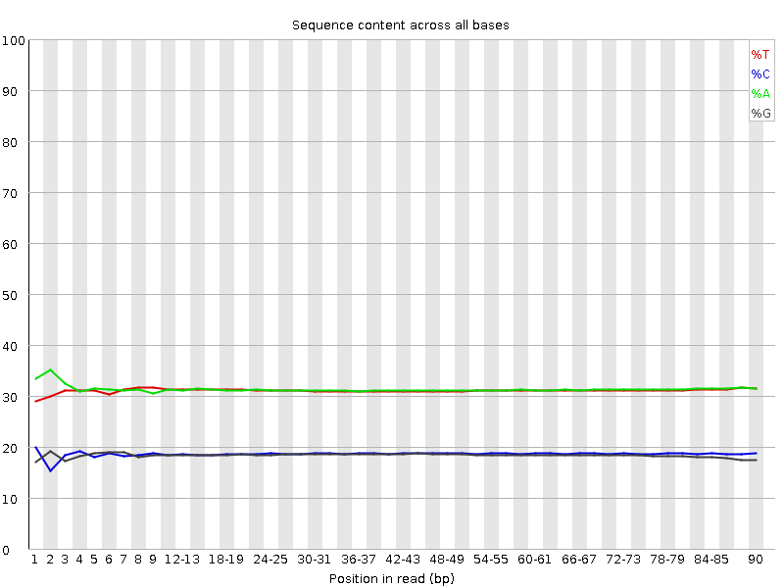
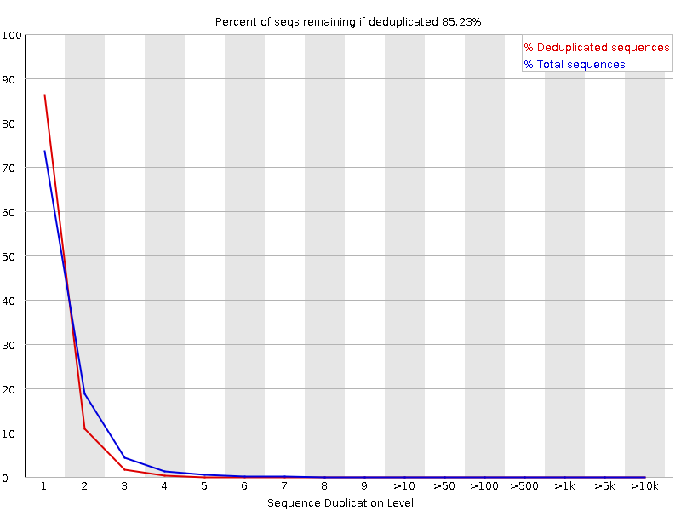
FastQC
Trim_read2
Encoding Illumina 1.5
Total Sequences: 1666280
Sequences flagged as poor quality: 0
Sequence length: 54-90
%GC: 37

Slide 24
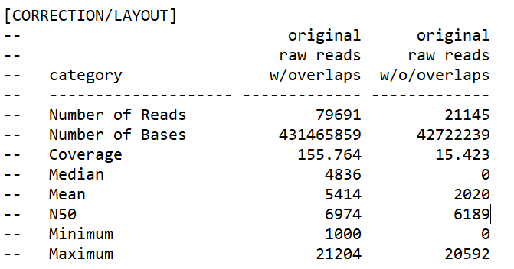
CANU
Majority with overlaps—good!

