Slide 1
🍕
Pizza Sales
SQL Analysis
From Basic Queries to Advanced Insights
BASIC
INTERMEDIATE
ADVANCED
Pizza Sales SQL Case Study • 13 Questions

Slide 2
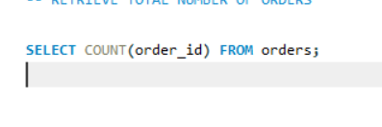
BASIC
Q1 • Order Metrics
Question
Retrieve the total number of orders placed.
SQL APPROACH
Q1

Slide 3
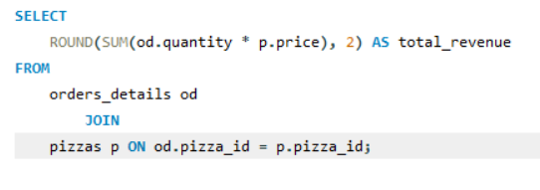
BASIC
Q2 • Revenue
Question
Calculate the total revenue generated from pizza sales.
SQL APPROACH
Q2

Slide 4
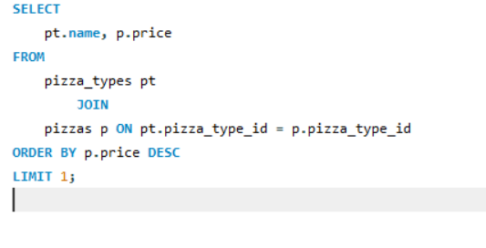
BASIC
Q3 • Pricing
Question
Identify the highest-priced pizza.
SQL APPROACH
Q3

Slide 5
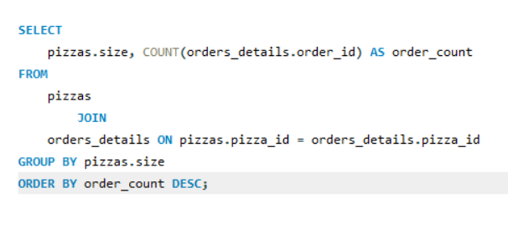
BASIC
Q4 • Order Patterns
Question
Identify the most common pizza size ordered.
SQL APPROACH
Q4

Slide 6
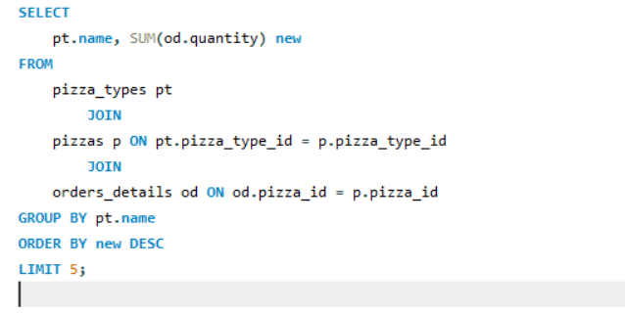
BASIC
Q5 • Top Items
Question
List the top 5 most ordered pizza types along with their quantities.
SQL APPROACH
Q5

Slide 7
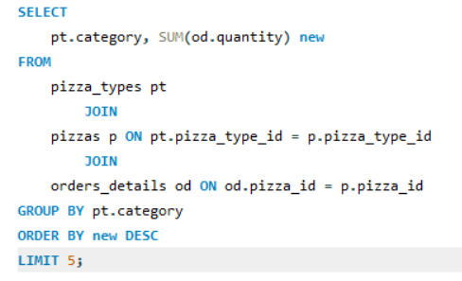
INTERMEDIATE
Q6 • Category Analysis
Question
Find the total quantity of each pizza category ordered.
SQL APPROACH
Q6

Slide 8
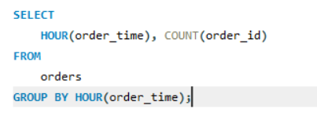
INTERMEDIATE
Q7 • Time Analysis
Question
Determine the distribution of orders by hour of the day.
SQL APPROACH
Q7

Slide 9
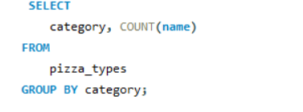
INTERMEDIATE
Q8 • Category Distribution
Question
Find the category-wise distribution of pizzas.
SQL APPROACH
Q8

Slide 10
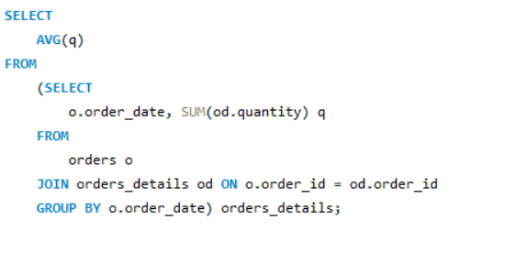
INTERMEDIATE
Q9 • Daily Averages
Question
Group orders by date and calculate the average number of pizzas ordered per day.
SQL APPROACH
Q9

Slide 11
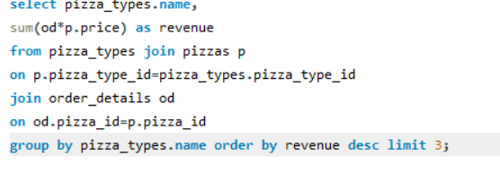
v
INTERMEDIATE
Q10 • Revenue Leaders
Question
Determine the top 3 most ordered pizza types based on revenue.
SQL APPROACH
Q10

Slide 12
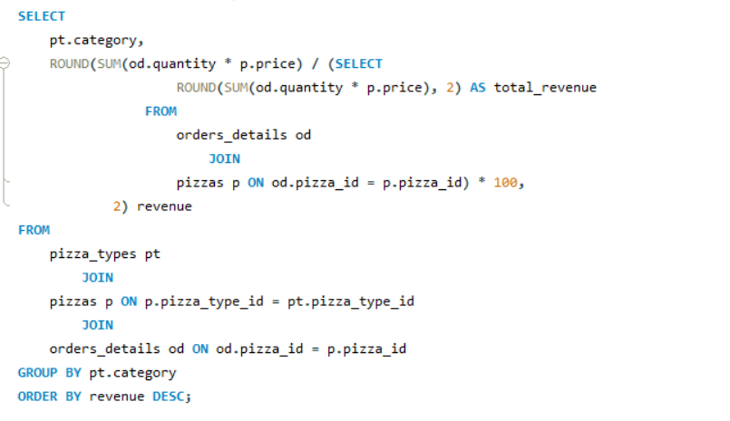
ADVANCED
Q11 • Revenue Share
Question
Calculate the percentage contribution of each pizza type to total revenue.
SQL APPROACH
Q11

Slide 13
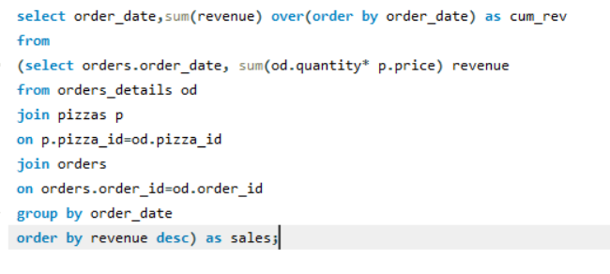
ADVANCED
Q12 • Trend Analysis
Question
Analyze the cumulative revenue generated over time.
SQL APPROACH
Q12

Slide 14
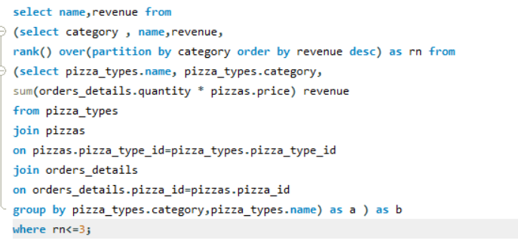
ADVANCED
Q13 • Category Leaders
Question
Determine the top 3 most ordered pizza types based on revenue for each pizza category.
SQL APPROACH
Q13

