Slide 1



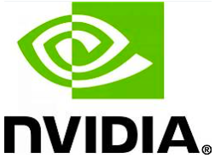



International Conference on
Next-Gen Intelligent Computing and Applications
(ICONICA 2026)
CHRIST (DEEMED TO BE UNIVERSITY)
Bangalore Central Campus
28-29 August 2026

Slide 2
Paper ID: 597
Comparative Analysis of Advanced CNN Architectures for Multi-Class Brain Tumor Classification Using MRI
Track 2: Artificial Intelligence and Machine Learning
Presented by
Tisha Chhabra, Kamal Upreti, Varuna Gupta

Slide 3
Abstract
Brief summary: Comparative analysis of advanced CNN architectures for 4-class brain tumor classification using MRI scans.
Key contributions: Rigorous evaluation of three advanced CNN architectures under identical pipelines to identify the optimal feature extractor.
Motivation: Manual MRI reading is labor-intensive; there is a critical need for rapid and automated diagnostic tools.
Main results: EfficientNetV2 achieved 98.92% accuracy (Macro-AUC: 0.9999), outperforming both DenseNet121 and ResNet50V2.

Slide 4
Introduction
Background: Brain tumors are severe neurological diseases where rapid diagnosis dictates patient outcomes.
Context: MRI is the diagnostic gold standard, but visually similar tumor features make manual assessment prone to human error.
Importance of the study: Automated classification improves diagnostic speed, reduces human error, and aids in rapid treatment planning.

Slide 5
Literature Review
Key Past Works | Gaps Identified | Research Positioning (Our Study)
Traditional ML vs. Basic CNNs(e.g., Saeedi et al., 2023; Sabry et al., 2025) Studies comparing traditional models (SVM, KNN) against basic 2D-CNNs. | Proved Deep Learning is superior, but lacked evaluation of modern, state-of-the-art architectures. | Focuses exclusively on comparing advanced, top-tier pre-trained backbones (EfficientNetV2, DenseNet, ResNet).
Comparative CNN Studies(e.g., Wong et al., 2025; Disci et al., 2025) Evaluated multiple architectures (VGG16, Xception, ResNet50) on MRI datasets. | Often lacked strict methodological control (unified classification heads) across the different models compared. | Employs a strictly unified custom classification head across all backbones to ensure a mathematically fair comparison.
“Black-Box” Medical AI Models(e.g., Patrício et al., 2022) Models achieving 98%+ accuracy on brain tumor classification. | Identified a severe lack of interpretability, making it difficult for clinicians to trust the high accuracy. | Integrates Grad-CAM to visually validate the regions of interest, confirming localized feature extraction.

Slide 6
Problem Statement
Define the core research problem: Identifying the most accurate and reliable deep learning model for classifying MRI scans into four categories (glioma, meningioma, pituitary, normal).
Limitations of existing solutions: Traditional machine learning lacks accuracy, and many existing deep learning studies fail to isolate the quality of the CNN backbone from the classification head.

Slide 7
Objectives
Objective 1: Classify MRI images into four distinct classes (glioma, meningioma, pituitary, and normal brain).
Objective 2: Evaluate and compare EfficientNetV2, DenseNet121, and ResNet50V2 under strictly identical experimental conditions.
Objective 3: Employ Grad-CAM to spatially map the feature representations driving the model's classification.

Slide 8
Proposed Methodology
Framework overview: Two-stage transfer learning approach utilizing pre-trained CNN feature extractors.
Models, algorithms used: EfficientNetV2, DenseNet121, ResNet50V2 (interchangeable backbones feeding into a unified custom classification head).
Tools & technologies: Data Augmentation (flipping, rotation), Optimization (weight decay, cosine decay LR), and Test-Time Augmentation (TTA).

Slide 9
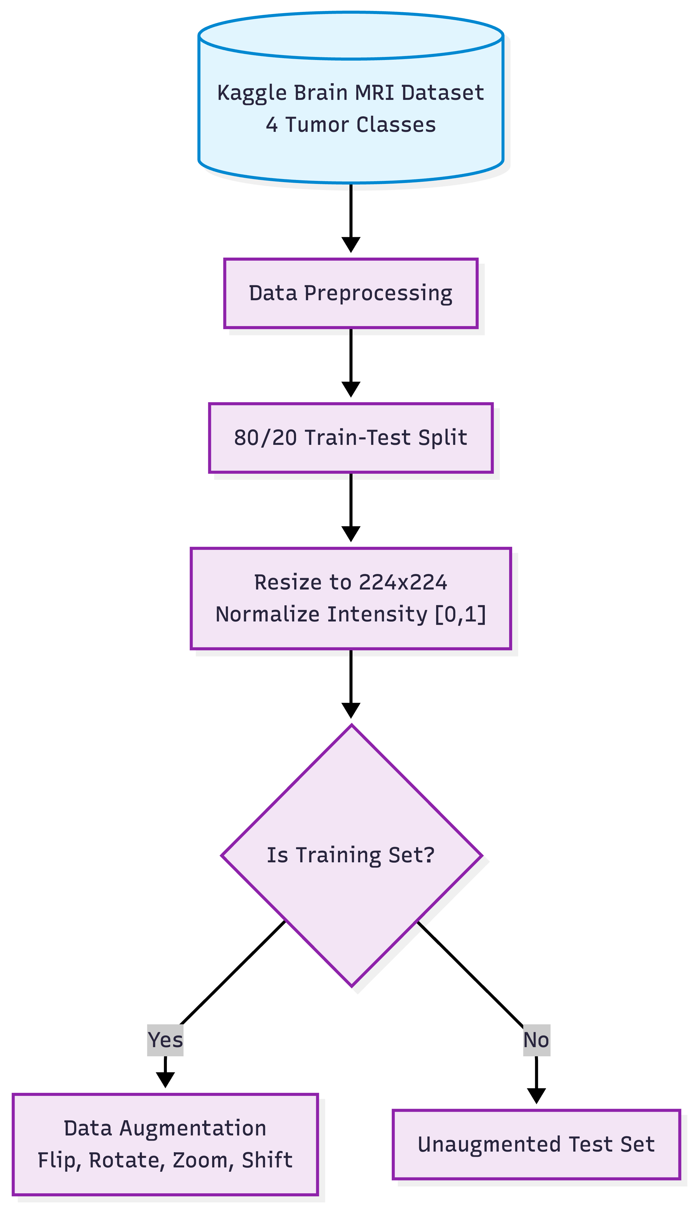
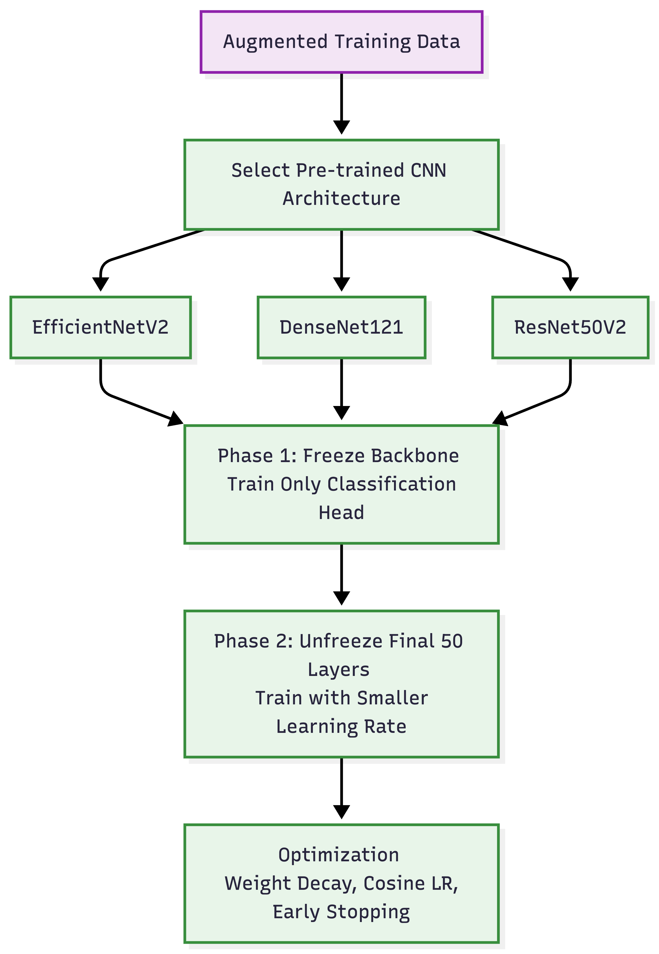
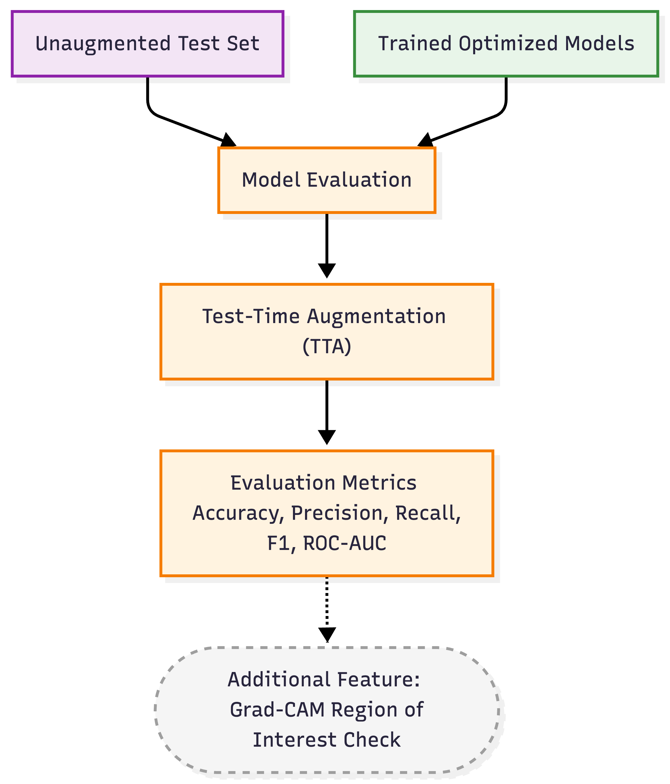
Methodology Diagram
Figure 1: Dataset preprocessing and augmentation pipeline.
Figure 2: Two-stage transfer learning methodology applied in parallel across all three backbones.
Figure 3: Evaluation phase incorporating Test-Time Augmentation (TTA) and Grad-CAM interpretability.

Slide 10
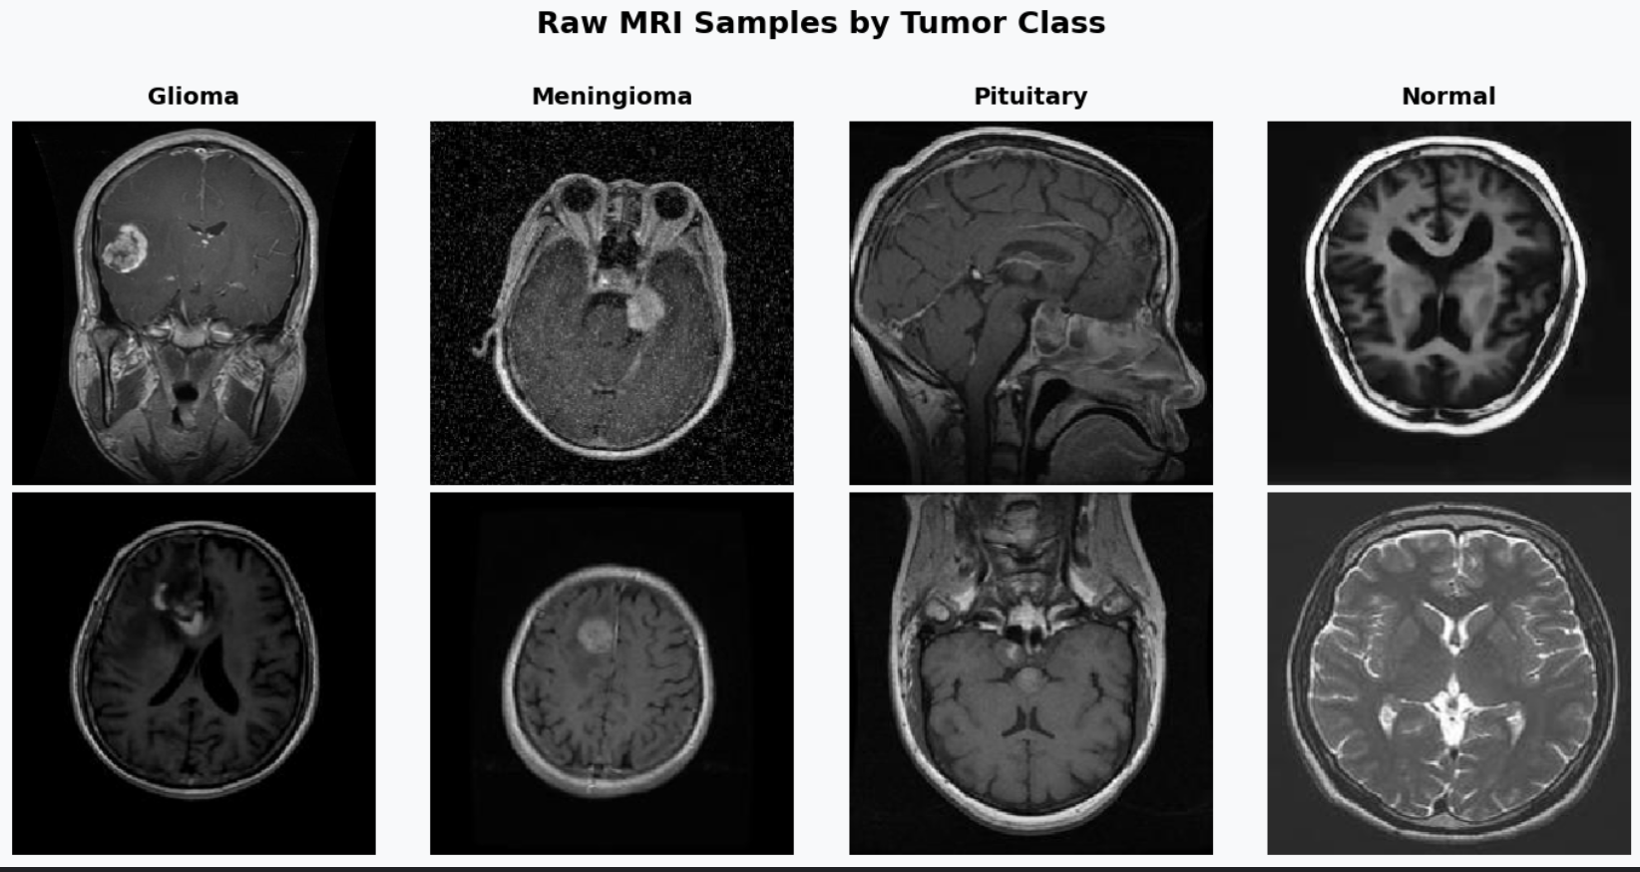
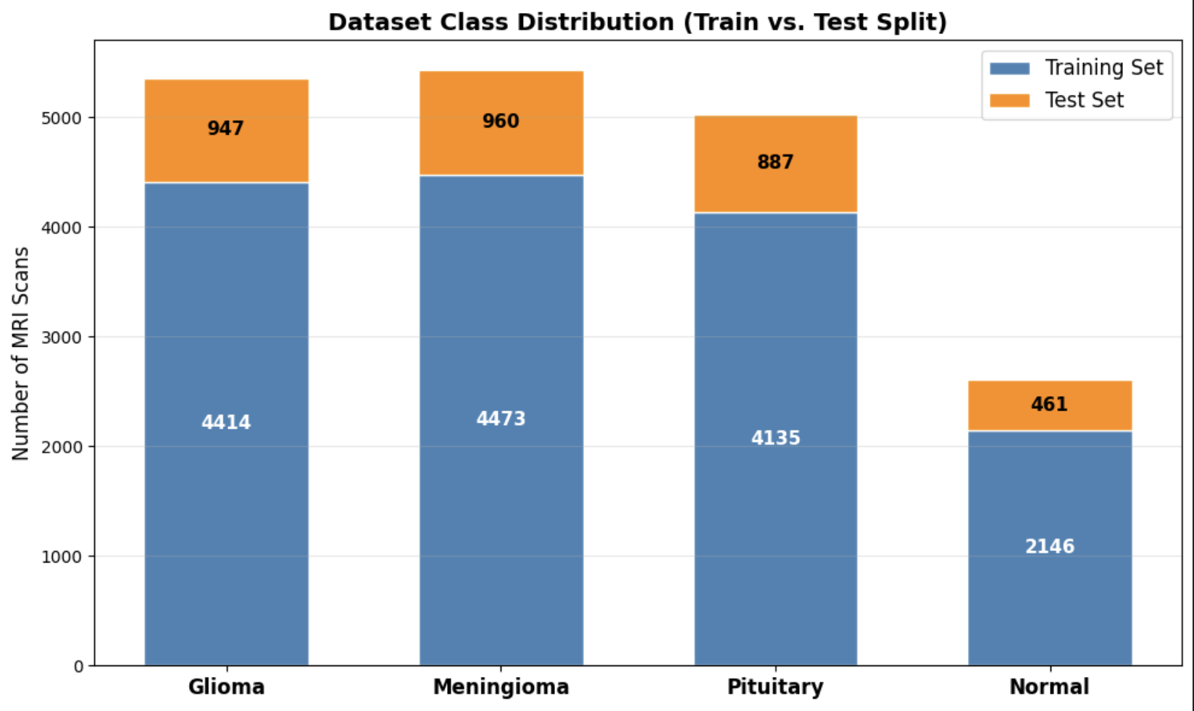
Experimental Setup
Dataset details: Public Kaggle Brain Tumor MRI Dataset (4 classes); images resized to 224×224 and normalized [0,1].
Train/validation/test split: 80% Training / 20% Testing (Data augmentation applied exclusively to the training set).
Evaluation metrics: Accuracy, Precision, Recall, F1-Score, ROC-AUC, and Confusion Matrix.

Slide 11
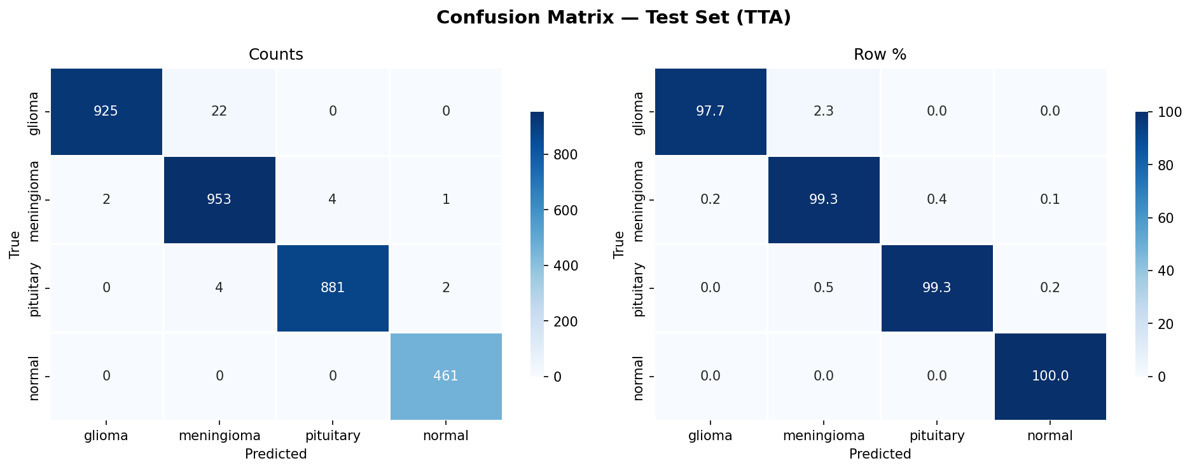
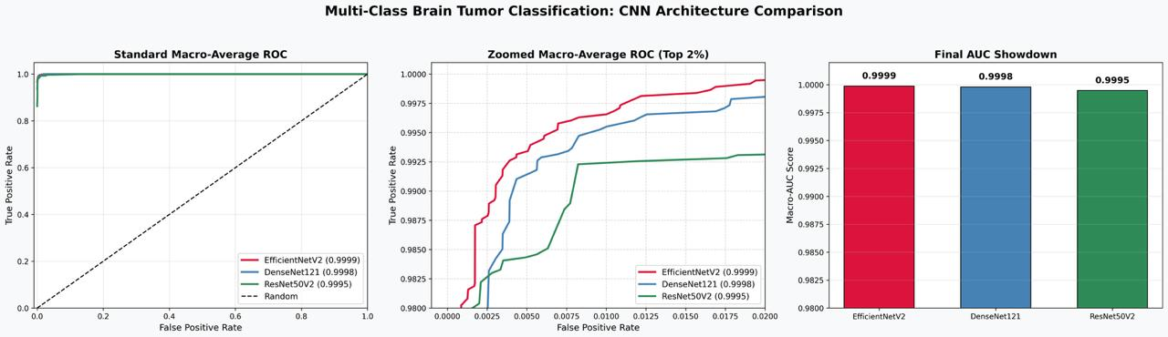
Results
Comparative Performance: All three models achieved near-perfect accuracy, but EfficientNetV2 consistently demonstrated superior sensitivity.
EfficientNetV2: Macro-AUC 0.9999 (Accuracy: 98.92%)
DenseNet121: Macro-AUC 0.9995
ResNet50V2: Macro-AUC 0.9995
Key finding: EfficientNetV2 maintained the highest True Positive rate even under strict evaluation (top 2% false positive region).

Slide 12
Discussion
Methodological Rigor: By using a unified custom classification head, we ensured performance differences were strictly due to backbone feature extraction quality.
Comparison with baseline methods: EfficientNetV2 specifically showed superior sensitivity in the top 2% false positive region of the ROC curve compared to DenseNet and ResNet.
Interpretation of results: EfficientNetV2’s architecture is highly effective at extracting complex features from medical images.

Slide 13
Conclusion
Summary of findings: The evaluated EfficientNetV2 model provides robust, reliable, and highly accurate multiclass brain tumor classification.
Key takeaways: EfficientNetV2's architecture extracts features far more effectively for this specific image classification task than older ResNet or DenseNet models.

Slide 14
Future Work
Potential improvements: Validate the evaluated models using larger, multi-institutional datasets to ensure broader clinical generalizability.
Scope for extension: Compare current CNN architectures with recently developed Vision Transformer (ViT)-based and hybrid CNN–Transformer models.

Slide 15
References
S. Saeedi, S. Rezayi, H. Keshavarz, and S. Kalhori, "MRI-based brain tumor detection using convolutional deep learning methods and chosen machine learning techniques," BMC Medical Informatics and Decision Making, vol. 23, 2023. doi: 10.1186/s12911-023-02114-6.
Y. Wong, E. Su, C. Yeong, W. Holderbaum, and C. Yang, "Brain tumor classification using MRI images and deep learning techniques," PLOS One, vol. 20, 2025. doi: 10.1371/journal.pone.0322624.
P. Jyothi and A. Singh, "Deep learning models and traditional automated techniques for brain tumor segmentation in MRI: a review," Artificial Intelligence Review, vol. 56, pp. 2923–2969, 2022. doi: 10.1007/s10462-022-10245-x.
B. N. Fonkem, "AI-Powered Risk Scoring Models for Real-Time Fraud Detection in Digital Banking Ecosystems," Journal of Computational Analysis and Applications, vol. 34, no. 11, pp. 349–371, 2025.
R. Disci, F. Gurcan, and A. Soylu, "Advanced Brain Tumor Classification in MR Images Using Transfer Learning and Pre-Trained Deep CNN Models," Cancers, vol. 17, 2025. doi: 10.3390/cancers17010121.
C. Patrício, J. Neves, and L. Teixeira, "Explainable Deep Learning Methods in Medical Image Classification: A Survey," ACM Computing Surveys, vol. 56, pp. 1–41, 2022. doi: 10.1145/3625287.

Slide 16
References
R. Missaoui, W. Hechkel, W. Saadaoui, A. Helali, and M. Leo, "Advanced Deep Learning and Machine Learning Techniques for MRI Brain Tumor Analysis: A Review," Sensors, vol. 25, 2025. doi: 10.3390/s25092746.
A. Sabry, K. Alazm, M. Saad, and T. Nassef, "Comparative Analysis of Traditional Machine Learning and Deep Learning Techniques for Brain Tumor Identification in MRI Data," in 2025 Intelligent Methods, Systems, and Applications (IMSA), pp. 604–609, 2025. doi: 10.1109/imsa65733.2025.11167683.
J. Kang, Z. Ullah, and J. Gwak, "MRI-Based Brain Tumor Classification Using Ensemble of Deep Features and Machine Learning Classifiers," Sensors, vol. 21, 2021. doi: 10.3390/s21062222.
S. Moldovanu, G. Tabacaru, and M. Barbu, "Convolutional Neural Network–Machine Learning Model: Hybrid Model for Meningioma Tumour and Healthy Brain Classification," Journal of Imaging, vol. 10, 2024. doi: 10.3390/jimaging10090235.
S. Elhadad and M. Saad, "Enhancing Brain Tumor Diagnosis: Comparative Analysis of Random Forest and Support Vector Machine for Brain Tumor Mri Classification," in 2025 International Mobile, Intelligent, and Ubiquitous Computing Conference (MIUCC), pp. 354–359, 2025. doi: 10.1109/miucc66482.2025.1119683.

Slide 17
References
M. Panahi, M. Hosseini, and S. Aghamiri, "Impact of image preprocessing methods on MRI radiomics feature variability and classification performance in Parkinson’s disease motor subtype analysis," Scientific Reports, vol. 15, 2025. doi: 10.1038/s41598-025-23702-8.
A. Asiri, T. Soomro, A. Shah, G. Pogrebna, M. Irfan, and S. Alqahtani, "Optimized Brain Tumor Detection: A Dual-Module Approach for MRI Image Enhancement and Tumor Classification," IEEE Access, vol. 12, pp. 42868–42887, 2024. doi: 10.1109/access.2024.3379136.
R. Syah and I. Kautsar, "Preprocessing-Driven Performance Variations in CNN-Based Brain Tumor Classification: Enhanced vs. Fast vs. Standard Approaches," in 2025 15th International Conference on Information & Communication Technology and System (ICTS), pp. 1–5, 2025. doi: 10.1109/icts67612.2025.11369641.
E. Göçeri, "Medical image data augmentation: techniques, comparisons and interpretations," Artificial Intelligence Review, pp. 1–45, 2023. doi: 10.1007/s10462-023-10453-z.
Y. Xie et al., "Convolutional Neural Network Techniques for Brain Tumor Classification (from 2015 to 2022): Review, Challenges, and Future Perspectives," Diagnostics, vol. 12, 2022. doi: 10.3390/diagnostics12081850.
Kaggle Brain Tumors Dataset, https://www.kaggle.com/datasets/mohammadhossein77/brain-tumors-dataset.

Slide 18
Acknowledgment
Institutional support: Department of Computer Science, CHRIST (Deemed to be University), Bengaluru, India.
Contributors: Tisha Chhabra, Kamal Upreti, Varuna Gupta.

Slide 19
Contact Information
Presenter name: Tisha Chhabra
Affiliation: CHRIST University, Bengaluru, India
Email: Chhabratisha9@gmail.com / kamalupreti1989@gmail.com / varunagupta.cs@gmail.com
Website: www.linkedin.com/in/tisha-chhabra23/

