Slide 1
Tunify!
Let the Music Speak!

Slide 2


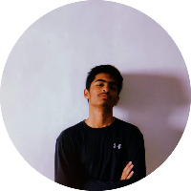
Team Tunify
Aayush
Neha
Vishu

