Slide 1
Fashion Zone

Slide 2
Group Details
Group No: - 17
Guided By :- Mr. Pooja Gandhi
A-53 : Tisha Sadariya
Enrollment Number :-
20200045002100053
A-27 : Khushi Makwana
Enrollment Number :-
2020004500210027
A-07 : Dhruvil Barot
Enrollment Number :-
2020004500210007

Slide 3
Introduction
The business-to-consumer aspect of product commerce (e-commerce) is the most visible business use of the world wide web. The primary goal of an e-commerce site is to sell goods online.
E-Commerce is fast gaining ground as an accepted and used business paradigm. More and more business houses are implementing web sites providing functionality for performing commercial transaction over the web. It is reasonable to say that the process of shopping on the web is becoming commonplace.
An online store is a virtual store on the Internet where customers can browse the catalog and select products of interest. The selected items may be collected in a shopping cart. At checkout time, the items in the shopping cart will be presented as an order. At that time, more information will be needed to complete the transaction. Usually, the customer will be asked to fill or select a billing address, a shipping address, a shipping option, and payment information such as credit card number or cash on delivery. An e-mail notification is sent to the customer as soon as the order is placed.

Slide 4
Existing System
In today’s fast-changing business environment, it’s extremely important to be able to respond to client needs in the most effective and timely manner. If your customers wish to see your business online and have instant access to your products or services.
Most of the people, nowadays just a sweeping some items into a phone and they are like the items than they can order it.
Most of the people, nowadays just sweeping some items into a phone. If they like something, they order it.
Easy to search, which is a customer need.

Slide 5
Need for the New System
Analysis will be very easy in proposed system as it is automated.
Easy service search, which is a homeowner’s need.
This system can offer several benefits for homeowners and service providers, making it a valuable addition to the home services industry.

Slide 6
Objective of the New System
The objective of ecommerce website is to be able to sell goods directly to a user. B2B type occurs when a transaction of products or services takes place between two businesses.
The objective of this project is to develop a general-purpose e-commerce store where product like clothes can be bought from the comfort of home through the Internet. However, for implementation purposes, this paper will deal with an online shopping for clothes.
The objective of this project is to develop a general-purpose e-commerce store where any kind of product can be bought from the comfort of home through the Internet. However, for implementation purposes, this paper will deal with an online shopping for baby product.
Nowadays Everyone is very busy in their own life, so that save their time.

Slide 7
Problem Definition
Existing system are a failing in providing quick operation
Cost is high as well.
Processing very lengthy and time consuming.
More time consume for before generation.

Slide 8
Advantages and Limitations
Advantages
Saves Time
Fresh and Quality Product Assurance
24/7 Ordering
Home Delivery
Discount coupons available online (like vouchers)
Detail information of Product
User can replace the order
Limitations / Constraint
14/7 customer service
User Can’t using UPI
User Can’t cancel order

Slide 9
Core Components
User Management
Registrations
Login
Homepage
Product page
Crud product
Product Categories
Search functionalities
Product Description
Product Availabilities
Wishlist
Shopping cart
Bill
Captcha
Feedback
About us
Contact us
Logout
Crud customer
Customer reviews and feedback
Dashboard
CSV/Excel
Bulk upload
Bulk Download

Slide 10
Transactional Management
Cart (Add/Remove)
Payment Gateway
Order management
Master Management
Dashboard Overview
Review Management
Order Management
Category Management
Products Management
User Management
Feedback Management
Bill Management
Report
Download PDF, CSV, Excel (admin)

Slide 11
Assumptions and Constraints
Assumptions
The customer have access to reliable internet connections for the smooth functioning of the system.
The system assumes that there is a sufficient demand for home services in the market to sustain the business model.
The system assumes that the quality of service providers available on the platform is high, which ensures customer satisfaction.
Constraints
The system's geographical coverage is limited to the regions.
The system may face challenges in ensuring consistent quality control.
The system depends on the availability of service providers to provide services.

Slide 12
Requirement Determination & Analysis
Requirement Determination
Some of the analysis of our system
Security
Only authorized people can make changes in database.
Main ability
If anything occur in the system it can be easily maintained.
Reusability
This project is reusable by any institute.
Targeted Users
Admin
Seller
User
Visitors

Slide 13
Project Profile
Project Title | Fashion Zone
Institute | L J Institute of Computer Application
Front End | HTML5 CSS3 Bootstrap JavaScript jQuery Django Version 4.1.6
Back End | MySQL Version 8.0
Language | Python Version 3.10.5

Slide 14
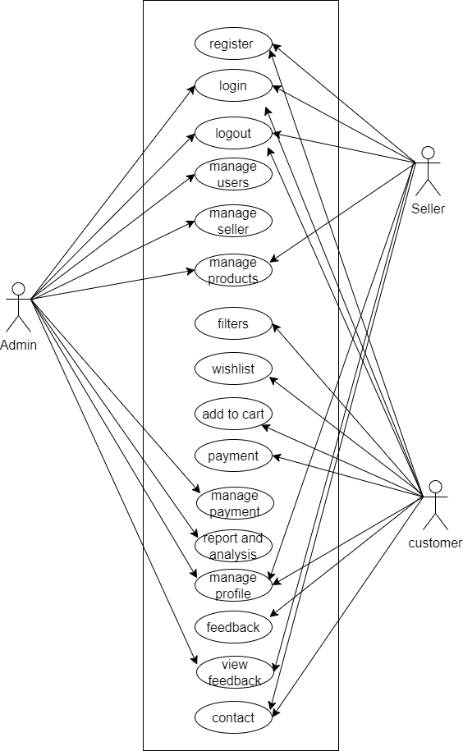
UML Diagram
1.Use Case Diagram:-

Slide 15
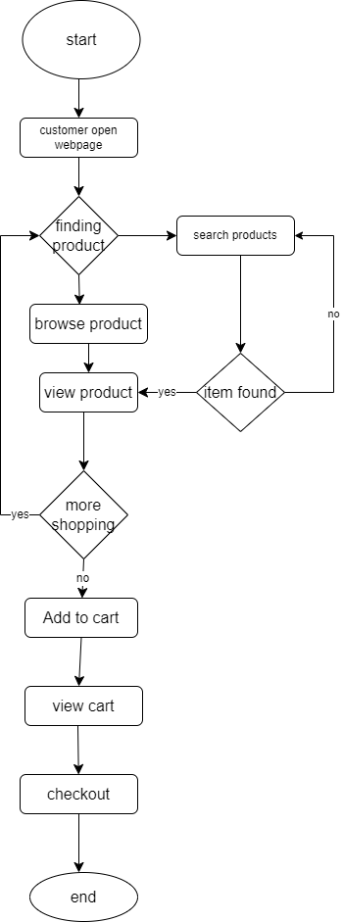
2. Activity Diagram:-

Slide 16
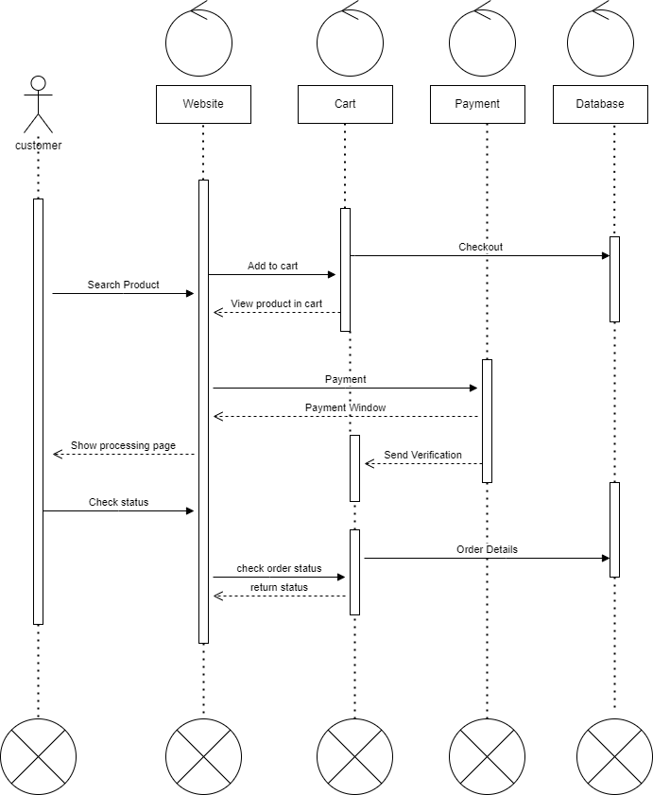
3. Sequence Diagram :-

Slide 17
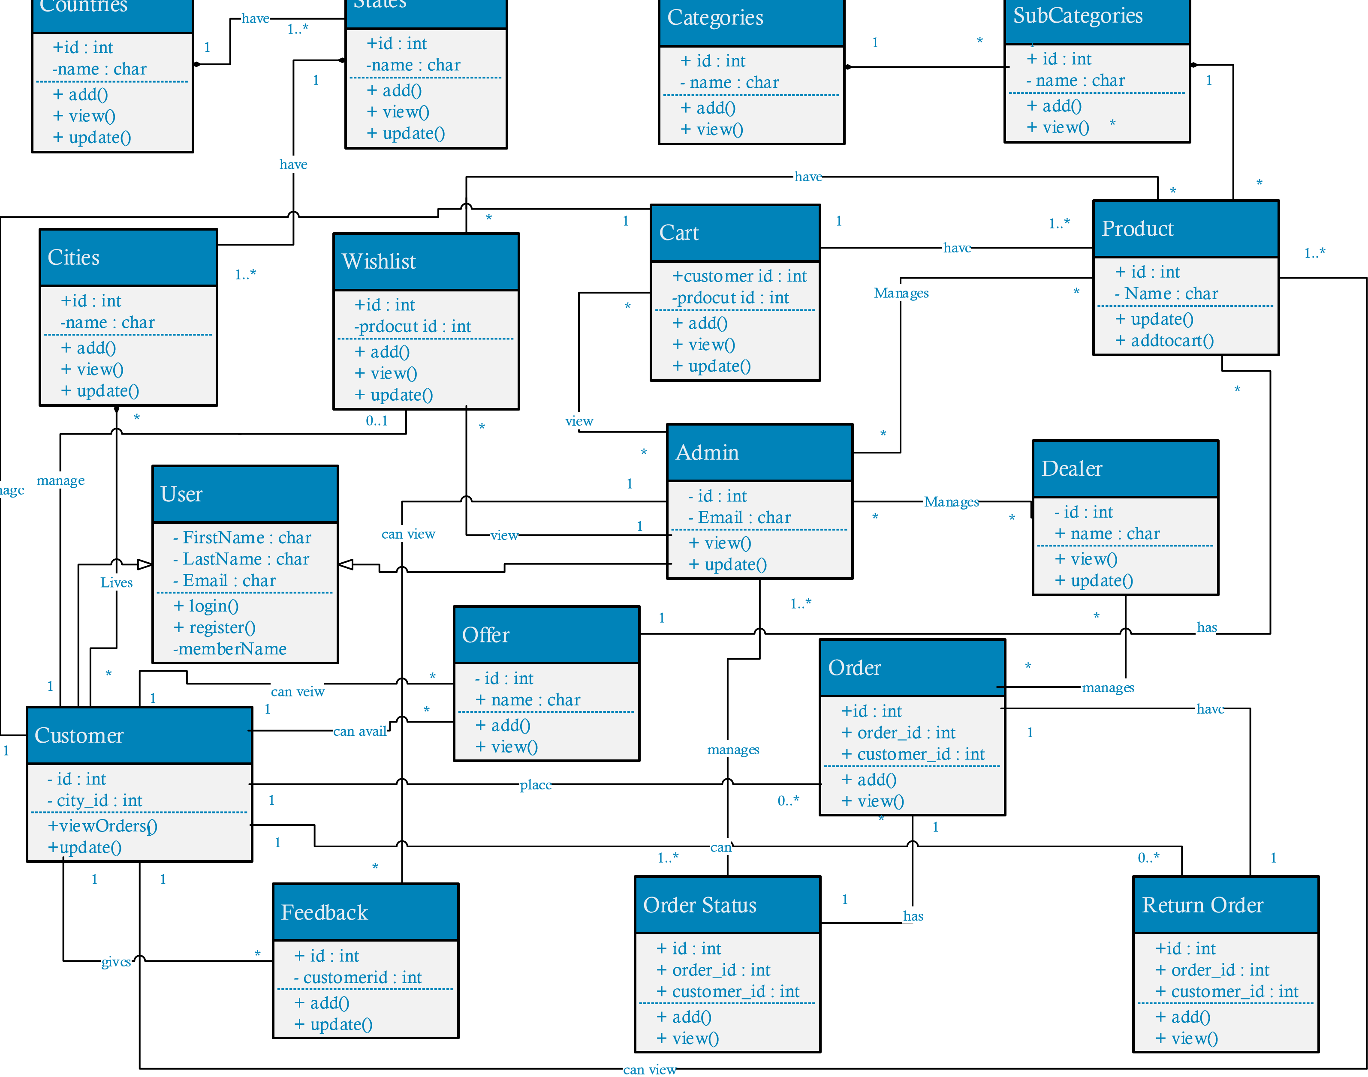
4.Class Diagram :-

Slide 18
Data Dictionary
Customer Table
Sr No | Field | Data Type | Constraint | Description
1 | Cust_id | Int(4) | Primary key | User ID
2 | first_name | Varchar(15) | Not Null | User First Name
3 | last_name | Varchar(15) | Not Null | User Last Name
4 | email_id | Varchar(40) | Not Null | User E-mail id
5 | Password | Varchar(15) | Not Null | User Password
6 | Image | Image | Not Null | User Image

Slide 19
Seller Table
Sr No | Field | Data Type | Constraint | Description
1 | Seller_id | Int(4) | Primary key | Seller id
2 | First_name | Varchar(15) | Not Null | Seller first Name
3 | Last_name | Varchar(15) | Not Null | Seller last Name
4 | Email_id | Varchar(40) | Not Null | Seller E-mail id
5 | Password | Varchar(15) | Not Null | Seller Password
6 | Image | Image | Not Null | Seller Image
7 | Seller_ States | Varchar(10) | Not Null | Seller States

Slide 20
Admin Table
Sr No | Field | Data Type | Constraint | Description
1 | Id | Int(4) | Primary key | Admin ID
2 | Email | Varchar(40) | Not Null | Admin E-mail id
3 | Password | Varchar(15) | Not Null | Admin Password

Slide 21
Category Table
Sr No | Field | Data Type | Constraint | Description
1 | Category_id | Int(4) | Primary key | Category ID
2 | Category_name | Varchar(15) | Not Null | Category Name
3 | Creation date | Date | Not Null | Category creating date

Slide 22
Product Table
Sr No | Field | Data Type | Constraint | Description
1 | Product_id | Int(4) | Primary key | Product Id
2 | Category_id | Int(4) | Foreign Key | Category ID
3 | Product_Name | Varchar(50) | Not Null | Product Name
4 | Image | Image | Not Null | Image of item
5 | Description | Varchar 2(100) | Not Null | Product description
6 | Creation date | Date | Not Null | Product creating date

Slide 23
Contact Us Table
Sr No | Field | Data Type | Constraint | Description
1 | Contact_id | Int(4) | Primary Key | Contact Us
2 | First_name | Varchar(50) | Not Null | First Name
3 | Last_name | Varchar(50) | Not Null | Last Name
4 | Email | Varchar(40) | Not Null | Email ID
5 | Mobile | Int(11) | Not Null | Phone Number
6 | Message | Varchar(500) | Not Null | Message

Slide 24
Feedback Table
Sr No | Field | Data Type | Constraint | Description
1 | Feedback_id | Int(4) | Primary Key | Feedback
2 | Cust_id | Int(4) | Foreign Key | User ID
3 | Status | Int(2) | Not Null | Read / Unread
4 | Message | Varchar(500) | Not Null | Question List

Slide 25
Cart Table
Sr No | Field | Data Type | Constraint | Description
1 | Id | Int(4) | Primary key | Place Order Id
2 | Cust _id | Int(4) | Foreign Key | User id
3 | Product_Name | Varchar(50) | Foreign Key | Product Name
4 | Image | Image | Not Null | Image of item
5 | Quantity | Int(200) | Not Null | Quantity of Product

Slide 26
Billing Table
Sr No | Field | Data Type | Constraint | Description
1 | ID | Int(4) | Primary key | Billing ID
2 | Cust_id | Int(4) | Primary key | User ID
3 | first_name | Varchar(15) | Not Null | User First Name
4 | Email | Varchar(40) | Not Null | User E-Mail
5 | Contact | Number(10) | Not Null | User Number
6 | Product_id | Int(4) | Foreign key | Product Id
7 | Product_Name | Varchar(50) | Foreign Key | Product Name
8 | Price | Number(20) | Not Null | Price
9 | Quantity | Int(200) | Not Null | Quantity
10 | Date of Generation | Date | Not Null | Date of join

