Slide 1

Automated Sensitive Data Removal System
Smart Redactor

Slide 2

Cybersecurity
  Tisha Das Gupta 2531179038
  Munira Akter 242532038
  Afrine Akter Jeme 252568040

Slide 3
Objective: Redact PII (Personally Identifiable Information) from text.
Core Constraints:
Preserve context & formatting.
Detect unseen/random names.
Avoid over-redaction (e.g., keeping words like "Hotel").

Slide 4
Initial Attempts & Failures
Attempt 1 (Pure Regex): Good for emails/phones, but failed on Names & Locations.
Attempt 2 (Pure AI - spaCy): Good for names, but introduced Hallucinations.
Bug: AI confused IP addresses with Locations([[Location])
Bug: AI deleted non-sensitive words (e.g., "Digital Classroom").

Slide 5
The Breakthrough: Hybrid Logic
Developed a 3-Step Pipeline:
Step 1: Placeholder Injection (Regex):
Converted IPs/Emails to temp tags (___IP___) to stop AI interference.
Step 2: Context-Aware Cleaning:
Logic to clean data after keys like Name:, City: .
Step 3: VIP Safe List (False Positive Prevention):
Whitelisted common words (Hotel, SMS) to prevent over-redaction.

Slide 6
Technology Stack
Backend Logic: Python (Custom Hybrid Engine).
NLP Model: Spacy (en_core_web_lg) for context understanding.
Web Server: Flask (API Integration).
Interface: HTML/CSS (Cybersecurity Theme).

Slide 7
Final Implementation & Features
Masking Mode: Replace data with [EMAIL], [PHONE].
Redaction Mode: Complete removal for high security.
Accuracy Metric: Real-time Levenshtein Similarity Score.
Data Log: Entity Visualization Table

Slide 8
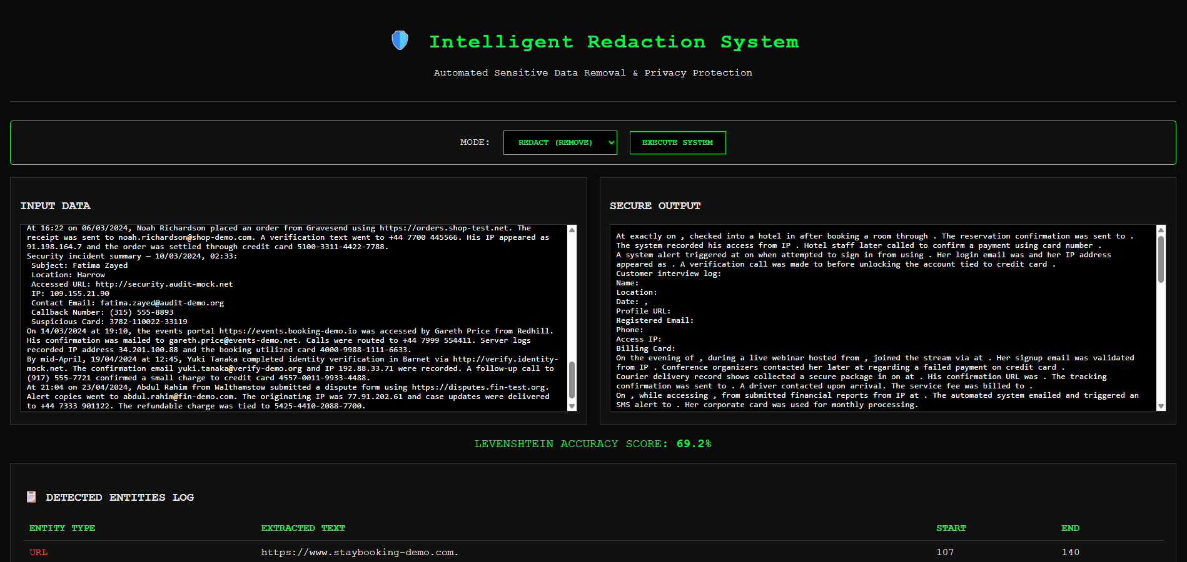
Application
REDACT MODE:

Slide 9
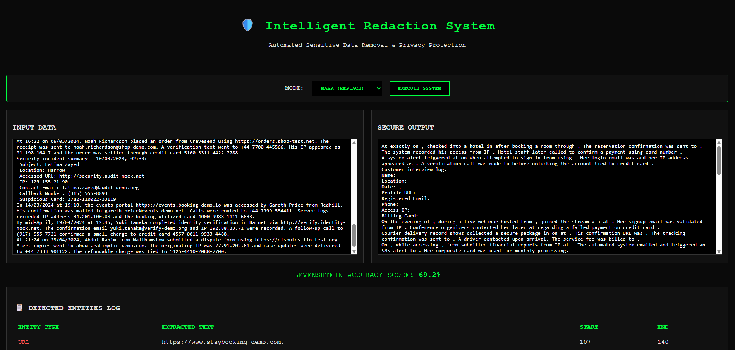
Application
MASK MODE:

Slide 10
THANK YOU

