Slide 1

06/10/2020

Slide 2
5 – Software Design
Lab session 3

Slide 3
Outline labs
Part A: UML diagrams Sessions 1 – 2
Part B: Design Patterns Session 3 – 5
Part C: Projects in groups of 2 Session 6 – 9

Slide 4
Part A: Design Patterns
Singleton & Observer Pattern

Slide 5
Singleton
The singleton pattern ensures a class has only one instance; and provides a global point of access to it.

Slide 6
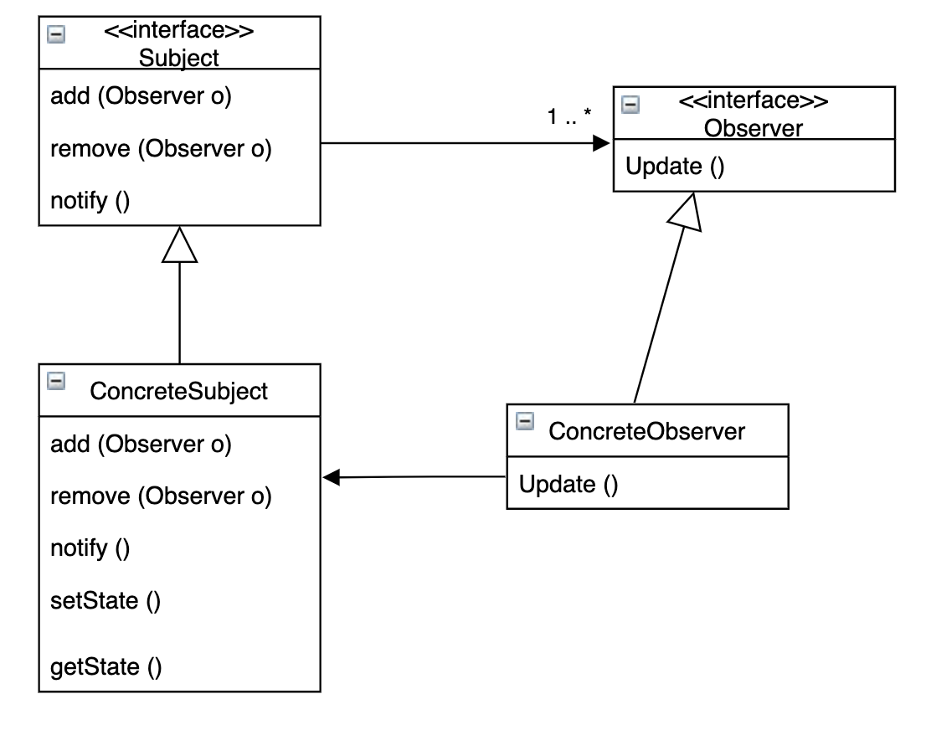
Observer Pattern
The observer pattern defines the one to many dependency between objects, so that when one object changes state, all of the dependencies are notified and updated automatically.

Slide 7
Assignments
Singleton & Observer Pattern

Slide 8
Assignment
Time Registration application Registering the last time an employee checked in/out
Consists of:
Registering database: contains registration entries ➞ extends an abstract class
Entry: an entry in the database ➞ has a special implementation: EntryNull (default when non-existent)
Registering controller: controlling the database ➞ implements a controller interface
Employees: contain a name and function title ➞ Manager, Programmer, CustomerService inheriting from Employee
Main Class, running the application

Slide 9
Assignment
Now: Database can be instantiated multiple times ➞ not a best practice
Should implement the Singleton Pattern
Now: changes to Database are printed manually in Main Class ➞ not a best practice
Should be replaced by observers
Make the database an Observable
Add observers in package “main.java.observers” that observe the database
One observer just notifies when the database got updated “Database got updated”
One observer prints the entry added to the database
Optional: one observer that prints both the name of employee + entry added to database
Observer pattern interfaces already implemented in Java: Google is your best friend
At least one integration test (free to choose) Unit tests already given for Database and Controller No tests needed for employees and entries
Diagrams not mandatory, but feel free

