Slide 1

27/10/2020

Slide 2
5 – Software Design
Lab session 4

Slide 3
Outline labs
Part A: UML diagrams Sessions 1 – 2
Part B: Design Patterns Session 3 – 5
Part C: Projects in groups of 2 Session 6 – 9

Slide 4
Part B: Design Patterns
Factory & Abstract Factory Patterns

Slide 5
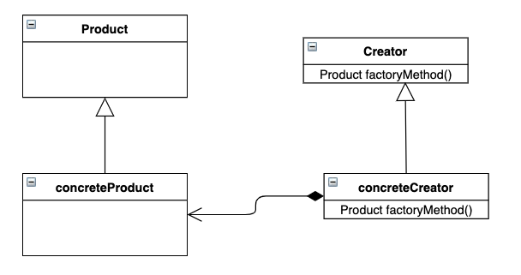
Factory Pattern
Factory Method Pattern defines an interface for creating an object, but lets the subclasses decide which class to instantiate

Slide 6
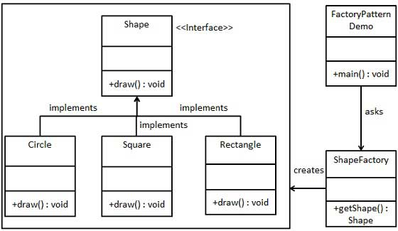
Factory Pattern
Factory Method Pattern defines an interface for creating an object, but lets the subclasses decide which class to instantiate
https://www.tutorialspoint.com/design_pattern/factory_pattern.htm

Slide 7
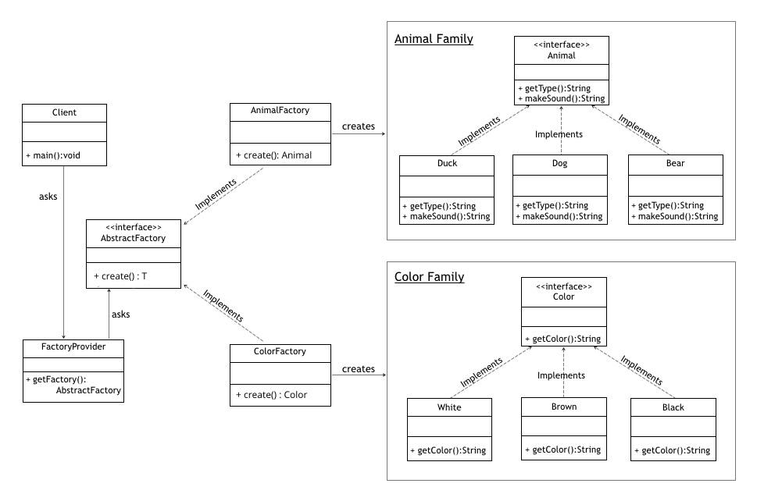
Abstract Factory
Factory of factories
Abstract Factory provides an interface for creating objects without specifying their concrete classes
https://www.baeldung.com/java-abstract-factory-pattern

Slide 8
Assignments
Factory & Abstract Factory Patterns

Slide 9
Assignment
Factory
Continue on last session: time registration
Implement Factory Pattern for generating different kinds of Employees
CustomerService, Manager, Programmer
➞ create extra package “factory”, which contains class “EmployeeFactory”
EmployeeFactory has following method:
Name is given to newly created Employee
Function is used to create appropriate employee in factory
E.g.: function is “Programmer”➞ factory should return new Programmer(…);

Slide 10


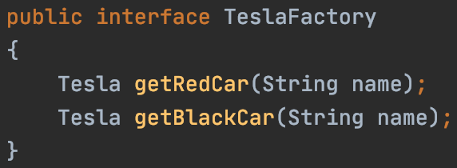
Assignment
Abstract Factory
Tesla sells 4 main types of cars:
Model S, 3, X, Y
Main sold colors are black & red
Create class diagram for this abstract factory pattern
Implement abstract factory pattern in code base:
Different factory for each type, each implementing interface:
Create Red or Black car in each factory

